Slide 1

GUAIX
UCM Group of Extragalactic Astrophysics and Astronomical Instrumentation
Instrumentation developments in Astrophysics —
Universidad Complutense de Madrid
IPARCOS Scientific Advisory Board: Bi-Annual Review — 2026

Slide 2
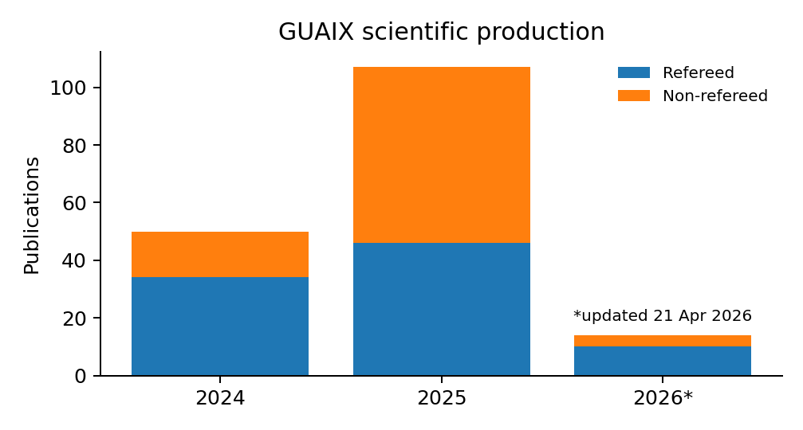
GUAIX at a glance
Last two years (~2024–2026): critical mass, high output and broad scientific reach
34
90
>4.7 M€
3+4
7+12
members
refereed papers
since Jan 2024
active funding
full + associate
professors
postdocs + PhD
students
GUAIX – UCM Group of Extragalactic Astrophysics and Astronomical Instrumentation
Human resources
• 3 Full Professors, 4 Associate Professors, 1 permanent lecturer
• 1 Ramón y Cajal + 1 senior Talent researcher
• 7 postdocs, 12 PhD students, technical + management support
Signature strength
Instrumentation builders + science users: GTC EMIR/MEGARA/FRIDA heritage feeding MOSAIC/ELT ARAKIHS ATLAS2 science.
Publication counts from the GUAIX publication page; group size and active funding from the Historial Científico.

Slide 3
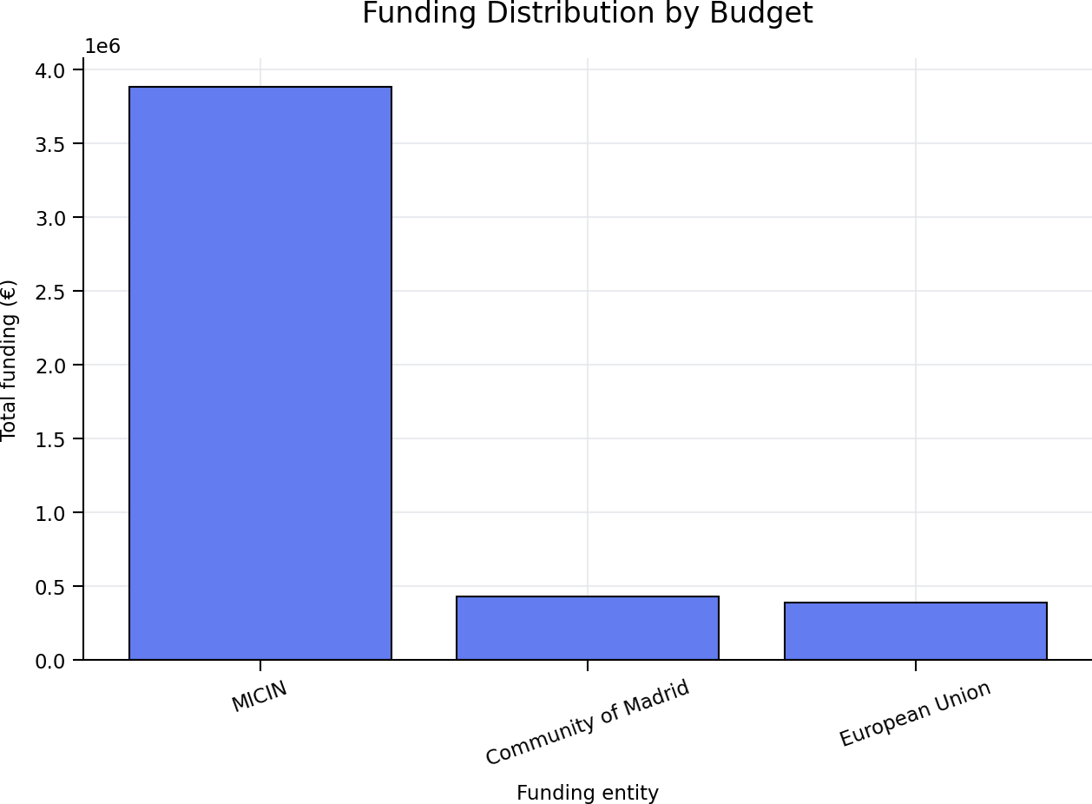





Key performance indicators
High-Impact Publications: 165 peer-reviewed papers. 165 in Q1 journals (SCImago SJR).
Funding Secured: The total funding across ongoing projects reaches €4.7 million.
Main sources:
  Spanish National Plan (PID projects)
  Horizon Europe programmes
  Regional Government of Madrid
Major projects include:
  MOSAIC-ELT (€893k + €518k)
  TARSIS (~€731k)
  ARRAKIHS (~€460k)
Horizon Europe projects (AtLAST2, PLAN-B, AC3)
GTC instrumentation: EMIR – FRIDA
Training:
24 PhD theses defended (total). 4 PhD theses defended in 2023–2024.
13 PhD theses currently in progress
(Two of them are about to be defended within the next two months).

Slide 4
Science map and current drivers
A broad extragalactic programme with instrumentation as an enabling layer
Nearby galaxies + stellar populations + Galaxy evolution
+ AGN feedback + high-energy/magnetism
connected through IFU spectroscopy, surveys, simulations and multi-wavelength facilities
Main active projects and collaborations
What the group delivers
• MOSAIC / ELT: Spanish contribution to PDR + LLI-FDR
• TARSIS: 4m-class instrument + science prep
• ARRAKIHS: ESA F-class mission phase at UCM
• AtLAST2 + Mad4Space + SKA-prep / cosmic magnetism
• GTC instrumentation: EMIR – MEGARA - FRIDA
• PLAN-B / light and noise pollution impacts
• AC3: cloud-edge continuum management
• Athena/X-IFU space mission
• Training pipeline for instrumentation + data-intensive astronomy
• MEGARA / EMIR science exploitation
• Survey science: MEGADES, PHANGS, TIMER, CAVITY, GATOS, POSSUM, OTELO
• Galaxy evolution across environments and cosmic time
• New constraints on feedback and outflows
Representative papers (2024–2026)
• Mroczkowski+25 — AtLAST conceptual design
• van Kampen+24 — AtLAST science: surveying the distant Universe
• Ceballos+24 — optimizing Athena/X-IFU-like TES detectors
• Peille+25 — X-ray Integral Field Unit after Athena reformulation
• Pello+24 MOSAIC instrument
• Pello+25 MOSAIC instrument
• Gallego+26 MOSAIC instrument
• Chamorro-Cazorla+26 — MEGADES science enabled by MEGARA
• Martínez-Delgado+24 — MEGARA follow-up of stellar streams
• García-Vargas+24 — MEGARA IFU on a low-metallicity dwarf
• Hermosa Muñoz+24 — MEGARA outflows in LINERs
• Gallego+26 Dwarfs4MOSAIC La Palma International Program

Slide 5
MOSAIC mIFU+MOS
Spectrograph for ELT
UCM-IPARCOS node

Slide 6


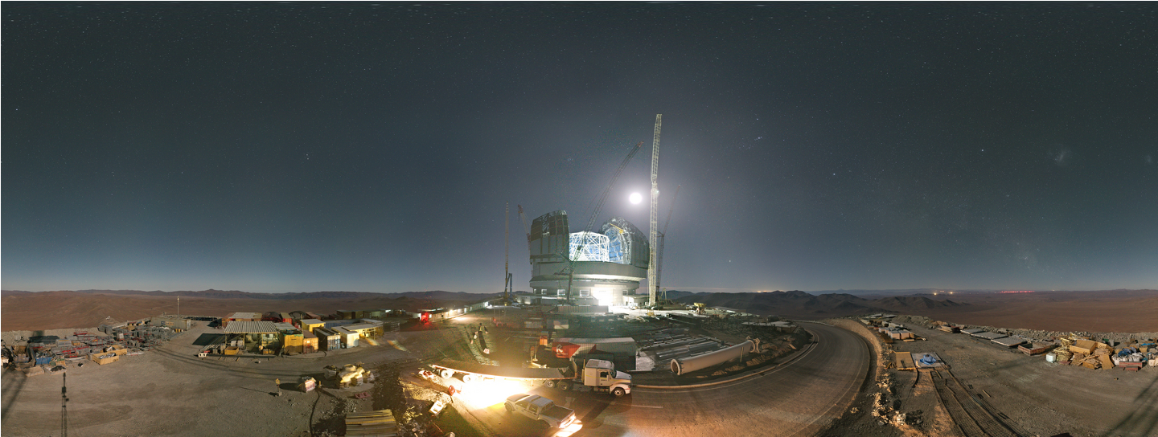
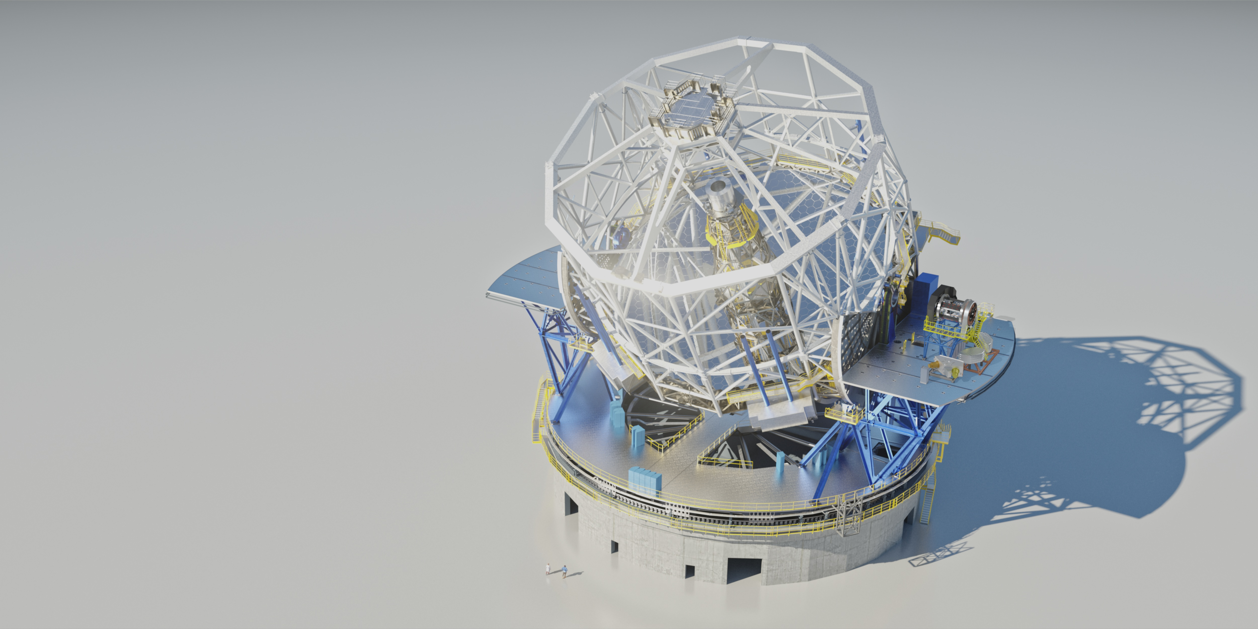
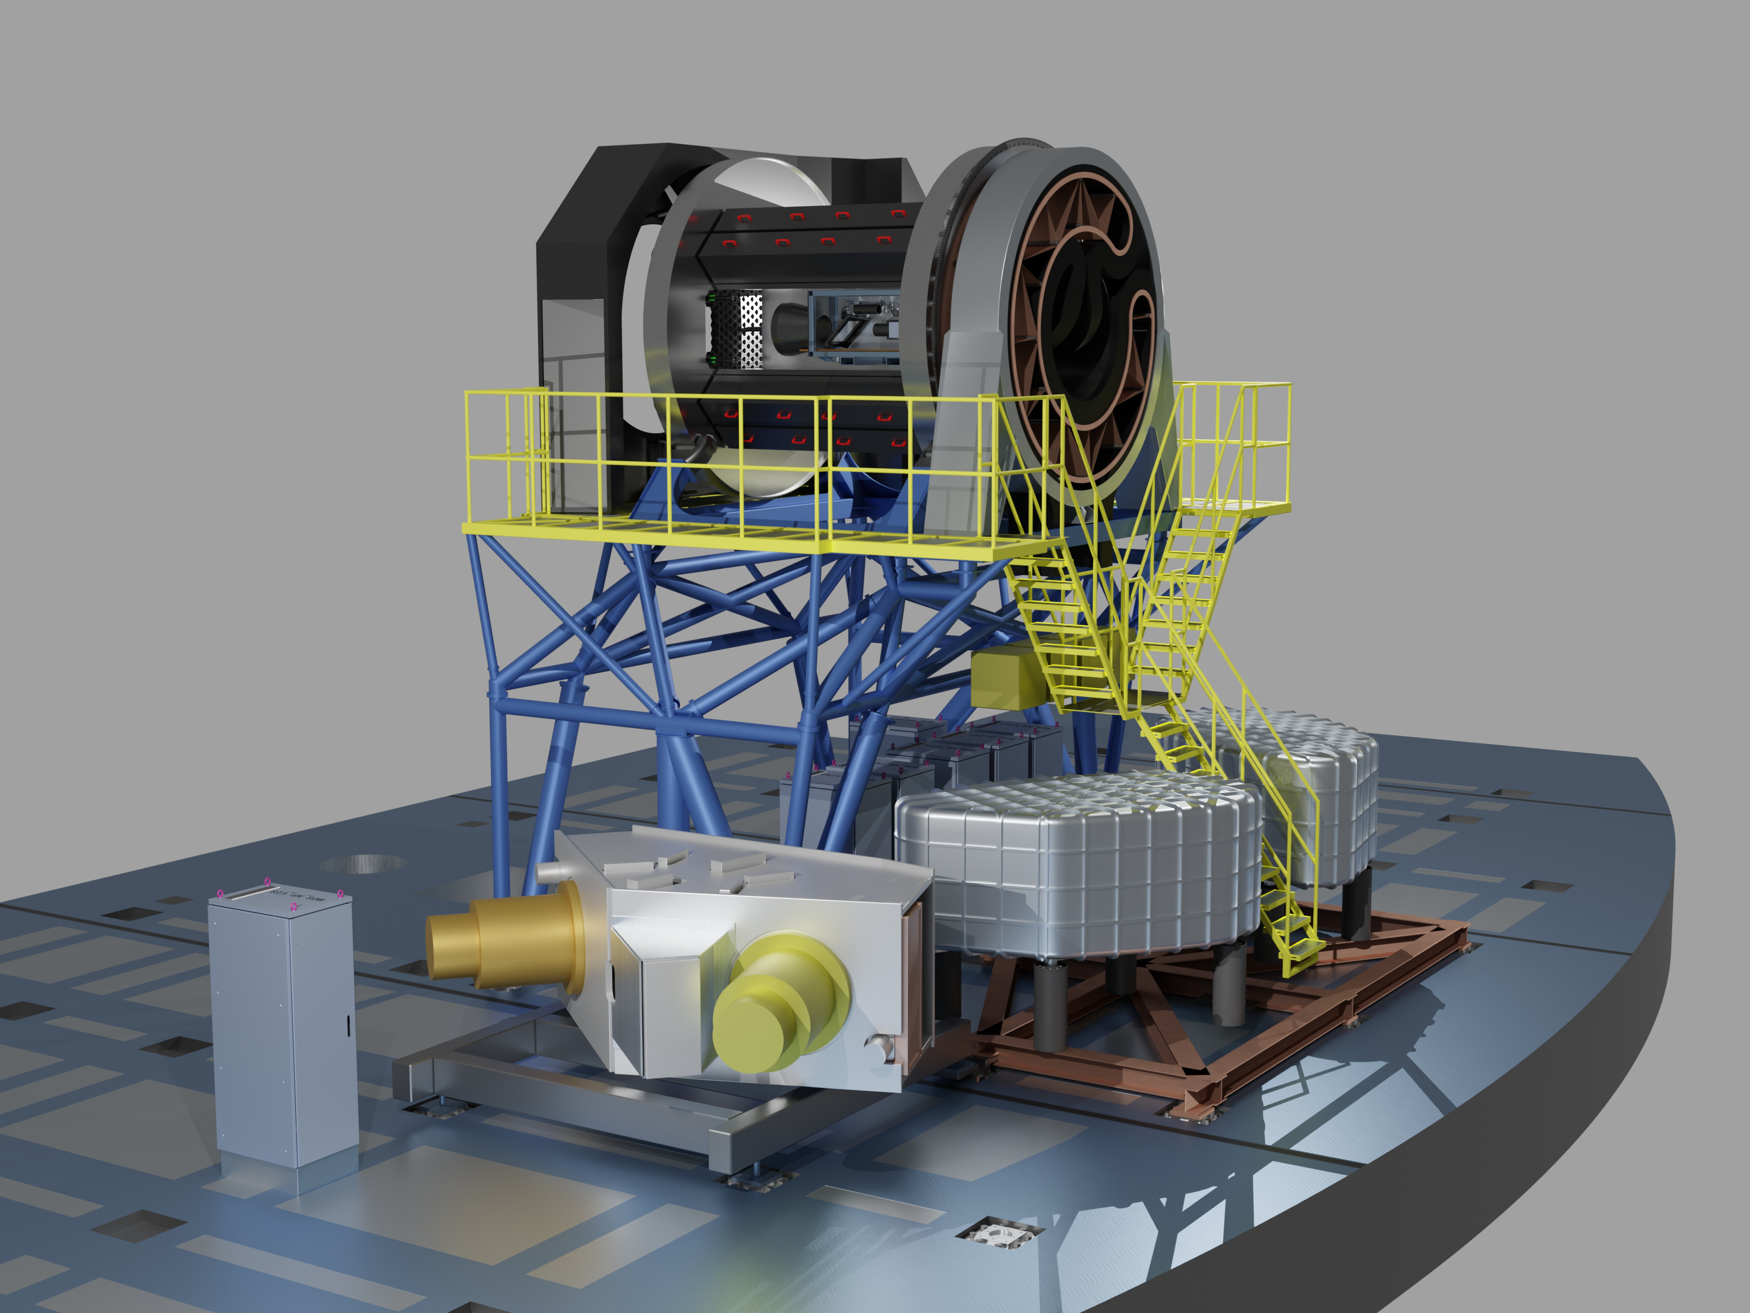
ELT: Extremely Large
39m Telescope
Cerro Armazones, December 2025
Planned first light: March 2029

Slide 7
Group’s Overview
Top 2-3 Scientific Highlights
Highlight 1: Massive surveys for Galaxy evolution: first galaxies; inventory of matter; mass asembly
Highlight 2: Extragalactic stellar populations; time-domain astrophysics
Leadership, Internationalization & Impact
Major Roles:
J. Gallego: National representative and co-chair of the Board. Members of Science Working Groups
        A. Gil de Paz: Calibration Scientist
        CALEMOS: Calibration unit: Á. Castillo+
        near-IR channel; near-IR spectrographs: F. Montenegro+ 10-15 % MOSAIC total (One channel, 3 WPs)
Recognitions: Fully embedded in the MOSAIC technological and science team
Tech Transfer / Out)reach (Optional but encouraged):
      Work with several private companies: FRACTAL; GMV
The Horizon
Next Big Milestone: Preliminary Design Review (PDR) with ESO in February 2028
MOSAIC Science Red book

Slide 8
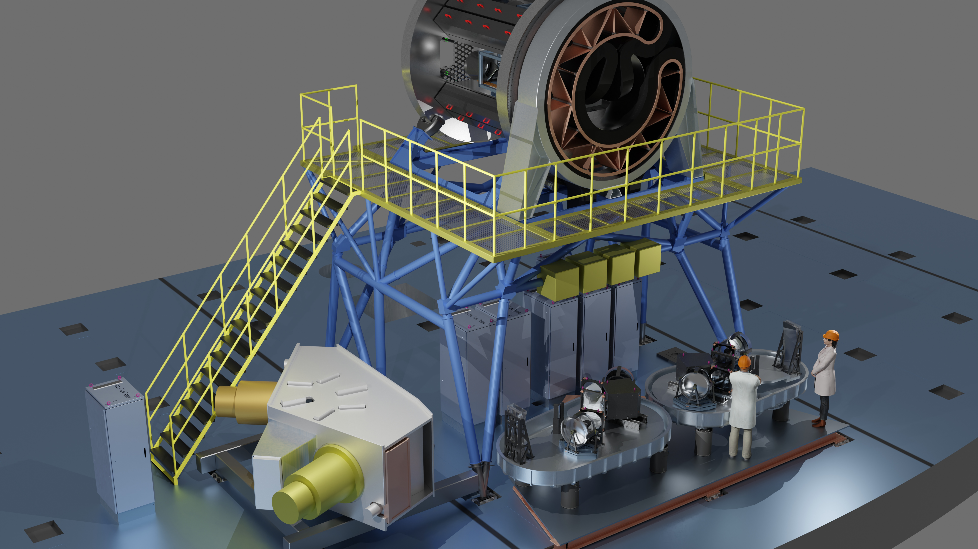
MOSAIC on Nasmyth platform
Light from
telescope
Front-End
VIS spectro.
NIR spectro. x2

Slide 9
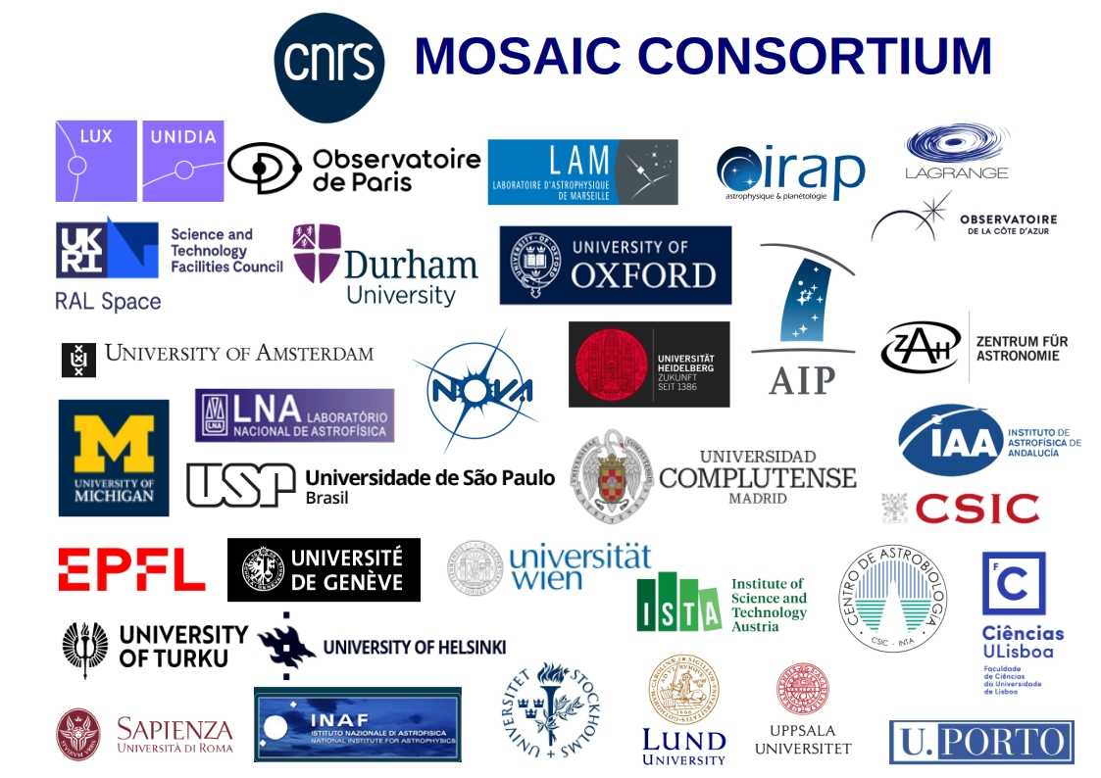
MOSAIC Consortium
MOSAIC Consortium
25 Institutional Partners
33 Laboratories
14 countries
~350 members
The consortium is responsible for raising the complete construction and commissioning funding of the instrument, including contingencies and functioning costs

Slide 10
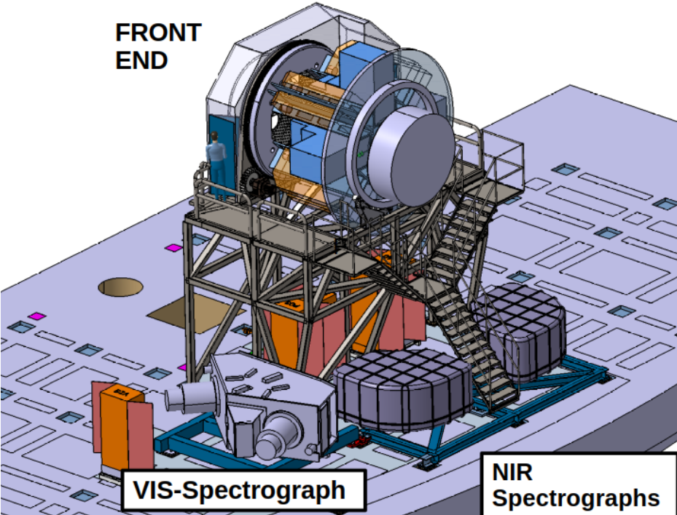
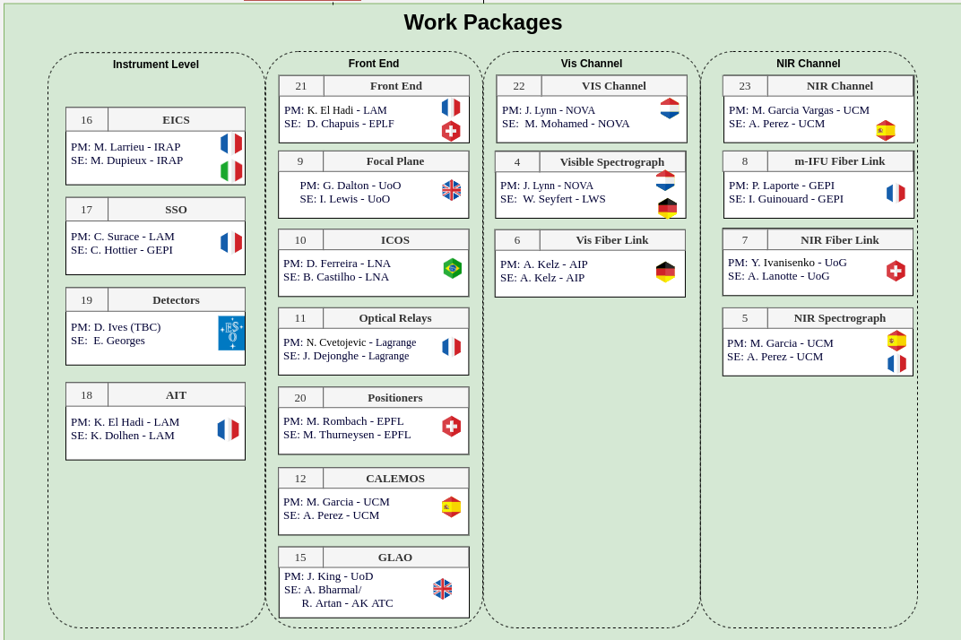
MOSAIC Organisation
Organisation by channels:
- Front End (including GLAO)
- Visible
- NIR
+ Instrument Level

Slide 11
Project Status
International/ESO context
Approved by the Council in December 2021
Phase B1 Kick-Off Meeting 14-15/03/23 in Paris
Signature of ESO/CNRS B1 Phase Agreement (8/08/23 )
JUN24: System Requirements Review (SRR), at UCM
APR25: Specifications and Architecture Review (SAR)
ESO headquarters, Garching
=> End of the Phase B1
16-18/09/2025: Phase B2 KOM & Progress Meeting at LAM (Marseille).
=> Starting the phase B2 (until the PDR)
27-29/10/2025: Consortium Science Meeting in Amsterdam
KOM for the Red Book

Slide 12
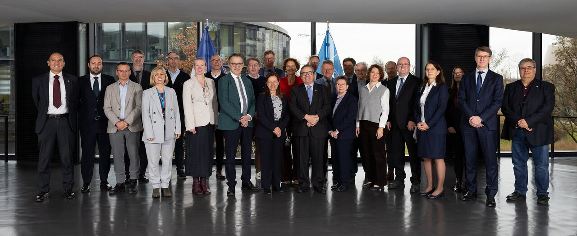
Project Status
01/12/2025: MOSAIC signing ceremony at ESO
Starting the phase B2 (until the PDR)

Slide 13
ARRAKIHS ESA mission
UCM-IPARCOS contribution

Slide 14
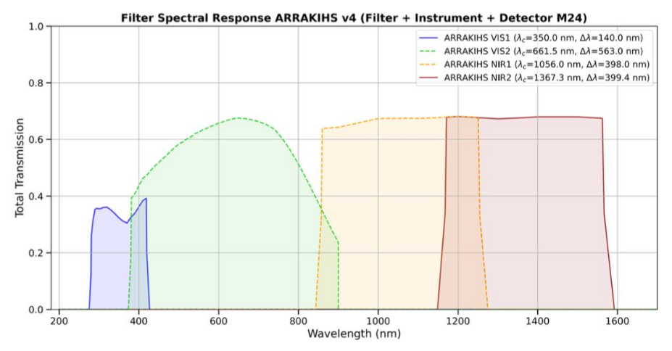
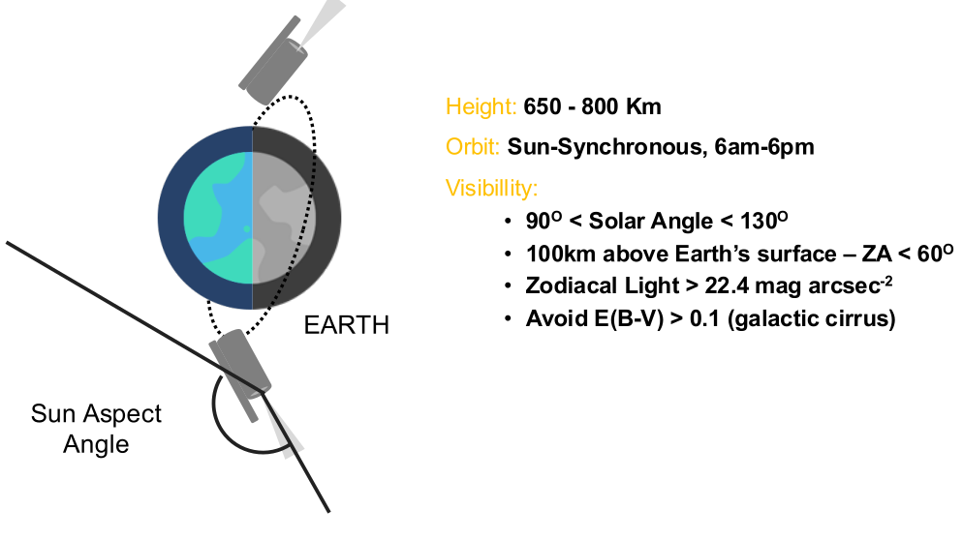

ARRAKIHS Mission
Overview
ARRAKIHS survey ~ 80 MW-like galaxies in four wavelength bands (2 VIS and 2 NIR)
SB limit ~ 31.5 mag/arcsec² in VIS and 30.5 mag/arcsec² in NIR
Detection of LSB features (e.g. stellar streams), satellite galaxies and the diffuse halo
Characterize the accretion history and its relation with the cosmological model and baryonic physics

Slide 15
Group’s Overview
Top 2-3 Scientific Highlights
Highlight 1: Definition Study Report of the ARRAKIHS space mission, which includes a description of the science, feasibility,
performance, ... of the mission
Highlight 2: HARKONENS cosmological simulations, which are a new generation of high-resolution cosmological simulations,
and the product of the 250Mhours of computation time obtained as part of an EuroHPC Joint Undertaking project
Leadership, Internationalization & Impact
Major Roles: Member of the ESA Science Study Team of the ARRAKIHS mission. Coordination of the Survey Strategy Working Group of ARRAKIHS and participation in other seven WGs of the mission. Coordination of the Spanish Team of the ARRAKIHS mission.
Recognitions: Invited conference at a conference organized by the Royal Astronomical Society. Science organization committee of an EAS2024 symposium.
Tech Transfer / Out)reach (Optional but encouraged): Development of the ATREIDS tool, which generates realistic mock images including a complete set of instrumental and observational effects.Organization of an outreach conference (“El impacto de la astrofotografía en la investigación y divulgación astronómica”), and a summer course as part of the UCM summer school program (“El Universo a nuestro alcance: El auge de las Ciencias del Espacio en España”
The Horizon
Next Big Milestone: Adoption of ARRAKIHS as the first F-class mission of science led by Spain Mid-2026

Slide 16
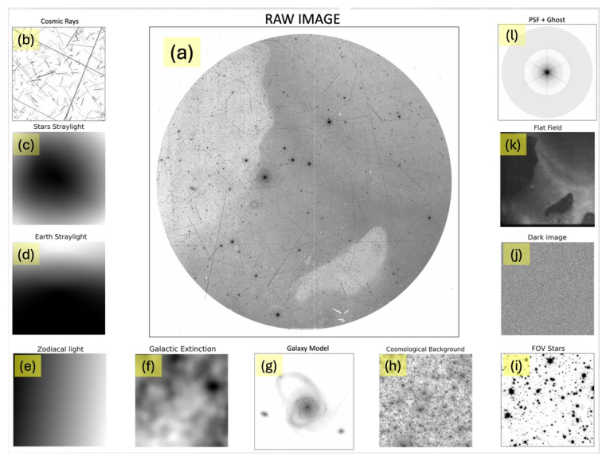
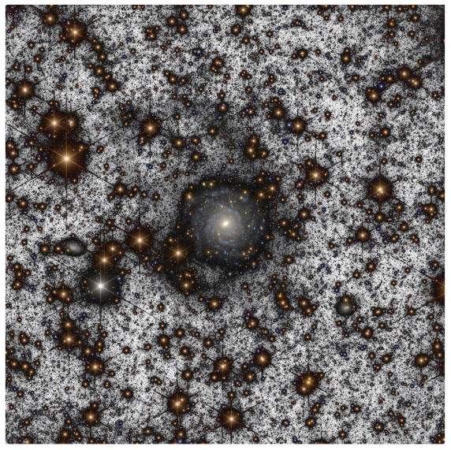
ATREIDS (ARRAKIHS Telescope Realistic Exploration and Imaging Detection Simulations)
ARRAKIHS Mission
ARRAKIHS Mission
Mock image generator

Slide 17
FRIDA AO-nIR imager and spectrograph for GTC 10.4m telescope
UCM-IPARCOS contribution

Slide 18

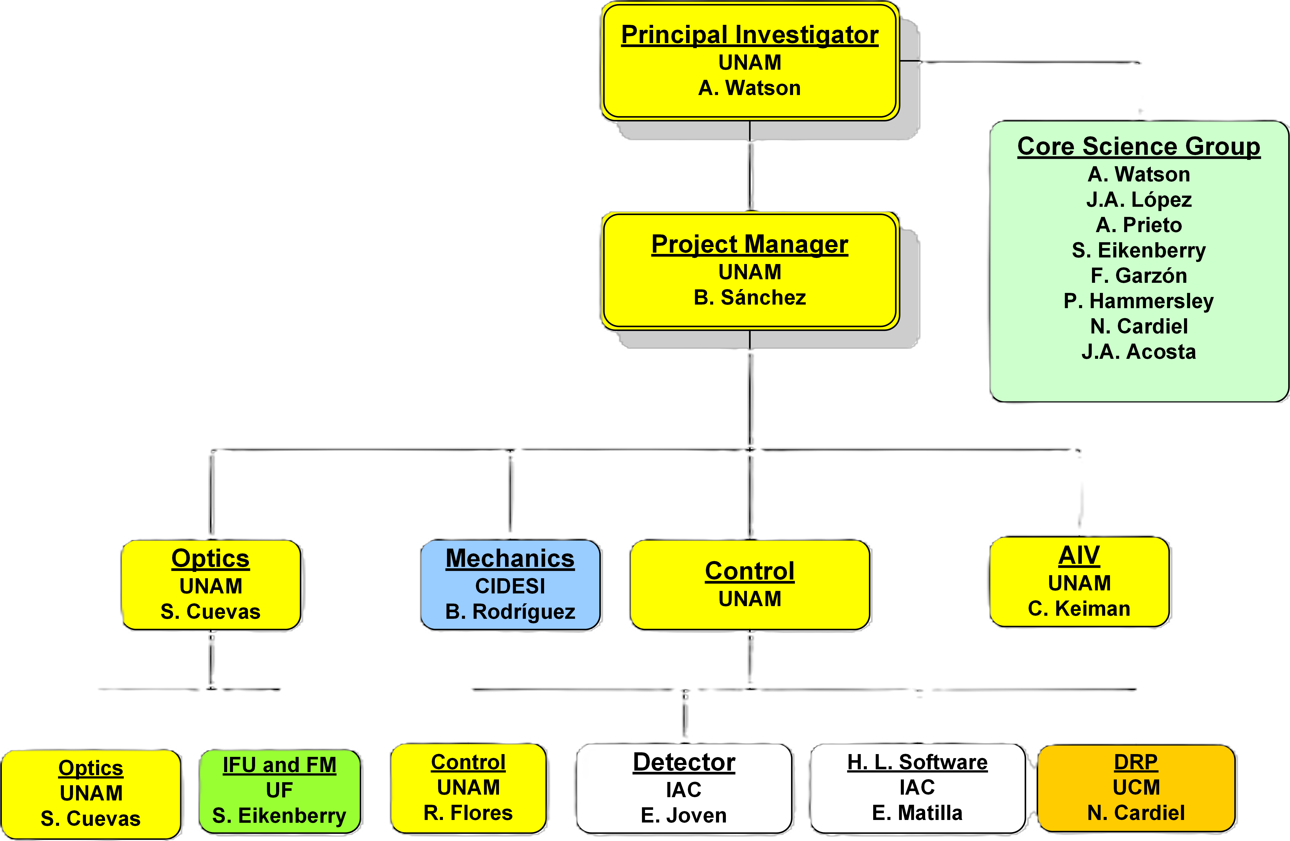
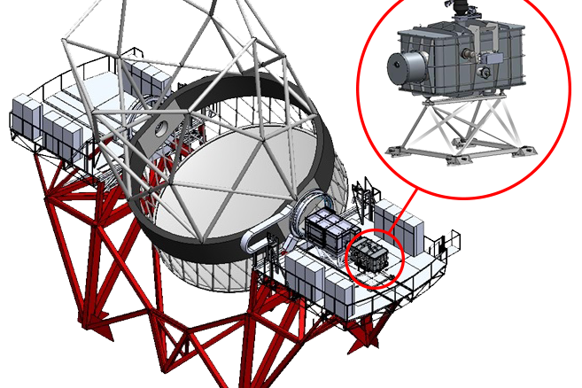


FRIDA (inFRared Imager and Dissector for Adaptive optics) is an Integral Field Spectrograph working in the near-infrared wavelength ranges with imaging capability. It will make use of the GTC Adaptive Optics system (GTCAO) at the Nasmyth-B focal station.

Slide 19
Group’s Overview
Top 2-3 Scientific Highlights
Highlight 1: Simulator of FRIDA IFU data cubes
Highlight 2: First prototypes of FRIDA Data Reduction Pipeline recipes following GTC standards
Leadership, Internationalization & Impact
Major Roles: Members of FRIDA Core Science Group, and developers of FRIDA Data Reduction Pipeline
Tech Transfer / Outreach (Optional but encouraged): Software released to the community through GitHub
The Horizon
Next Big Milestone: Convert prototypes of DRP recipes into validated science-grade data-production code. In this sense, we are currently pending the acquisition of calibration images required to characterize the distortions across all observing modes and configurations of the FRIDA instrument.
NOTE: (Last two years only, ~from 2024 on)

Slide 20
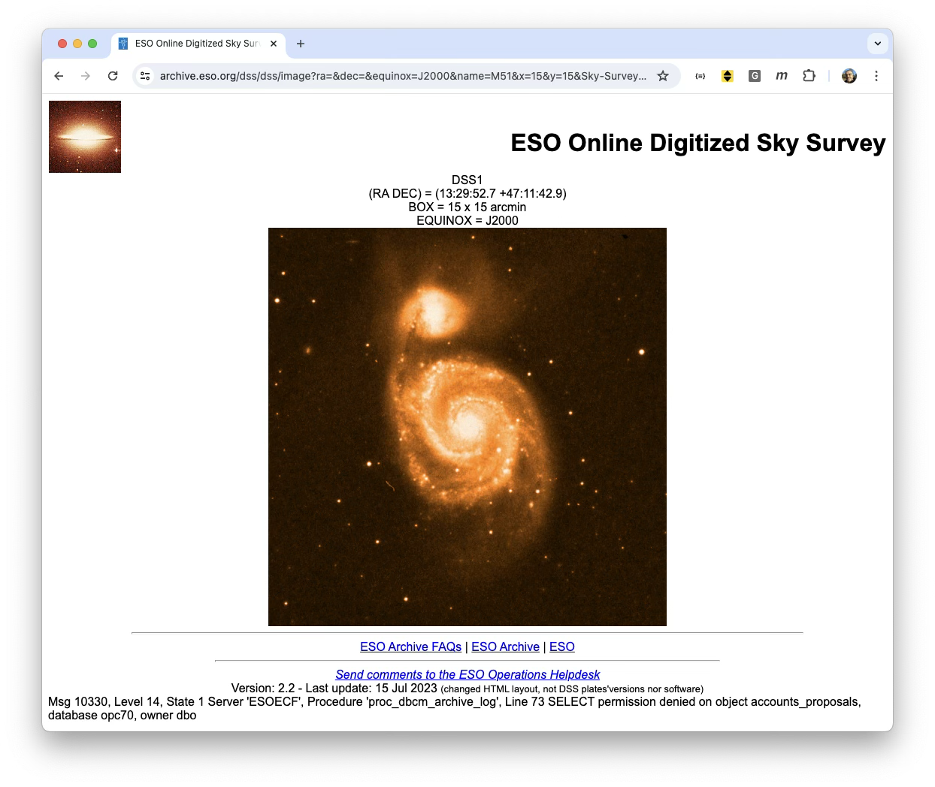
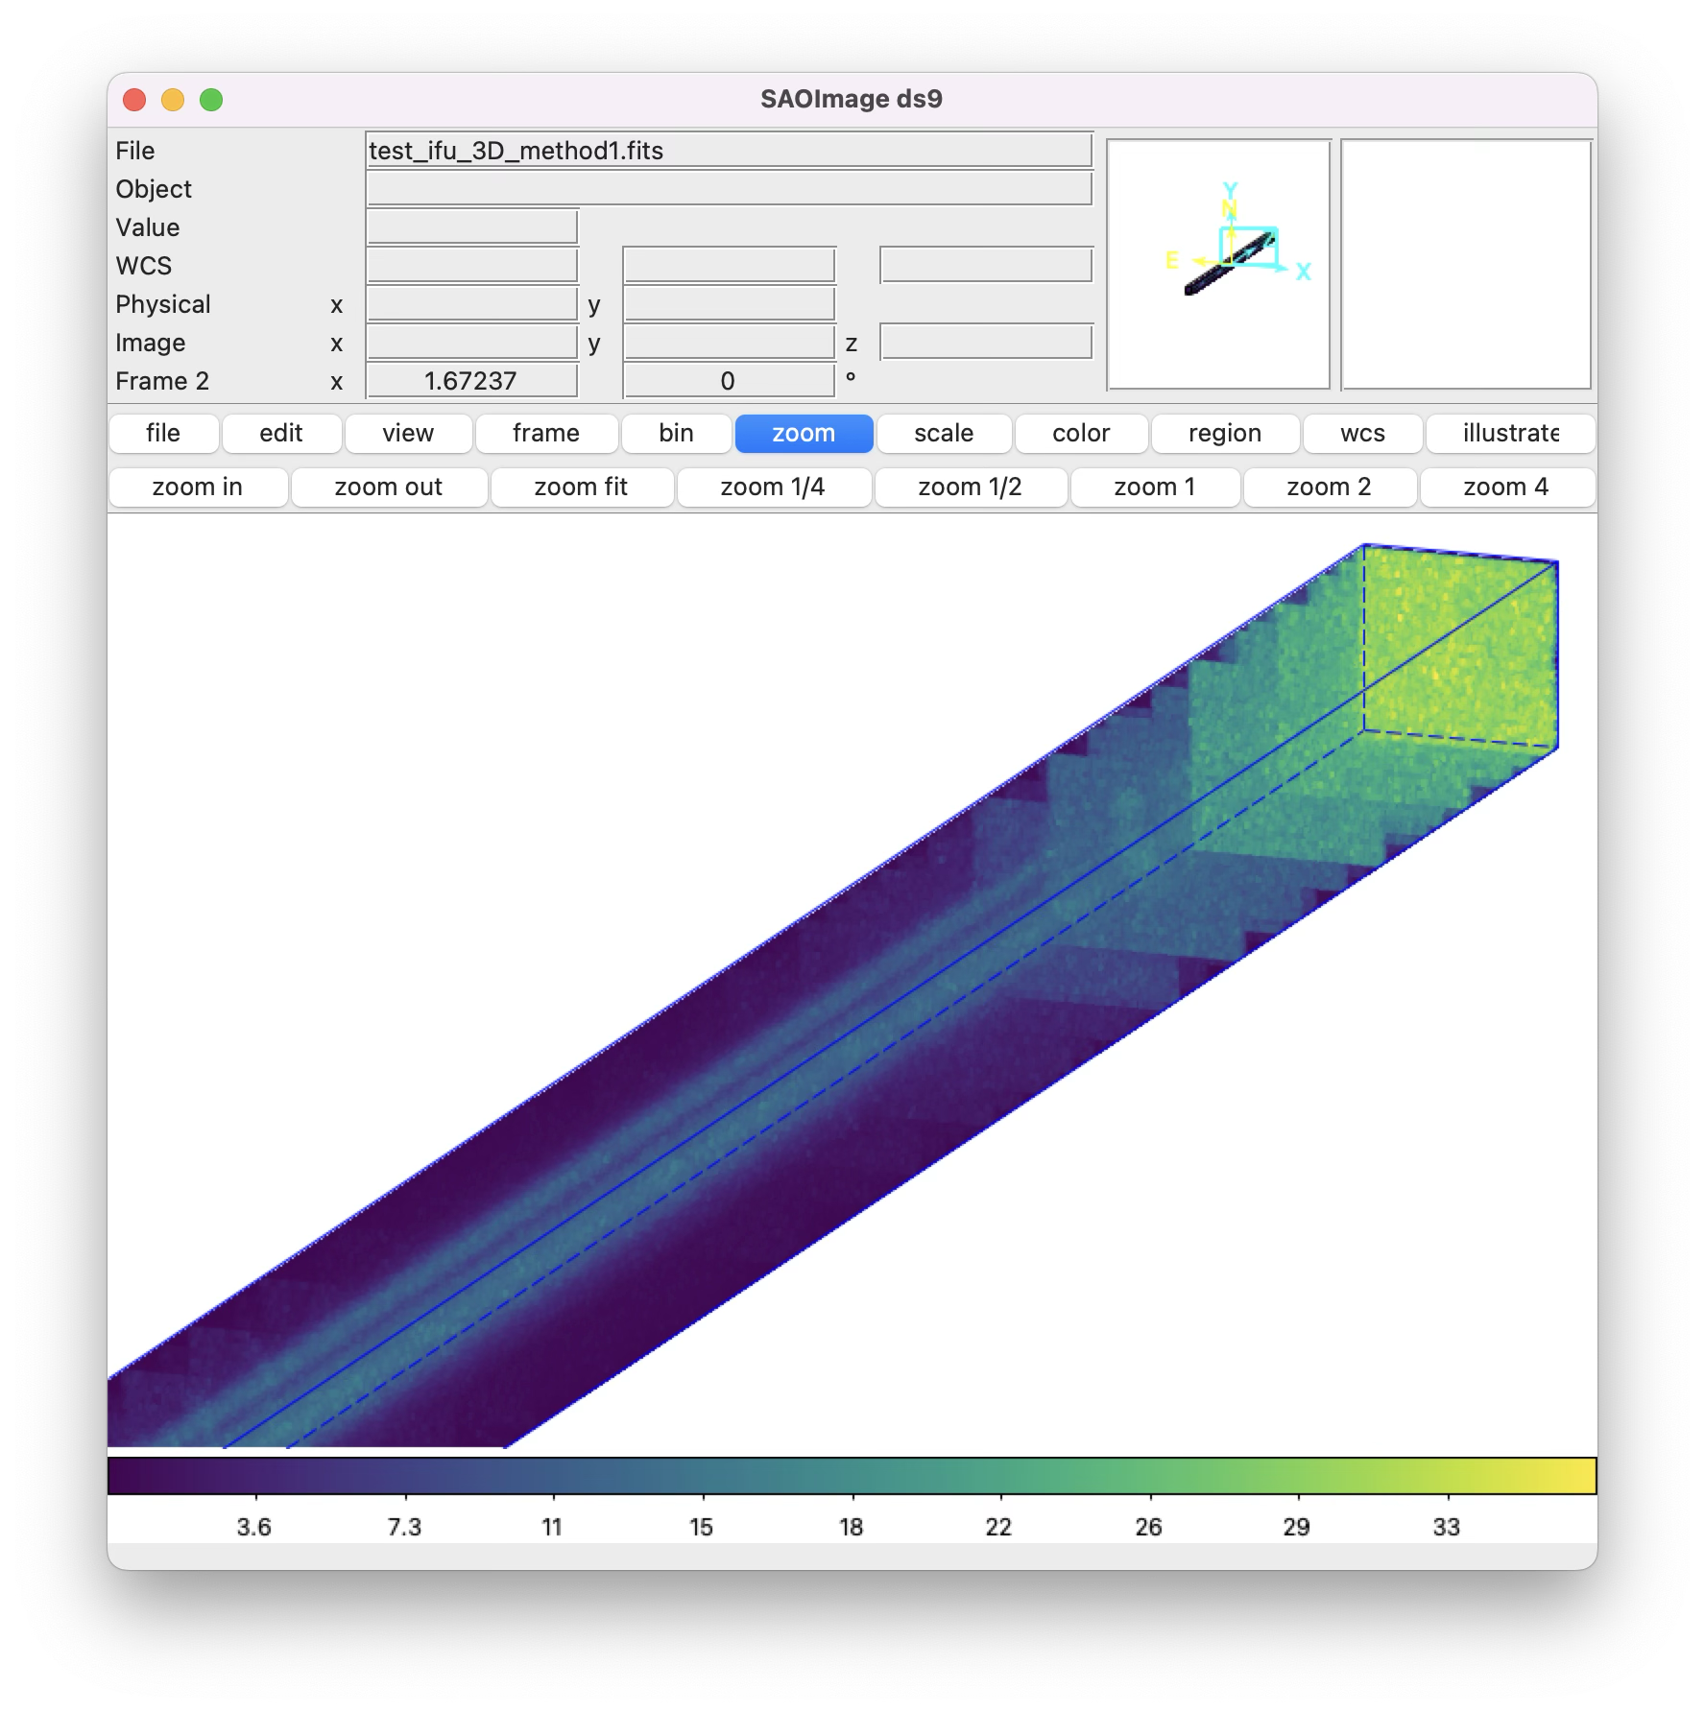
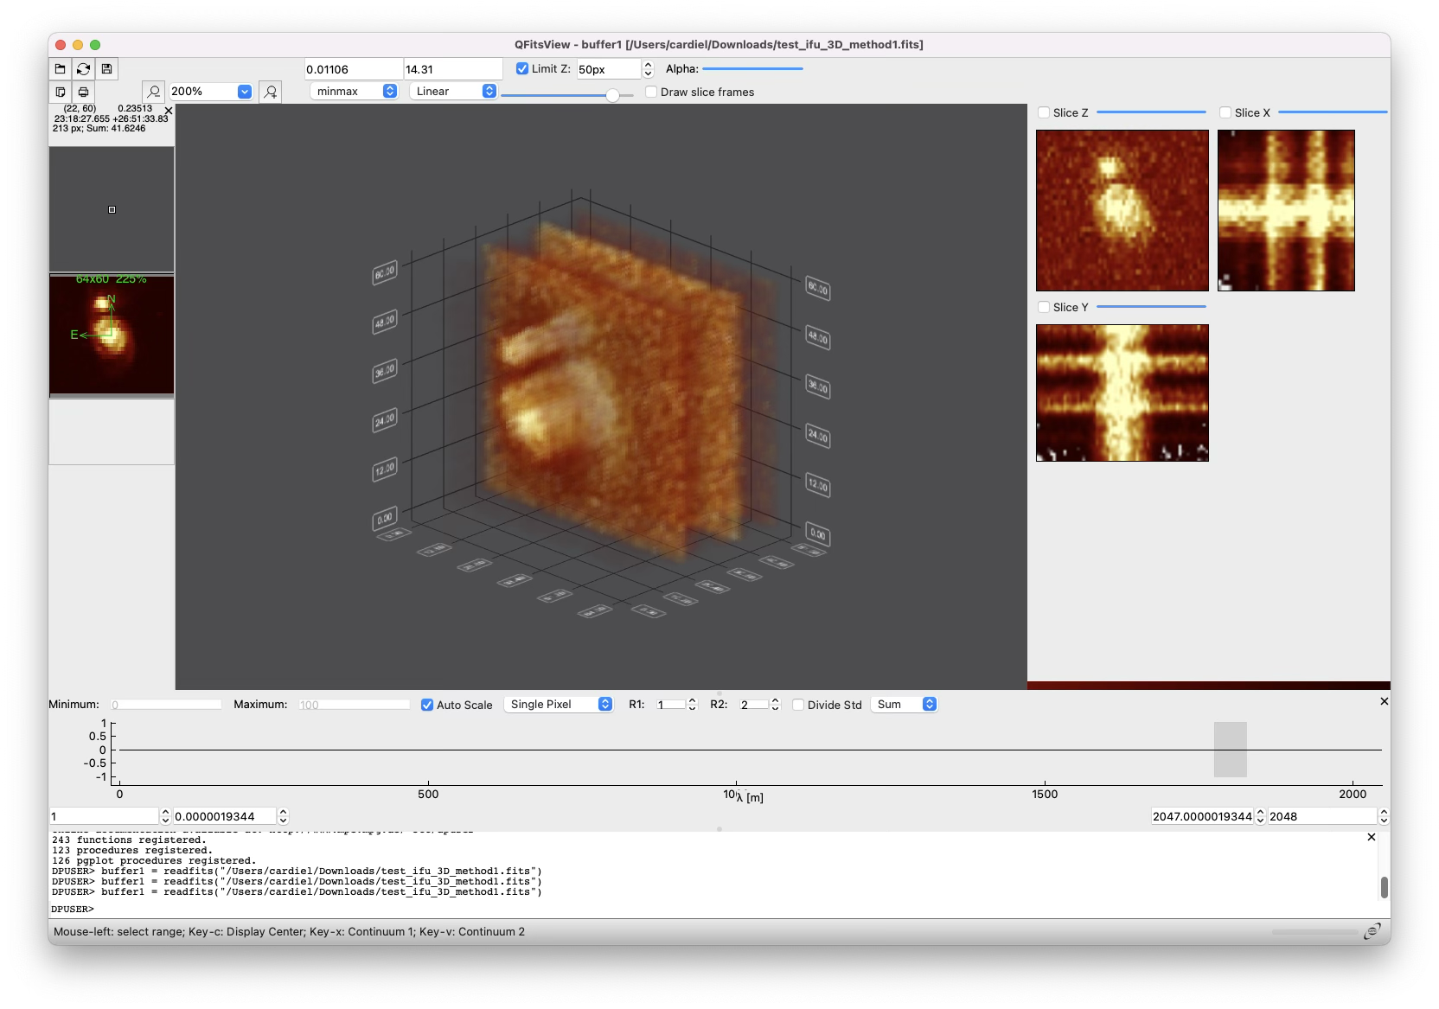
Simulator of FRIDA IFU data cubes
Raw Stacked Spectra
The IFU image simulator has been essential for initiating the development of the instrument’s DRP prototypes.
Detector Image (Hawaii 2)

Slide 21
AtLAST UCM-IPARCOS node

Slide 22
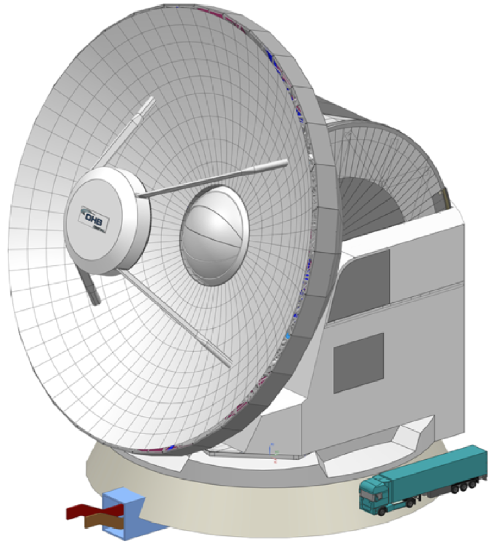

The Atacama Large Aperture Submm Telescope (AtLAST)
First high-res (< 2" at ν > 650 GHz) and wide-field (> 1 deg) single-dish submm observatory
Pioneering sustainable astronomy: tailored off-grid renewable energy system
Global effort building upon European and Japanese submm expertise
A facility for >30 yr, committed to open science
1 mJy RMS (Δν = 8 GHz) @ 350 GHz in < 8 s
50m diameter
30 – 950 GHz
Mapping speed 10³ - 10⁵ x ALMA
Max FoV = 2 deg
6 large instrument cabins
Multi (>10⁵)- beam & multi-band receivers ​
MILKY WAY, GALAXIES, AND COSMOLOGY
Link sub-pc protostellar cores & disks with their large-scale environment in our Galaxy
Resolve the cosmic infrared background
SDSS-like submm surveys of the local Universe
Map elusive gas flows and cosmic web filaments
Time domain science
Solar observations
3 deg/s scanning
Continuum & line polarization
CROSS-FIELDS
Discover transient & time-varying submm sky
Solve missing flux issue of interferometers
SOLAR SYSTEM
Track solar activity driving space weather
Survey HDO & D₂O in comets
Active optics
Mroczkowski et al. (2025), A&A, 694, A142
Find out more : www.atlast-telescope.org

Slide 23
Group’s Overview
Top 2-3 Scientific Highlights
Highlight 1: (e.g., "First measurement of X using Y telescope/accelerator data.")
Highlight 2: (e.g., "Developed new theoretical model for Z, resolving long-standing discrepancy.")
Leadership, Internationalization & Impact
Major Roles: Leadership positions in international collaborations (e.g., working group convener at CERN, board member for a major telescope/mission).
Recognitions: Major awards, honors, or keynote plenary talks at top-tier international conferences.
Tech Transfer / Outreach (Optional but encouraged): Patents, software released to the community, or high-impact public engagement.
The Horizon
Next Big Milestone: (e.g., "Preparing for Run 4 data taking," or "Shifting focus to multi-messenger modeling.")
NOTE: (Last two years only, ~from 2024 on)

Slide 24



















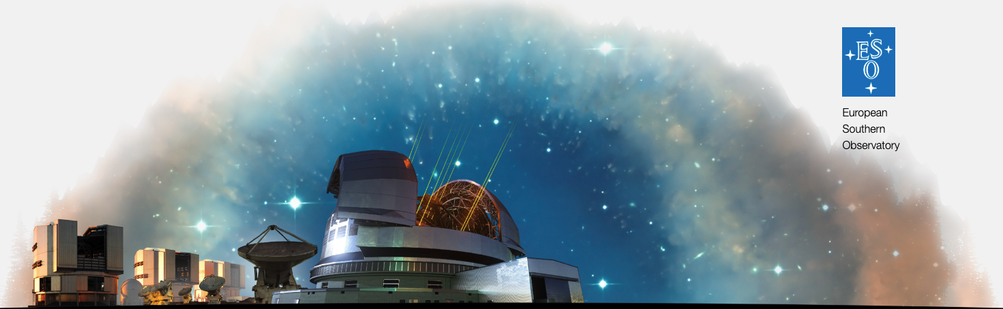
 | Project | Timeline | Partners | EU Funds | Funds UCM
AtLAST-1 | Horizon 2020: “Towards an Atacama Large Aperture Submillimeter Telescope” (Grant agreement: 951815) | Mar 21 – Aug 24 | 5 | 3.5 M€ | In-kind
AtLAST-2 | Horizon Europe “Consolidating plans for the Atacama Large Aperture Submillimeter Telescope” (GA: 101188037) | Jan 25 – Jul 28 | 21 | 4 M€ | 187 k€
AtLAST-2 High-level goals
Consolidate the AtLAST concept
Prototype and test technology solutions
Perform a full lifecycle assessment of the facility
Expand our user community
Increase TRL of crucial components
Be ready for the implementation phase
Contender for:
ESO’s Expanding Horizons
Transforming Astronomy in the 2040s
27 submitted White papers
Montenegro-Montes et al. (2025) arxiv:2512.14238
IPARCOS participation in 3 additional white papers

Slide 25
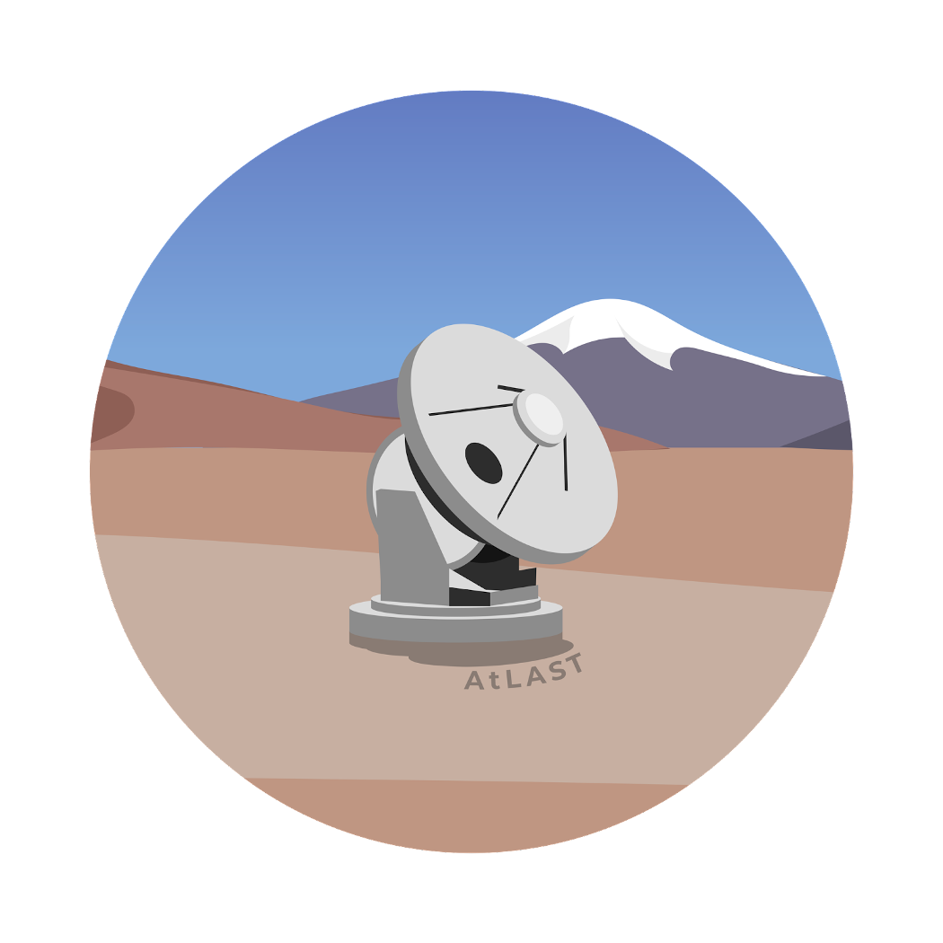
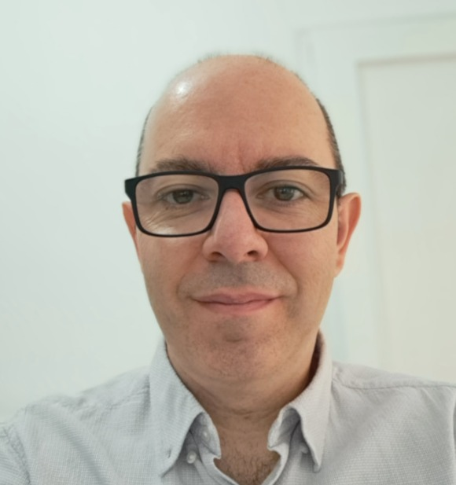
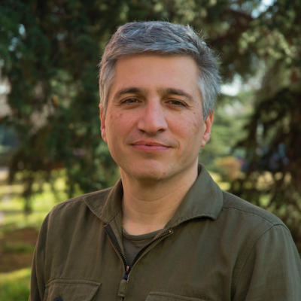
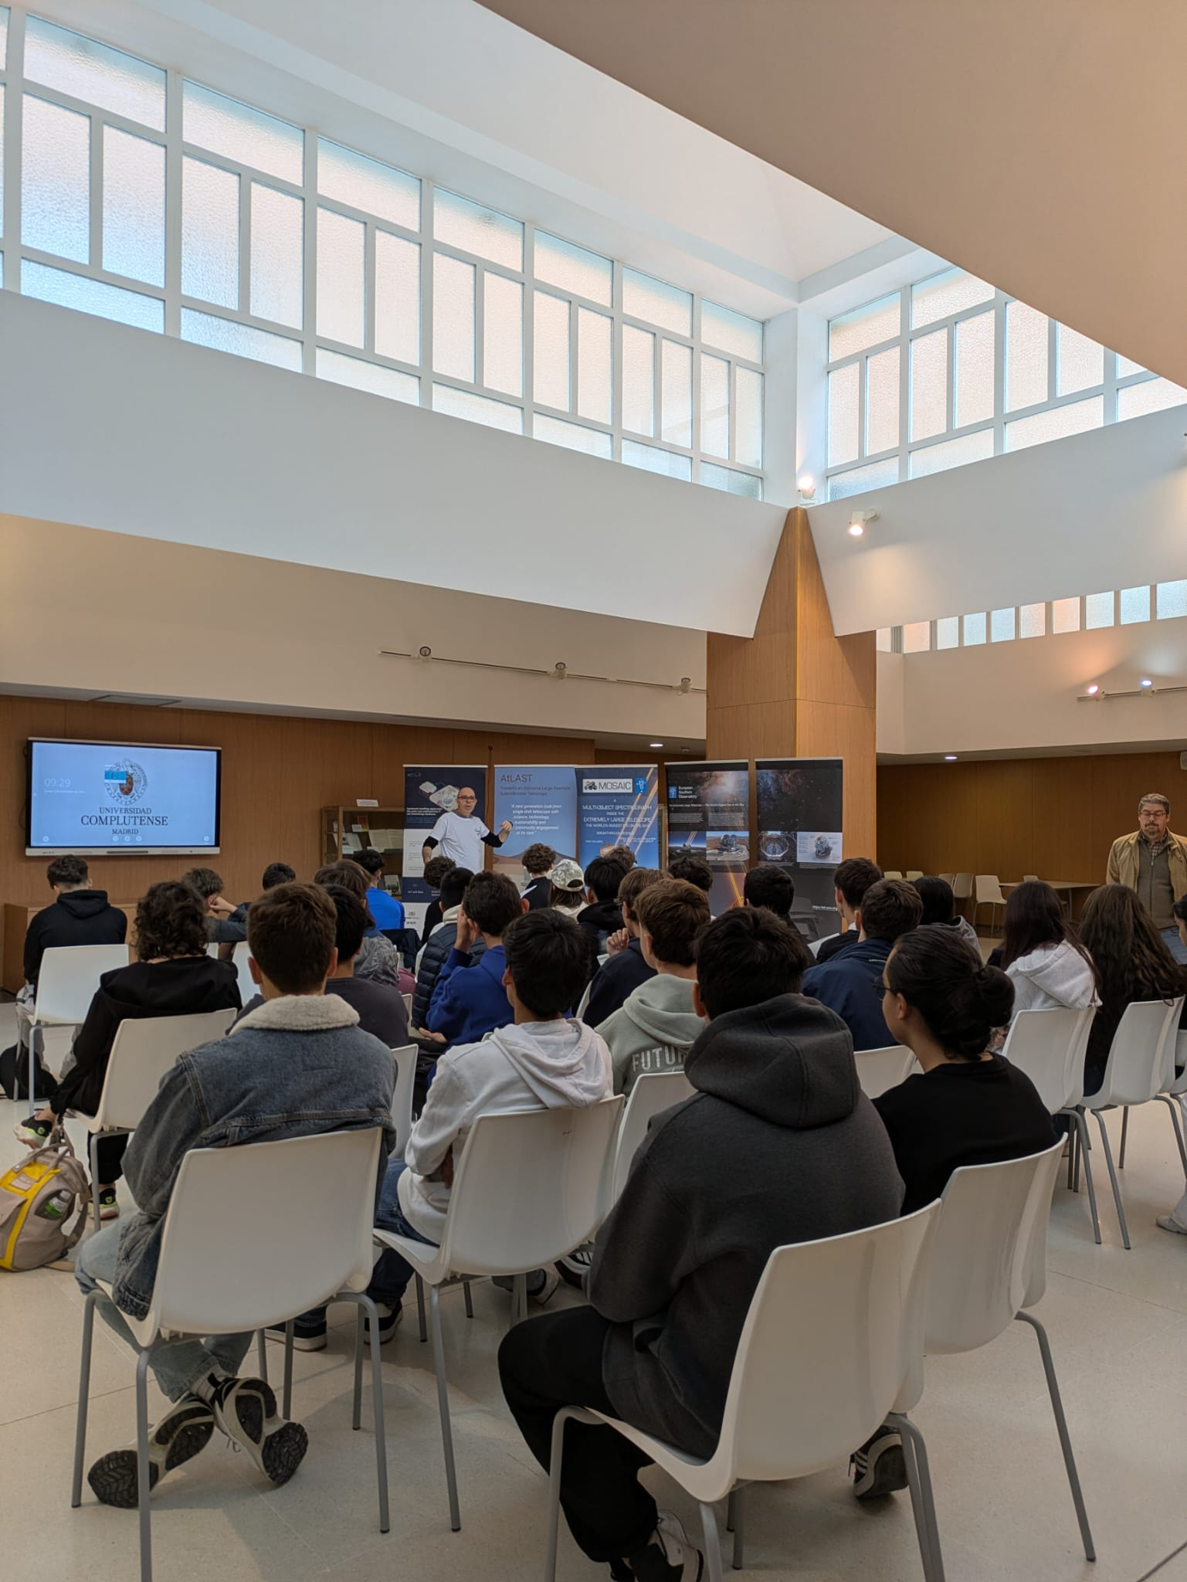
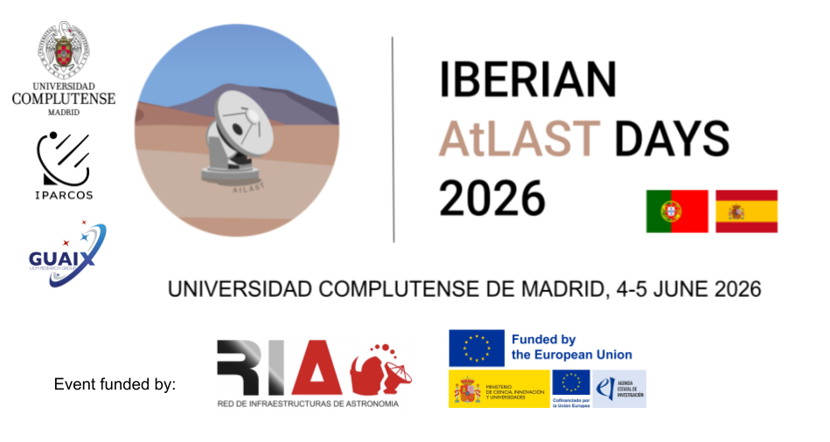
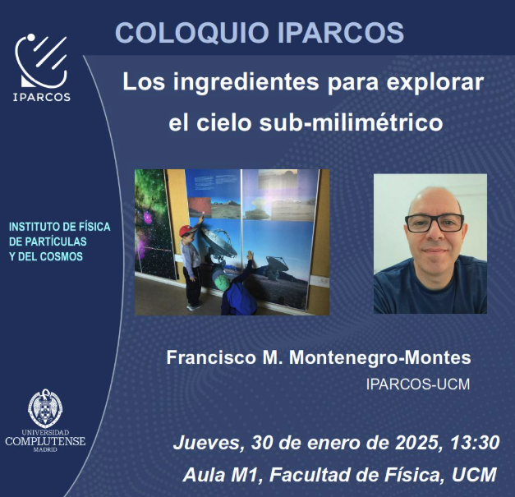
AtLAST-2 UCM-IPARCOS node
PI: Armando Gil de Paz
Scientific Coordinator: F. M. Montenegro-Montes
12 IPARCOS members involved
Responsibilities and Main Activities
E. Hatziminaoglou, F.M. Montenegro-Montes (2024)
Deliverable 4.1. “AtLAST Operations plan”
F. M. Montenegro-Montes, E. Hatziminaoglou, C. De Breuck (2024)
Deliverable 4.2 ”On the Use of existing infrastructures”
Co-lead Operations and User Experience (WP4)
Modern operations concepts: Remote and distributed operations
Data infrastructure, archving and user access
User support models
Engagement of Spanish community
Contribute to Science Reference Plan
Outreach:
IPARCOS colloquium
Semana de la ciencia 2024 / 2025

Slide 26
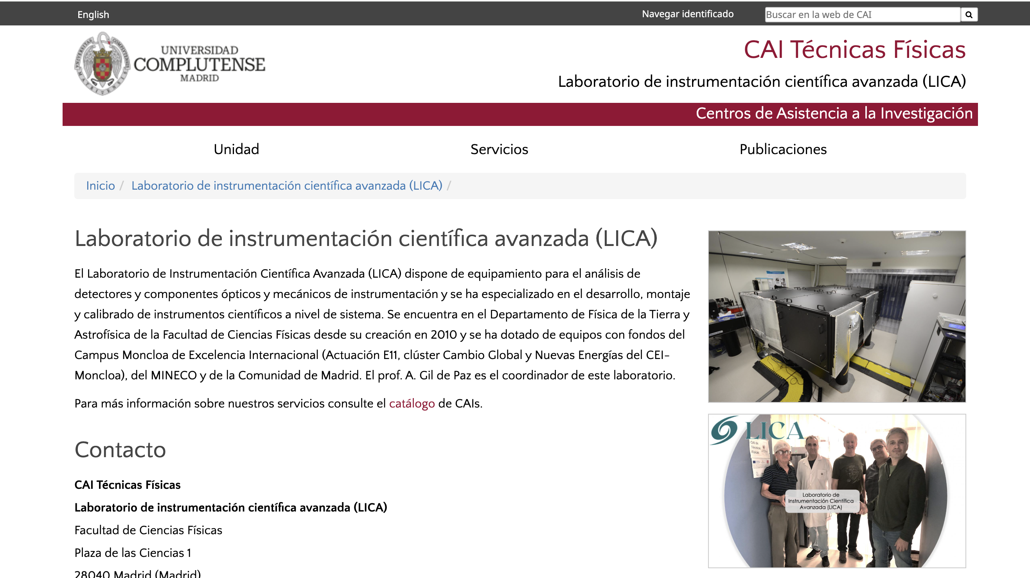


The Advanced Scientific Instrumentation Laboratory (LICA) has equipment for the analysis of detectors and optical and mechanical instrumentation components and has specialized in the development, assembly and calibration of scientific instruments at the system level. It has been in the Department of Earth Physics and Astrophysics of the Faculty of Physical Sciences since its creation in 2010 and has been equipped with equipment with funds from the Moncloa Campus of International Excellence (Action E11, Global Change and New Energies cluster of the CEI-Moncloa), the MINECO and the Community of Madrid. Prof. A. Gil de Paz is the coordinator of this laboratory.
ISO 9001–certified laboratory

Slide 27
Horizon: opportunities and challenges
Positioning GUAIX for ELT/SKA/JWST-era science while sustaining people and data capacity
Next big scientific opportunities
Main challenges for the group
• MOSAIC/ELT and TARSIS: turn instrumentation leadership into flagship science
• MEGADES / MEGARA legacy: consolidated IFU diagnostics and public data products
• SKA/POSSUM/LOFAR: cosmic magnetism and radio transients
• JWST + ALMA + NOEMA + GTC: multi-phase feedback constraints
• Simulations + surveys: connect resolved physics to population evolution
• Funding continuity across instrumentation + exploitation cycles
• Retaining postdocs and technical expertise after project peaks
• Scaling reduction, analysis and archive tools for IFU/multiwavelength data
• Maintaining visibility in large collaborations while protecting GUAIX-led science
• Balancing dedicated instrument effort with broad astrophysics output
Take-home message: GUAIX is a compact but highly productive group
whose distinctive value is the coupling of astronomical instrumentation,
IFU expertise and multiwavelength extragalactic science.

