Slide 1
GUAIX / Science
IPARCOS Scientific Advisory Board: Bi-Annual Review 2026

Slide 2
GUAIX Overview
GUAIX – UCM Group of Extragalactic Astrophysics and Astronomical Instrumentation
PI: Prof. Jesús Gallego
Current Size: 36 members:
3 Full Professors (catedráticos)
4 Professors (prof. Titulares)
1 PPL Professor
1 Assistant Professor
2 Senior Researchers (Ramón y Cajal / Talent Attraction Program)
7 Postdoctoral Researchers
13 PhD Students
1 Researcher
1 Lab Technician
1 Honorary Professor
2 Project Managers
Key Personnel Changes: Dr. Fumihiro Naokawa, a JSPS Research Fellow from the Tohoku University, will conduct a two-year research stay within our group.
36
165
4.7 M€
3+4
7+13+2+1
members
refereed papers
since Jan 2024
active funding
full + associate
professors
postdocs + PhD
students + PM + Tech.
NOTE: (Last two years only, ~from 2024 on)

Slide 3
Key Performance Indicators
High-Impact Publications: 165 peer-reviewed papers. 165 in Q1 journals (SCImago SJR).
Funding Secured: The total funding across ongoing projects reaches €4.7 million.
Main sources:
  Spanish National Plan (PID projects)
  Horizon Europe programmes
  Regional Government of Madrid
Major projects include:
  MOSAIC-ELT (€893k + €518k)
  TARSIS (€731k)
  ARRAKIHS (€460k)
Horizon Europe projects (AtLAST2, PLAN-B, AC3)
Training:
24 PhD theses defended (total). 4 PhD theses defended in 2023–2024.
13 PhD theses currently in progress (2 to be defended within the next two months).

Slide 4
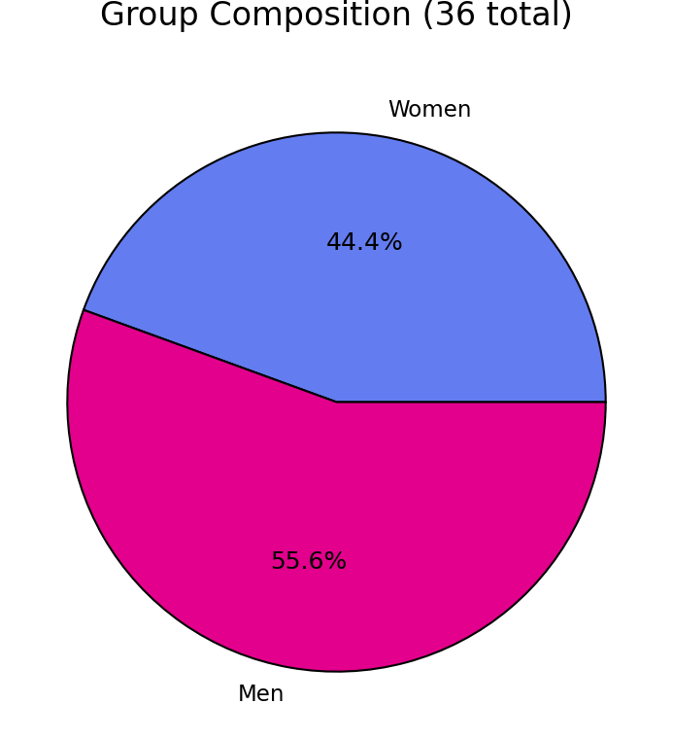
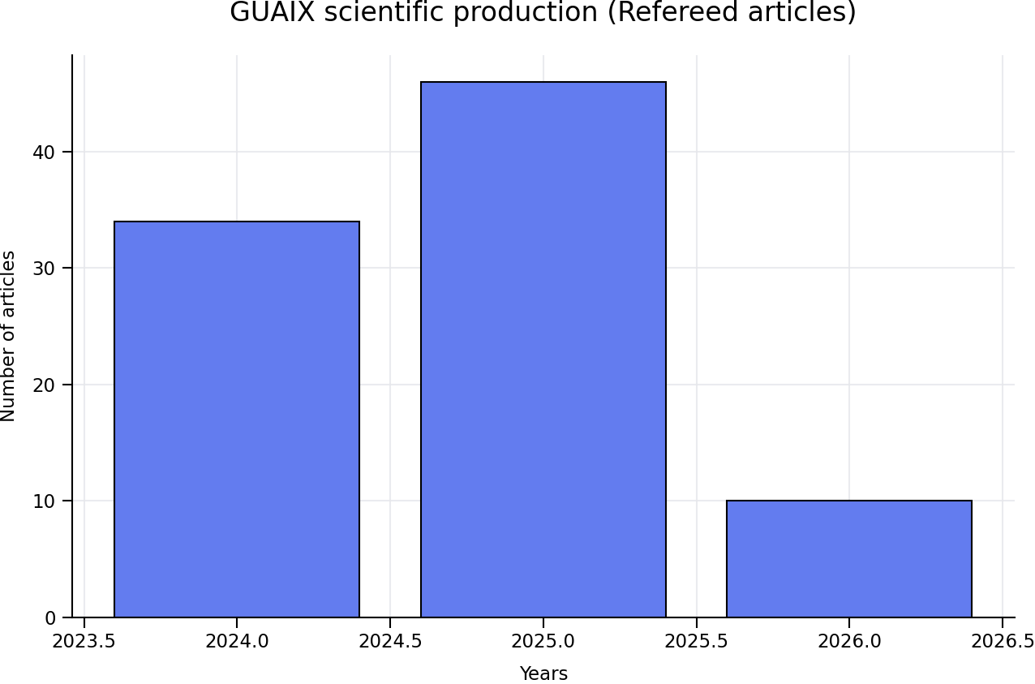

Slide 5
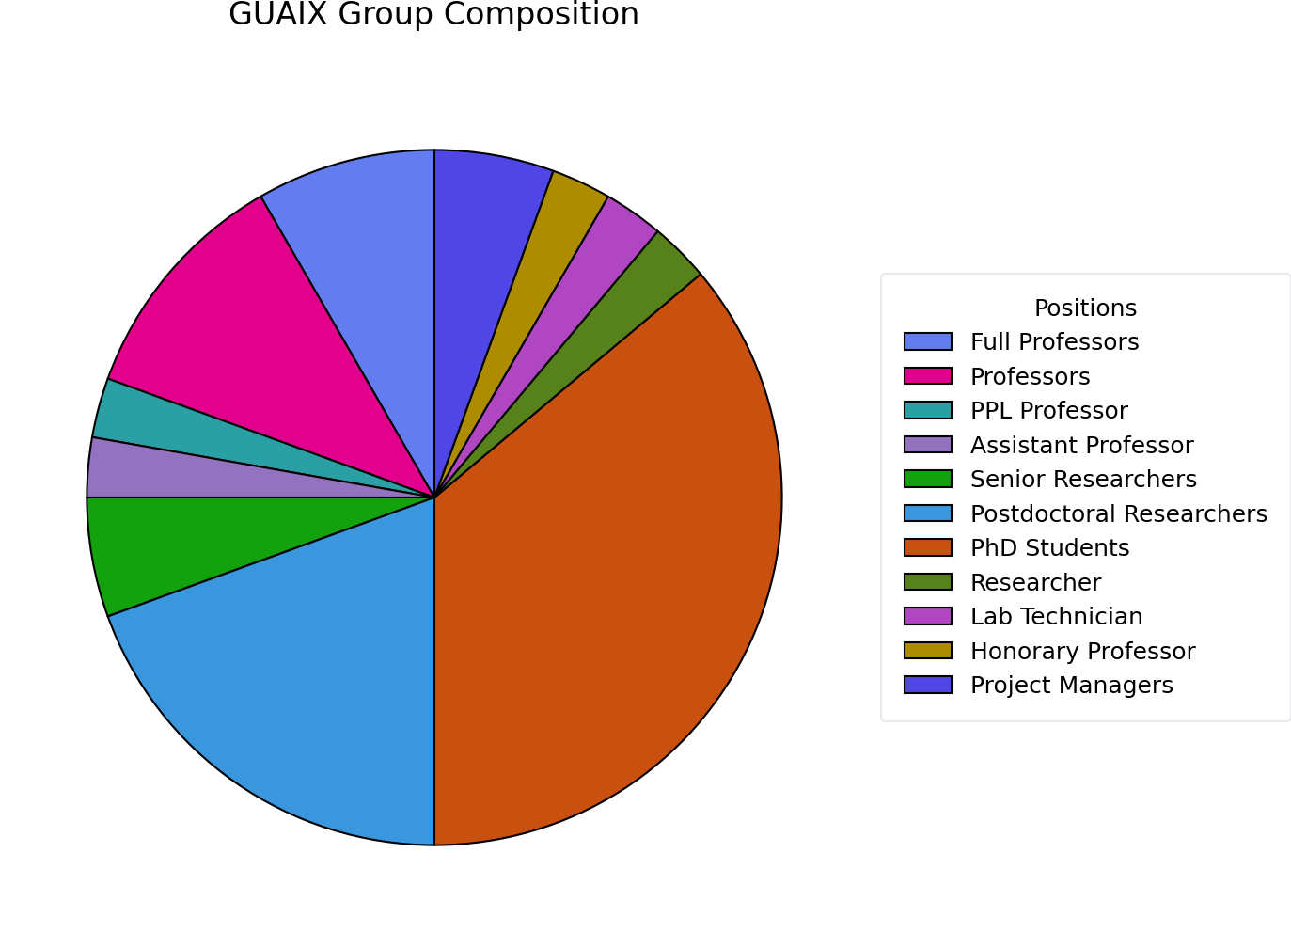
Tech., Proj.
Managers, …
Permanent
Staff
PhD
Students
Postdocs

Slide 6
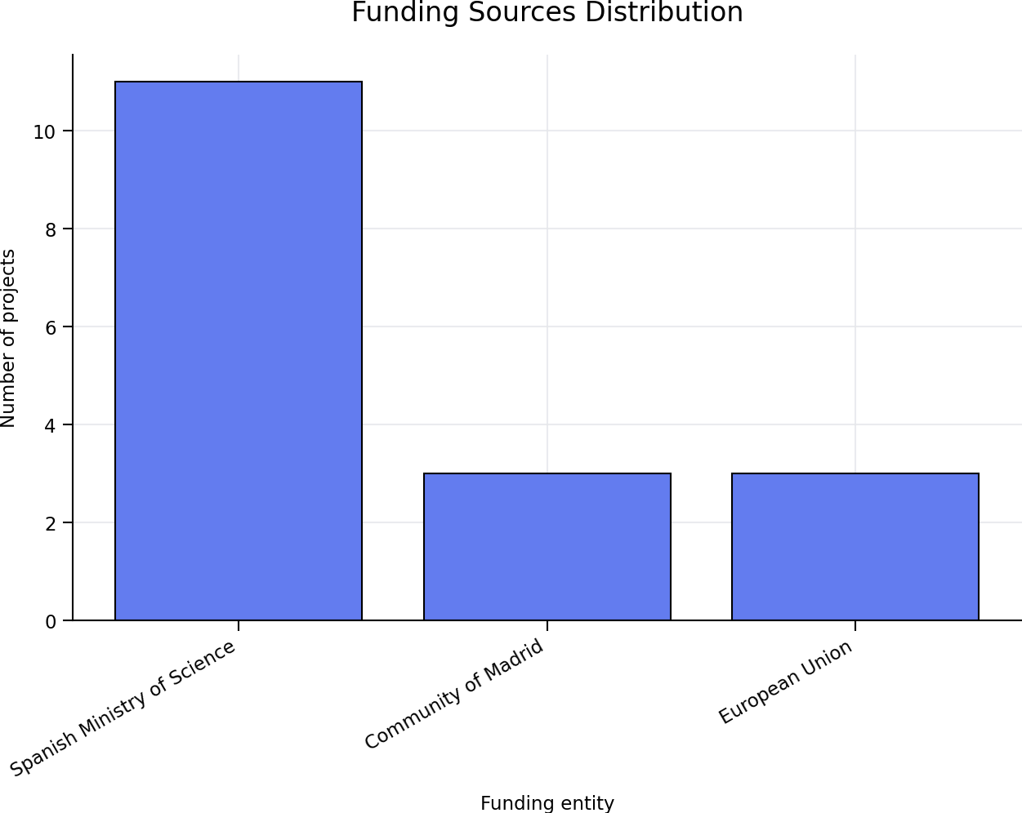
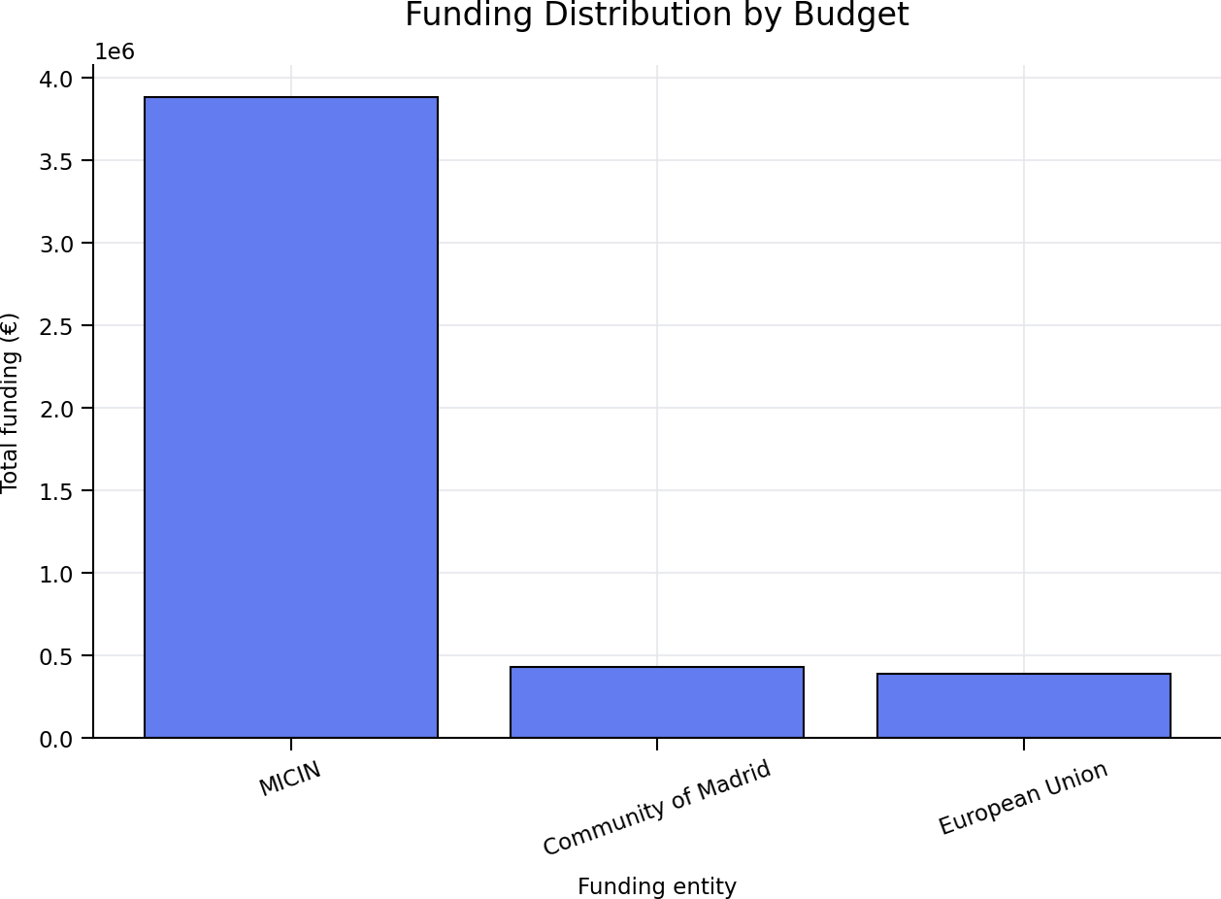

Slide 7
Science map and current drivers
A broad extragalactic programme with instrumentation as an enabling layer
Nearby galaxies + stellar populations + AGN feedback + high-energy/magnetism
connected through IFU spectroscopy, surveys, simulations and multi-wavelength facilities
Main active projects and collaborations
What the group delivers
• MOSAIC / ELT: Spanish contribution to PDR + LLI-FDR
• TARSIS: Calar Alto 3.5m instrument + science prep.
• ARRAKIHS: ESA F-class mission phase at UCM
• AtLAST2 + Mad4Space + SKA-prep / cosmic magnetism
• PLAN-B / light and noise pollution impacts
• AC3: cloud-edge continuum management
• Dwarfs4MOSAIC: IFU observations (MEGARA & WEAVE) of nearby dwarfs as local analogs of early star-forming galaxies
• MEGARA science exploitation
• Survey science: MEGADES, PHANGS, TIMER, CAVITY, GATOS, POSSUM
• Galaxy evolution across environments and cosmic time
• New constraints on feedback and outflows
• Metallicity determinations in nearby galaxies: Metal-THINGS
• Training pipeline for instrumentation + data-intensive astronomy

Slide 8
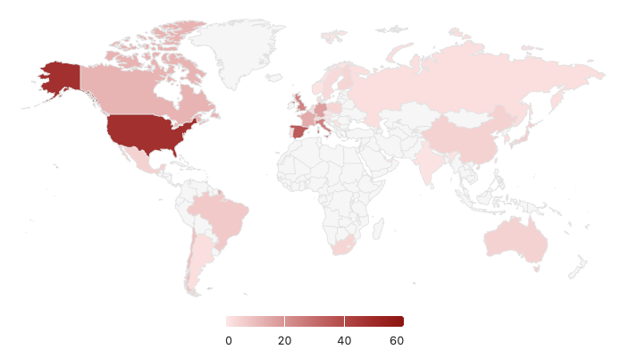
GUAIX scientific internationalization
Fostering international collaboration between GUAIX and other research groups worldwide
Norway
AtLAST
Germany
CAVITY
LOFAR
AtLAST
Athena/X-IFU
CATARSIS
Dw4MOS
Metal-THINGS
Canada
PHANGS
LOFAR
UK
AtLAST
Dw4MOS
Sweden
ARRAKIHS
AtLAST
AGORA
Dw4MOS
Netherlands
LOFAR
Athena/X-IFU
AtLAST
South Korea
AGORA
USA
PHANGS
POSSUM
GATOS
Metal-THINGS
LOFAR
AtLAST
Athena/X-IFU
CATARSIS
AGORA
Switzerland
AtLAST
ARRAKIHS
France
Athena/X-IFU
Dw4MOS
Japan
Athena/X-IFU
AtLAST
CATARSIS
AGORA
Greece
AC3
Spain
MEGADES
CATARSIS
ARRAKIHS
AtLAST
Dw4MOS
Metal-THINGS
Italy
Athena-X-IFU
AtLAST
Mexico
CATARSIS
MEGADES
Metal-THINGS
Brazil
TIMER
PHANGS
Australia
POSSUM
LOFAR
AGORA
Chile
GAMA
PHANGS
South Africa
AtLAST
Number of collaborators
from each country in the 2024-2026 GUAIX publications

Slide 9
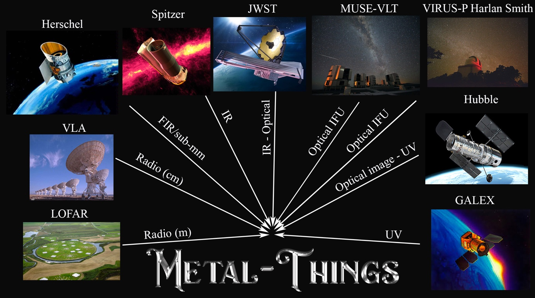
Nearby galaxies, ISM and star formation
Resolved gas, H II regions, metallicity gradients and local galaxy laboratories
Glimpse of the programme
• IFU mapping of ionized gas and stellar populations
• Gas flows, metallicity gradients and H II-region physics
• Strong GTC/MEGARA exploitation (incl. MEGADES), linked to PHANGS, Metal-THINGS and other IFU-based science
• OTELO/GAMA science
Representative papers (2024–2026)
• Chamorro-Cazorla+26 — MEGADES: ionised-gas diagnosis
• Valé+25 — Metal-THINGS gas metallicity gradients
• Pilyugin+25 — Metal-THINGS: NGC 3521
• Arroyo-Polonio+25 — IZw18 with GTC/MEGARA + JWST/MIRI
• García-Vargas+24 — low-metallicity dwarf SDSSJ0859+3923 with MEGARA
• Querejeta+24 — PHANGS: spiral arms and star-formation efficiency
• Pathak+25 — 18,000 H II regions: masses, SFE and evolution
• Koda+24 — compact high-excitation molecular clumps in M83
• Cedrés+25 — OTELO downsizing at 0.38<z<1.43
• Molina-Calzada+25 — GAMA: environment, metallicity and SFR

Slide 10
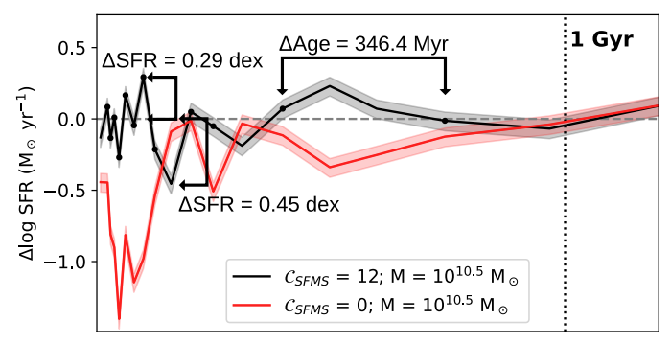
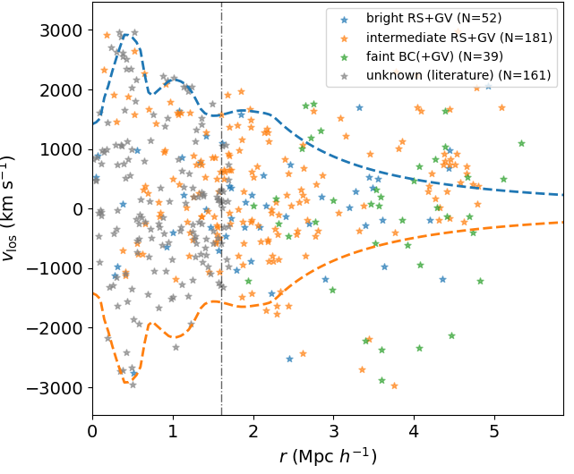
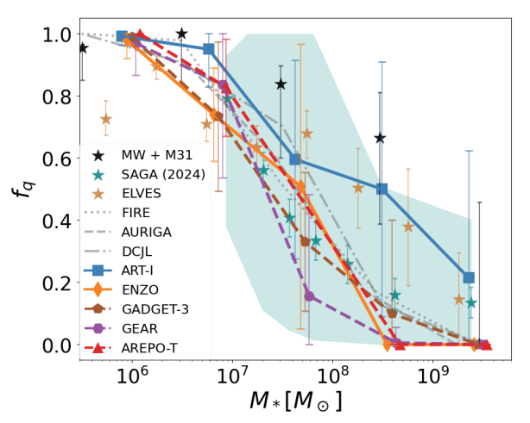
Stellar populations, dynamics and galaxy assembly
From local streams and discs to survey-driven stellar population constraints
Glimpse of the programme
• Stellar populations and dynamics as fossil records of assembly
• Environmental effects: voids, cosmic web, bars and streams
• IFU + simulations + deep imaging as complementary tools
Camps-Fariña+26
Rodríguez-Cardoso+25
Representative papers (2024–2026)
• Camps-Fariña+26 — sub-Gyr variability around the star-formation main sequence
• Camps-Fariña+24 — mass/morphology effects on mass assembly
• Conrado+24 — CAVITY: spatially resolved stellar populations in voids
• García-Benito+24 — CAVITY first public data release
• Pérez+25 — galaxy mass-size segregation in the cosmic web
• de Sá-Freitas+25 — bar ages in nearby galaxies (TIMER)
• Sánchez-Menguiano+26 — bars and H II regions in TIMER
• Ikhsanova+25 — mock TNG50 galaxies for WEAVE-StePS
• Martínez-Delgado+24 — NGC 7241 blue stellar stream with MEGARA
• Miró-Carretero+25 — tidal streams: observations meet simulations
• Rodríguez-Cardoso+25 — AGORA simulations: satellite quenching
• Marrero-de la Rosa+26 — BEARD: drivers of mass-size relation

Slide 11
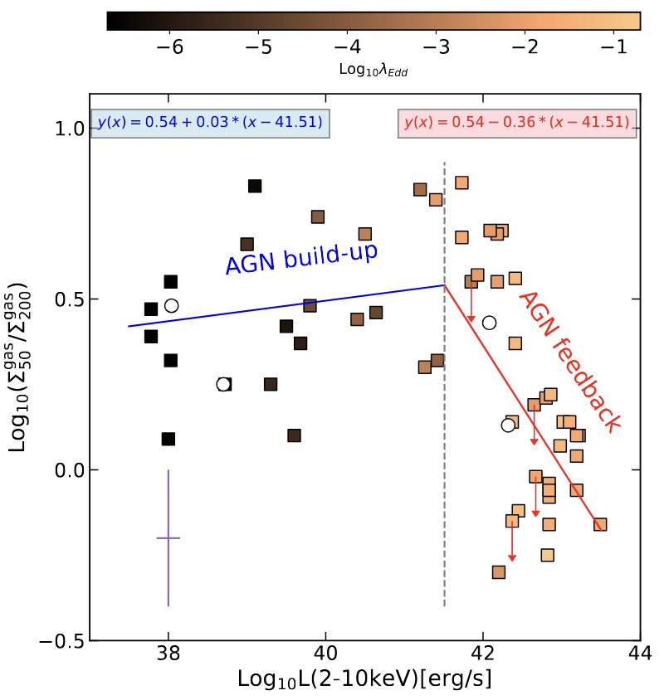
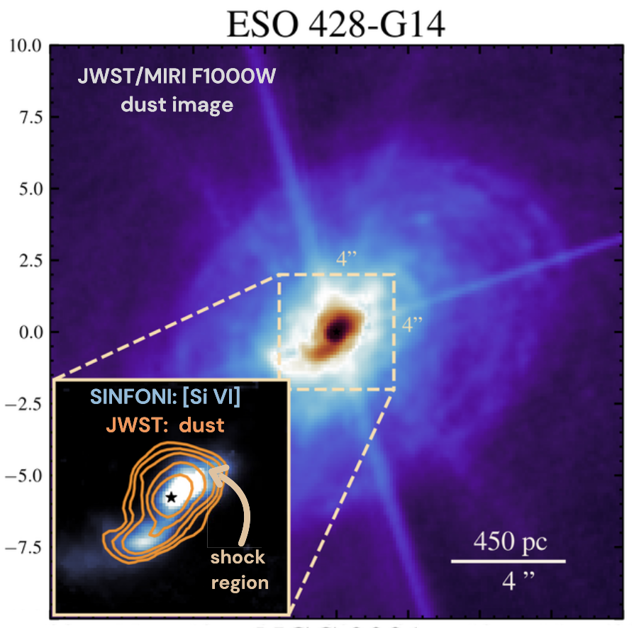
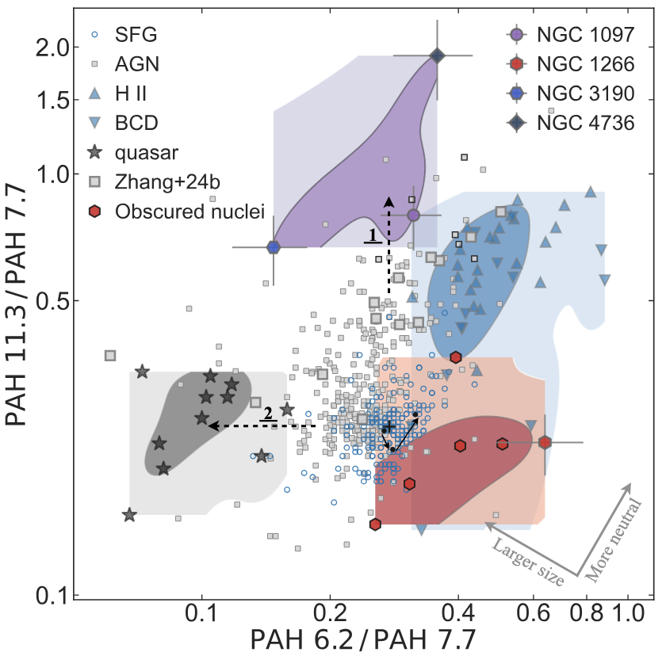
AGN feedback and outflows
Ionized, molecular and mid-IR diagnostics of how AGN couple to their host galaxies
Glimpse of the programme
• MEGARA and JWST/MIRI data expose outflow geometry and energetics
• GATOS and related collaborations connect dust, molecular gas and nuclear activity
• The group contributes to both survey-scale and target-specific feedback constraints
The AGN feedback reshapes the structure of the molecular gas in the nucleus, reducing its clumpiness (and likely its ability to form stars)
(Fast) shocks may be a key driver of the extended dust emission in the central few hundred parsecs of AGN, potentially dominating over direct AGN radiative heating
LLAGN show higher 11.3/7.7 ratios → dominance of large PAHs, consistent with destruction of small PAHs by AGN feedback
García-Burillo+21,24, Esposito+26
Haidar+24,26
Zhang+24,26,
García-Bernete+24
Other representative papers (2024–2026)
• Bellocchi+26 — multi-phase AGN-driven outflow in IRAS 17020+4544
• Hermosa Muñoz+24 — MEGARA view of outflows in LINERs
• Esposito+26 — GATOS X: molecular gas clumpiness under AGN influence
• Zhang+26 — feedback effects in low-luminosity AGN with JWST
• Haidar+26 — GATOS XI: excess dust heating in NLRs
• Lopez-Rodriguez+25 — GATOS VIII: extended mid-IR emission in AGN
• Fuller+25 — GATOS VII: SOFIA 20–214 μm imaging atlas
• González-Martín+25 — JWST diversity of nuclear obscuring dust
• Campbell+25 — GATOS IX: emission-line contamination in JWST/MIRI
• Delaney+25 — molecular hydrogen excitation in Seyferts

Slide 12
High-energy, magnetism and multiwavelength transients
Gamma rays, radio polarization and transient hosts as complementary windows on feedback and environments
Glimpse of the programme
• Optical spectroscopy connects AGN/outflow energetics to γ-ray limits
• POSSUM/LOFAR work probes magnetized cosmic structures
• FRB and blazar host follow-up extends the group into fast multiwavelength science
Alonso-López+26
Representative papers (2024–2026)
• León+26 — LINER outflows with Fermi-LAT and MEGARA
• Álvarez-Crespo+25 — Fermi blazar candidates; changing-look blazar
• Hazra+24 — most distant γ-ray BL Lac object
• Bhardwaj+25 — hyperactive FRB in an SMC-like satellite host
• Hewitt+24 — repeating FRB source in a low-luminosity dwarf galaxy
• Alonso-López+26 — magnetic fields in the Shapley Supercluster core
• Pignataro+25 — detection of magnetic fields in superclusters
• Gaensler+25 — POSSUM science goals and survey description
• Carretti+25 — LOFAR RMs and magnetic fields in cosmic filaments
• Piras+25 — LOFAR Deep Fields polarized extragalactic sources

Slide 13
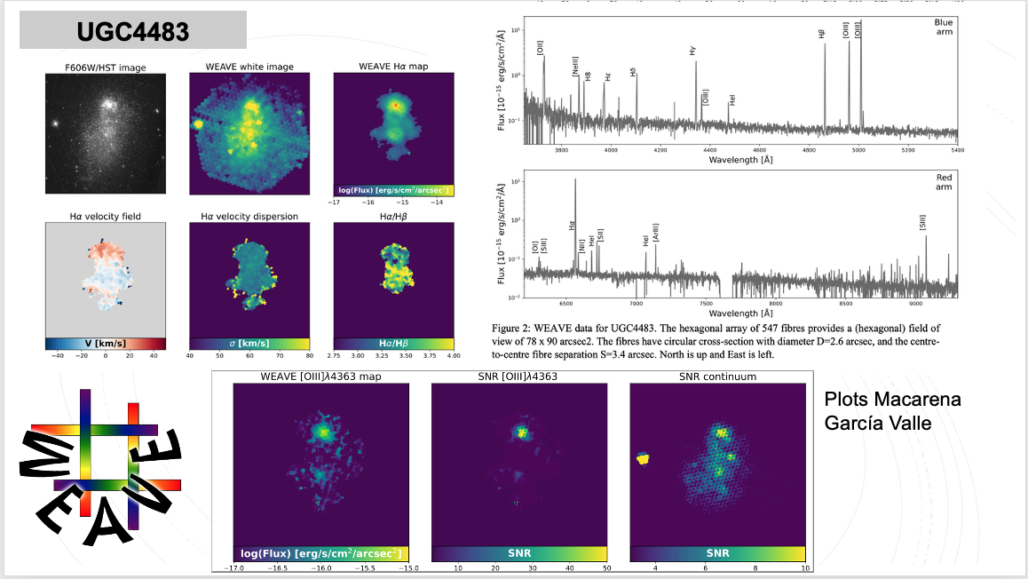
Dwarfs4MOSAIC: La Palma ITP project
A 2D study of low-mass star-forming galaxies as low-redshift analogs to reionization-epoch primeval galaxies. A pilot study for MOSAIC at ELT
Glimpse of the observational programme
• From June 2024 to December 2026
• 80h GTC/MEGARA
• 82h WHT/WEAVE
• 3n LT/IO
• 7n INT/WFC
Scientific cases
• Local counterparts and Lyman continuum leakers
• Probing mass assembly in low-mass galaxies through gas metallicity gradients
• Census of central black holes in low-mass galaxies
• Highly ionized gas in high-z dwarg Galaxy analogs
• Stellar kinematics of low-mass star-forming galaxies
• PopII galaxies in nearby Galaxy clusters
• Reconcilying the cosmological dust attenuation with the one per stellar mass bin
• Tidal streams or any sign of past interaction in low-mass galaxies
• Synergies with present and future facilities
Representative papers (2024–2026)
• Gallego et al 2025, Presentation of the Data Release 1 to the MOSAIC consortium
• Gallego et al 2026, Public release of the Dwarfs4MOSAIC Data Release 1
• Chillarón-Víctor et al 2026, Presentation of the Project to the Spanish Astronomical Society

Slide 14
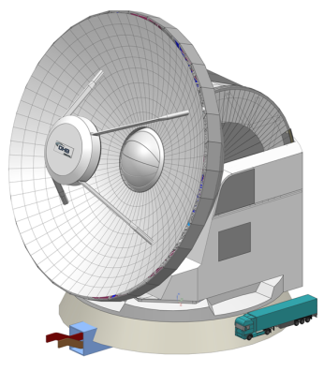
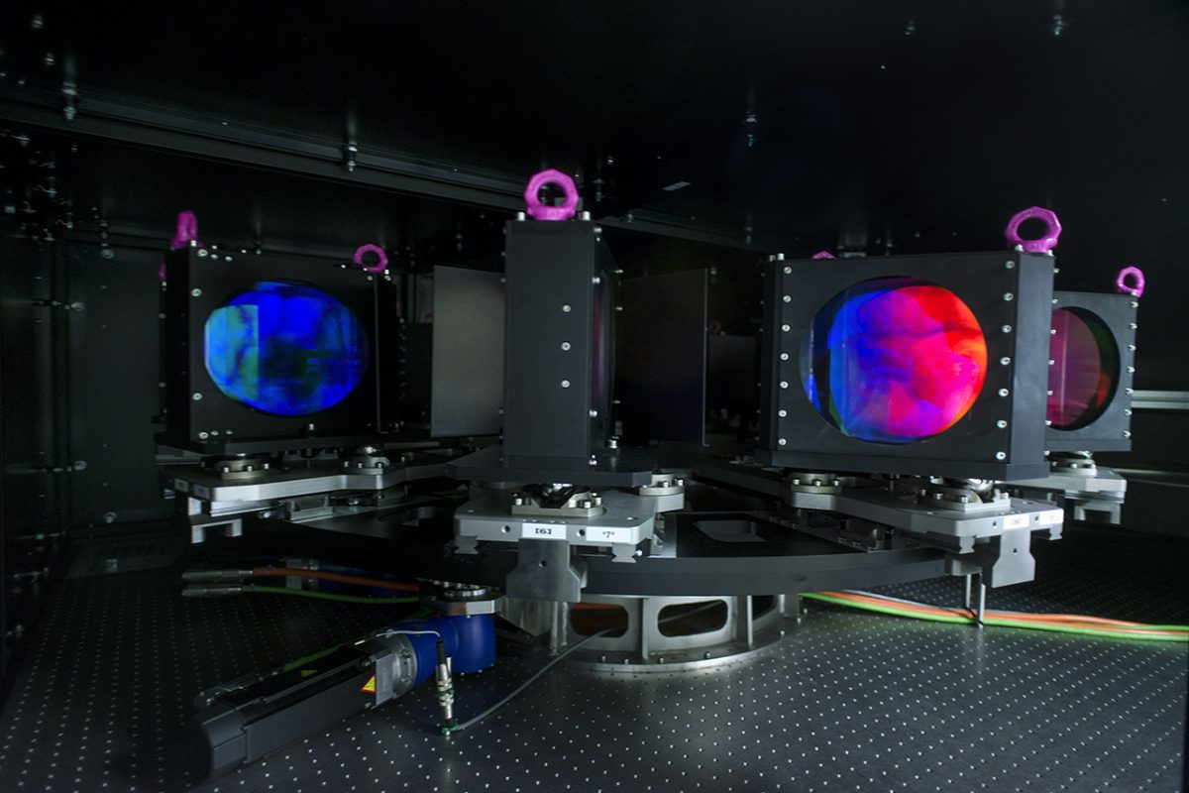
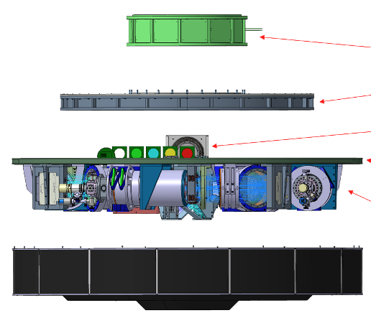
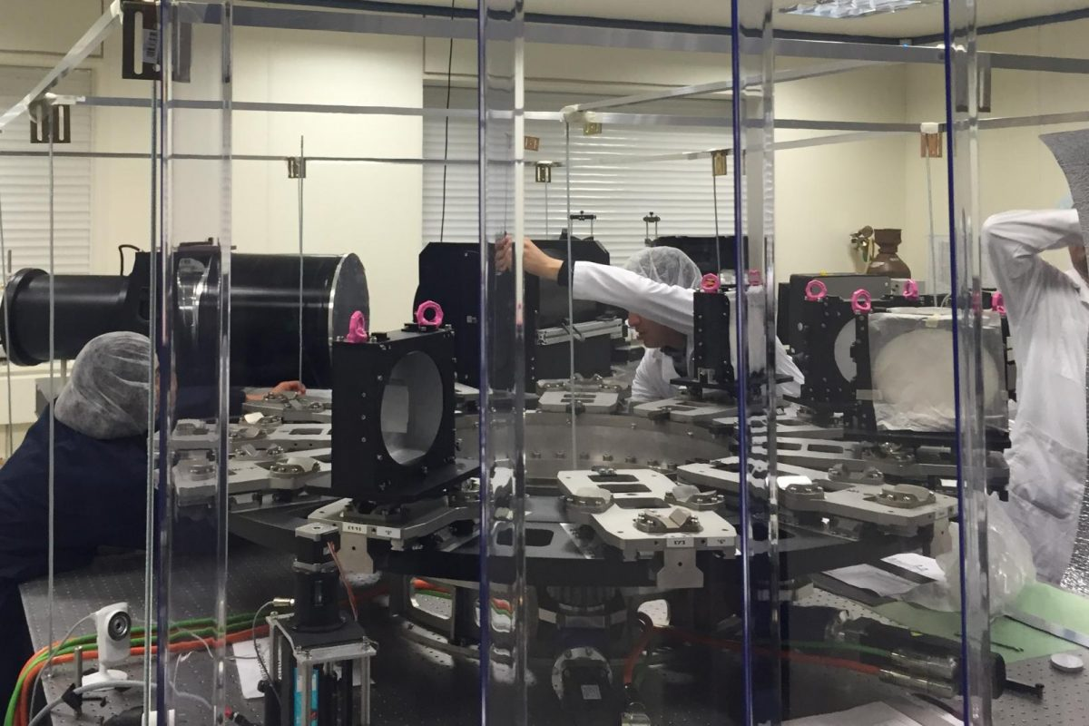
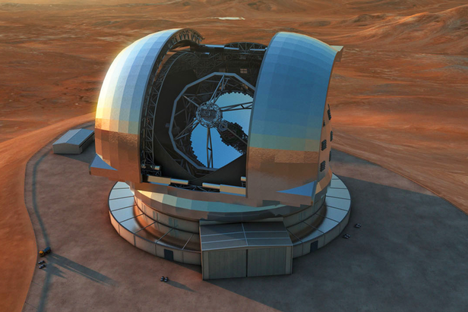
Instrumentation as a science accelerator
(details covered in the dedicated GUAIX instrumentation presentation by J. Gallego)
Science-enabling role
• MEGARA: mature science exploitation and community impact
• TARSIS: science preparation + construction (PDR completed) (after Calar Alto EC ruling, the team is looking for alternatives: ESO, PO, ING)
• MOSAIC / ELT: Spanish contribution through design milestones
• ARRAKIHS, Athena/X-IFU and AtLAST: broader instrumental footprint
Representative papers (2024–2026)
• Mroczkowski+25 — AtLAST conceptual design
• van Kampen+24 — AtLAST science: surveying the distant Universe
• Ceballos+24 — optimizing Athena/X-IFU-like TES detectors
• Peille+25 — X-ray Integral Field Unit after Athena reformulation
• Chamorro-Cazorla+26 — MEGADES science enabled by MEGARA
• Martínez-Delgado+24 — MEGARA follow-up of stellar streams
• García-Vargas+24 — MEGARA IFU on a low-metallicity dwarf
• Hermosa Muñoz+24 — MEGARA outflows in LINERs

Slide 15
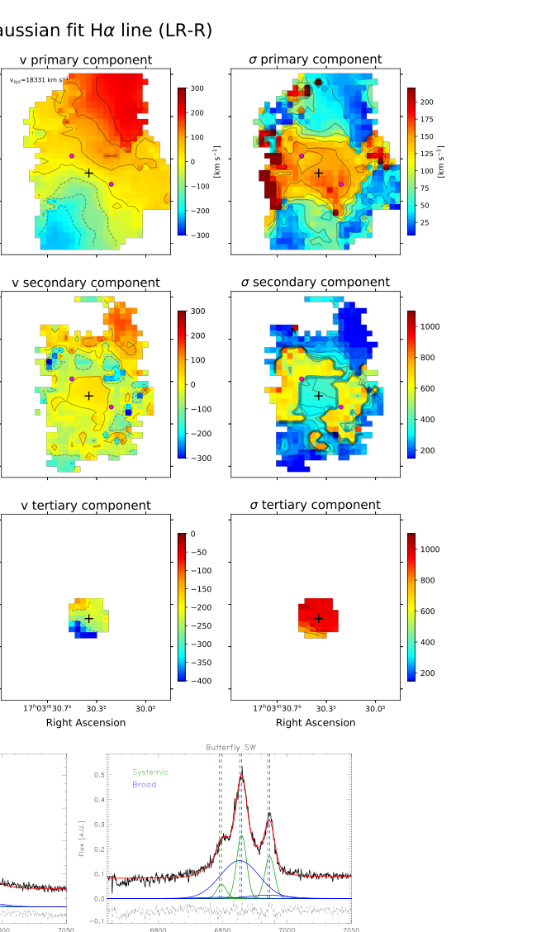
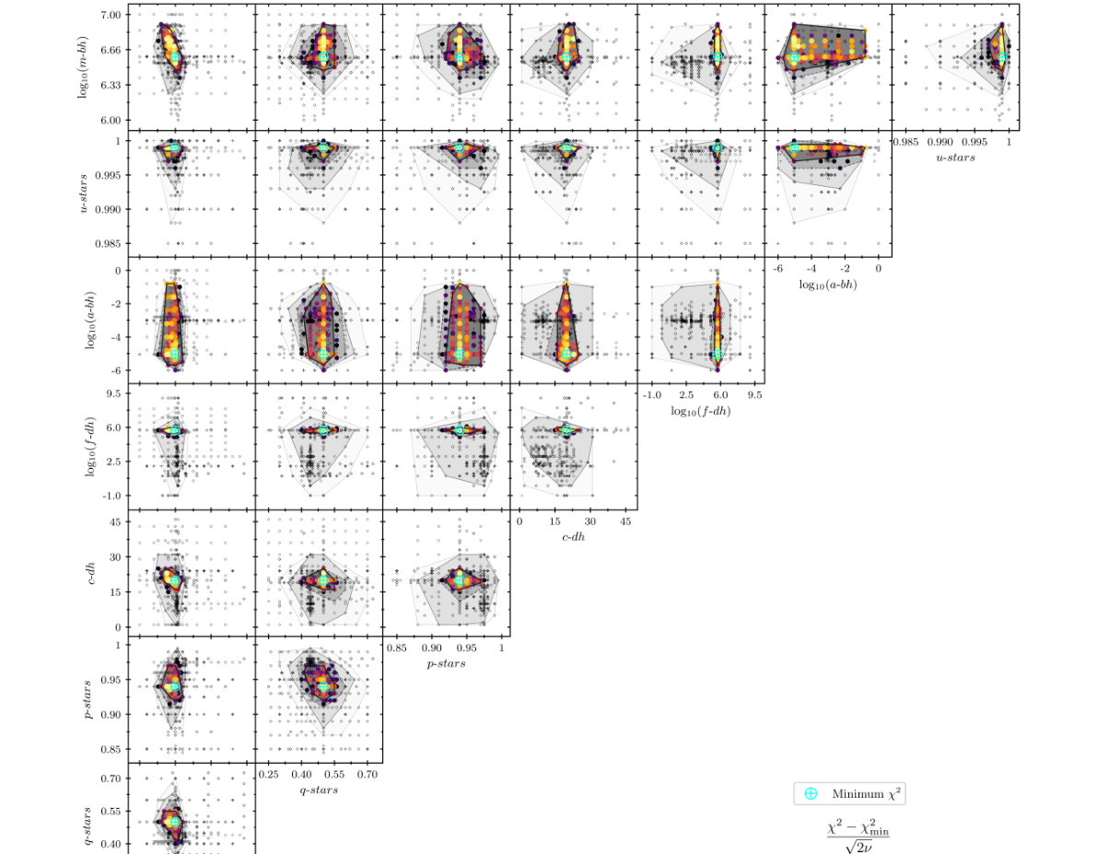
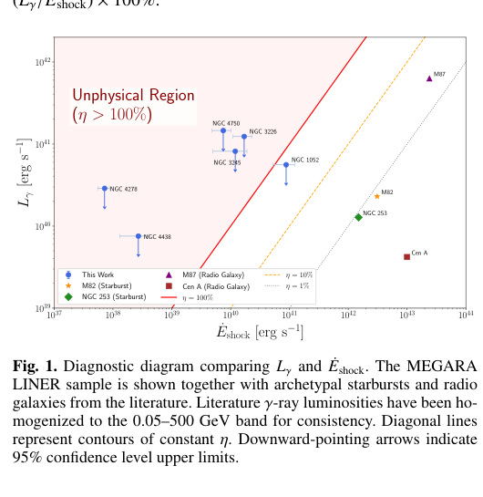
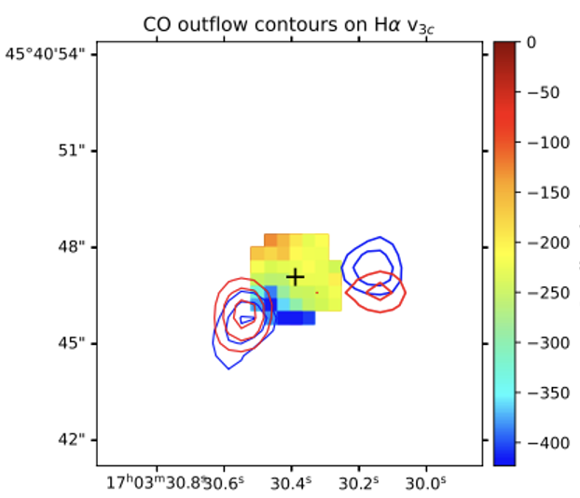
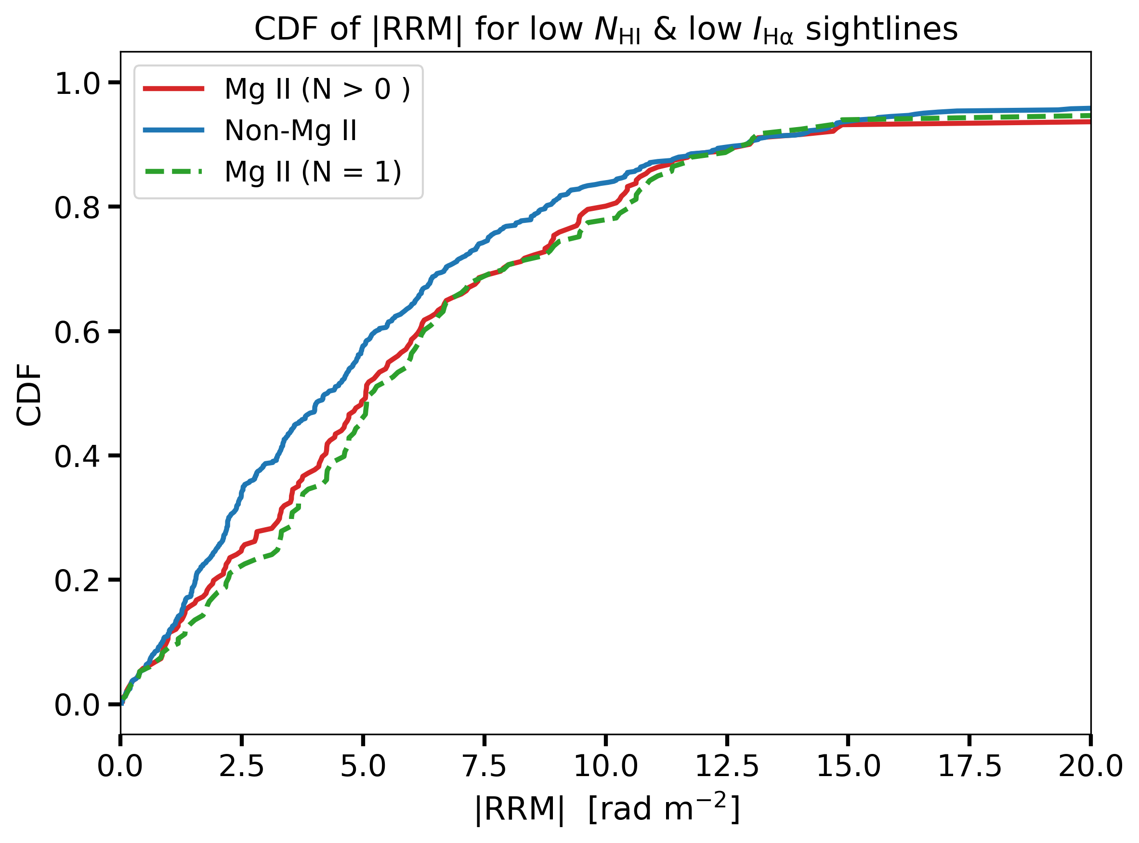
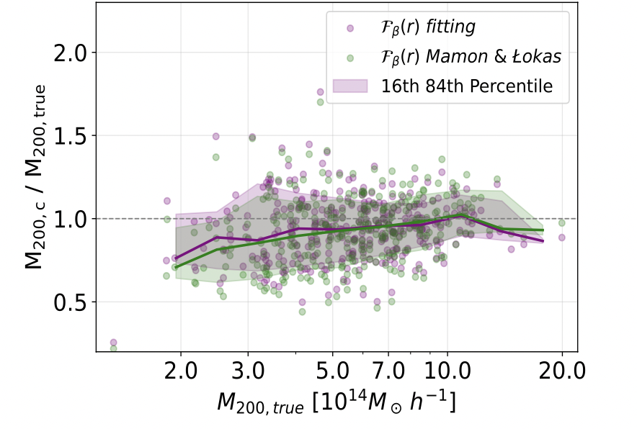
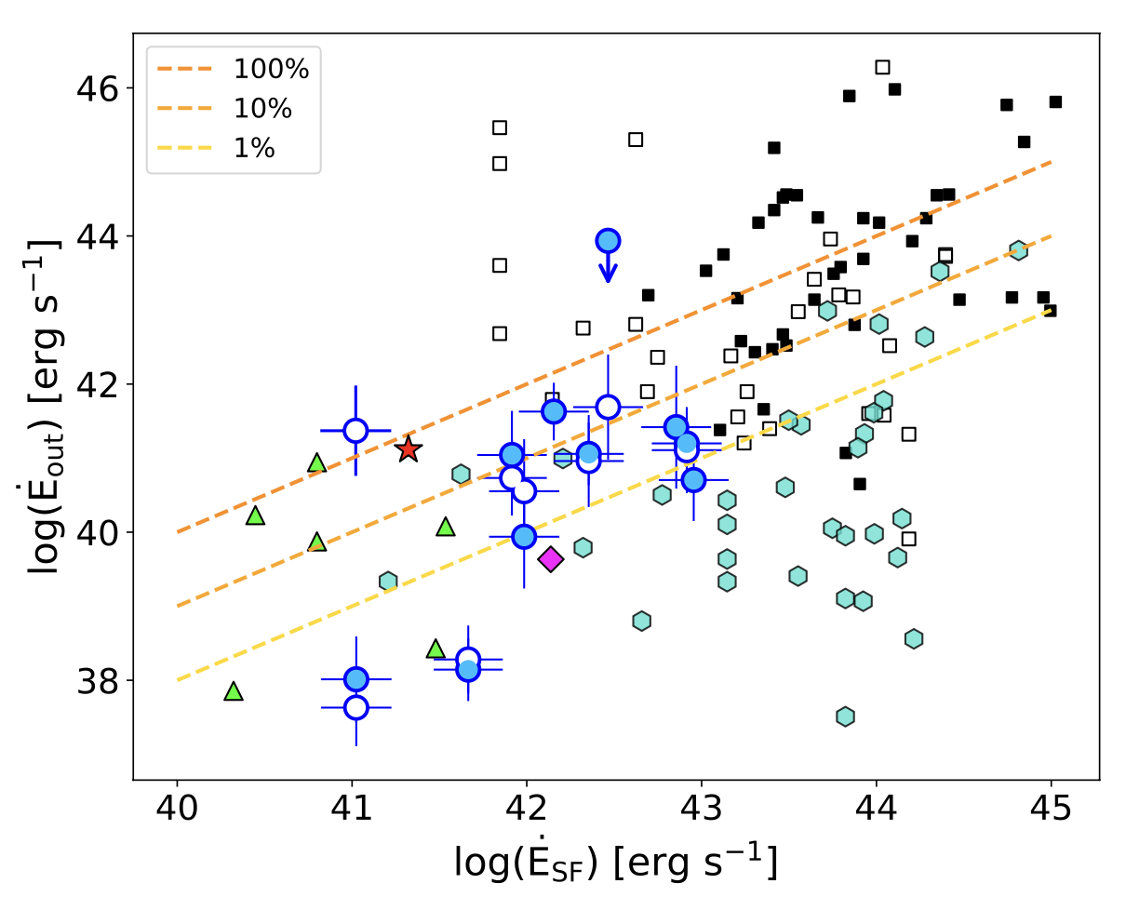
UFO in IRAS 17020+4544
Planes of
satellites (sims)
Latest results — off the press
H𝛂
Submitted GUAIX-participated publications
M32 dynamics
LINERs + Fermi-LAT
Molecular outflow
León, Domínguez, Dinesh & Gil de Paz
Submitted to Fermi-LAT collaboration
• First population limits on γ-ray efficiency
• Extended LINER shocks inefficient
• Efficient γ-rays require compact jets
Rodríguez-Cardoso, Roca, Agertz, Gallego et al., subm. A&A
• Planarity and dynamical coherence of satellite distributions enhanced by a massive GSE-like merger
• Planes driven by anisotropies in host DM halos and LSS
Beamuz-Mingote, Gil de Paz & Chamorro-Cazorla
Ready for submission
• Schwarzschild modeling with MEGARA
• SMBH mass: 3.6×10⁶ M☉
• Nuclear disk-like dynamical component
Bellocchi et al., Accepted in A&A
• Fast ionized outflow in Hα and [OIII]
• Multi-phase, energy-conserving feedback
• Molecular phase dominates mass budget
Caustic masses of The300 clusters (sims)
CGM magnetic fields at high-z
Ionized outflows in MEGADES
Coma Cluster UDGs
CDFs
MEGADES
Malik et al., accepted for publication
• First robust detection of CGM magnetic fields at high-z
Bellocchi, Álvarez-Martín, Catalán-Torrecilla, Gil de Paz, Castillo-Morales, Chamorro-Cazorla, Ready for submission
• Ionized outflows (H𝜶 & [OIII]) found in Seyfert & LINERs
• Similar sizes and v_{out} to nearby LINERs and U/LIRGs
• Ionized outflows mainly powered by from SF
Callejas-Córdoba, Sánchez-Blázquez, Gil de Paz et al., Accepted in A&A
• Improving the determination of Caustic masses in galaxies clusters using N-body+hydro simulations.
• Velocity anisotropy vs. mass profile degeneracies
Macías, Koda, Gil de Paz, Catalán-Torrecilla, in prep.
• Smooth transition between normal galaxies and UDGs (no dichotomy).
These are not yet represented in the refereed publication statistics shown earlier.

Slide 16
Horizon: opportunities and challenges
Positioning GUAIX for ELT/SKA/JWST-era science while sustaining people and data capacity
Next big scientific opportunities
• MOSAIC/ELT and TARSIS: turn instrumentation leadership into flagship science
• MEGARA legacy: consolidated IFU diagnostics and public data
• SKA/POSSUM/LOFAR: cosmic magnetism and radio transients
• JWST + ALMA + NOEMA + GTC: multi-phase feedback constraints
• Simulations + surveys: connect resolved physics to population evolution
• CTA/HE & optical/nIR synergies: fostering IPARCOS collaborations
Main challenges for the group
• Funding continuity across instrumentation + exploitation cycles
• Retaining postdocs and technical expertise after project peaks
• Scaling reduction, analysis and archive tools for IFU/multiwavelength data
• Maintaining visibility in large collaborations while protecting GUAIX-led science
• Balancing dedicated instrument effort with broad astrophysics output
• Strengthening the collaboration with other IPARCOS groups
Take-home message: GUAIX is a compact but highly productive group whose distinctive value is the coupling of astronomical instrumentation, IFU expertise and multiwavelength extragalactic science

