Slide 1





Studying satellite galaxies for the ARRAKIHS mission
Juba Barrios Ortiz
María de los Ángeles Gómez Flechoso & Helena Domínguez Sáncehz

Slide 2
Context
ΛCDM predicts a tail of satellites
Hierarchical structure formation
Abundant population of subhalos that (a fraction) should host satellite galaxies
Deep surveys have discovered many ultra-faint satellites, alleviating the tension
LSB makes detection difficult
Fainter than the sky (μB​ ≳ 23 mag/arcsec²)
High M/L, i.e, dominated by DM
Detected with deep surveys
Key for the study of dwarf galaxies

Slide 3
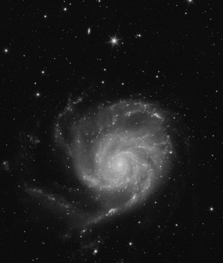
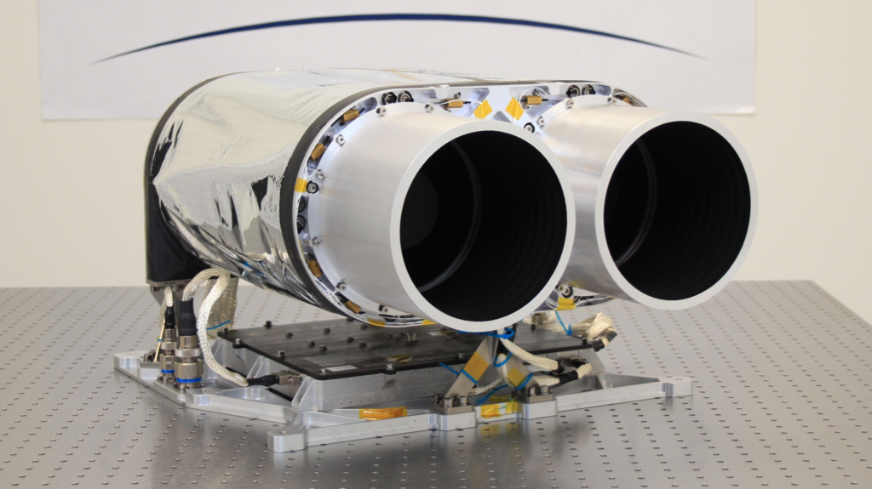
ARRAKIHS
Study of the LSB Universe (++deep): Haloes, stellar streams and dwarf galaxies
4 bands: 2 NIR & 2 VIS
Launch in 2030
Nearby Milky Way - like galaxies

Slide 4
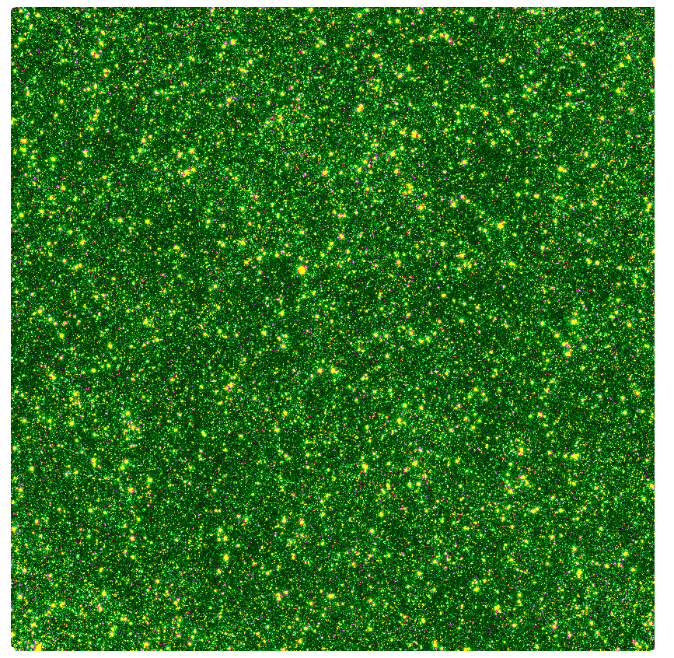
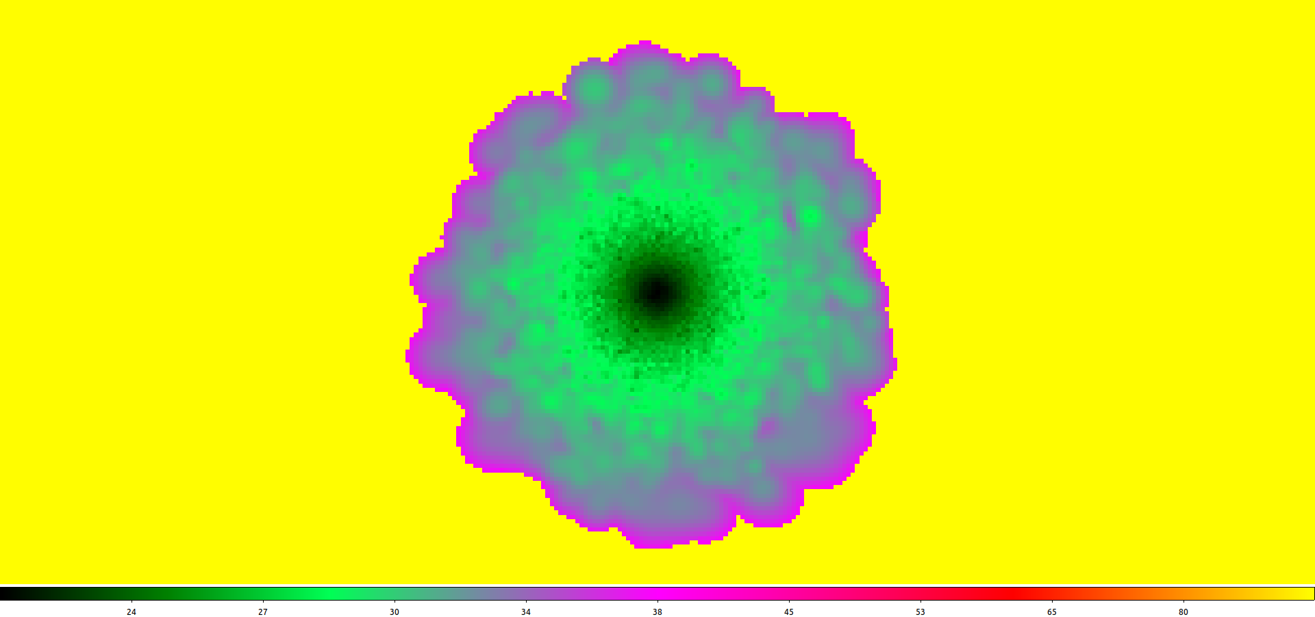
SIMULATED IMAGES
Plummer models for satellites (SB maps)
Illustris simulation background
Dwarf processing and injection

Slide 5
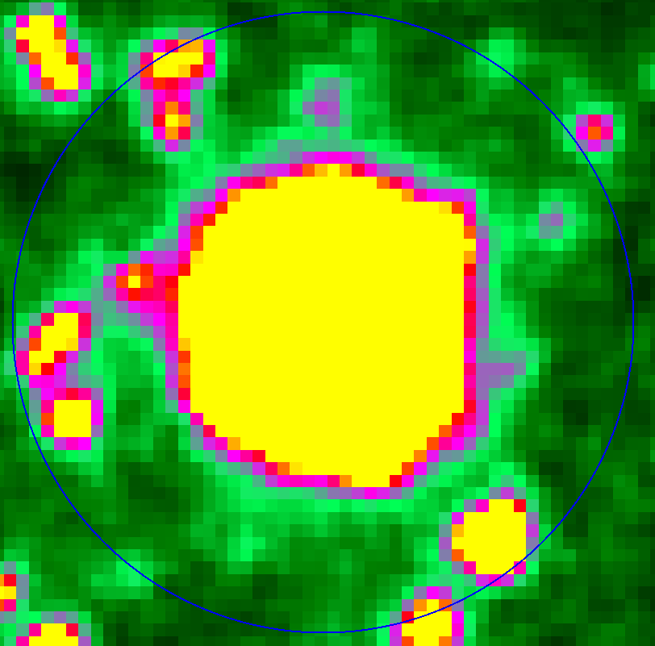
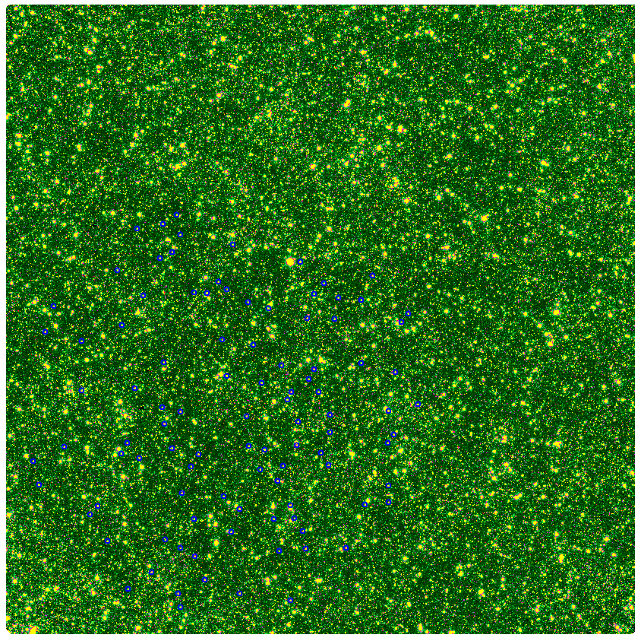
SIMULATED IMAGES
Plummer models for satellites (SB maps)
Illustris simulation background
Dwarf processing and injection

Slide 6
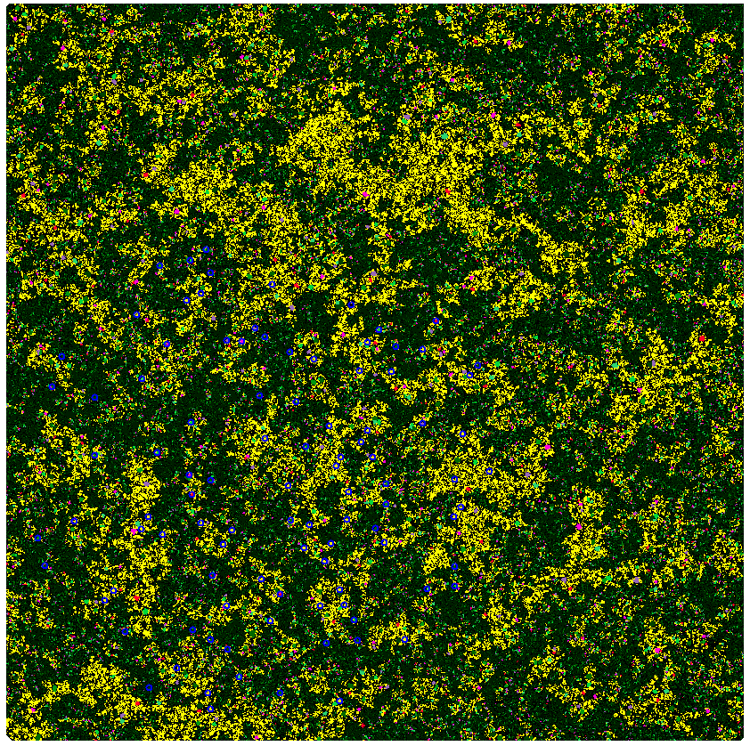
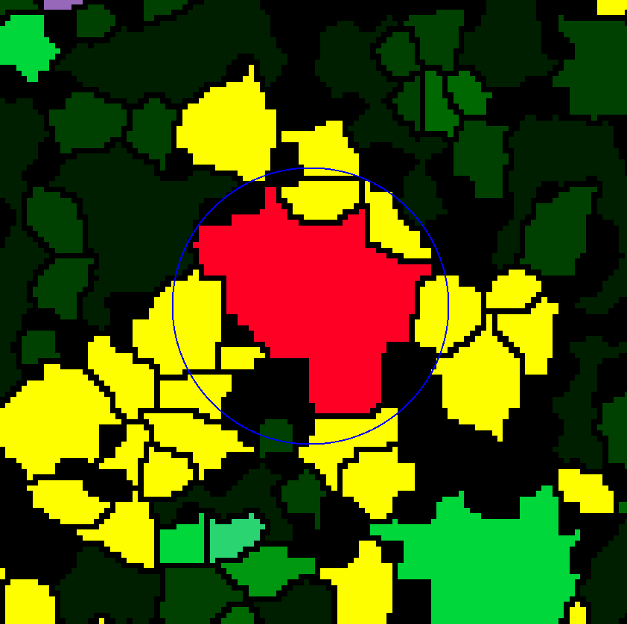
Detecting the satellites
GnuAstro detection with NoiseChisel: Clumps division of the image and match with dwarf positions
VIS2 catalogue: Photometry of all the clumps.
Catalogue in other bands: Forced photometry in VIS2 clumps
Completeness plots: Detection rates vs M0/SB

Slide 7
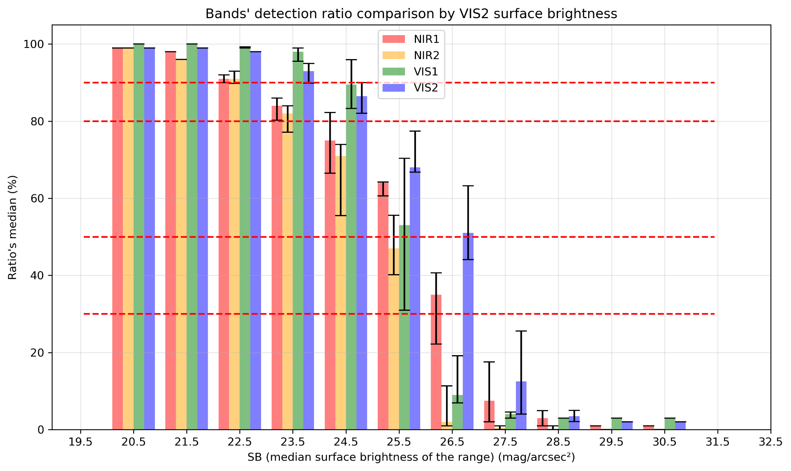
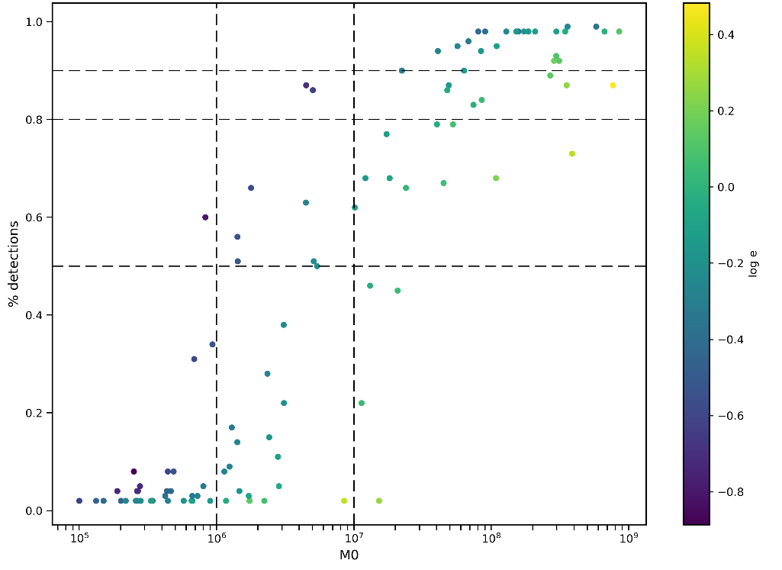
Detecting the satellites
GnuAstro detection with NoiseChisel: Clumps division of the image and match with dwarf positions
VIS2 catalogue: Photometry of all the clumps.
Catalogue in other bands: Forced photometry in VIS2 clumps
Completeness plots: Detection rates vs M0/SB

Slide 8
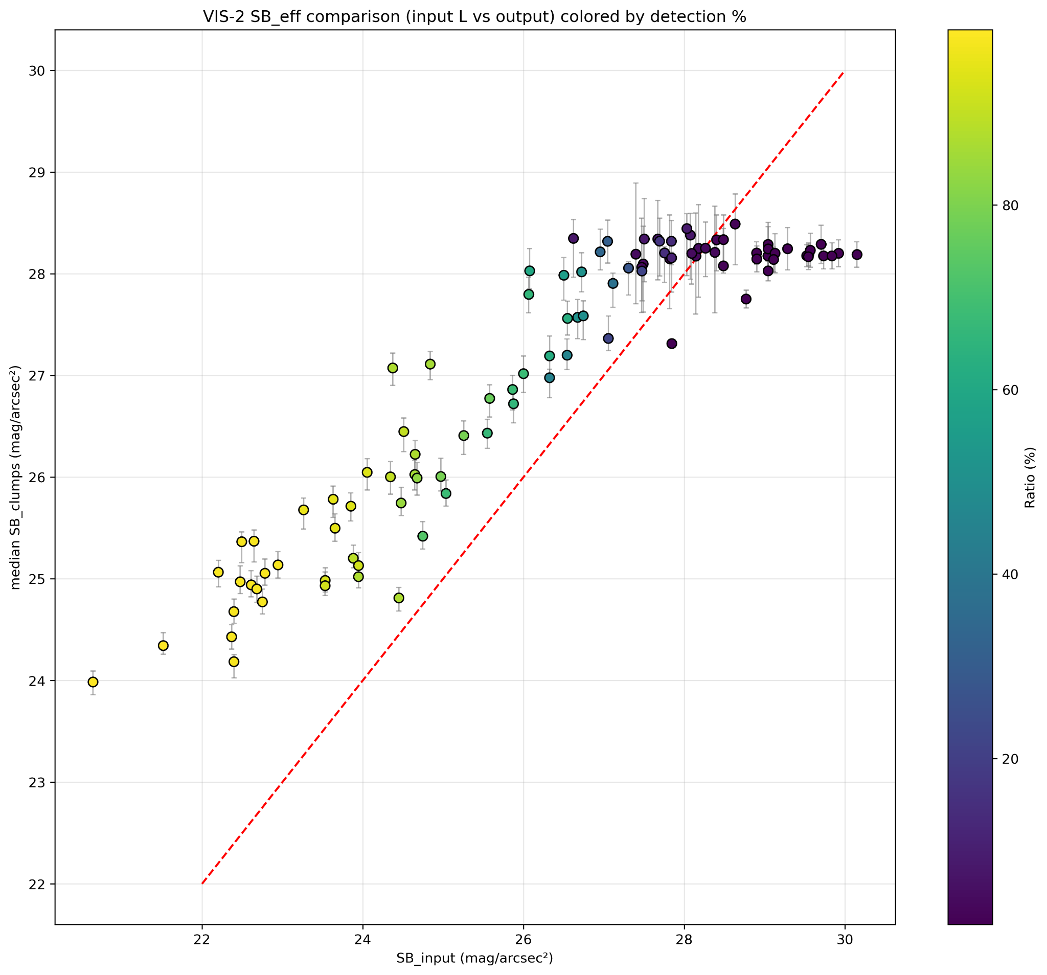
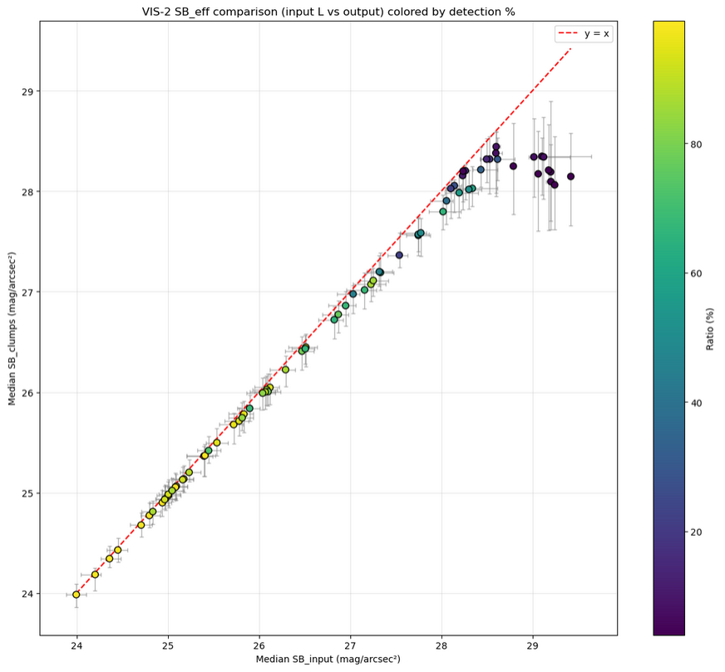
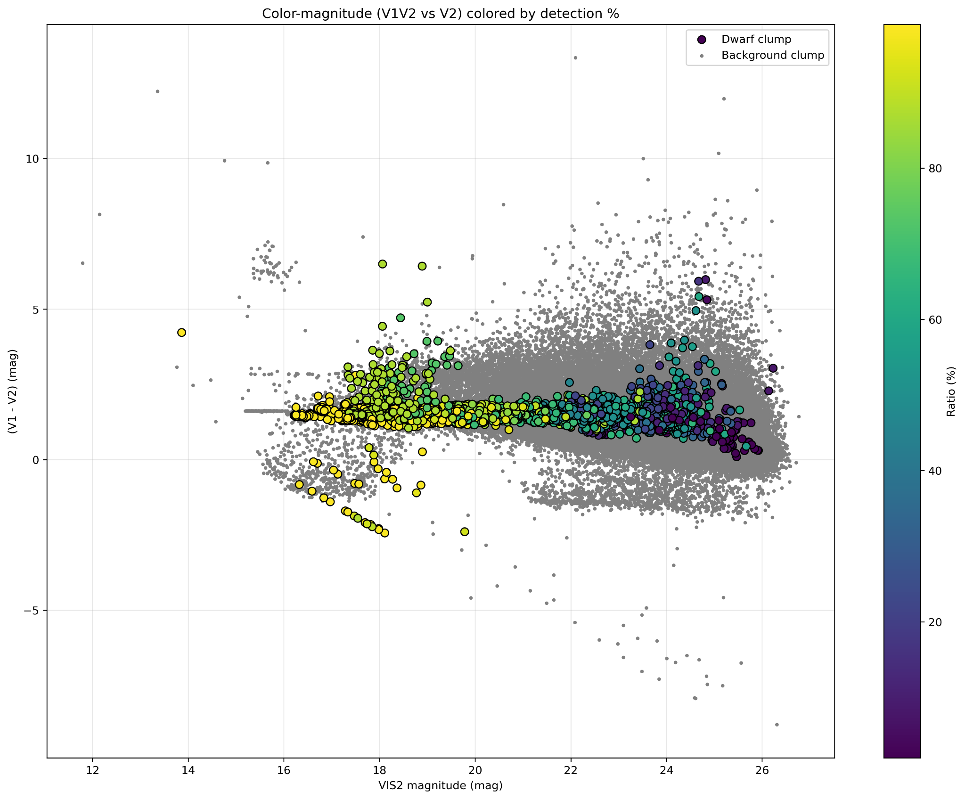
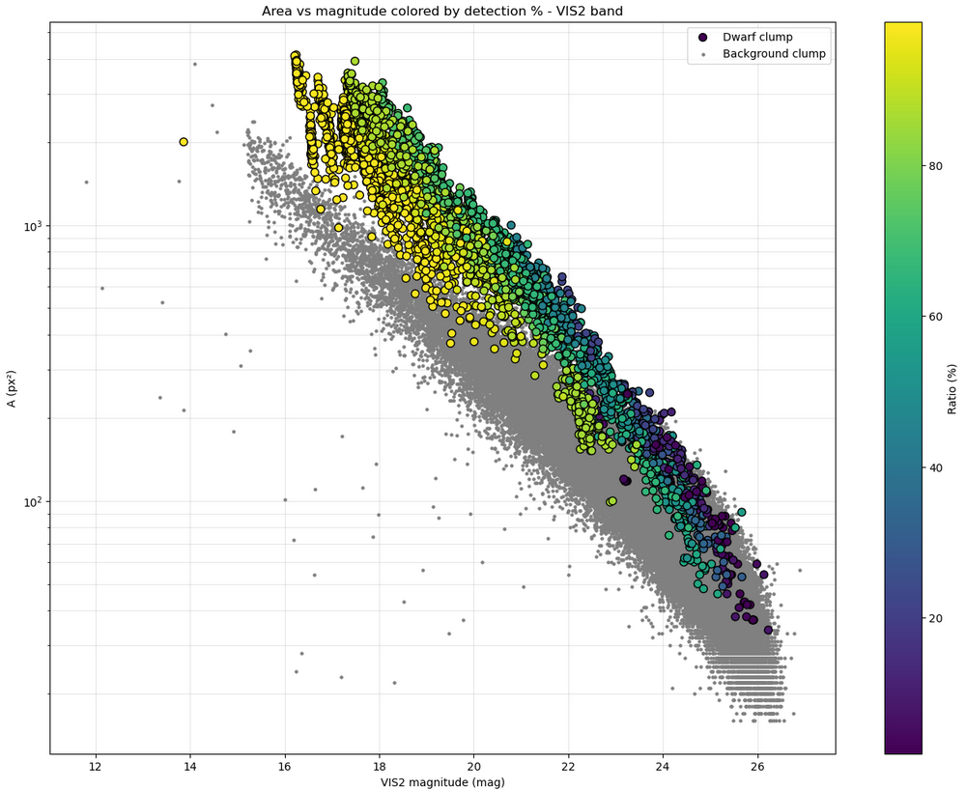
Characterizing the dwarfs
Info about size, SB, colors, ...
Injected models vs dwf clumps
GT vs dwf clumps
Bkg clumps vs dwf clumps

Slide 9
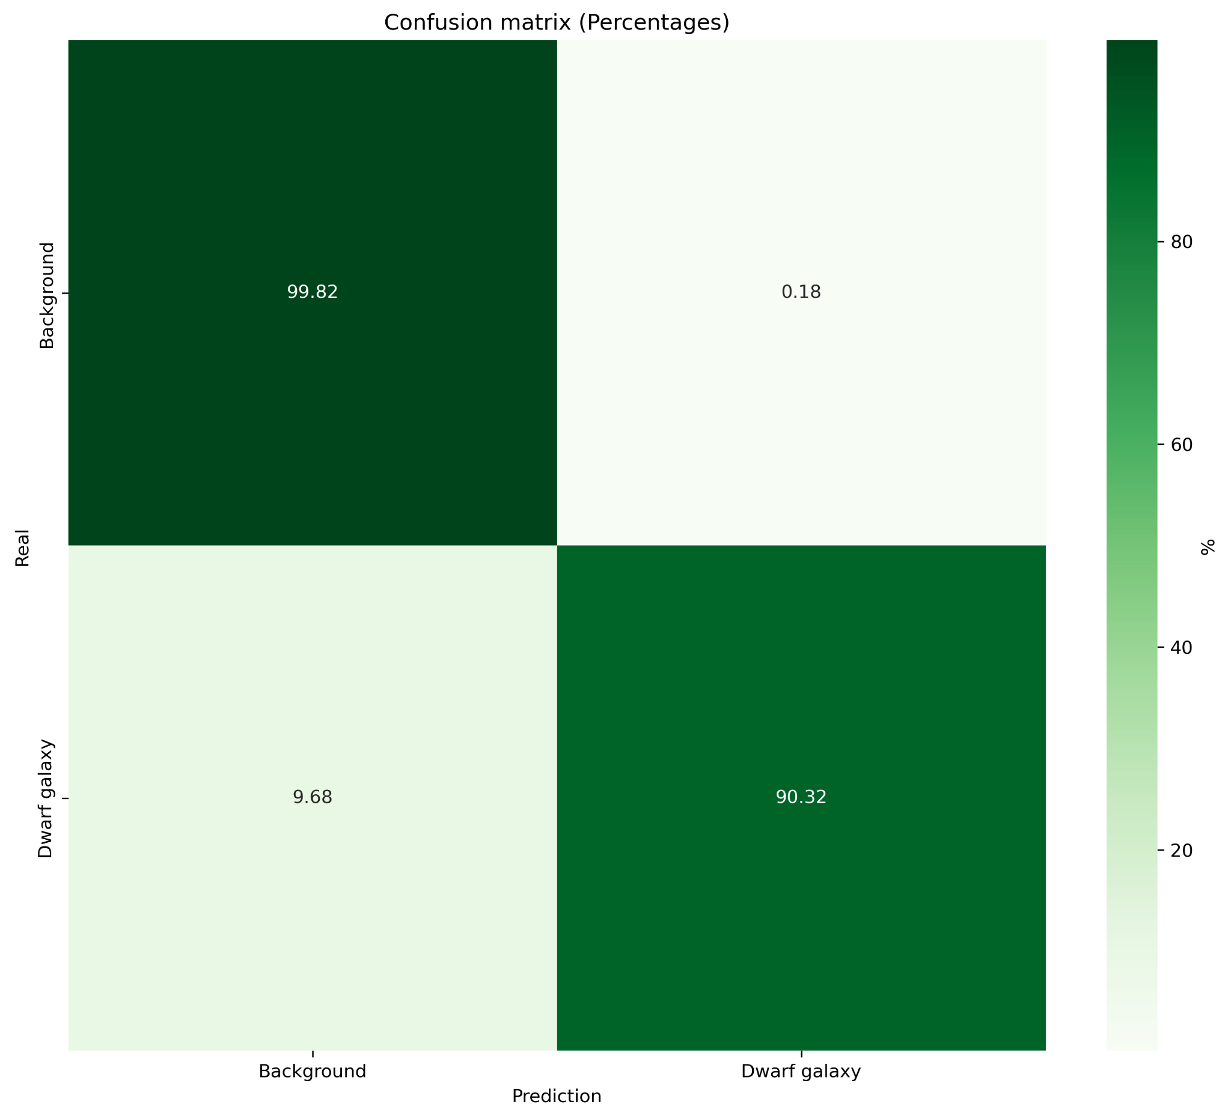
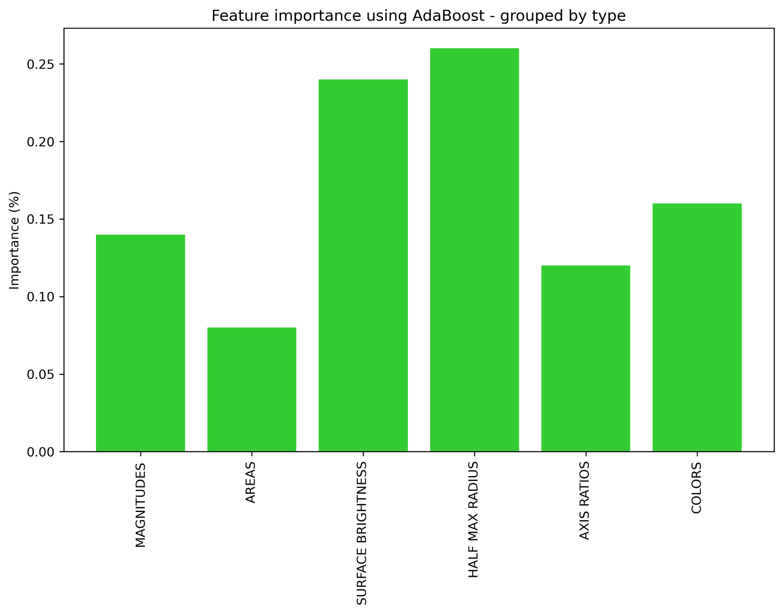
Machine learning: clumps automatized classification
Use of AdaBoost algorithms to characterize dwarfs vs background
Automated separation of dwarfs in ARRAKIHS-like images

Slide 10
Summary and future work
Creation of ARRAKIHS-like simulated images with dwarf galaxies
Detection algorithms for these galaxies and completeness plots in each band
Photometric catalogs of the images (background + dwarf galaxies) to study the properties of the satellites
Use of photometric properties to identify our targets in the images
Images with 100 dwarf galaxies following an expected distribution function
Add a central galaxy
More checks (always)
Turn this into a nice paper that people will really like

Slide 11
Thanks!!
This work has been supported by PIPF-2023/TEC-30588 grant funded by Comunidad de Madrid and PID2022-138896NB-C55, funded by MCIN/AEI/10.13039/501100011033/FEDER, EU

