Slide 1
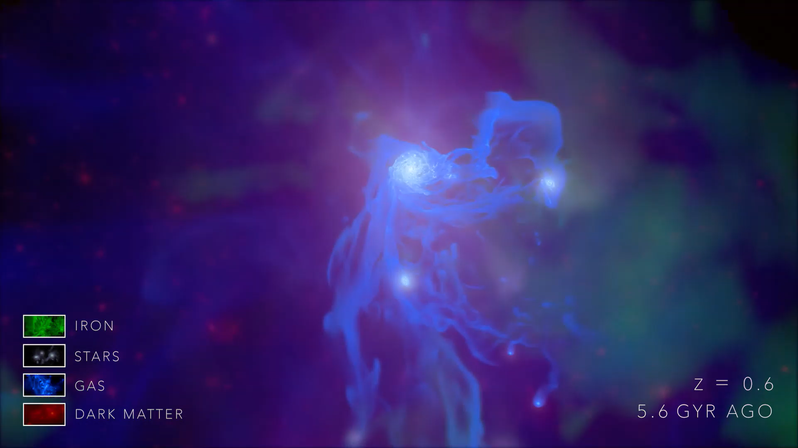



Planes of satellites in VINTERGATAN-GM zoom-in simulations of MW-mass halos
AUTHORS: R. RODRÍGUEZ-CARDOSO, JESUS GALLEGO, S. ROCA-FÀBREGA, OSCAR AGERTZ

Slide 2
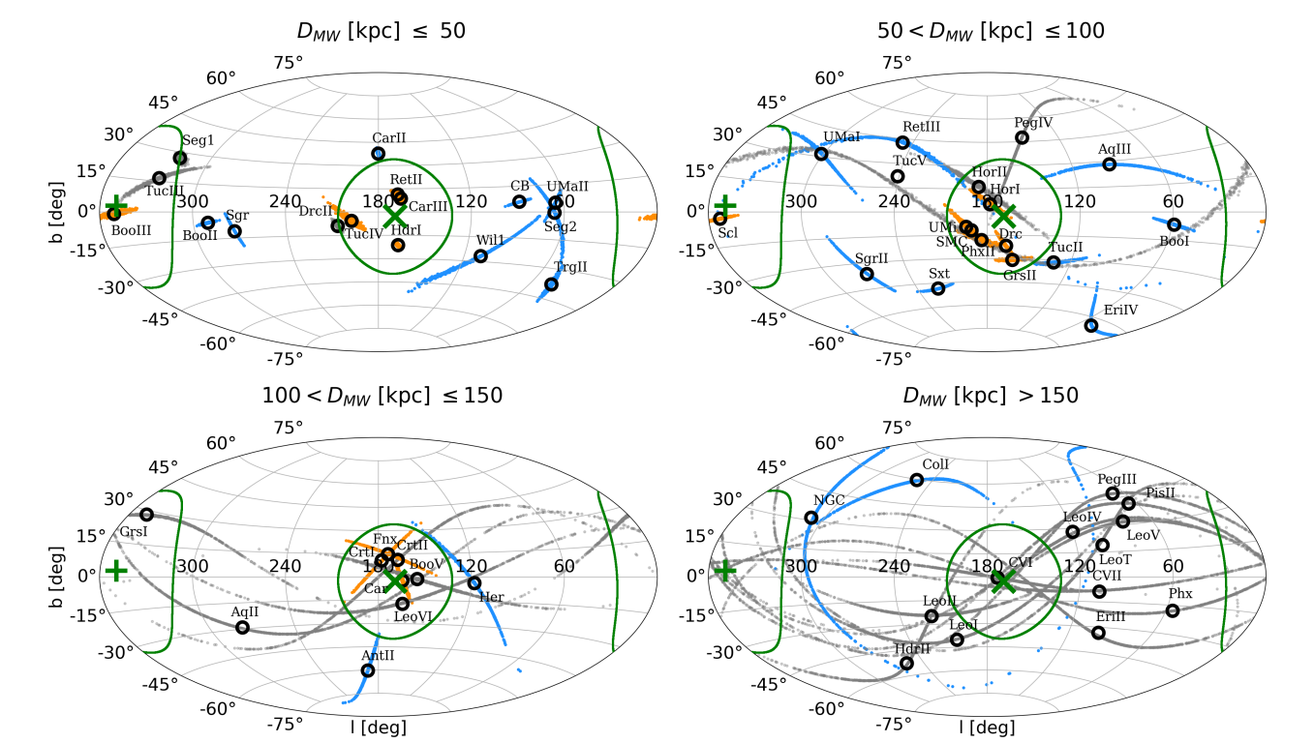
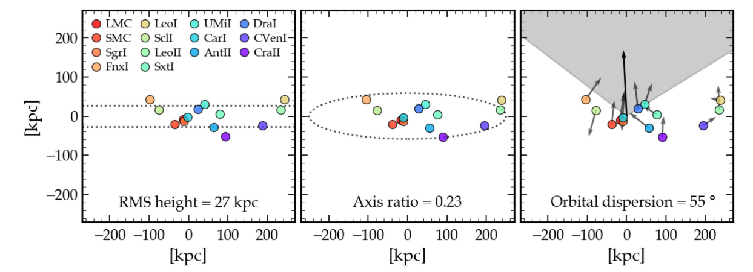
Planes of satellites
A challenging small-scale problem to ΛCDM
Satellite galaxies in MW and M31 have been found to preferentially align in flattened planes, with a high fraction exhibiting coherent co-rotation.
ΛCDM cosmological simulations historically predict a more isotropic and spherical distribution and have struggled to reproduce such planar structures.
Samuel et al 2021
Martínez-García & del Pino 2025

Slide 3
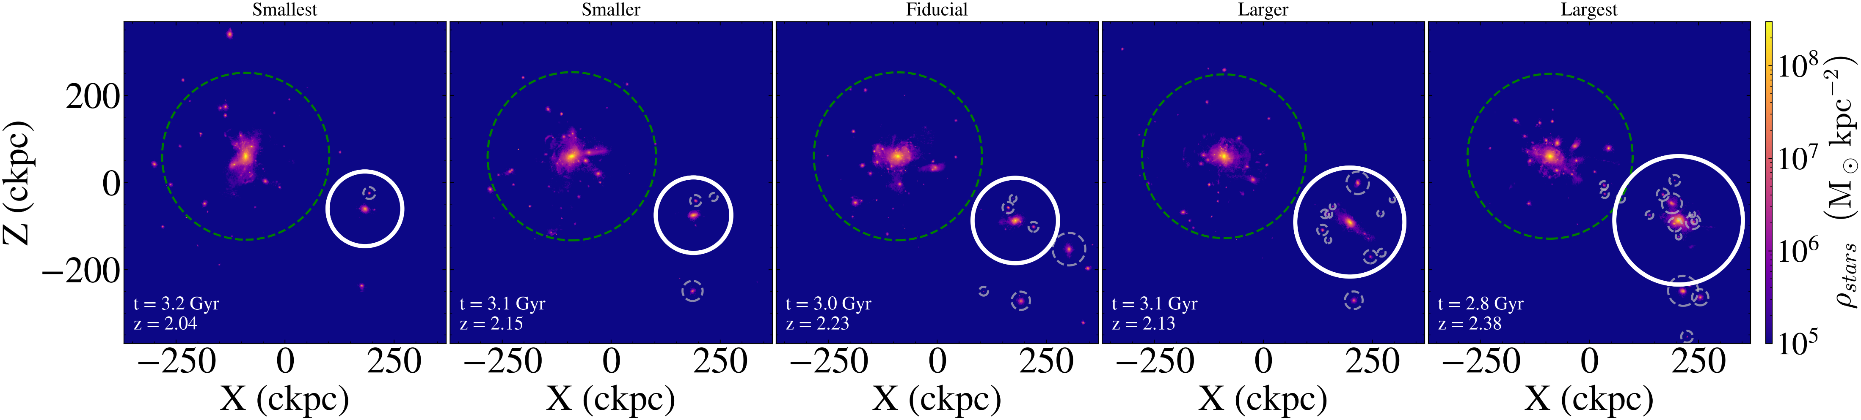
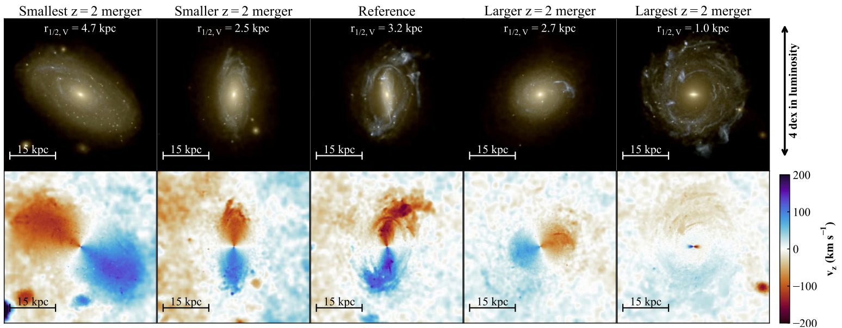
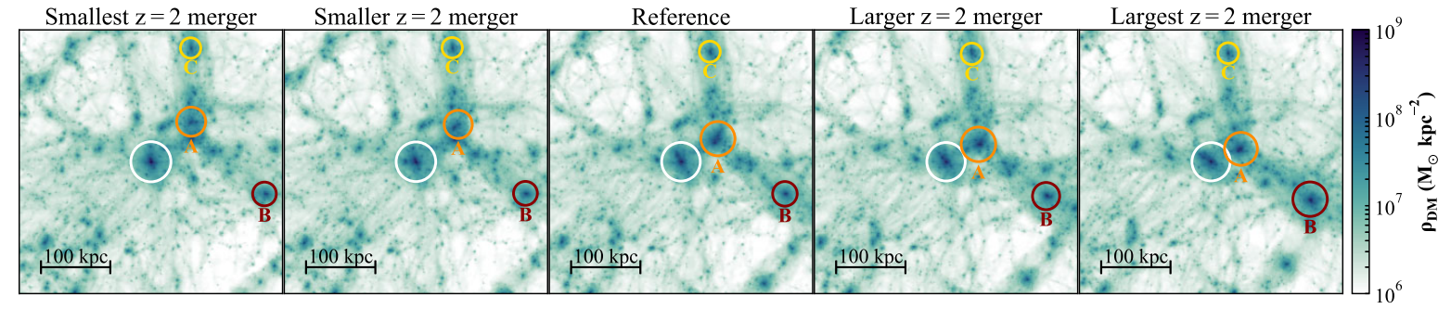

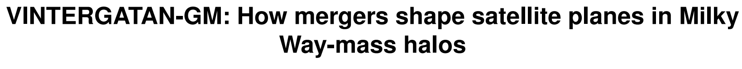
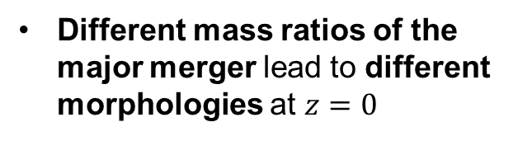
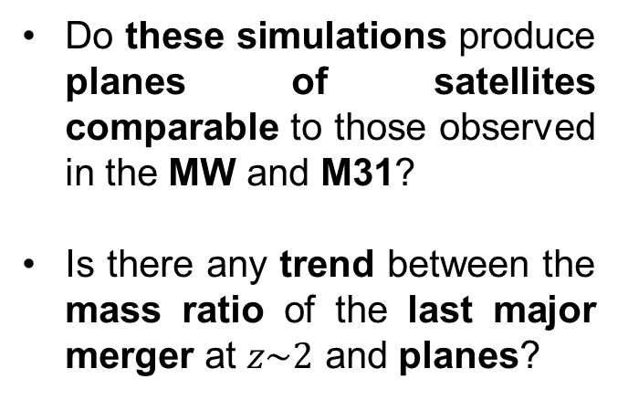
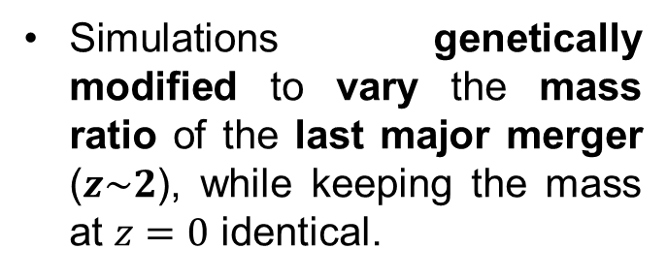
VINTERGATAN-GM
GM-High Resolution zoom in sims of MW-mass halos
Martin P. Rey et al 2023
Simulations genetically modified to vary the mass ratio of the last major merger ($z\sim 2$), while keeping the mass at $z=0$ identical.
Different mass ratios of the major merger lead to different morphologies at $z=0$
Do these simulations produce planes of satellites comparable to those observed in the MW and M31?
Is there any trend between the mass ratio of the last major merger at $z\sim 2$ and planes?
Rodríguez-Cardoso et al in prep

Slide 4
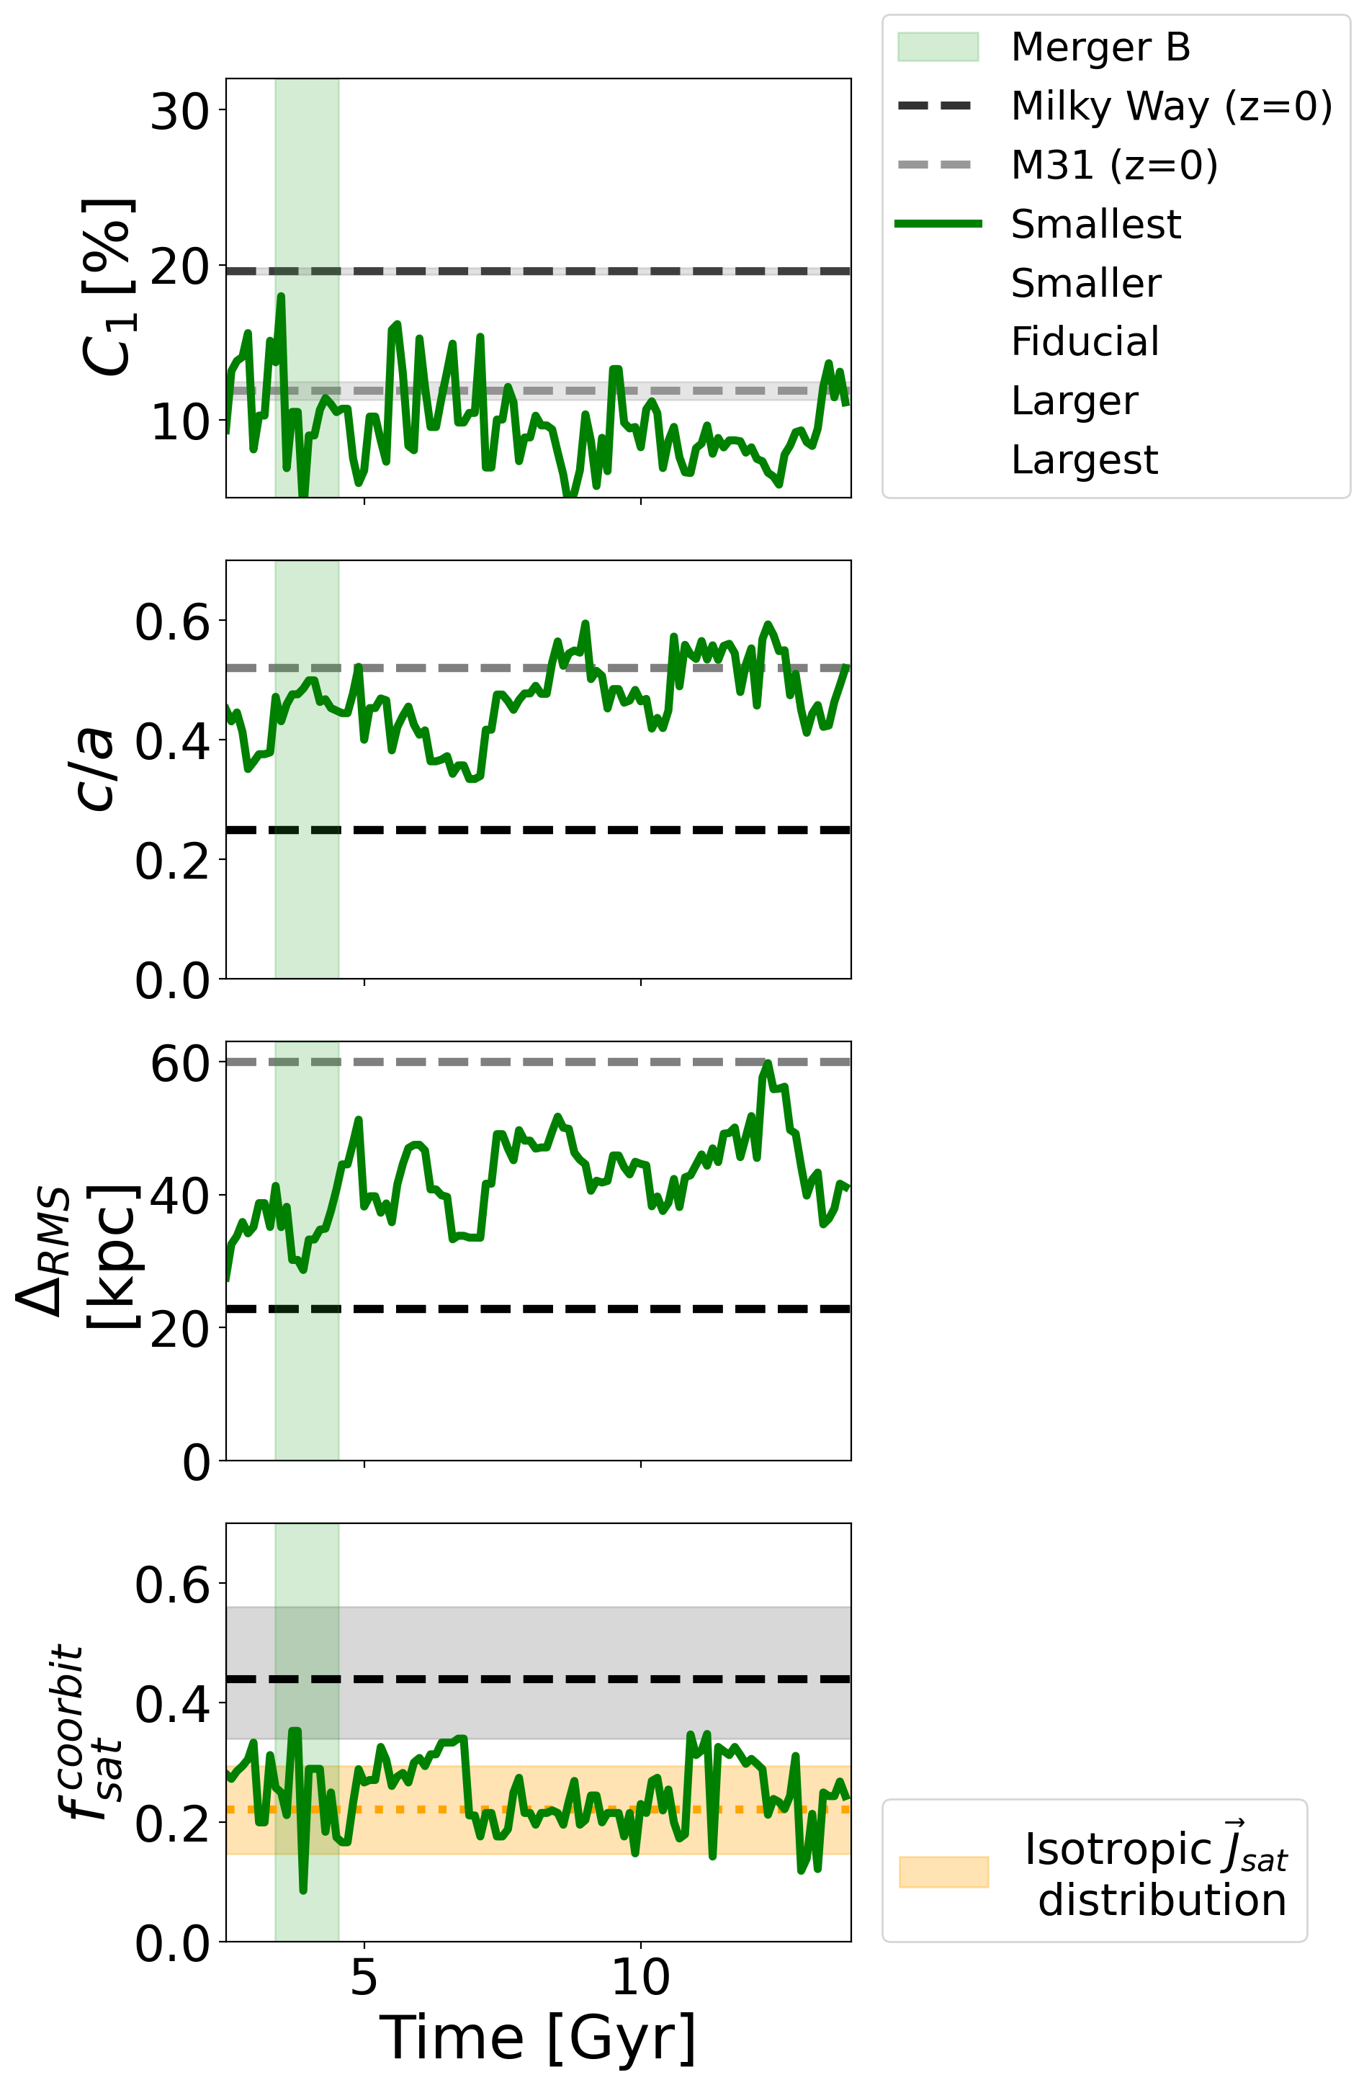
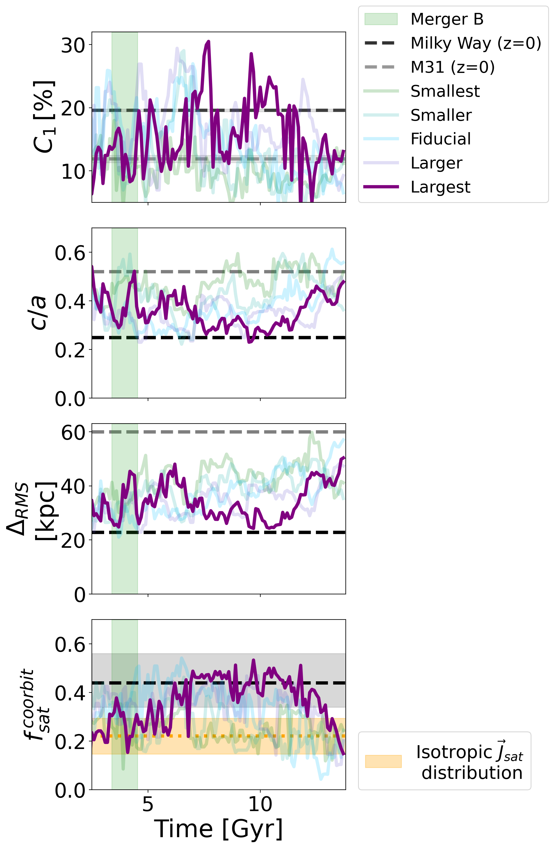
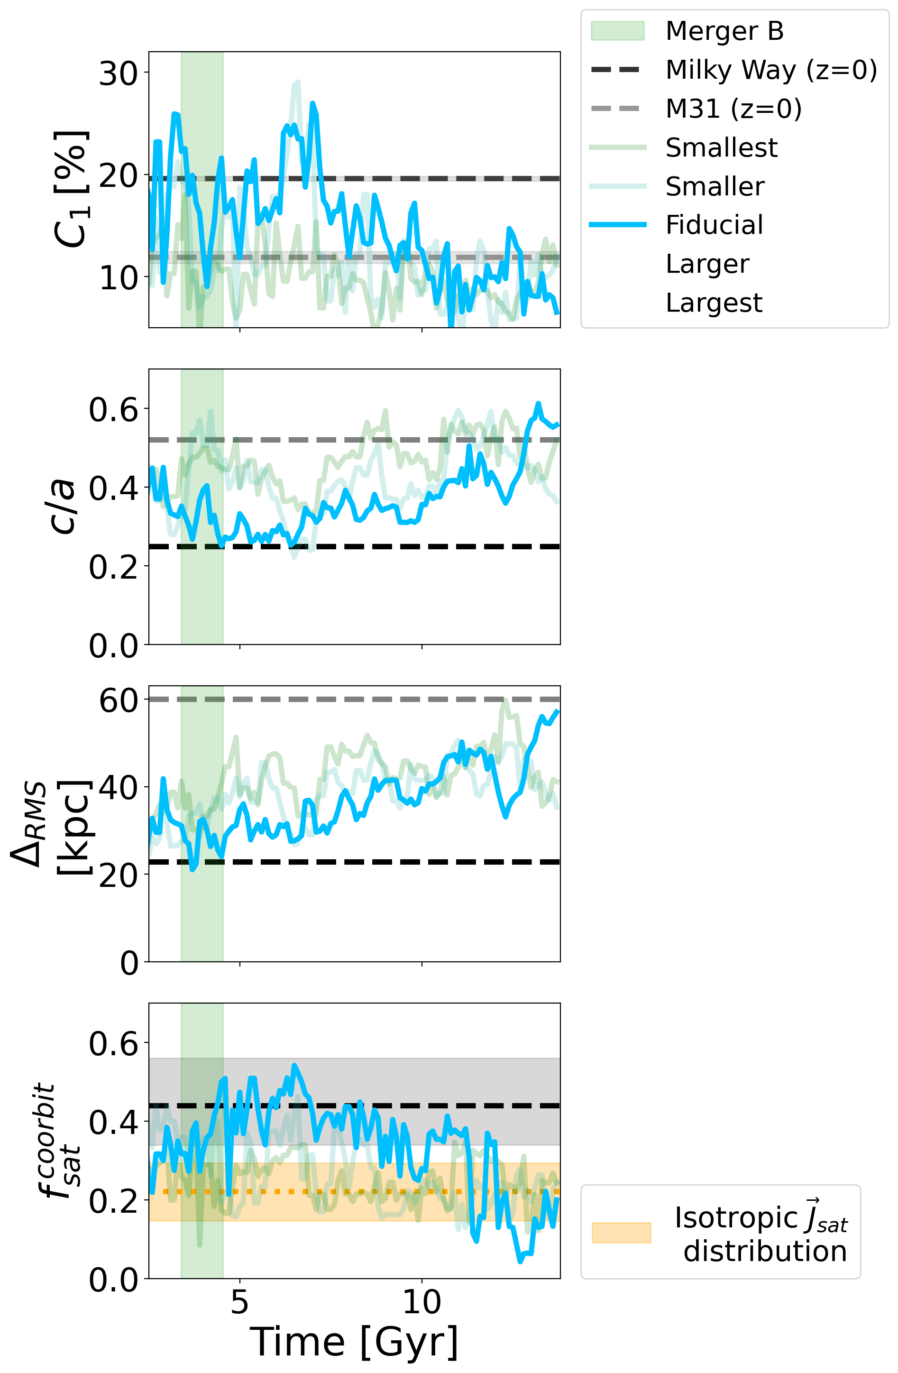
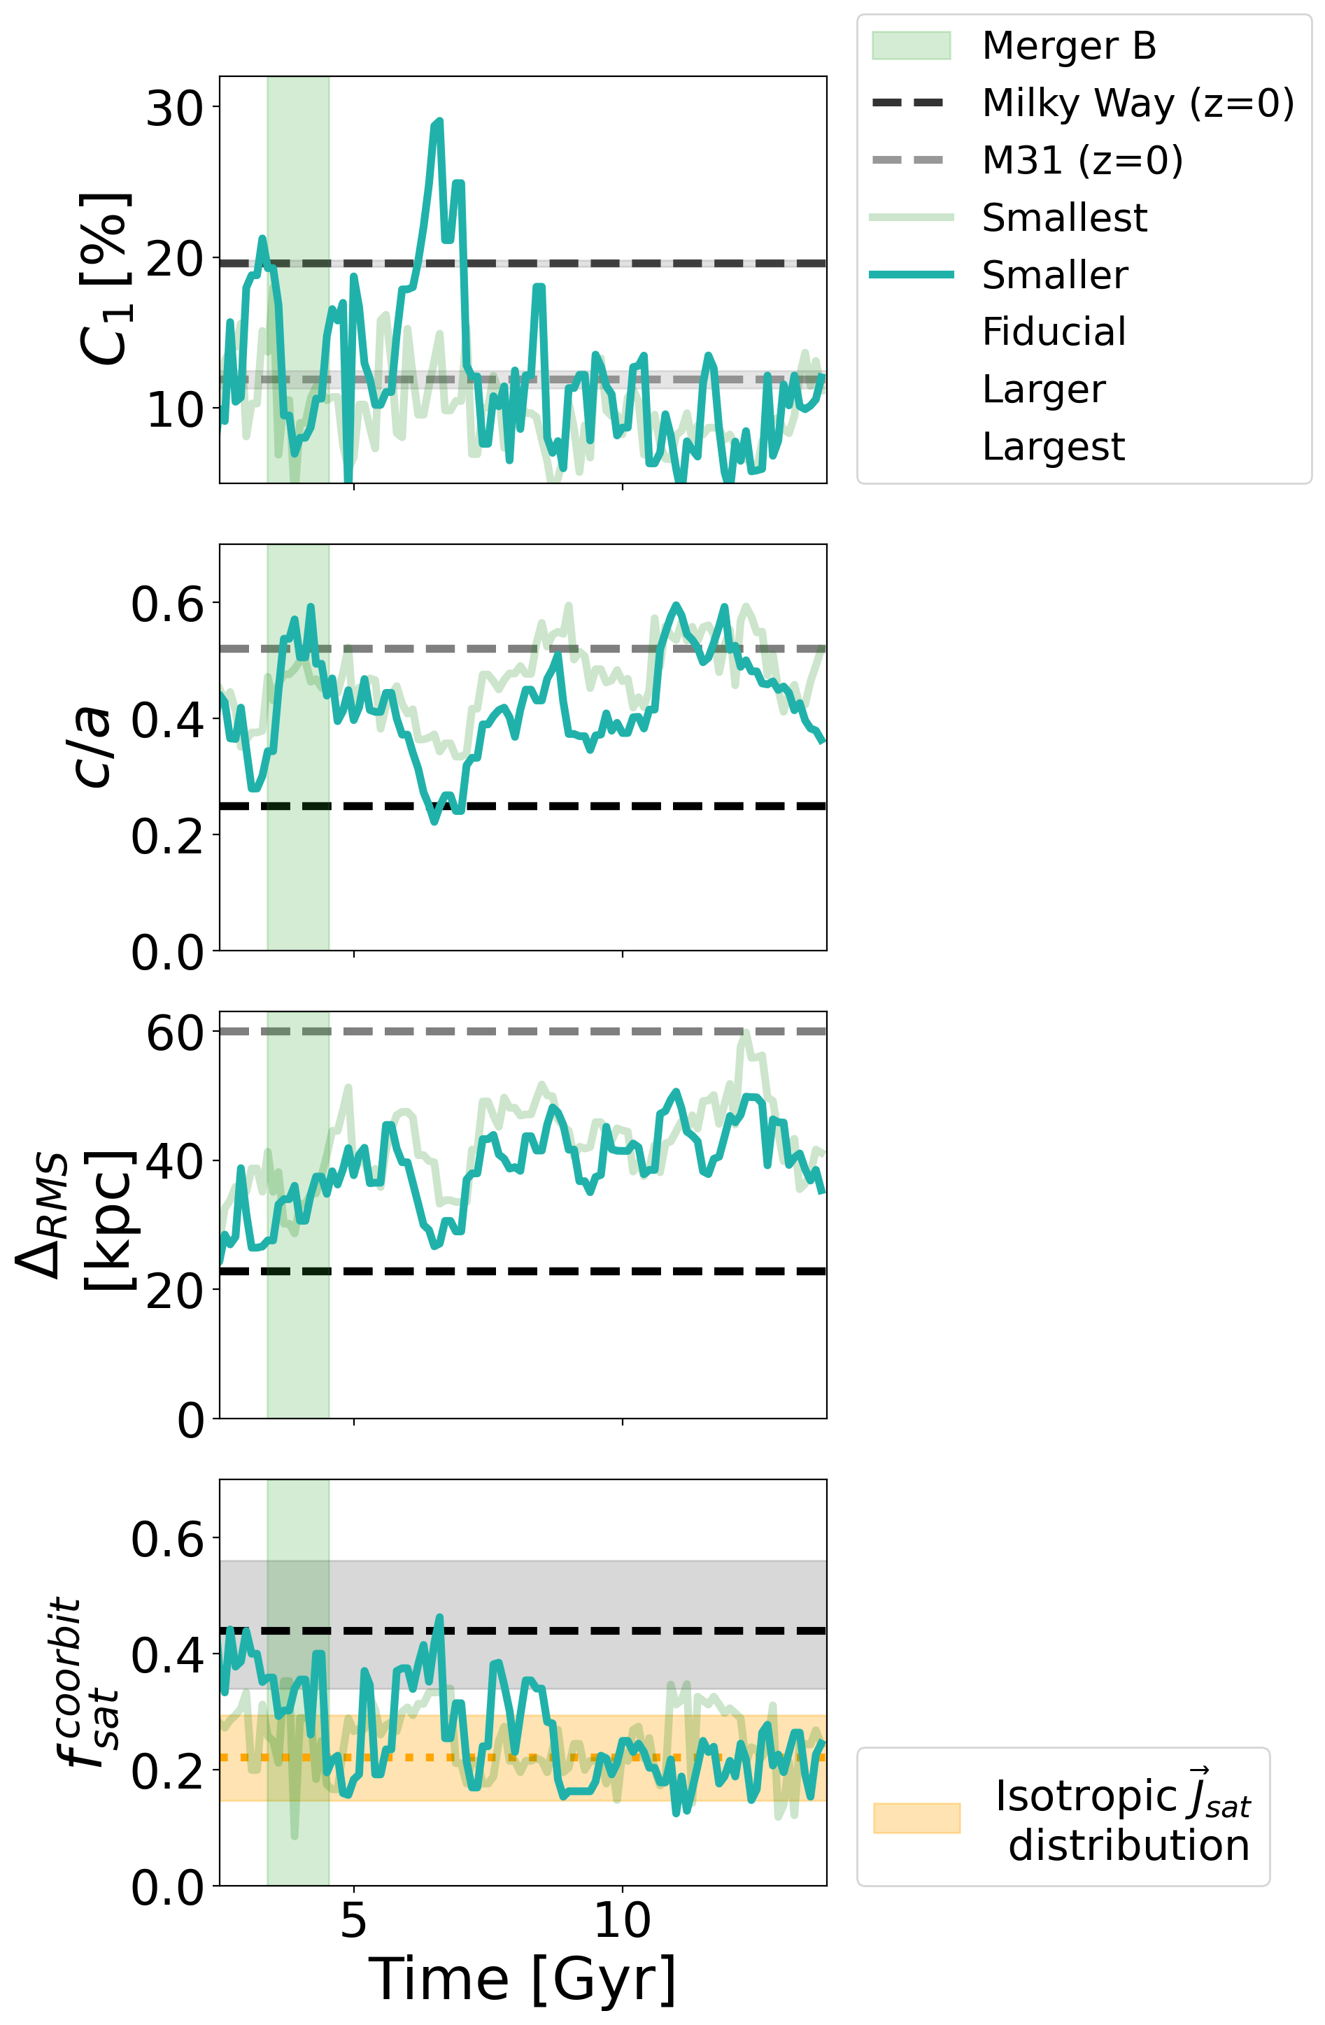
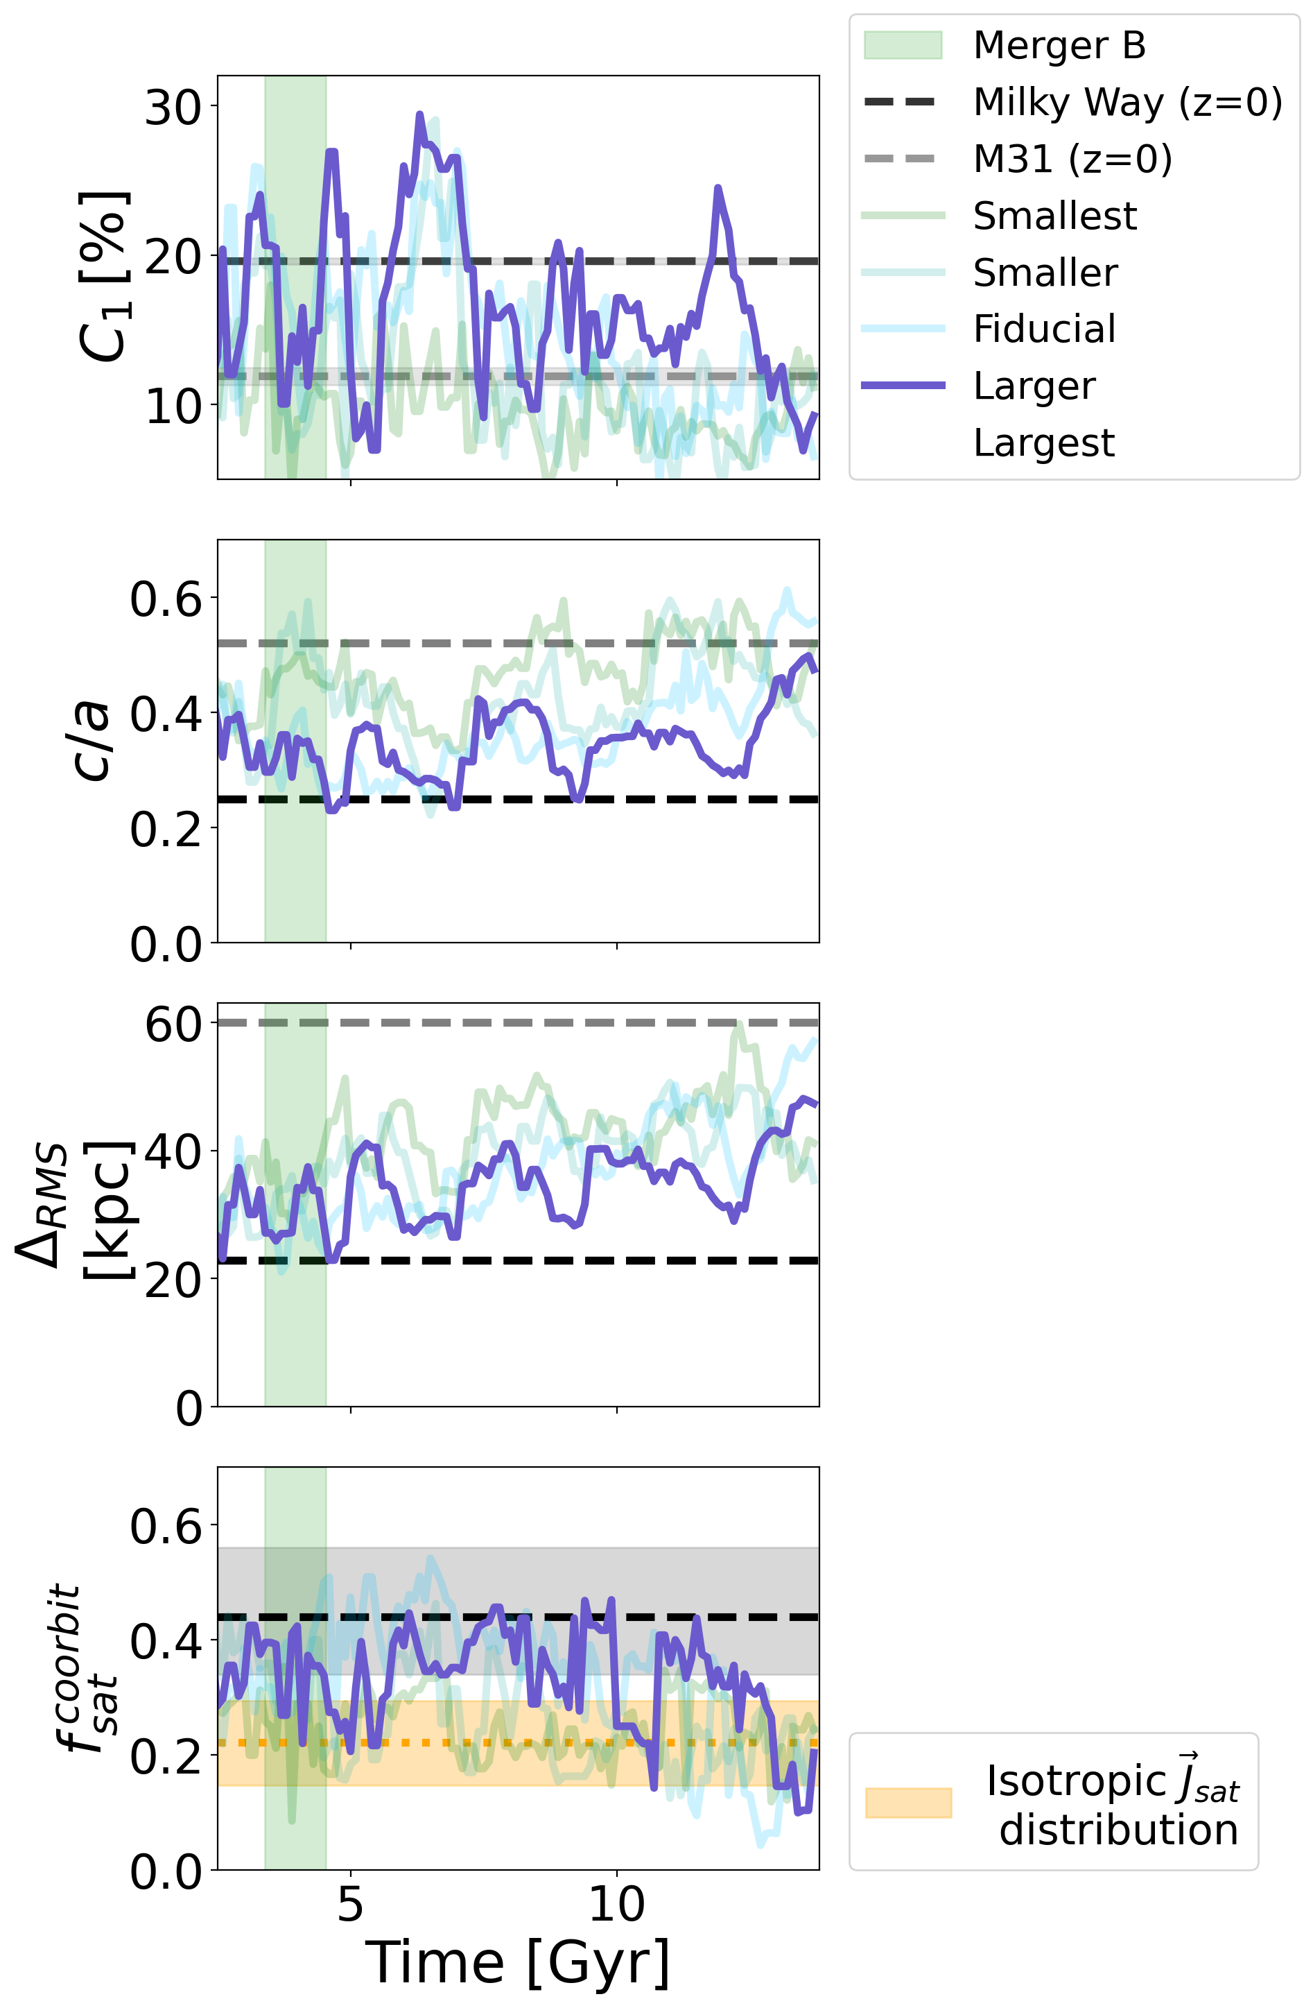
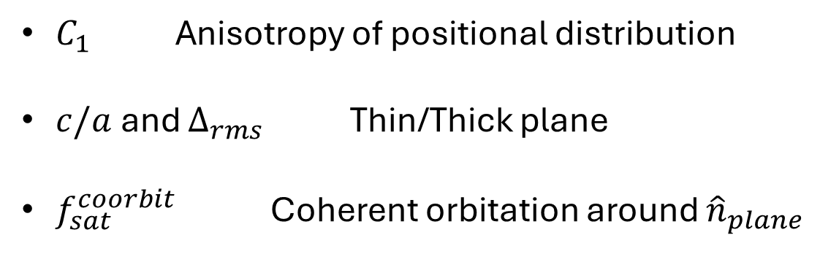
Positional plane of satellites
Plane Quality Comparison
with MW & M31
$C_{1}$ Anisotropy of positional distribution
$c/a$and $Δ_{rms}$ Thin/Thick plane
$f_{sat}^{coorbit}$ Coherent orbitation around ${\hat{n}}_{plane}$
The more massive the GSE-like major merger
The more planar the distribution of satellites
Planes comparable to MW

Slide 5
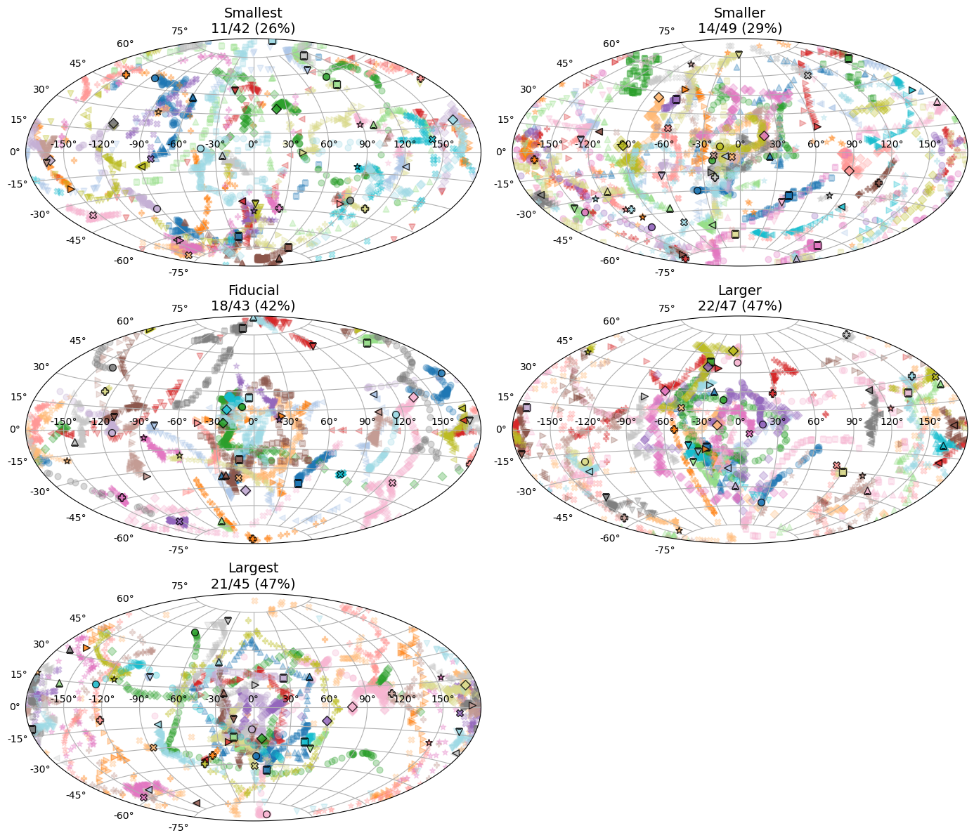
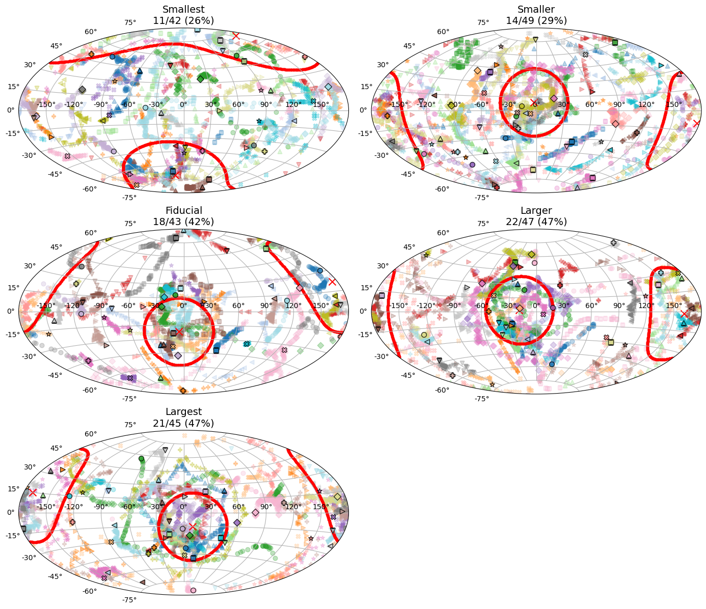
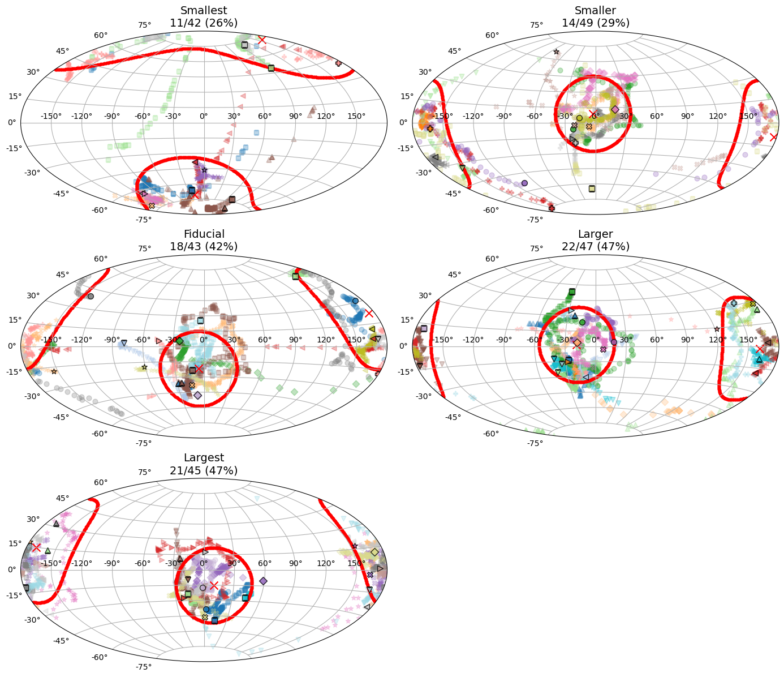
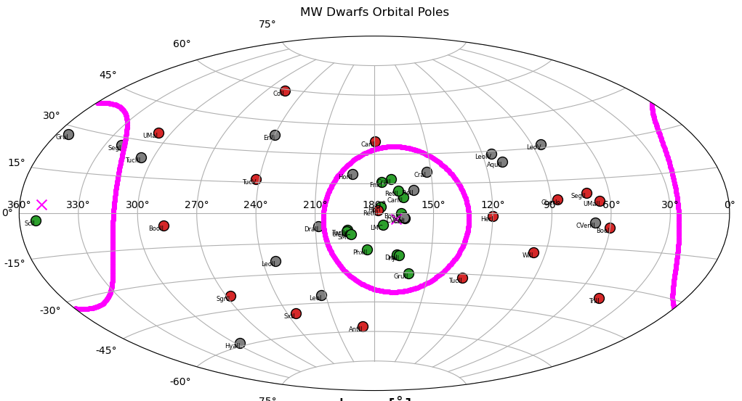
Kinematic Persistent Planes
Pole orbital clustering
We look for satellites’ angular momentum pole clustering to detect KPP.
The more massive the major merger
The more populated the KPP
KPP comparable to MW
MW ~ 40%
5/9

Slide 6

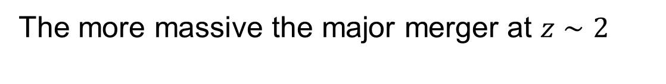
Detected trend
the more planar the satellite distribution at low-z
The more massive the major merger at $z∼2$
the more populated the KPP
Proposed origins
Unexpected changes in large scale structure (e.g. Gámez-Marín et al 2025)
Group accretion due to a larger number of major merger satellites (e.g. Li & Helmi 2008)
Changes in host halo potential shaping preferred orbits

Slide 7
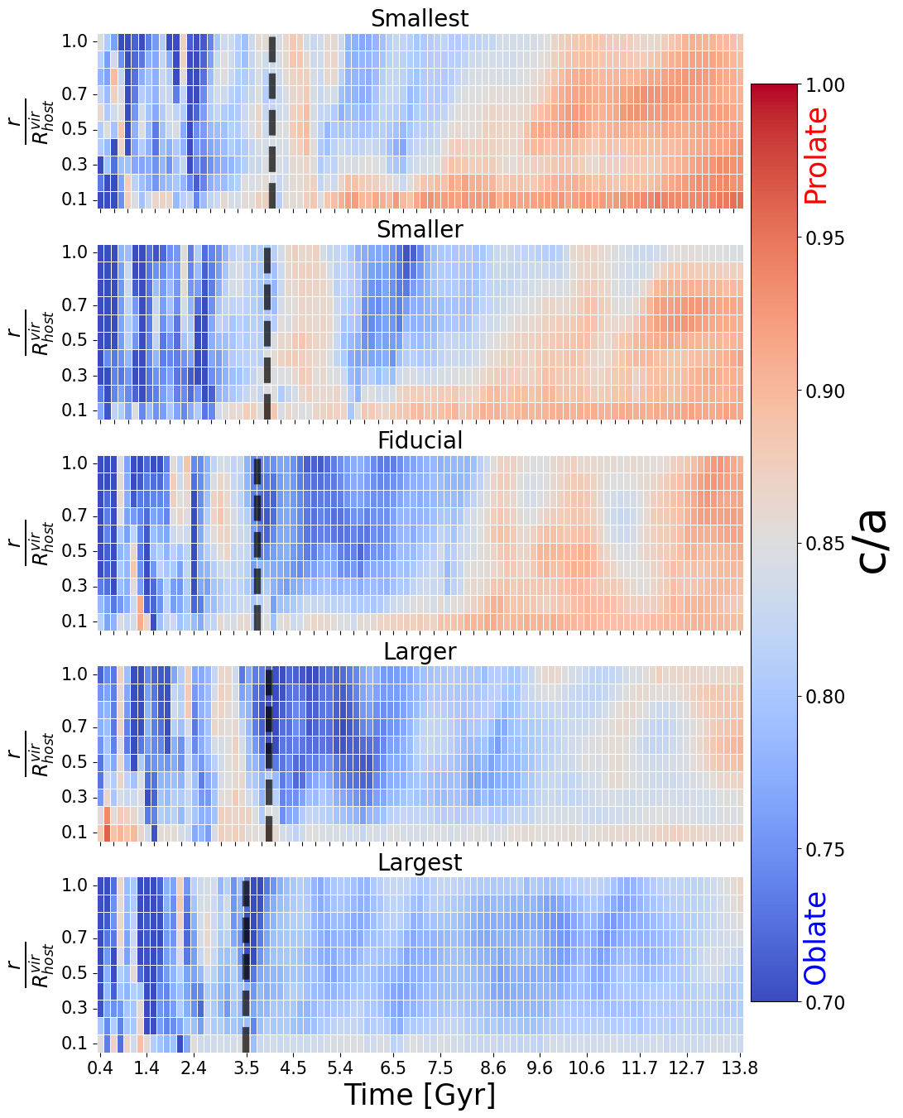
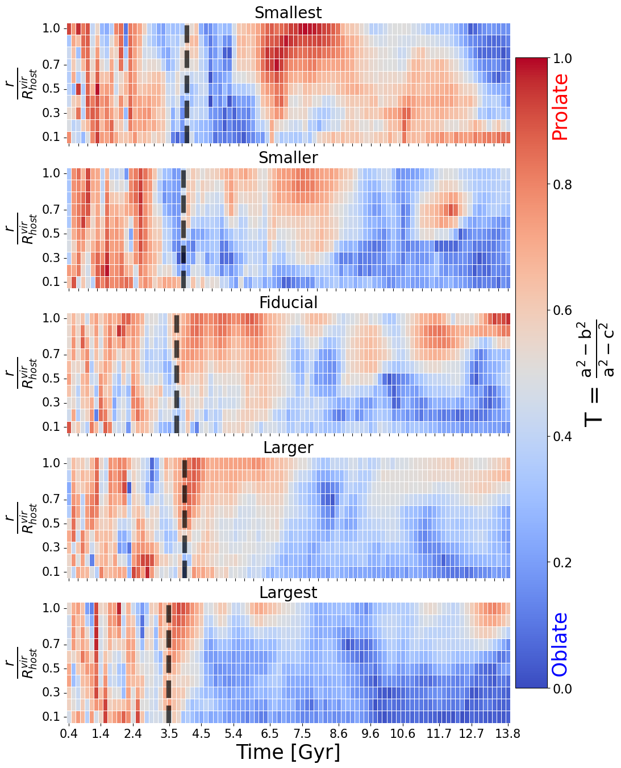
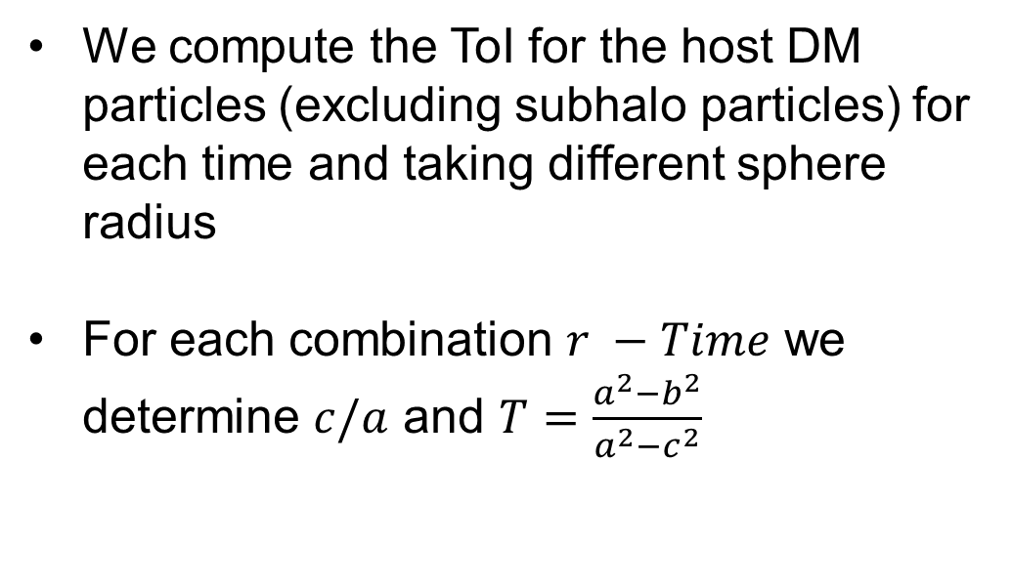
Host Halo Shape
ToI analysis
We compute the ToI for the host DM particles (excluding subhalo particles) for each time and taking different sphere radius
For each combination $r −Time$ we determine $c/a$ and $T=\frac{a^{2}−b^{2}}{a^{2}−c^{2}}$
The more massive the major merger the more planar and oblate the host halo at low z

Slide 8
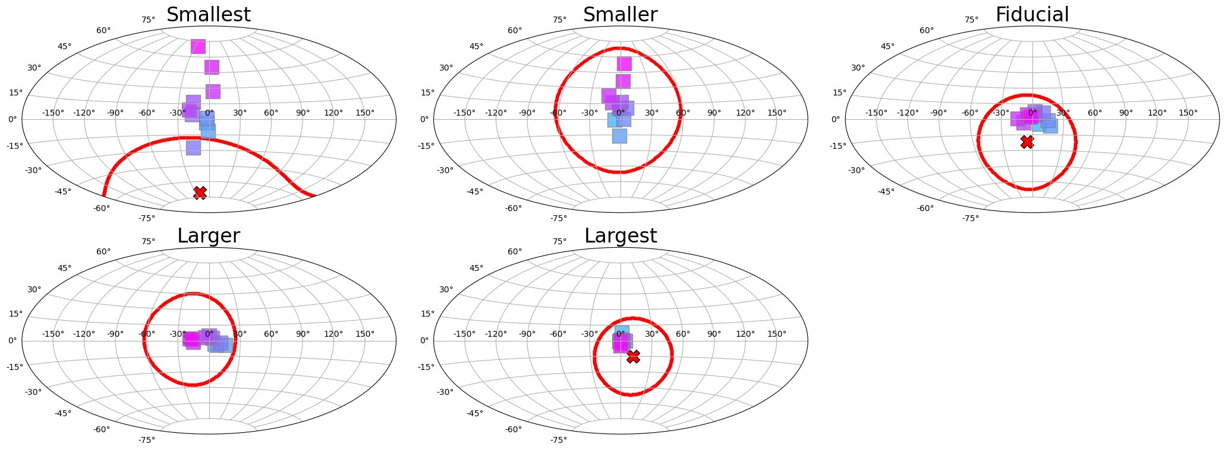
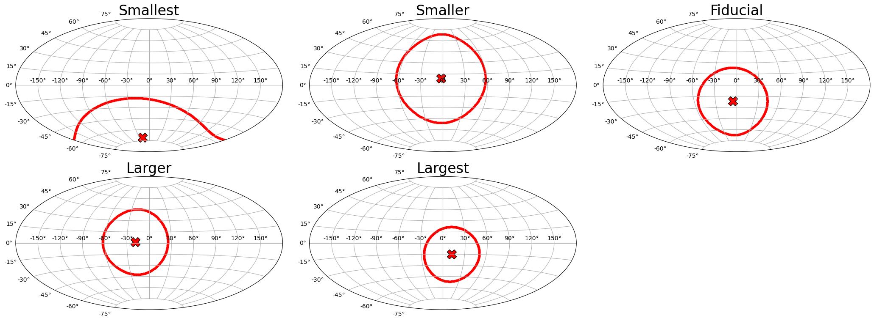
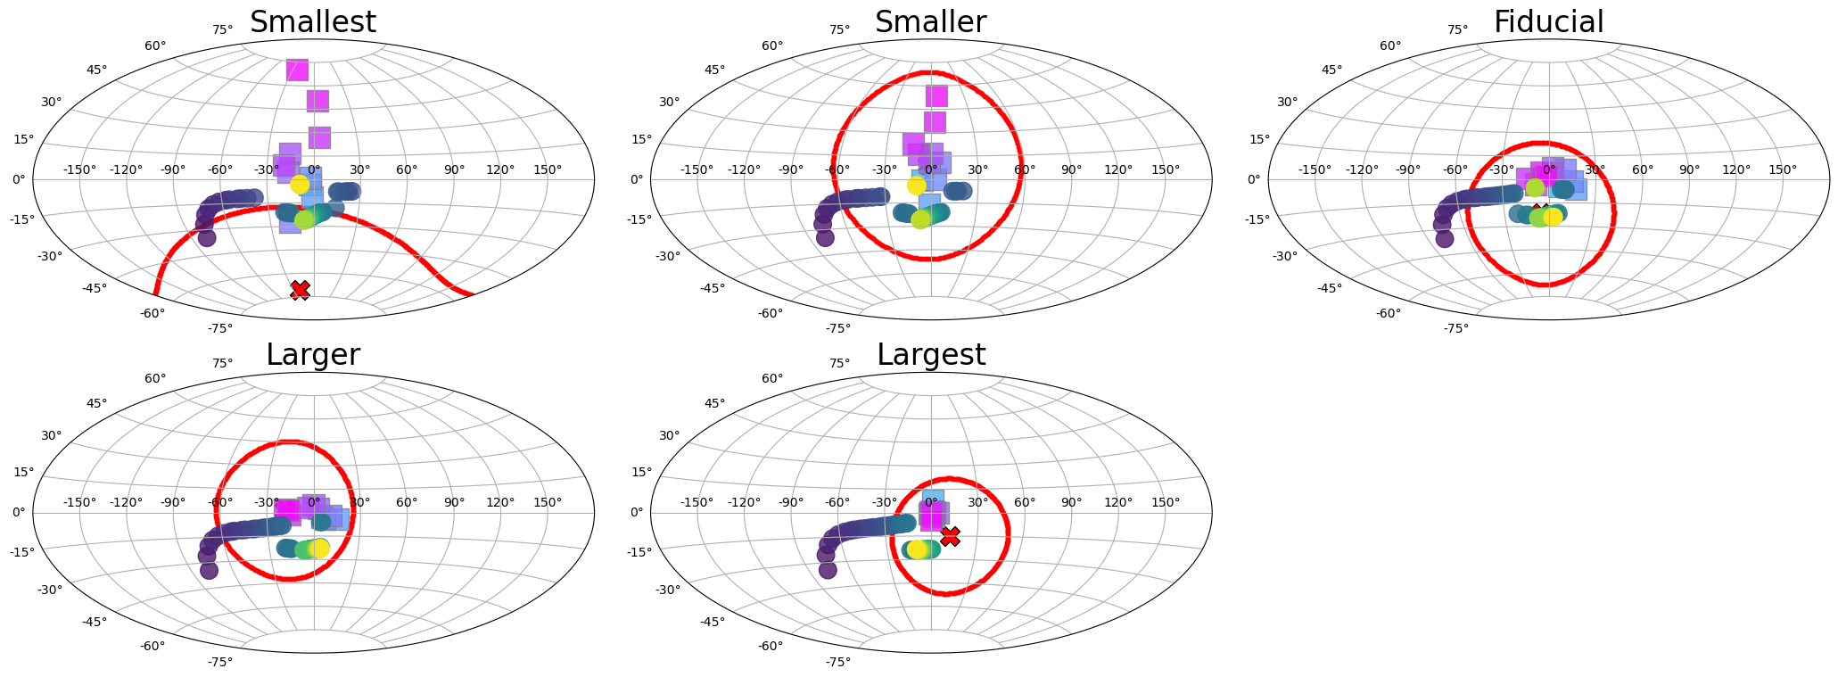
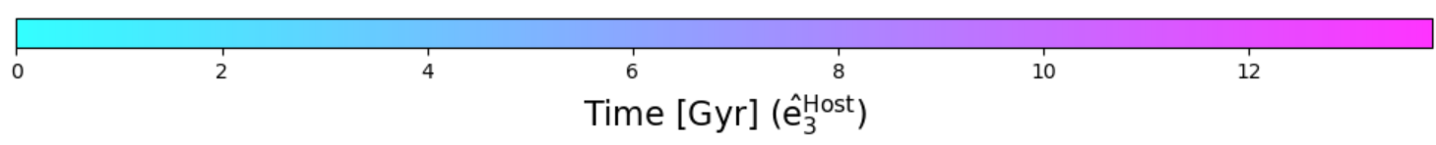

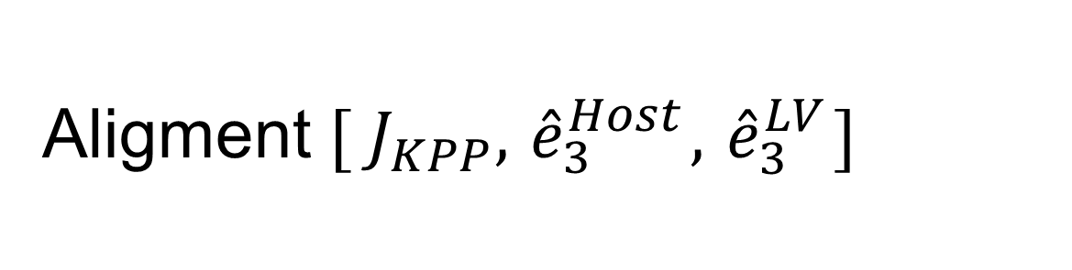

Aligment ${[ J}_{KPP}, { \hat{e}}_{3}^{Host},{ \hat{e}}_{3}^{LV}]$
The more massive the major merger
The more planar and oblate the host halo
The higher the enhancement of equatorial orbits
Aligned
Aligned
$${[ J}_{KPP}, { \hat{e}}_{3}^{Host}]$$
$$[{ \hat{e}}_{3}^{Host},{ \hat{e}}_{3}^{LV}]$$
8/9

Slide 9

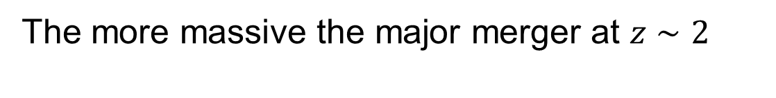
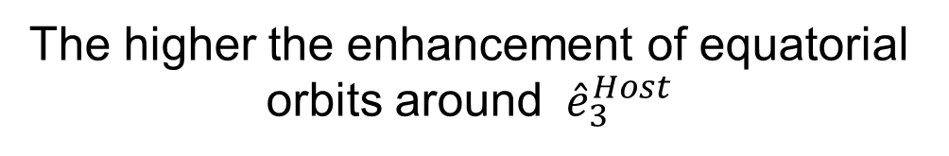
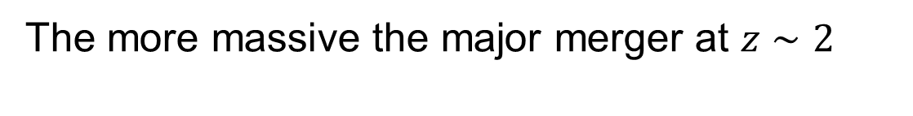
Conclusions
the more planar the satellite distribution at low-z
The more massive the major merger at $z∼2$
the more populated the KPP
Why?
The more massive the major merger at $z∼2$
The more planar and oblate the host halo
The more aligned $[{ \hat{e}}_{3}^{Host},{ \hat{e}}_{3}^{LV}]$
The higher the enhancement of equatorial orbits around ${ \hat{e}}_{3}^{Host}$
A massive major merger (~ 1: 2) at $z\sim 2$ as GSE enhance the presence of planes of satellites in MW-mass halos comparable to the observed ones!!

Slide 10
Backup Slides

Slide 11
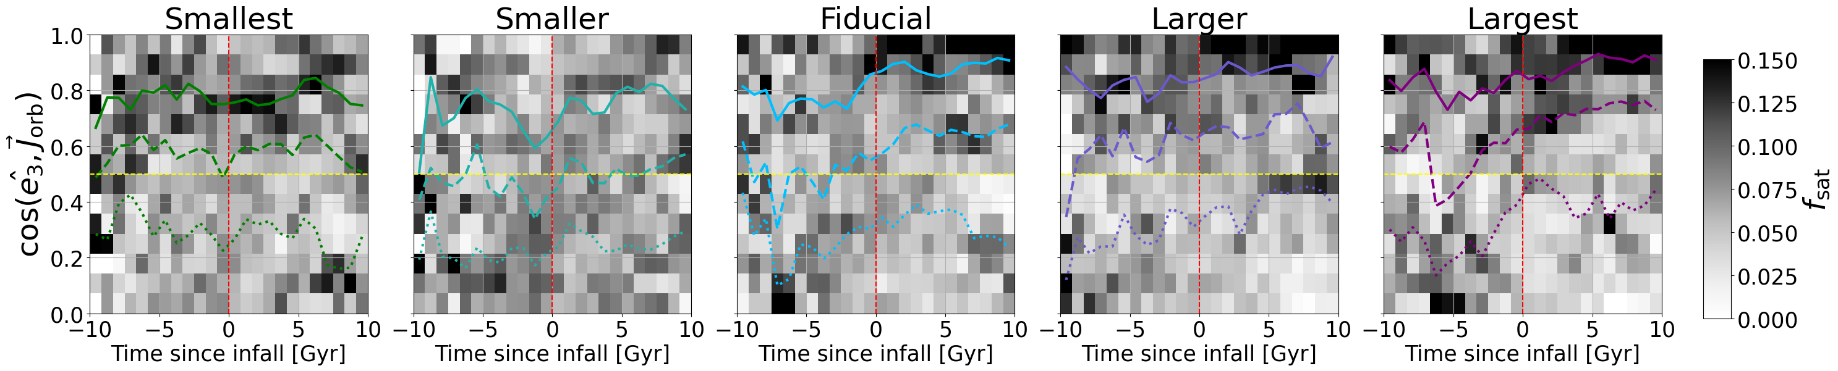
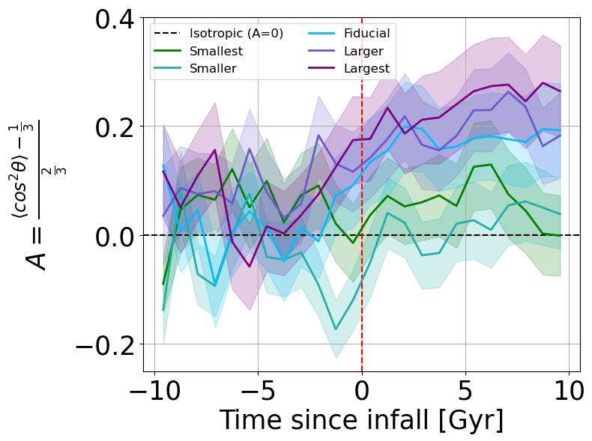
Host Halo Shape
Equatorial orbits enhancement
The more massive the major merger
The more planar and oblate the host halo
The higher the enhancement of equatorial orbits

Slide 12
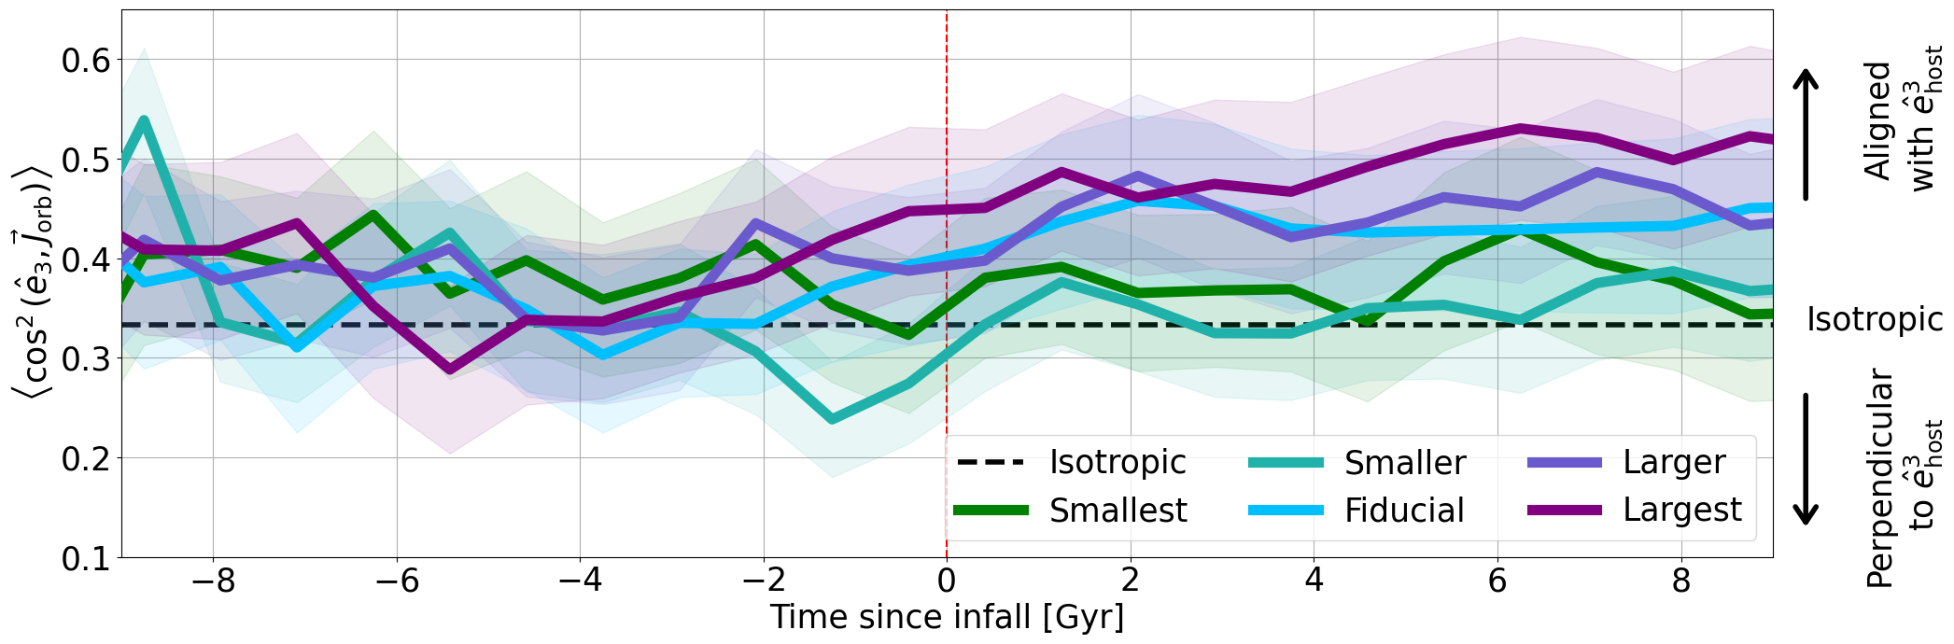
Host Halo Shape
Equatorial orbits enhancement
The more massive the major merger
The more planar and oblate the host halo
The higher the enhancement of equatorial orbits

Slide 13
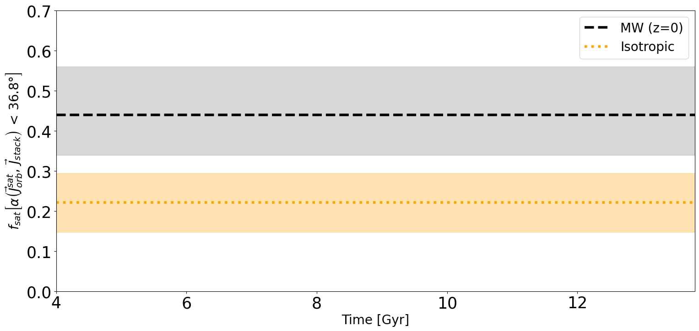
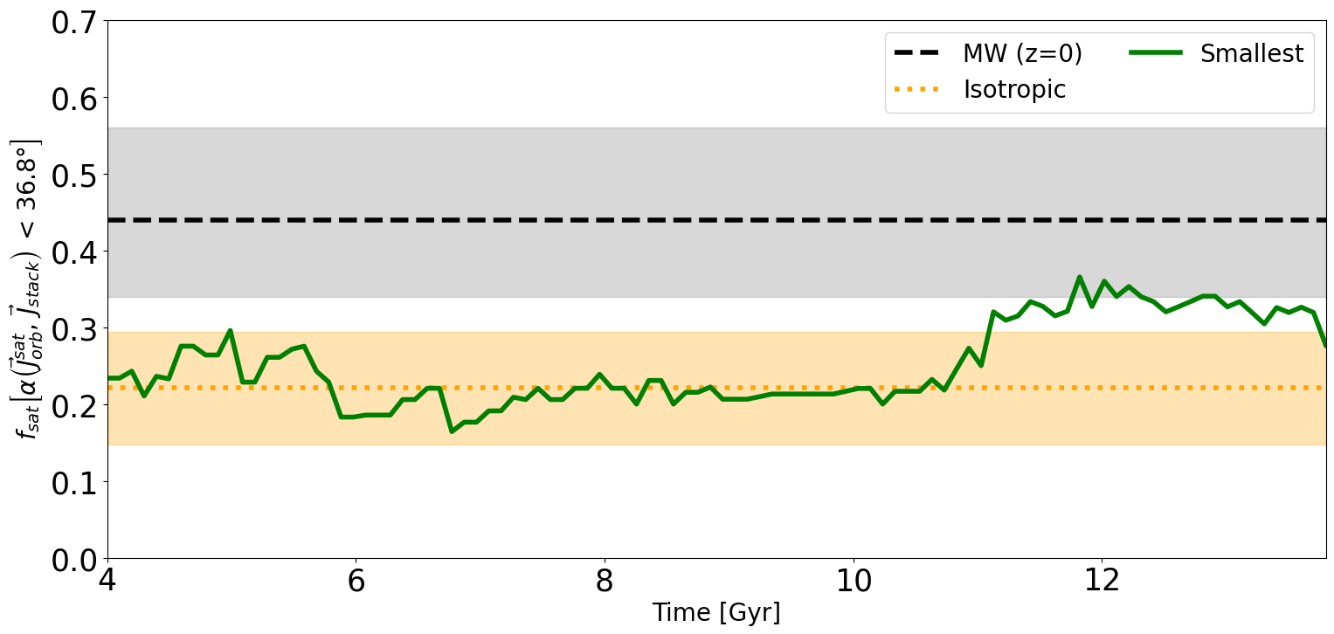
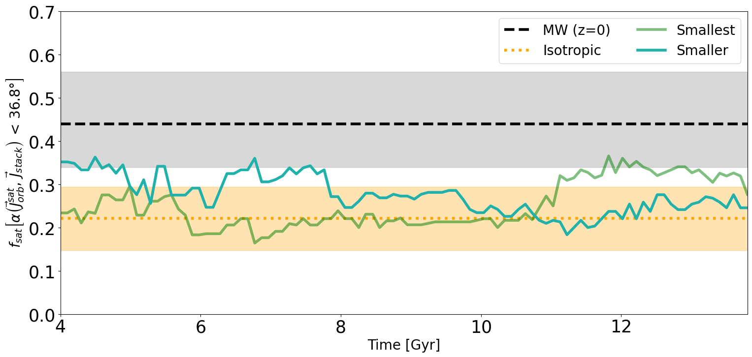
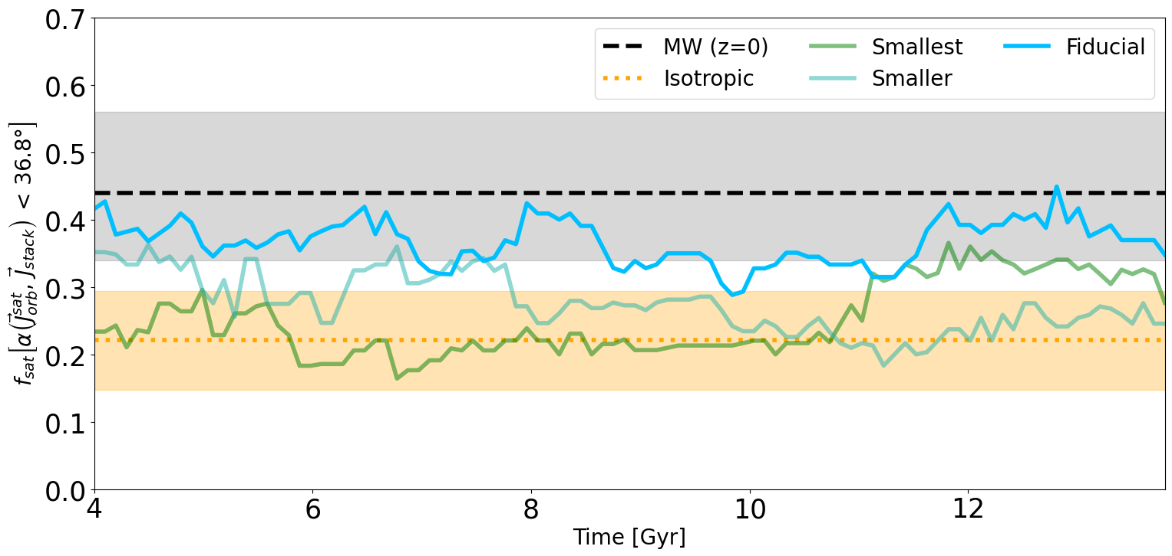
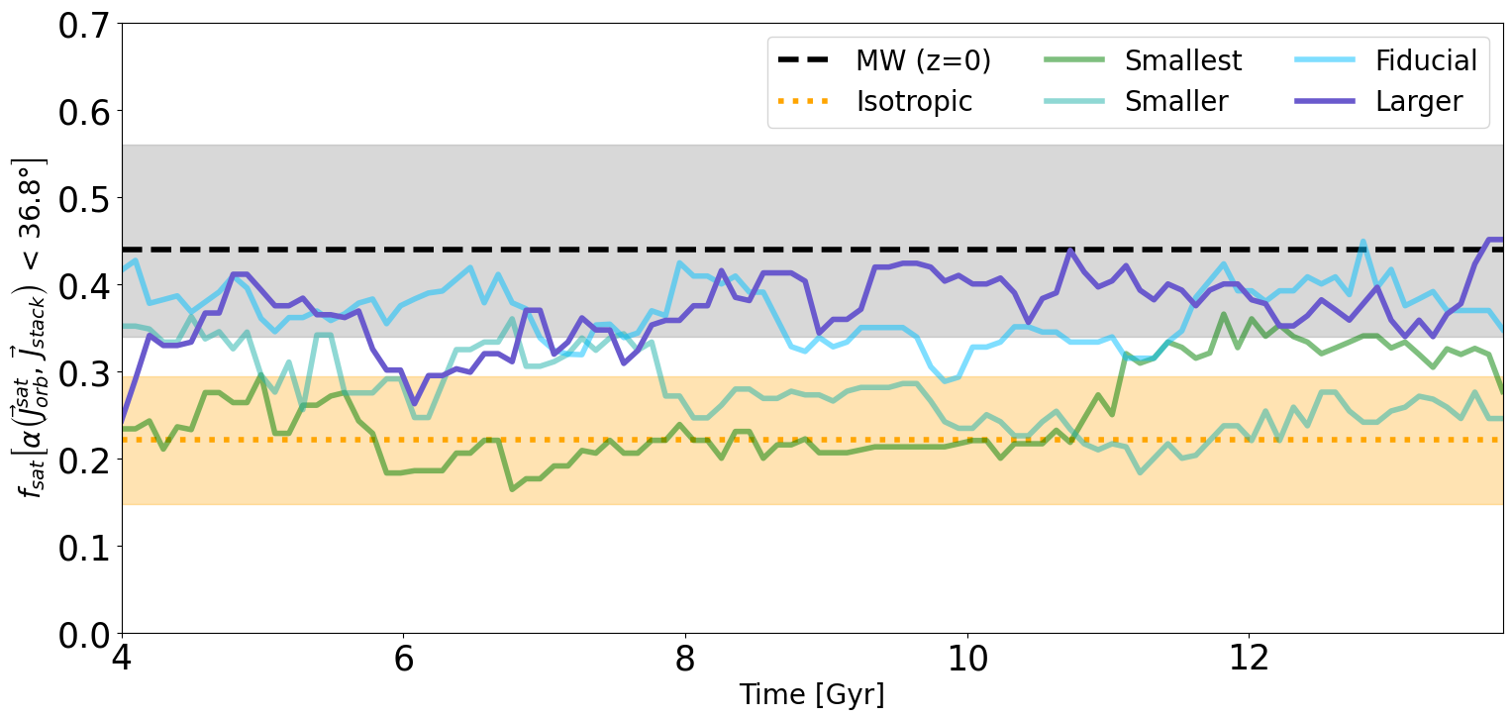
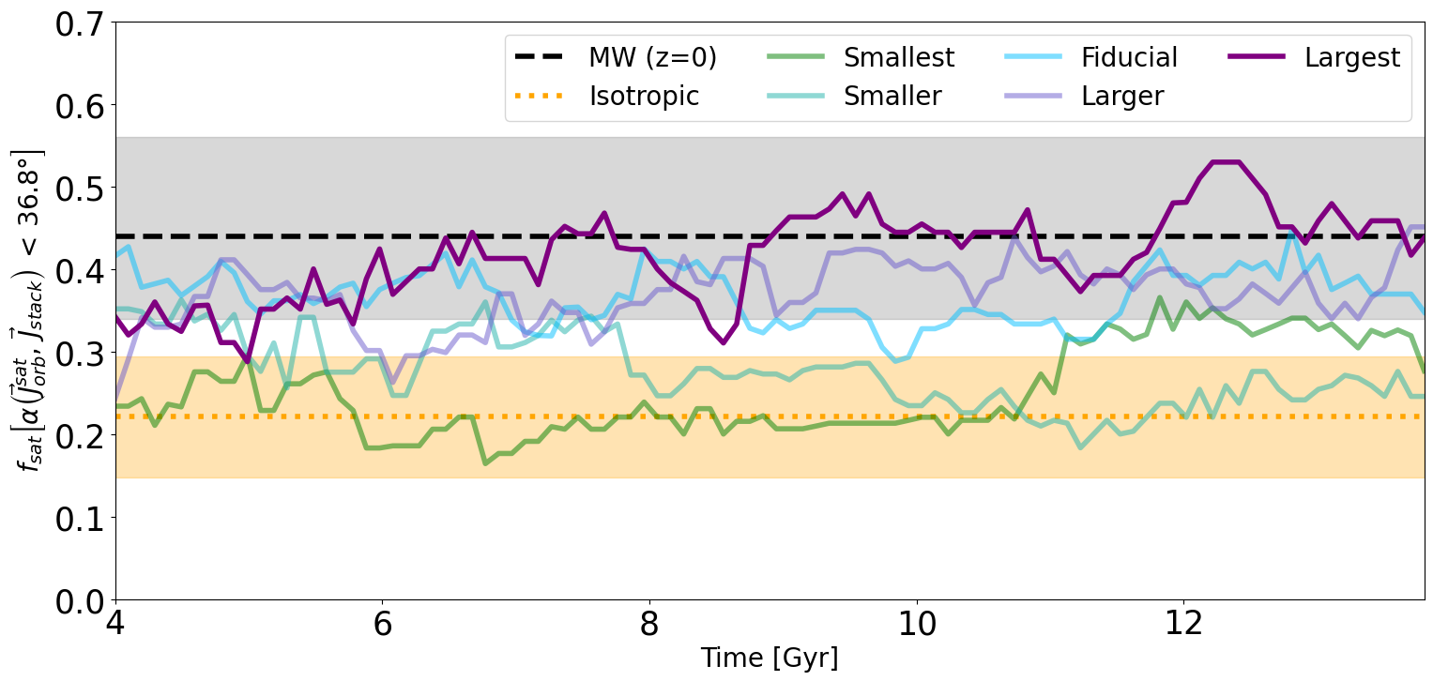
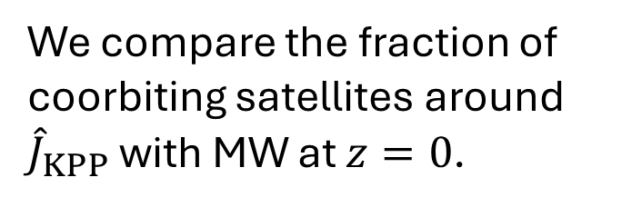
Kinematic Persistent Planes
Fraction of coorbiting satellites
We compare the fraction of coorbiting satellites around ${\hat{J}}_{KPP}$with MW at $z=0$.
As we increase the mass of the major merger, we transition from a isotropic distribution of angular momentum to a coherent rotation of satellite population (as the one observed in the MW).

Slide 14
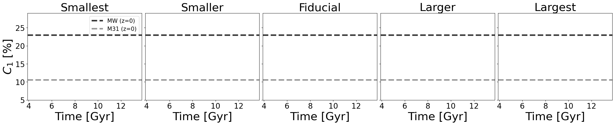
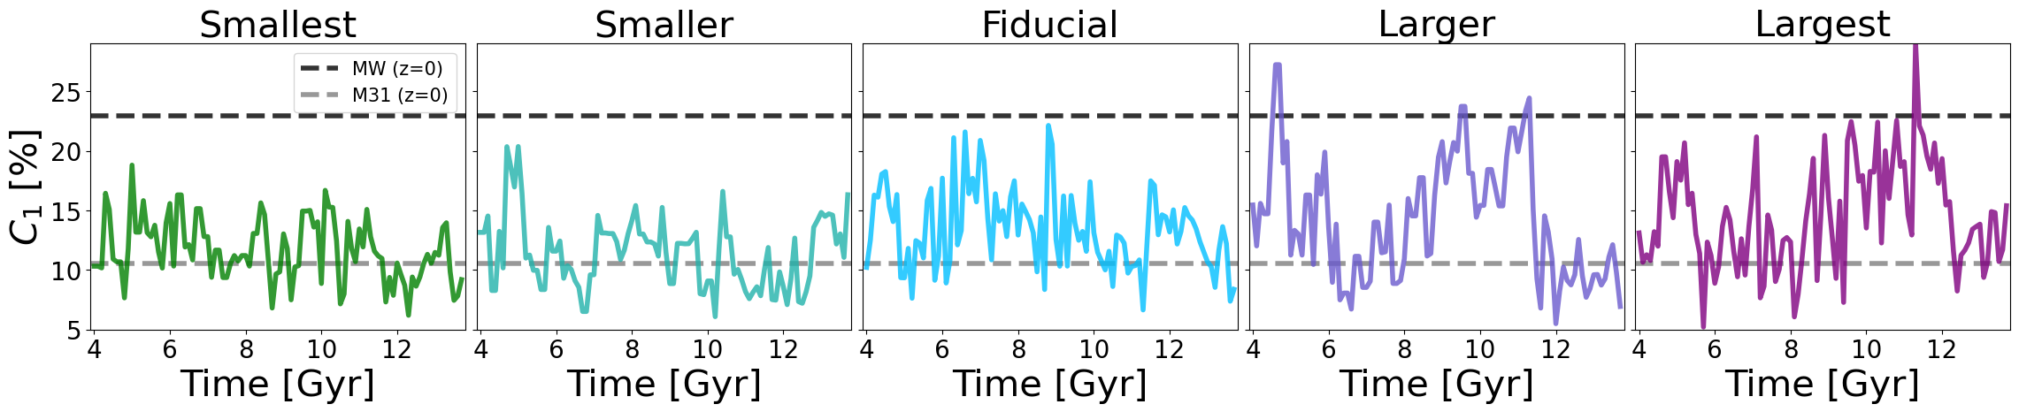
Positional plane of satellites
4GND Comparison with MW & M31 – Peak Strength
Peak strength ($C_{1}$) gives a measure of the degree of anisotropy in positions of satellites.
The more massive the major merger the higher $C_{1},$reaching MW values for periods of time.

Slide 15
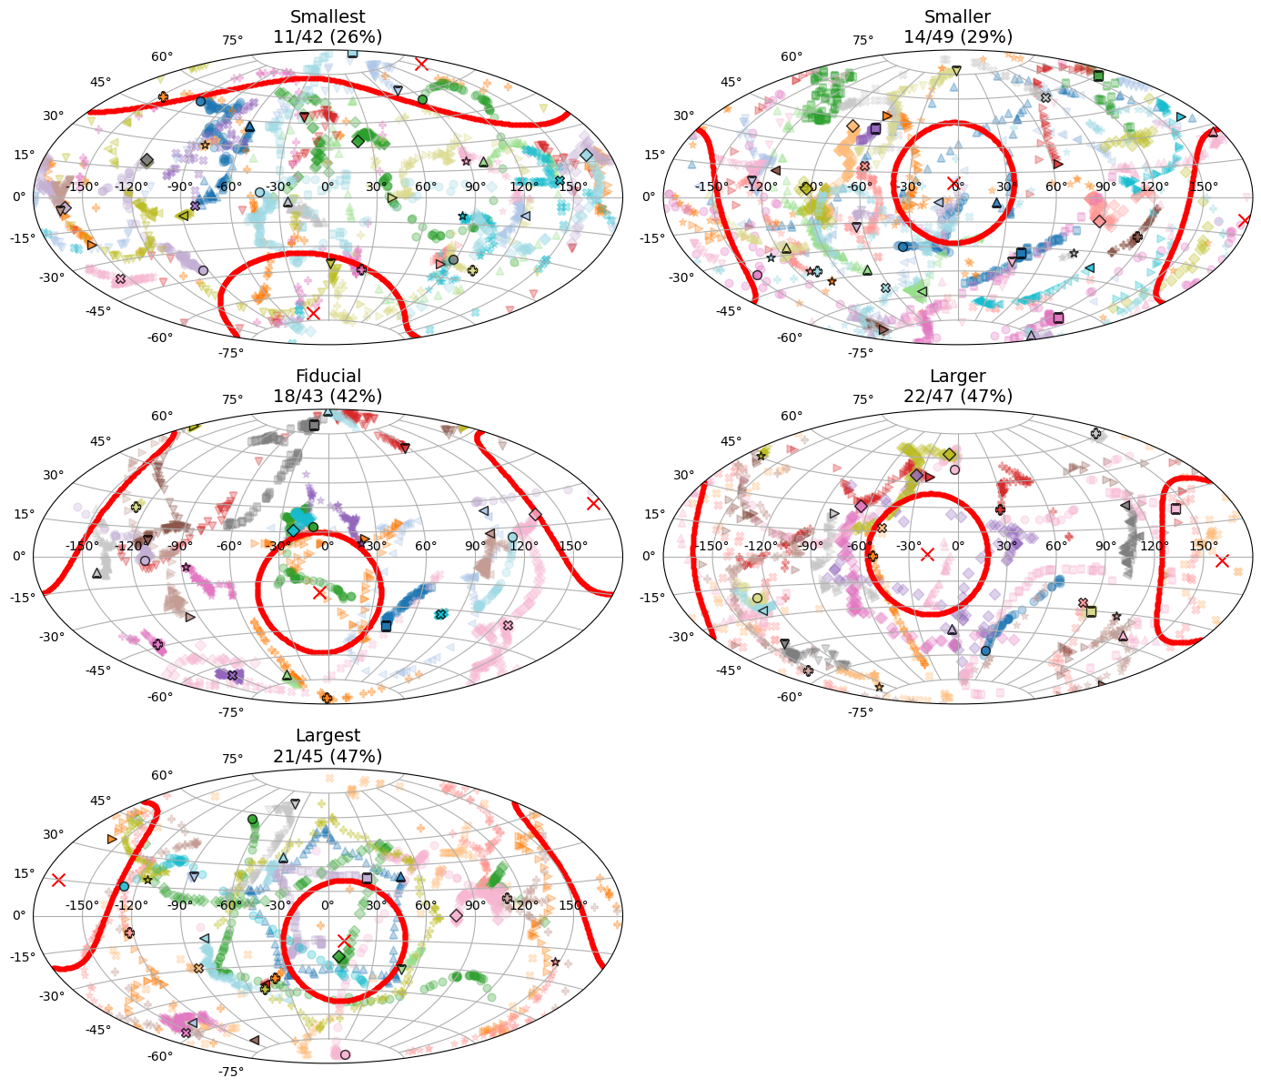
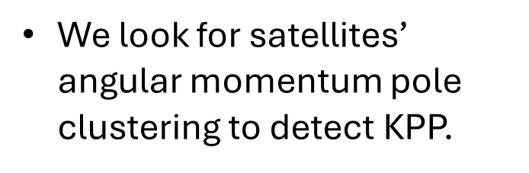
Kinematic Persistent Planes
Pole orbital clustering
We look for satellites’ angular momentum pole clustering to detect KPP.
The more massive the major merger, the more populated the KPP.
KPP comparable to MW.
MW ~ 40%

Slide 16
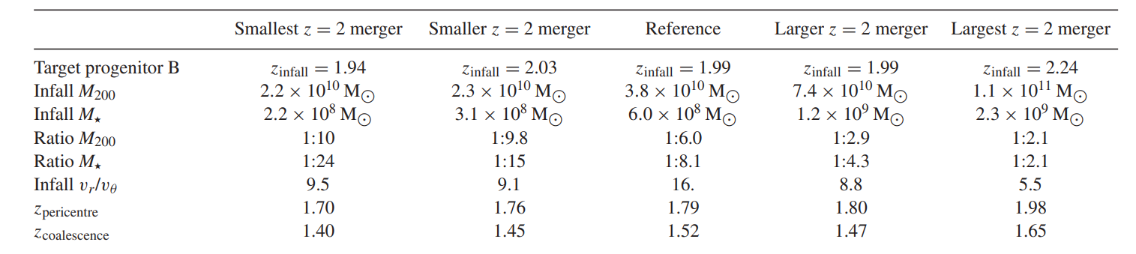

Slide 17

Detected trend
the more planar the satellite distribution at low-z
The more massive the major merger at $z∼2$
the more populated the KPP
Proposed origins
Unexpected changes in large scale structure
Group accretion due to a larger number of major merger satellites
Changes in host halo potential shaping preferred orbits

Slide 18
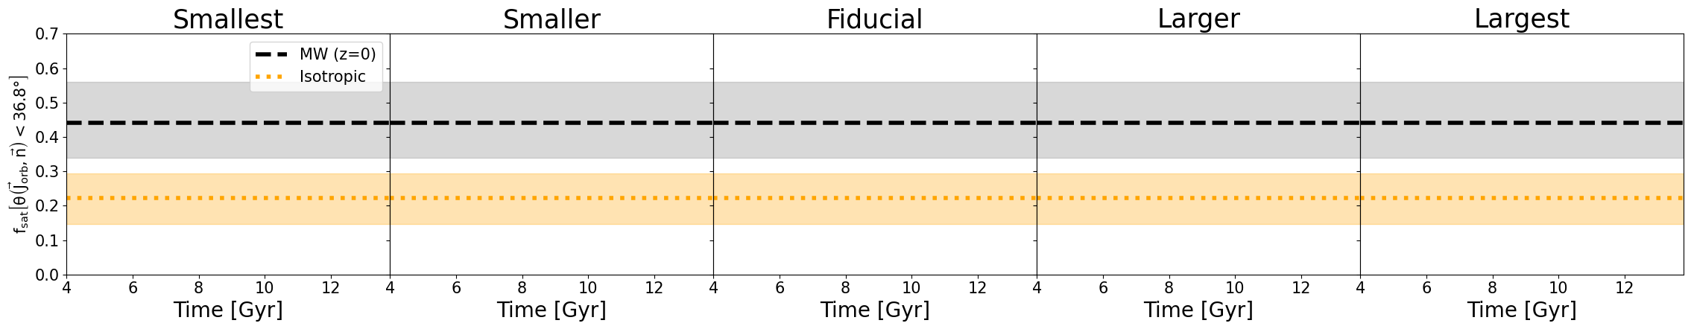
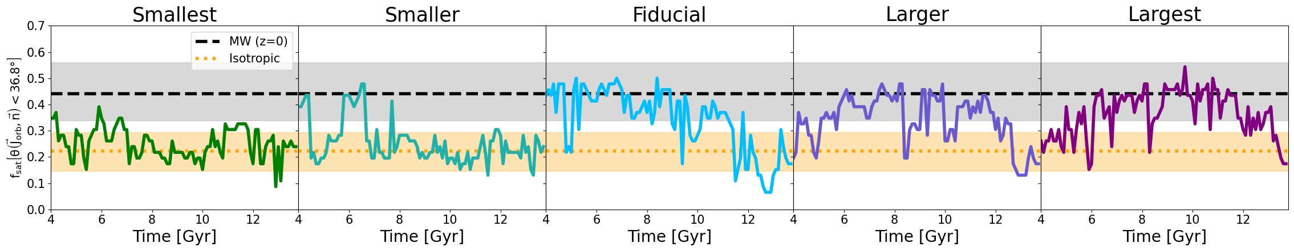
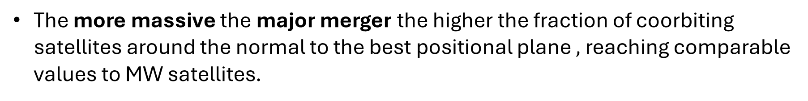
Positional plane of satellites
4GND Coorbitation Comparison with MW & M31
MW satellites exhibit a high fraction (~40%) of coorbiting satellites around the normal to the plane (${\hat{n}}_{plane}).$
The more massive the major merger the higher the fraction of coorbiting satellites around the normal to the best positional plane $,$reaching comparable values to MW satellites.

Slide 19
Positional plane of satellites
4GND Coorbitation Comparison with MW & M31
MW satellites exhibit a high fraction (~40%) of coorbiting satellites around the normal to the plane (${\hat{n}}_{plane}).$
The more massive the major merger the higher the fraction of coorbiting satellites around the normal to the best positional plane $,$reaching comparable values to MW satellites.

Slide 20





Large Scale Convergence

Slide 21






Kinematic Persistent Planes
Fraction of coorbiting satellites
We compare the fraction of coorbiting satellites around ${\hat{J}}_{KPP}$with MW at $z=0$.
As we increase the mass of the major merger, we transition from a isotropic distribution of angular momentum to a coherent rotation of satellite population (as the one observed in the MW).

