Slide 1
Participation in SKAO Science Data Challenges by a HPC resources provider - impressions and some lessons learned
Pedro Alberto
Laboratory for Advanced Computing of the University of Coimbra
UC-LCA

Slide 2
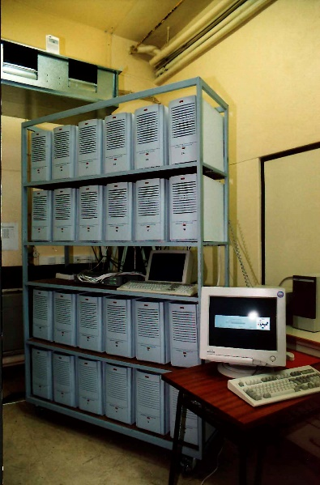
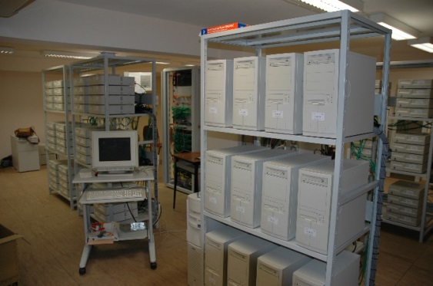
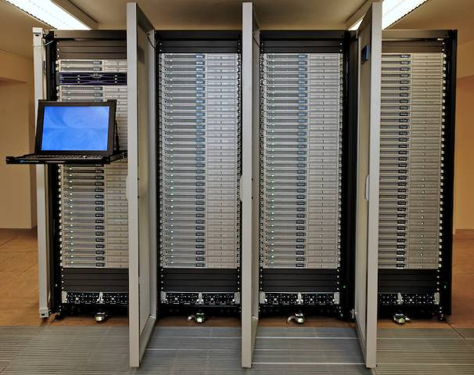
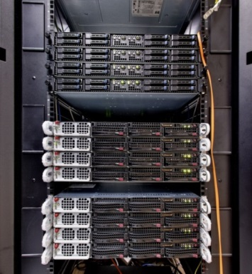
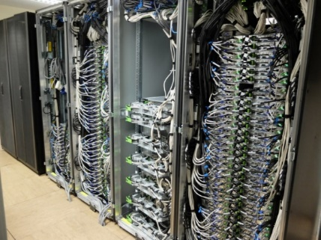
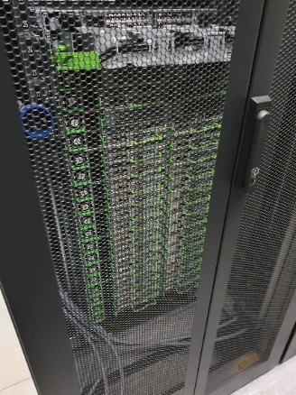
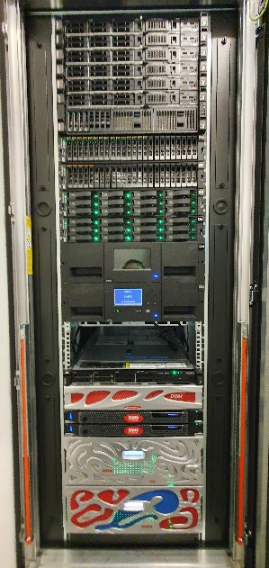
Some history of UC-LCA
HPC Clusters since 1998
CPU time allocation since 2007
Member of the National Roadmap of Scientific Infrastructures since 2014
Centopeia 1998 - 2006
Navigator
2015 –
UCoimbra Data Center
Centaurus
Milipeia 2006 - 2015

Slide 3
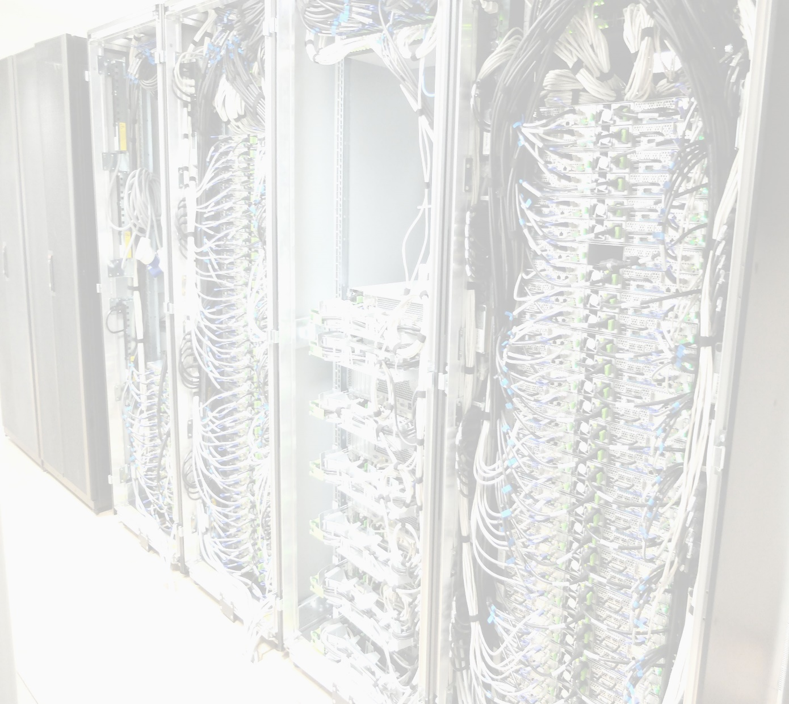
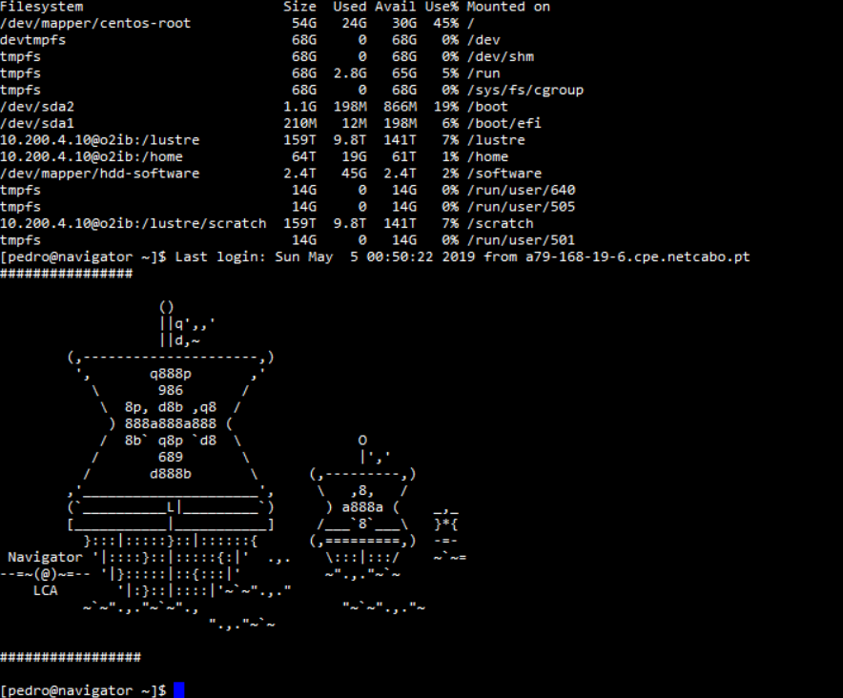
Some numbers
# cores | 5 288
# servers | 197
Shared storage (PBytes) | 1,5
# GPUs (V100/L40s/H200) | 8/4/2
# high memory servers 386 GB | 7
Infiniband interconnect FDR/EDR | 2:1 / non-blocking
Peak performance (TFlop/s) | 247+120
Very high memory server (3TB) 72 cores | 1
To be ugraded
Management/archive/visualization
Cluster of virtual machines
6x48 cores; 22 TB external storage; 25Gbit/s switch
Archive and backup system
95 TB disk/960 TB LT08 tape library
Visualization server (2 x Nvidia A40, 1 TB RAM, 3,8 TB NVMe)

Slide 4


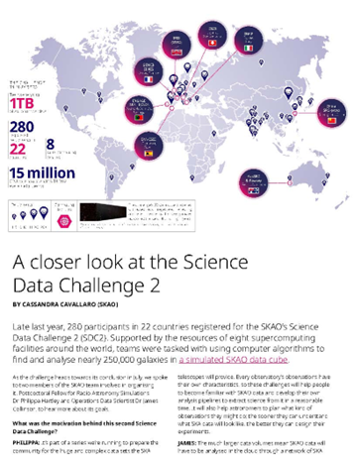
Recent International projects
PRACE (PaRtnership for Advanced Computing in Europe)
  ESFRI Landmark Infrastruture
  Lead member (Associate members: UPorto, ULisbon, UÉvora)
  Industry colaboration within SHAPE “TOOLING4G |Minimize the airflow generated noise on automotive HVAC systems” https://prace-ri.eu/wp-content/uploads/WP302.pdf
  Collaboration with SKAO started in PRACE-6IP
RISC2 - A network for supporting the coordination of High-Performance Computing research between Europe and Latin America
EuroCC/2/3 - EuroHPC National Competence Centers (HPC+AI+Quantum)
EUMaster4HPC
SKAO Science Data Challenges since SDC2

Slide 5
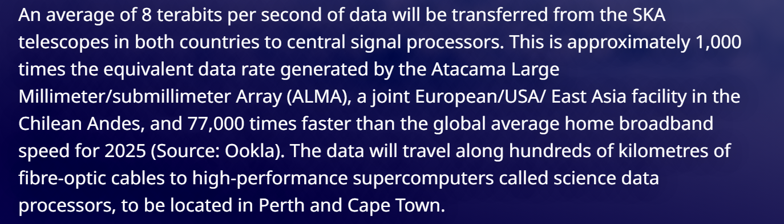
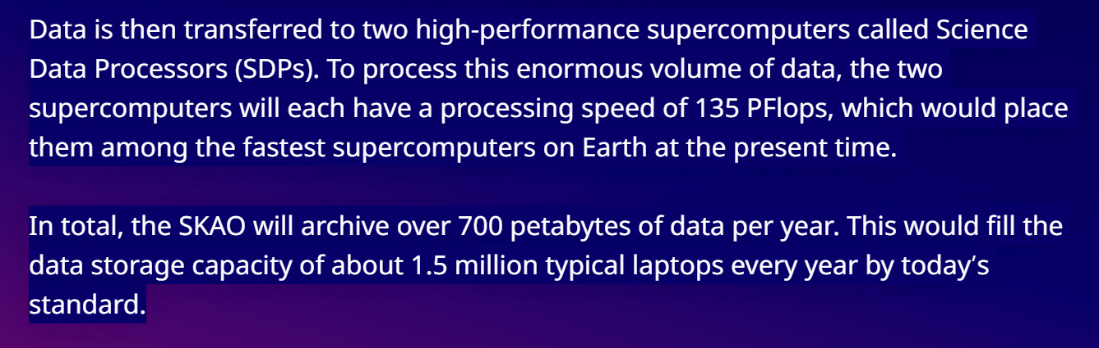
SKAO
Big data from the 2 telescope sites

Slide 6

SKAO
Science data challenges 3a/b
“The goal is to prepare the radio-astronomical community for the novel nature of the data expected from the Square Kilometre Array” (from the SKAO site)
Scientific data challenges in SKAO aim at practicing data analysis on realistic synthetic datasets emulating the SKA's capabilities in order to test existing methods and eventually develop new ones, in a challenge format.
If massive data processing is required, access to HPC systems is mandatory!

Slide 7
SKAO
Science data challenges 3a/b
Scientific goal:
  Determine when the Epoch of Reionisation occurred during the formation of stars in galaxies after the Big Bang, looking for the 21 cm Hydrogen line.
Two challenges:
  Removal of foreground emission from Galactic and Extragalactic sources (3a) (3/2023-> 10/2023) https://doi.org/10.1093/mnras/staf1466
  Inference of important parameters of the Epoch of Reionisation (3b) (10/2024 -> 5/2025) - paper being prepared
Data sets downloaded from a central location in the UK
  7.5 TB for 3a
  5 TB for 3b

Slide 8
SKAO
Science data challenges 3a/b
Iberian HPC facilities involved in the SDC3a/b:
  UC-LCA (Univ Évora will be involved in SDC4 as well)
  CESGA (Galician supercomputing center)
  SPRSC (SKA Regional Centre Prototype at the Instituto de Astrofísica de Andalucia)
Teams assigned to each HPC facility
For UC-LCA:
  typical resources allocated: 100k core-hours, up to 20 TB disk (SDC3a)
  No GPU usage in UC-LCA (but it could be, and some teams asked for it)

Slide 9
Reflections on SKAO
SDCs in a HPC context
Constraints on the usage of a HPC facility by the teams
  Data availability – it takes time to download 7.5 TBytes from a remote location (it took about 5 days in our case)
  Unfamiliarity with the HPC environment (job allocation, software libraries and applications) – quite different from workstation usage (not all teams).
  Software availability and its usage in an effective way (parallel computing) - SKAO has done this part
  Good estimate of the resources needed (e.g. #cores, GPUs, running time - fortunately, for the latest challenges, the UK SKAO team provided some estimations for needed resources.

Slide 10
Reflections on SKAO
SDCs in a HPC context
Lessons learned (1)
  Data availability – ensure that point to point network bandwidth is adequate to transfer large data sets (several repositories available, dedicated channel if available, fast storage systems at both ends of the transfer)
  If unfamiliar with the HPC environment, provide documentation and even some short training. Having on the HPC facility side a more friendly interface might help (e.g. Open OnDemand).
  Test software beforehand in a parallel computing setting to maximize usage efficiency (if needed, provide containers for certain program/libraries combinations) – useful for Python workflows, for example. This has improved in SDC over time

Slide 11
Reflections on SKAO
SDAs in a HPC context
Lessons learned (2)
  Check with the HPC facility which resources are available and whether the existing access modes/resources available are adequate for the simulations/data analysis required.
Other considerations
  When massive data analysis is at stake (as in SKAO) pilot trials are (possibly) training are crucial. There is a lot to be learned!
  Pre-processing near the data source maybe crucial as well to minimize data transfer and processing in the several distributed locations.
  Depending on the amount of data, a distributed network for processing maybe needed as in SKAO.

Slide 12
Reflections on SKAO
SDAs in a HPC context
Other considerations
  Keep in touch with other developments and projects in Europe, namely for IT organization of radio astronomy infrastructures (on going project submission).
Thank you for your attention, I hope these remarks will be useful for AtLAST data processing – Questions?

