Slide 1
The Conceptual design of the 50-m Atacama Large Aperture Submm Telescope
Tony Mroczkowski (ESO, and soon ICE)
on behalf of the AtLAST design teams
AtLAST Iberian Days
4 June 2026
Funded by the European Union. Views and opinions expressed are however those of the author(s) only and do not necessarily reflect those of the European Union or European Research Executive Agency. Neither the European Union nor the European Research Executive Agency can be held responsible for them.

Slide 2
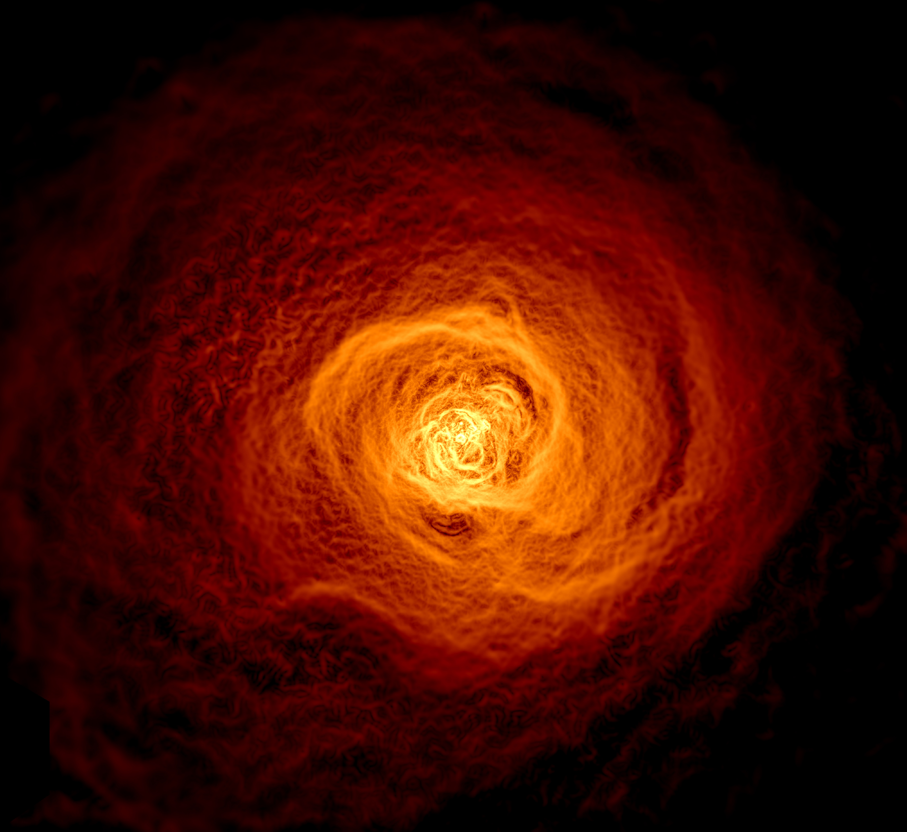
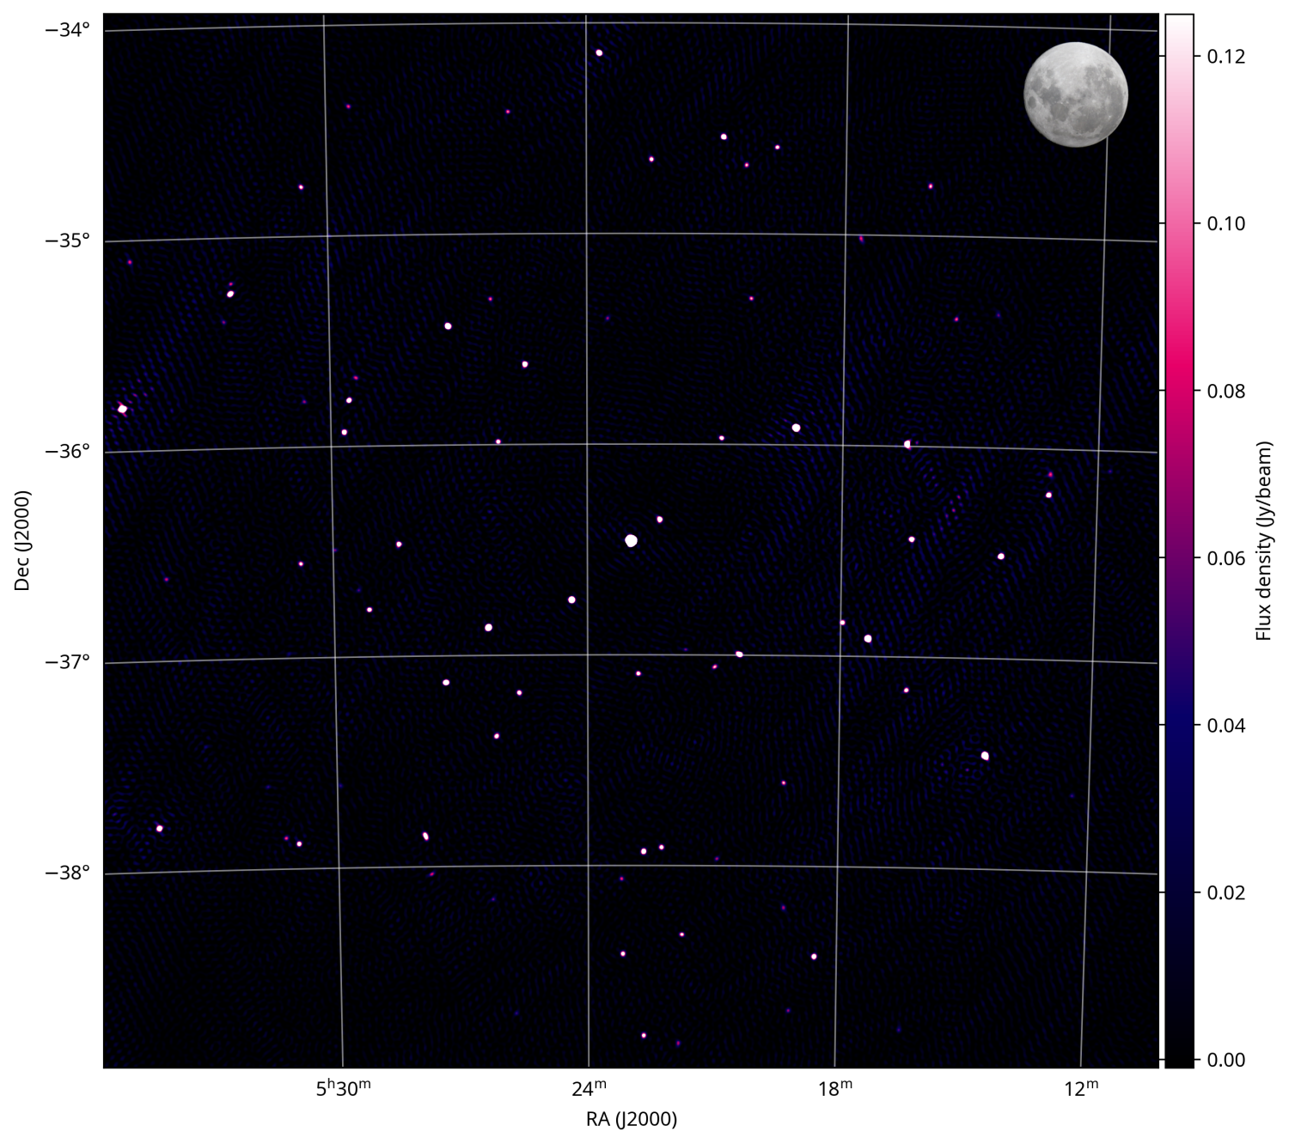
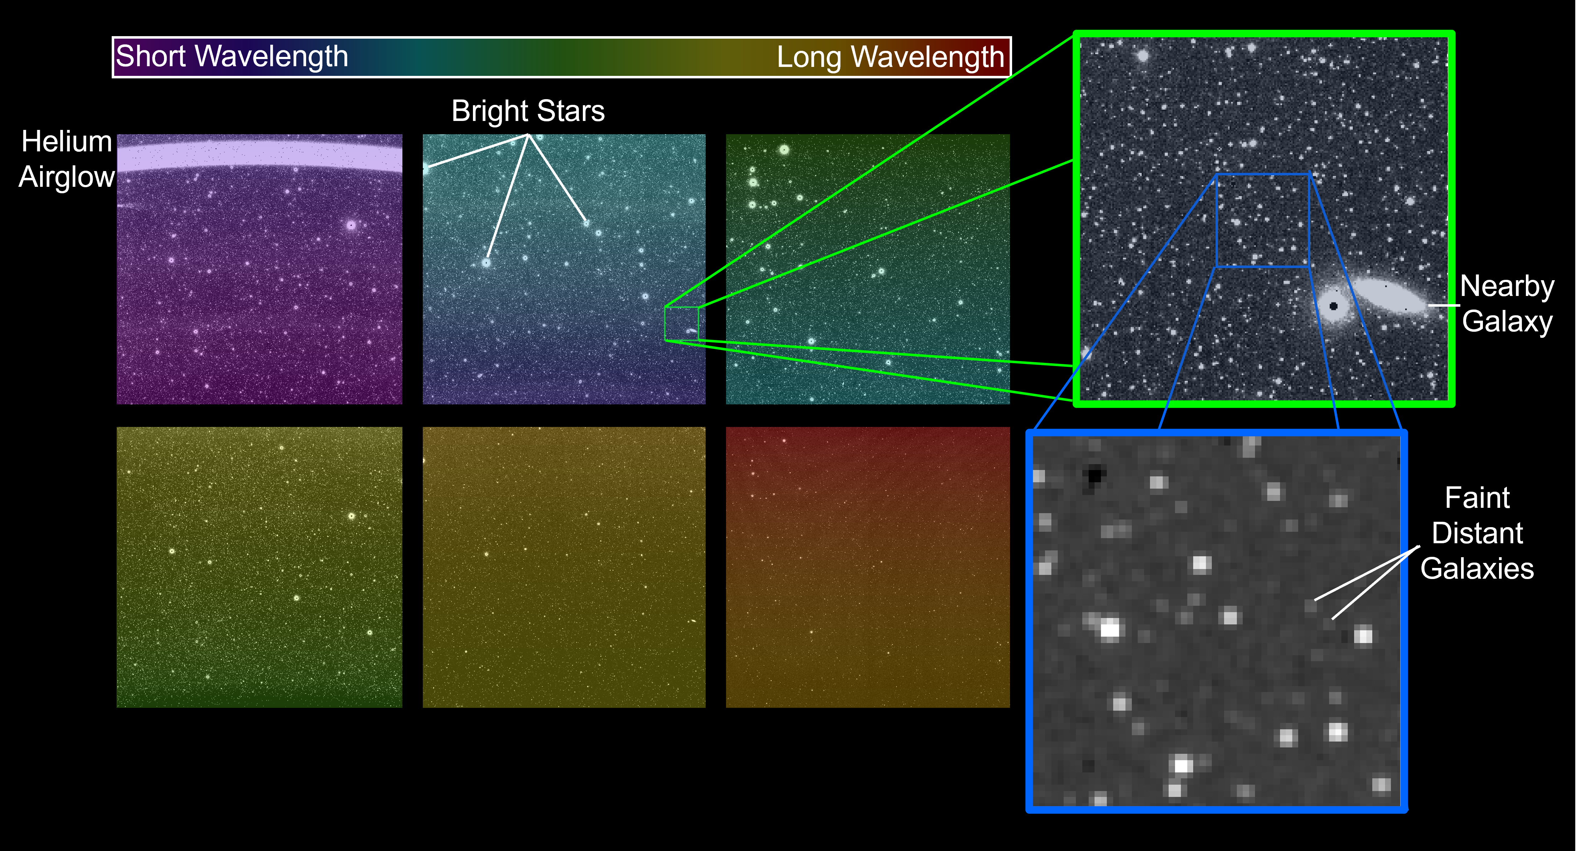
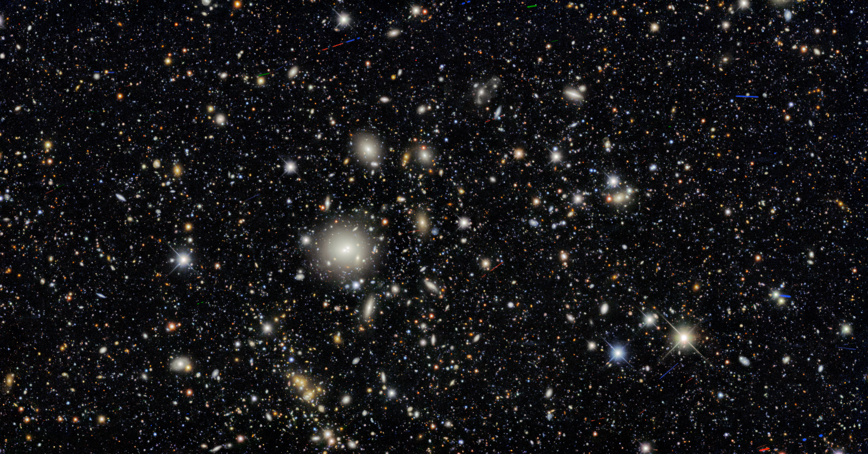
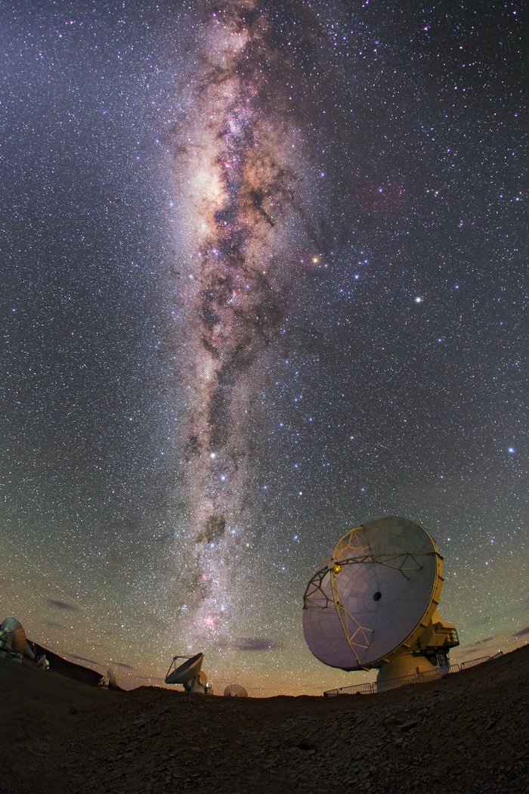
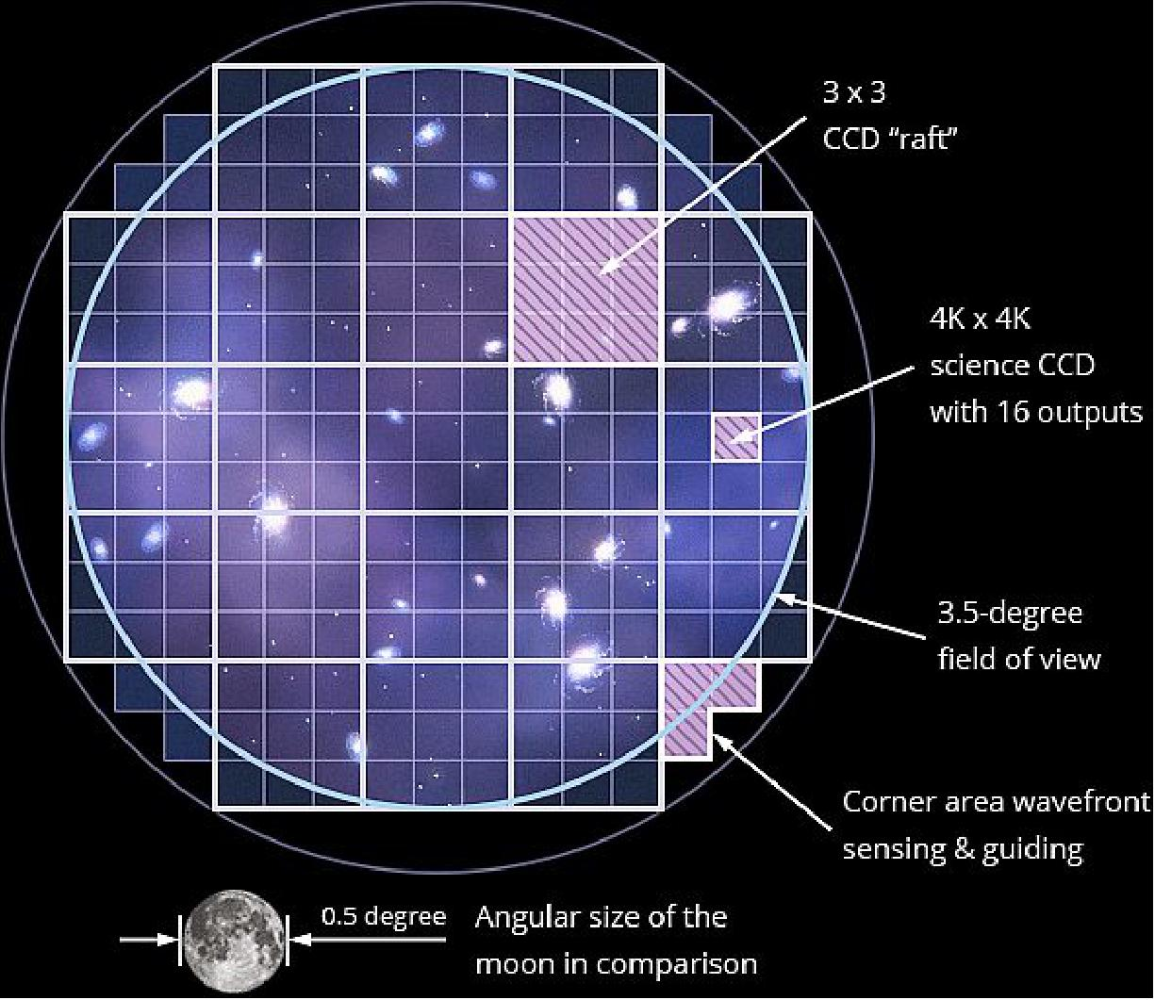
Completing our ability to map the multiwavelength sky
Dark Energy Survey (DES) has a 2.2 deg wide instantaneous field of view.
Credit: Dark Energy Survey/DOE/FNAL/DECam/CTIO/NOIRLab/NSF/AURA
Acknowledgments: T.A. Rector (University of Alaska Anchorage/NSF NOIRLab), J. Miller, M. Zamani & D. de Martin (NSF NOIRLab)
Chandra X-ray observatory mosaic of 16’x16’pointings on the Perseus Cluster. Credit: NASA/CXC/GSFC/ S.A.Walker, et al. https://chandra.harvard.edu/photo/2017/perseus/
First light IR (0.75-5 micron) images from NASA's Spectro-Photometer for the History of the Universe, Epoch of Reionization, and Ices Explorer (SPHEREx).
Credit: https://www.nasa.gov/missions/spherex/nasas-spherex-takes-first-images-preps-to-study-millions-of-galaxies/
First light SKA-Low image (~25 sq. deg). Credit: https://www.skao.int/en/news/621/ska-low-first-glimpse-universe
Rubin Observatory will cover 9.6 deg² per pointing
Credit: https://directory.eoportal.org/other-space-activities/rubin-observatory#focal-plane
ALMA, < 1’ field at 90 GHz, < 10” field at >500 GHz. Cannot map significant areas!
Photo Credit: ESO/B. Tafreshi
We can image ~degree fields across the sky with few arcsec resolution at every wavelength except the submm!
Notes:
Note: there are telescopes across the electromagnetic spectrum that can all map ~degree scales at few arcsec resolution except in the mm/submm

Slide 3
Completing our ability to map the multiwavelength sky
Dark Energy Survey (DES) has a 2.2 deg wide instantaneous field of view.
Credit: Dark Energy Survey/DOE/FNAL/DECam/CTIO/NOIRLab/NSF/AURA
Acknowledgments: T.A. Rector (University of Alaska Anchorage/NSF NOIRLab), J. Miller, M. Zamani & D. de Martin (NSF NOIRLab)
Chandra X-ray observatory mosaic of 16’x16’pointings on the Perseus Cluster. Credit: NASA/CXC/GSFC/ S.A.Walker, et al. https://chandra.harvard.edu/photo/2017/perseus/
First light IR (0.75-5 micron) images from NASA's Spectro-Photometer for the History of the Universe, Epoch of Reionization, and Ices Explorer (SPHEREx).
Credit: https://www.nasa.gov/missions/spherex/nasas-spherex-takes-first-images-preps-to-study-millions-of-galaxies/
First light SKA-Low image (~25 sq. deg). Credit: https://www.skao.int/en/news/621/ska-low-first-glimpse-universe
Rubin Observatory will cover 9.6 deg² per pointing
Credit: https://directory.eoportal.org/other-space-activities/rubin-observatory#focal-plane
ALMA, < 1’ field at 90 GHz, < 10” field at >500 GHz. Cannot map significant areas!
Photo Credit: ESO/B. Tafreshi
We can image ~degree fields across the sky with few arcsec resolution at every wavelength except the submm!
Plot above shows the resolutions and frequency coverages across many bands for several degree-scale facilities vs a galaxy at z=6

Slide 4
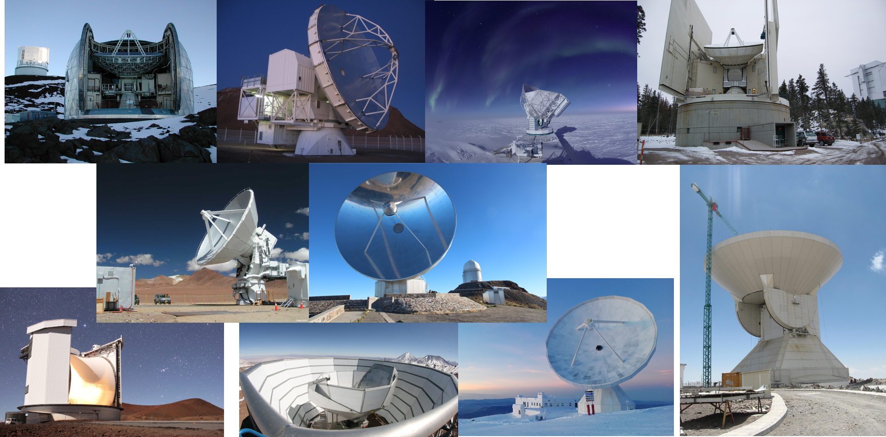
The landscape of current (sub-)mm single dish telescopes
Notes:
Mark will say more about the science motivations in the 2nd presentation today.

Slide 5
AtLAST Technical Specifications
Parameter | Value
Wavelength (λ) range | 0.3 -10 mm
Primary mirror (M1) diameter | 50 m
Secondary mirror (M2) diameter | 12 m
Field of view (FoV) | 2°(1°)
Number of instrument mount points | 6
Optical design | Ritchey-Chrétien
Night(Day)-time half wavefront error | 20 (30) μm
Mechanical pointing accuracy | 2.5 arcsec
Astronomically-corrected pointing | < 0.5 arcsec
Solar observations | Yes
Scan speed | 3°/s
Acceleration | 1°/s²
Elevation (EL) range | 20° to 90°
Azimuthal (AZ) range | + 270°
Mount type | AZ-EL
Site location | 22°58'52"S, 67°45'56"W
Site elevation | ≈5000 m
AtLAST technical specifications (see Mroczkowski et al. 2025).
The 50-meter primary mirror yields a resolution of 1.5” at 350 μm and 10” at 2 mm.
Fast scanning will allow recovery of large angular scales, ensuring high fidelity imaging (see van Marrewijk et al. 2024).
Mechanical pointing accuracy is before any astronomical pointing model corrections.

Slide 6
Combination of large aperture and FoV makes AtLAST unique
We want this one!
Primary Mirror Diameter: driven by the need for both resolution and sensitivity (collecting area)
Field of View (FoV): driven by the need for large angular scales and fast mapping
Throughput (AΩ): number of detectors on sky.
Need >3 million detectors at 850 μm to fill the FoV
Note: Plots include only single dish facilities that can observe at least up to 270GHz (1.1mm)

Slide 7
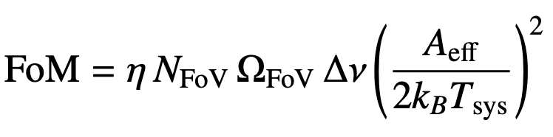
Faster!
AtLAST!
Throughput (AΩ)
Collecting area WTF!
But AtLAST also have more collecting area (instantaneous sensitivity per beam).
The righthand plot shows a figure of merit (FoM) that tracks mapping speed
(see Tools of Radio Astronomy from Wilson, Huttemeister, & Rohlfs)

Slide 8
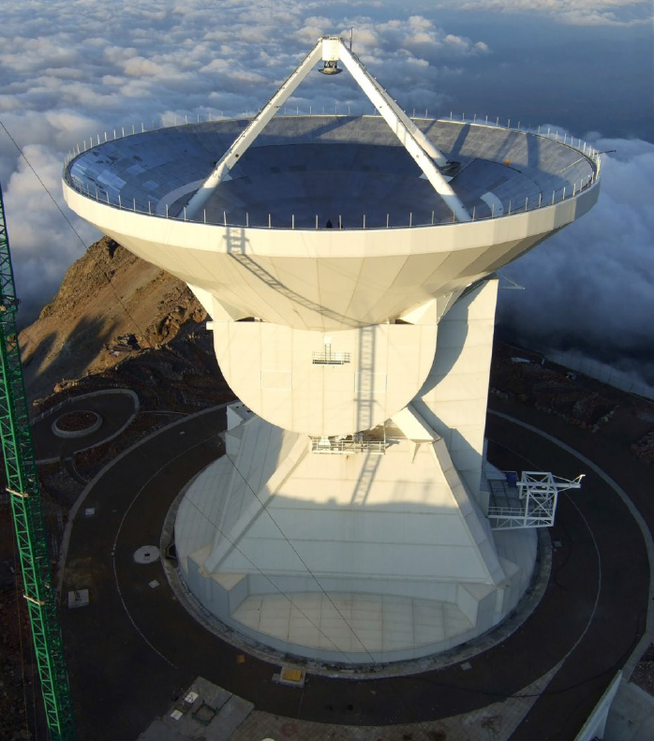
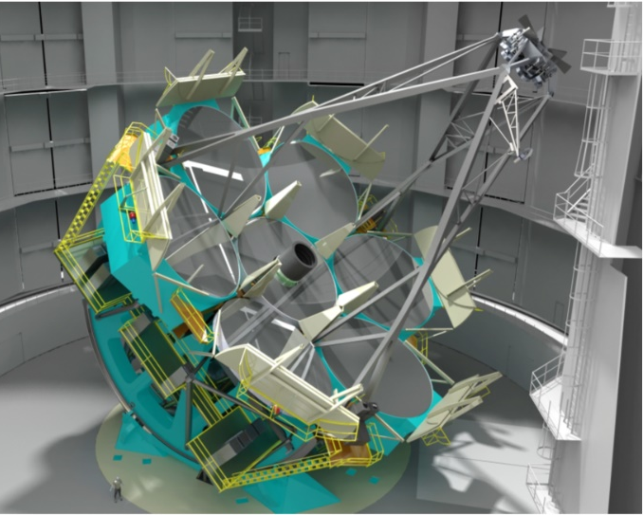
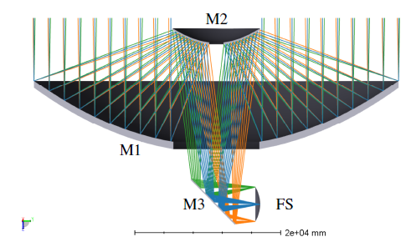
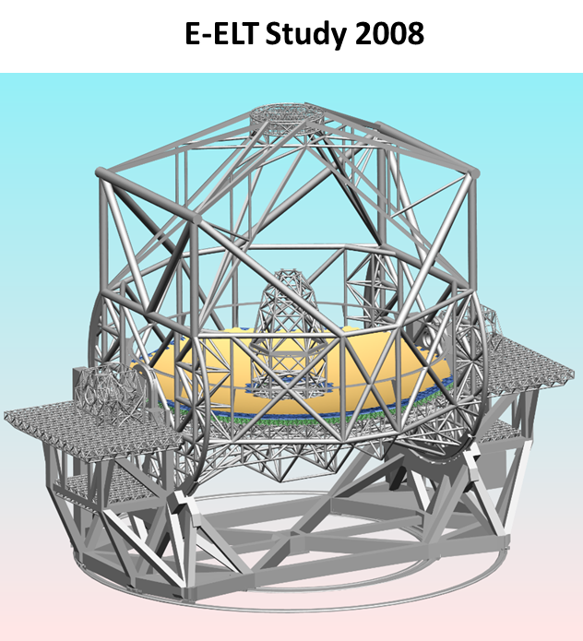
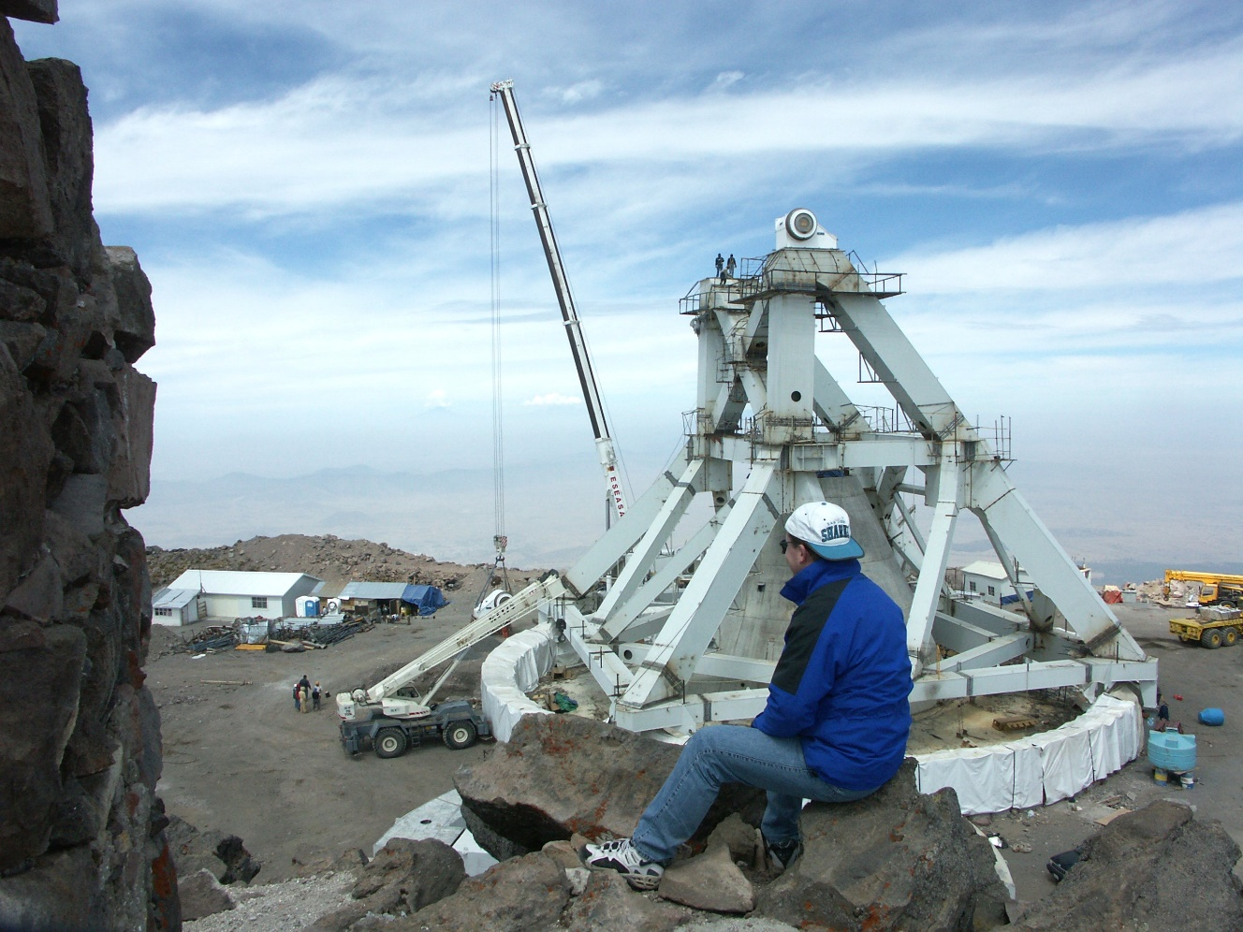
Basic Design Development
Inspirations from Existing Telescopes
50m Large Millimeter Telescope (LMT) in Puebla, Mexico
Large Optical Telescopes
Giant Magellan Telescope
?
?

Slide 9
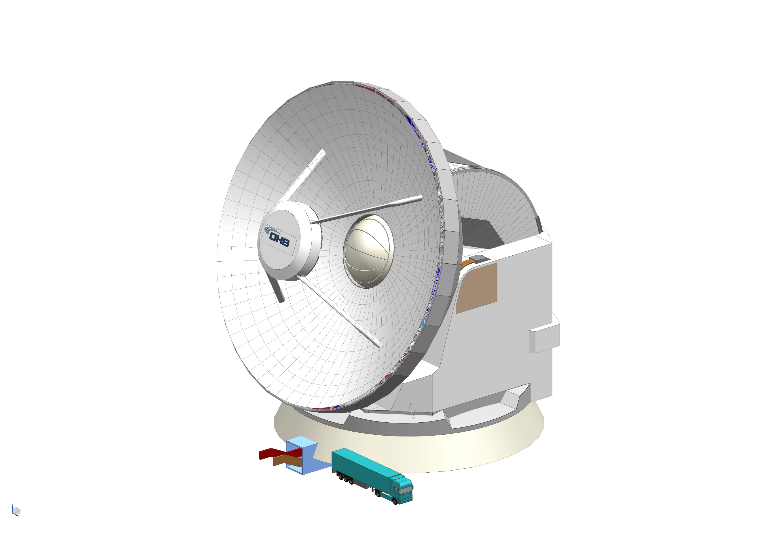
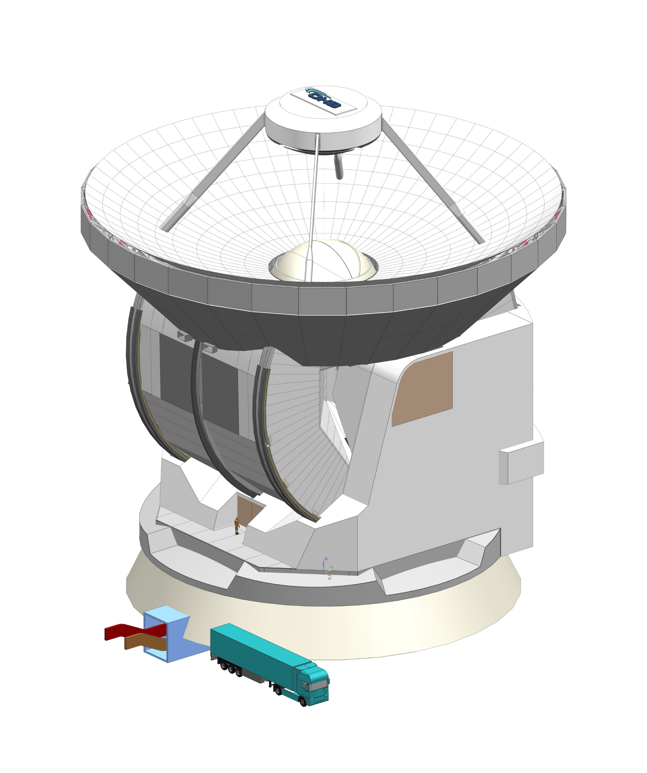
Design Overview
Exposed Rocking Chair Design
Min elevation = 20 deg
Max elevation= 90 deg
12m secondary
50m primary
Full cladding
Apex shutter
Elevation Structure (“wheel”)
Instrument and access portals
Azimuth Structure
Facility tunnel
Foundation
Mroczkowski et al. 2025 (A&A 694A, 142)

Slide 10
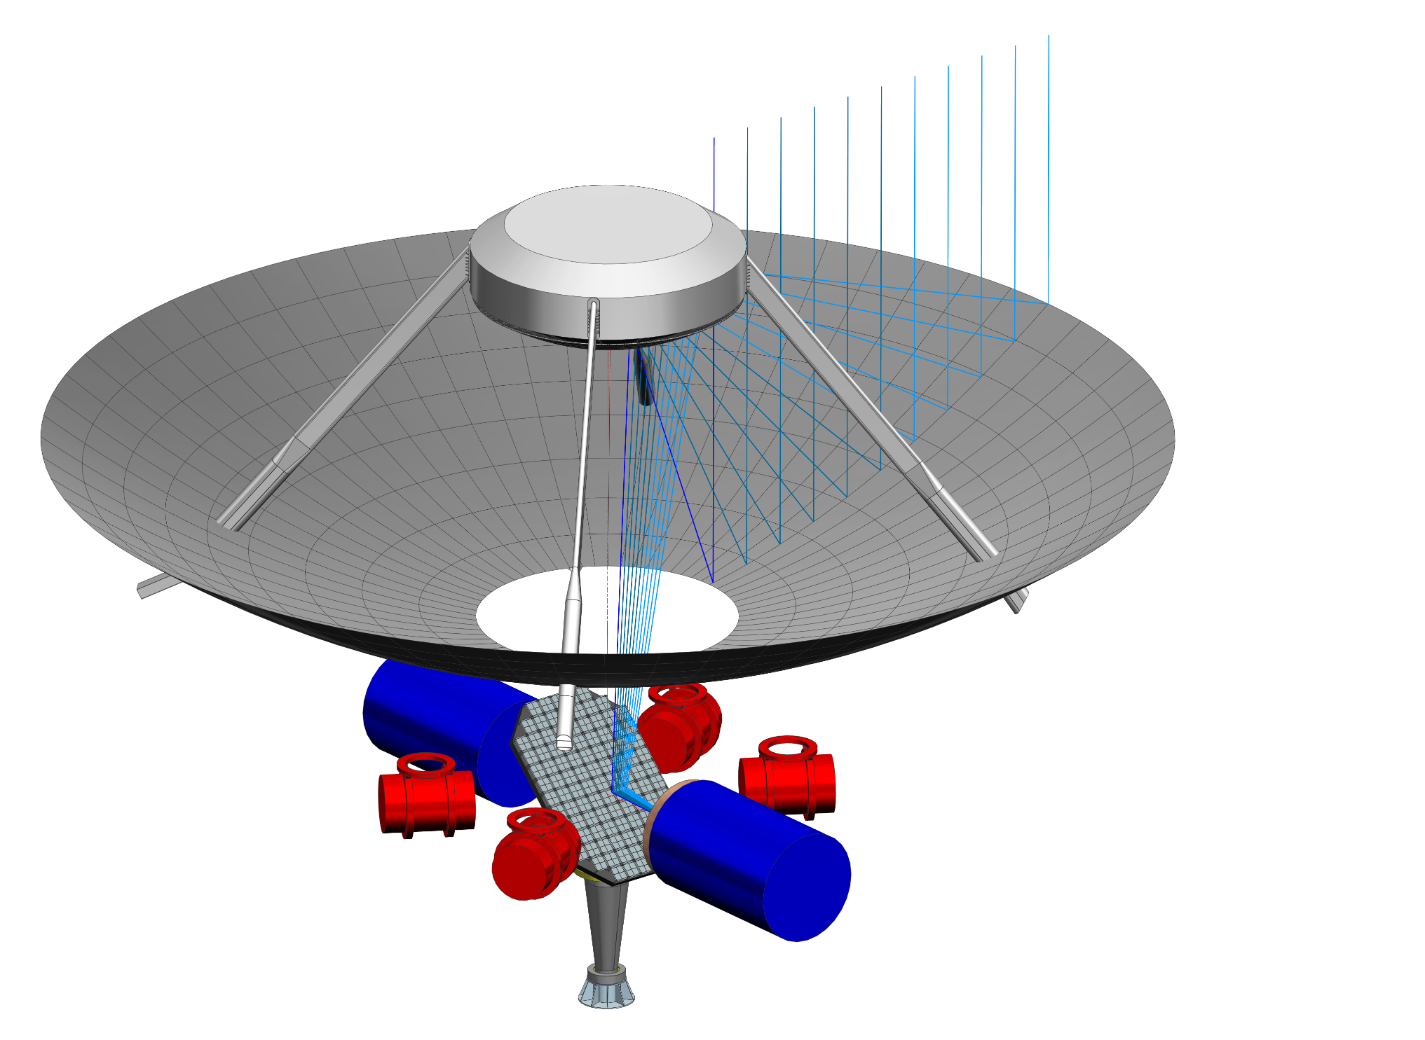
Large FOV and Multiple instruments
Optical Design, unprecedented receiver cabin space
Optical design by R. Hills (see AtLAST memo 1)
12m
M2
M1
Nasmyth Instruments
Envelopes:
L = 8m, D = 5m
30 tons (each)
Elevation Axis
50m
M3
8x6m
5m
Cassegrain Instruments Envelopes:
L = 4m, D = 2.6m,10 tons (each)
More details about AtLAST optics:
SPIE Paper 13094-84 by Patricio Gallardo: Optical design for AtLAST
SPIE Paper 13094-130 by Roberto Puddu: Physical optics characterization…

Slide 11
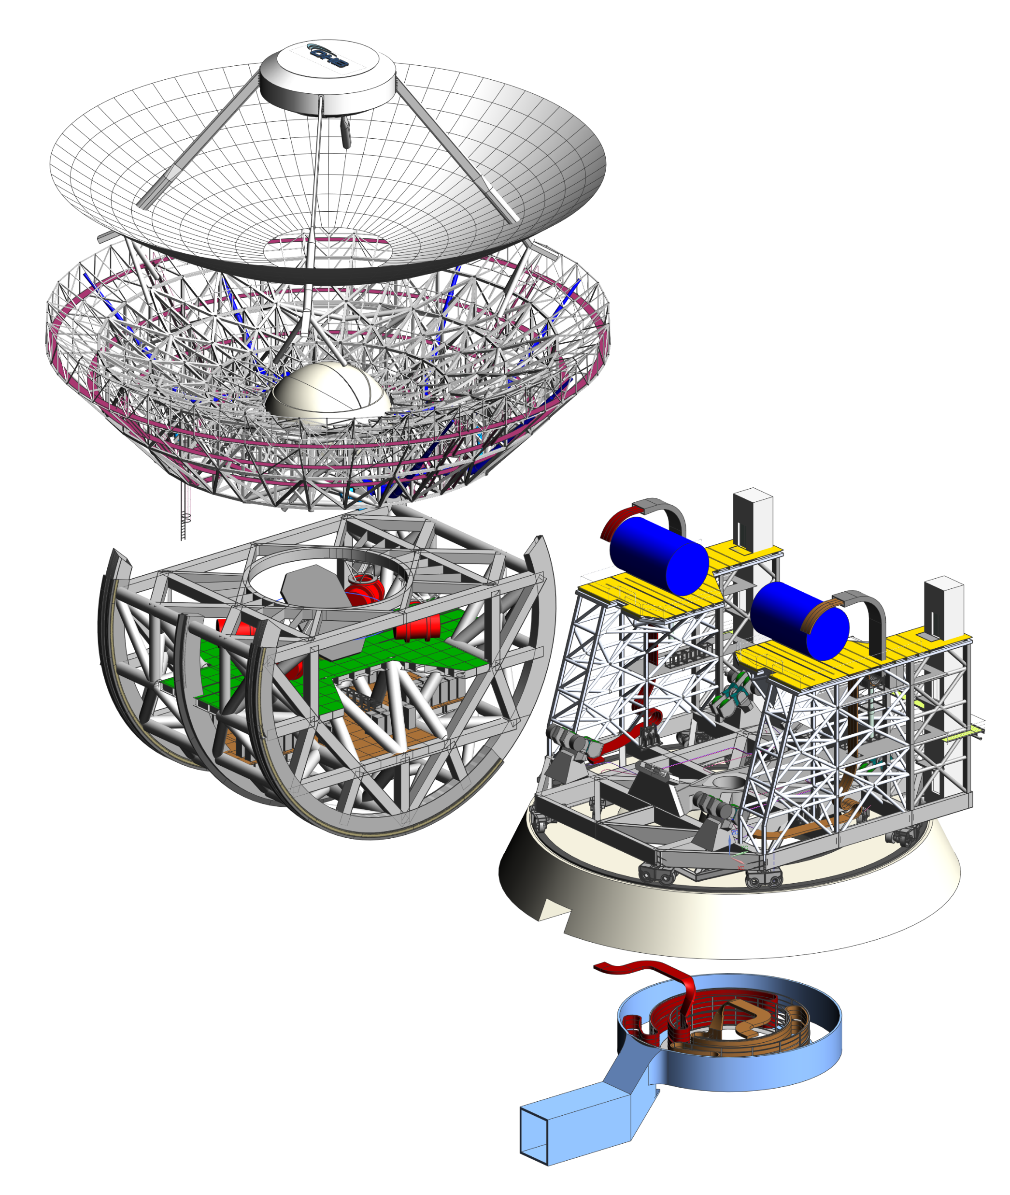
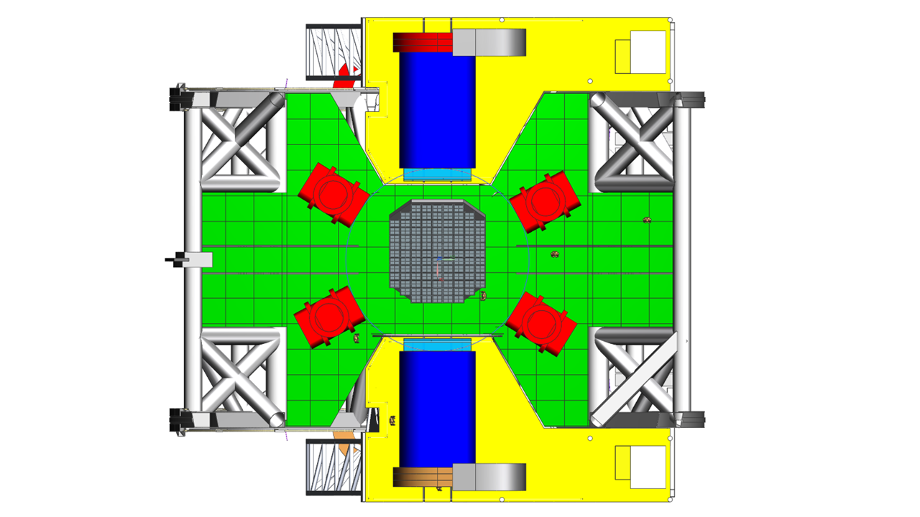
Design Overview
Concept CAD Model
12m secondary with carbon fiber structure
50m active primary mirror
2 Nasmyth Instruments
Azimuth structure with Nasmyth instruments
Rotating Flat 8m tertiary
Steel back up structure with ventilation
Elevation Wheel with instrument room
12 azimuthal bogies on 2 nested tracks
Azimuthal cable wrap
4 Cassegrain Instruments (co-rotating in elevation)
Elevators

Slide 12
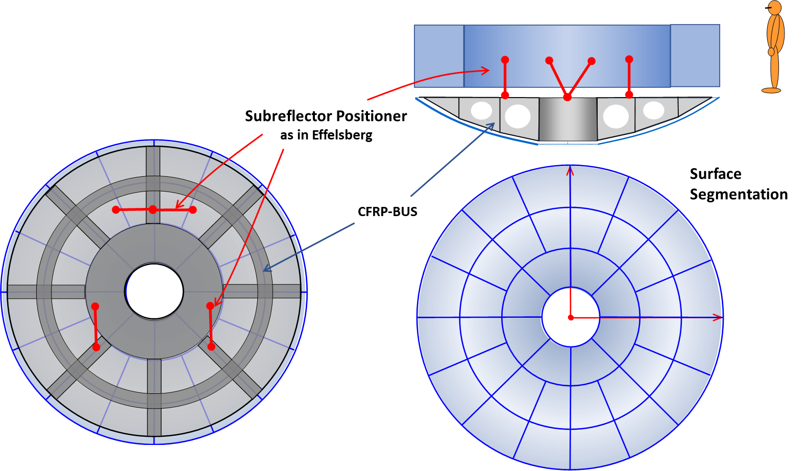
Design Overview
Secondary Reflector
Passive M2 (no active surface error compensation)

Slide 13
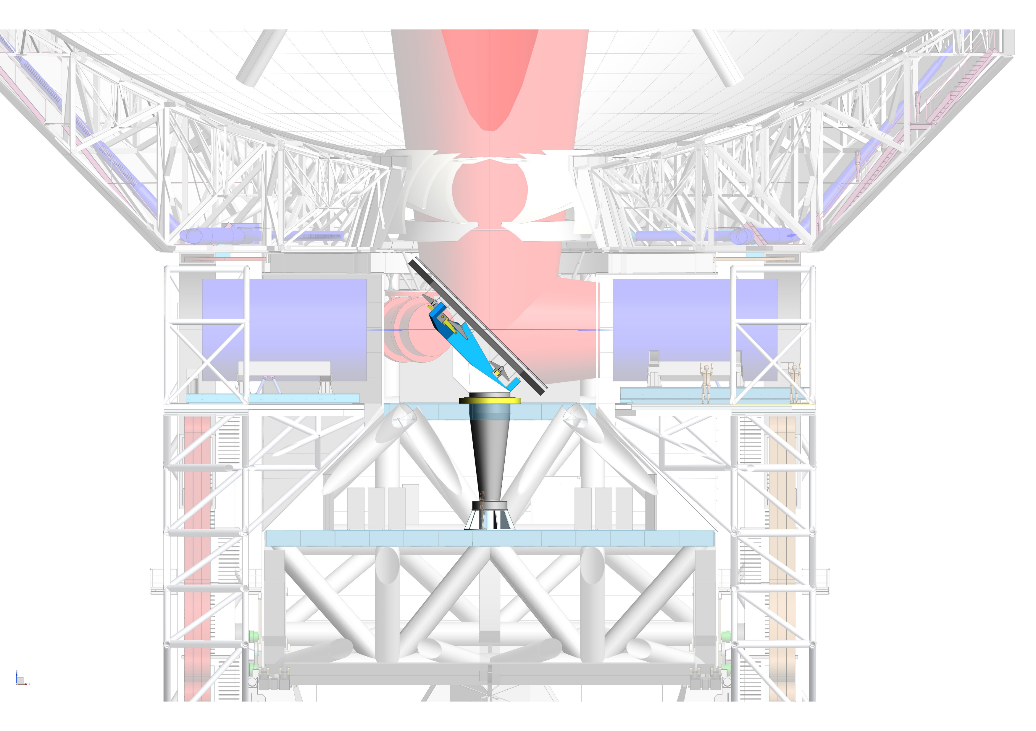
Design Overview
Tertiary Mirror
Flat M3 with aluminum tiles
Isostatic mounting
Rotation mechanism
Notes:
Access by ladders from operational floor
Catwalks for maintenance of Apex Shutter, actuators, HVAC system
Apex shutter
Spherical shape fits best (11m)
Watermanagement: Tub collects
Gore-Tex film: enviromental protaction, and

Slide 14
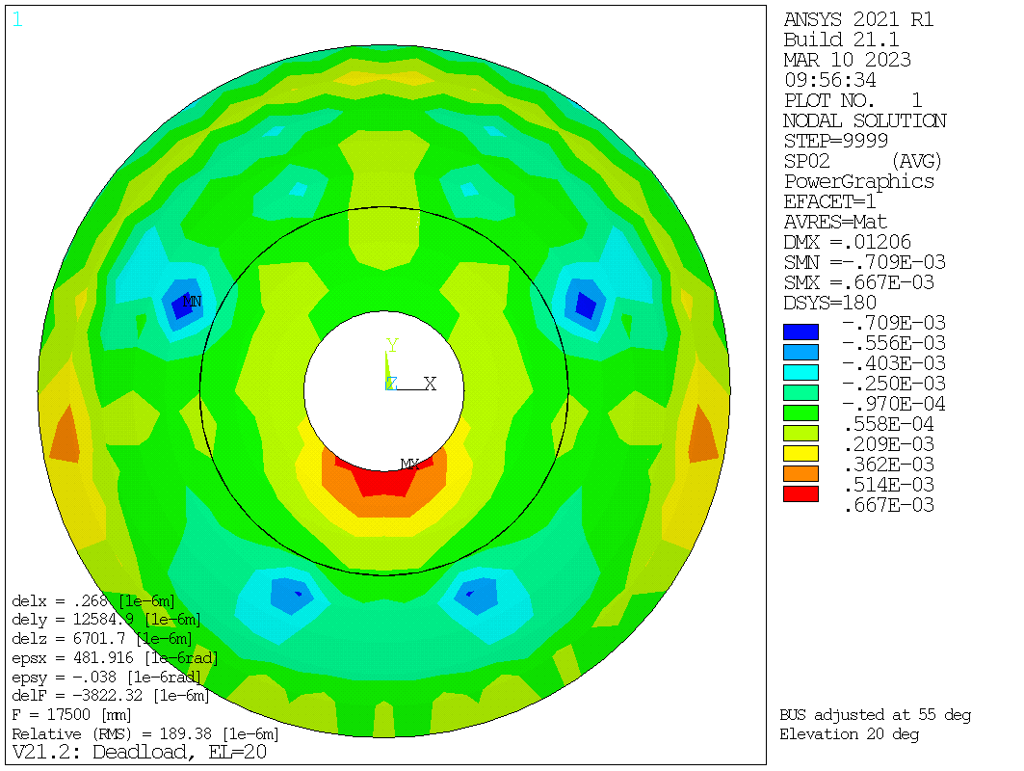
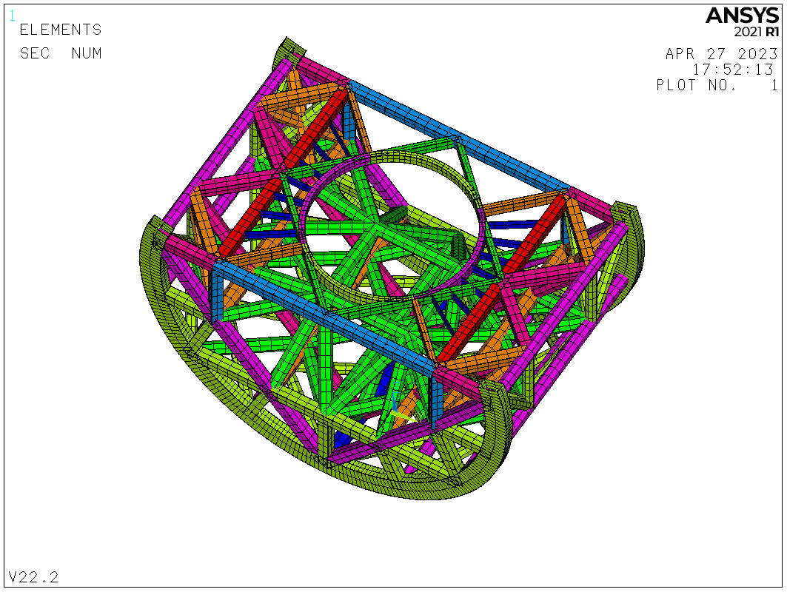
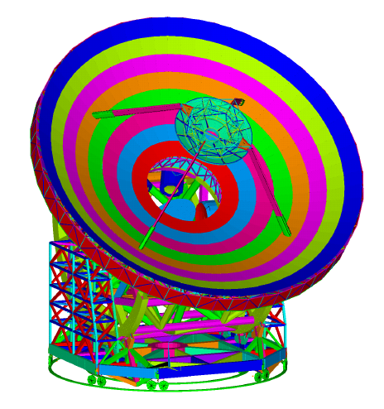
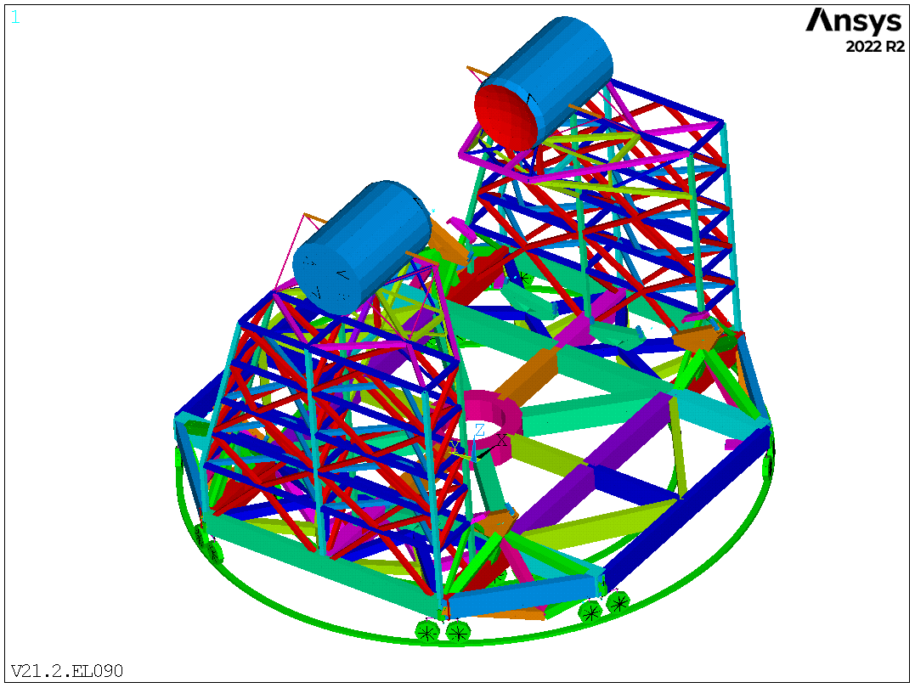
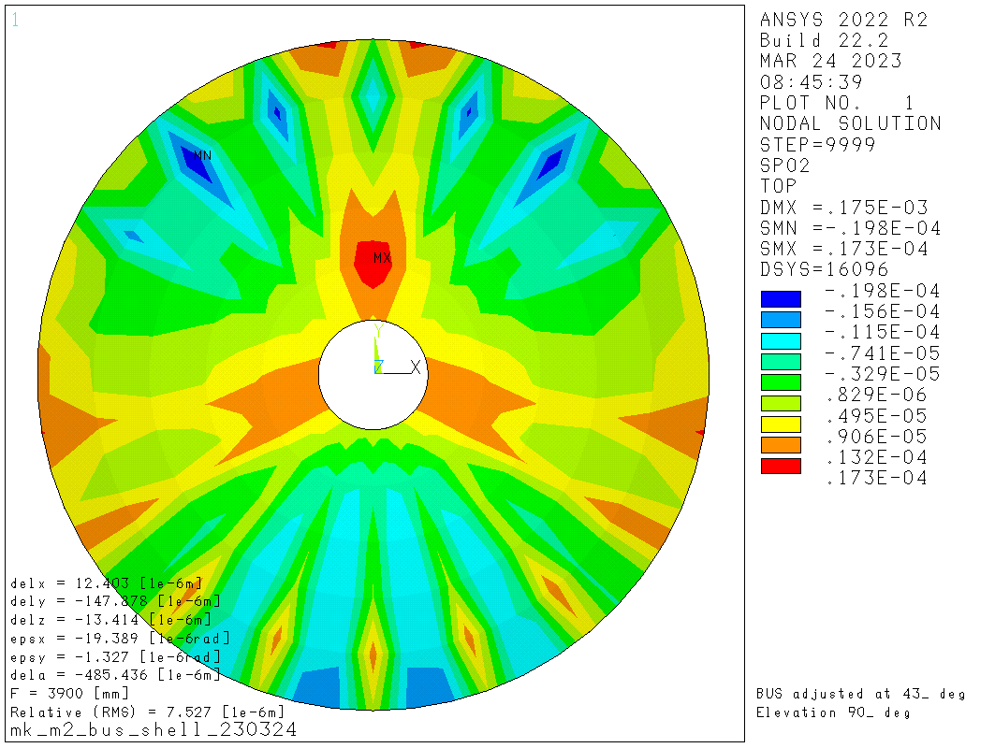
Verification with Finite Element Modelling
Static Load Cases in Overall model
Example surface plots
M1 Requirement < 200 µm rms under gravity
without active surface
Elevation wheel structure
189.4 µm rms @EL=90°
M2 Requirement < 10 µm rms under gravity
7.5 µm rms @EL=90°
Note: gravity is reproducible
and correctable (e.g. GBT 100-m)

Slide 15
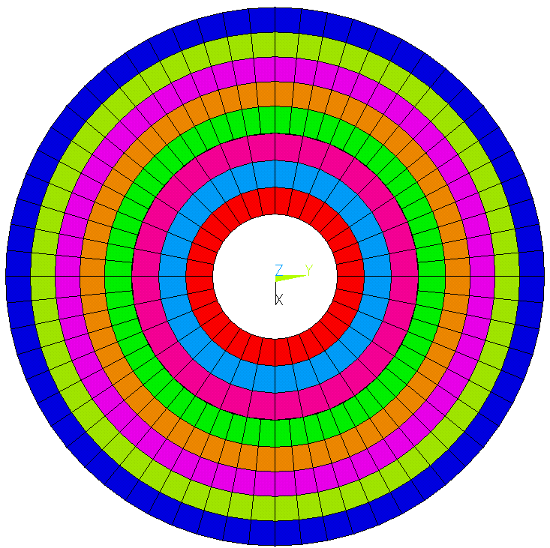
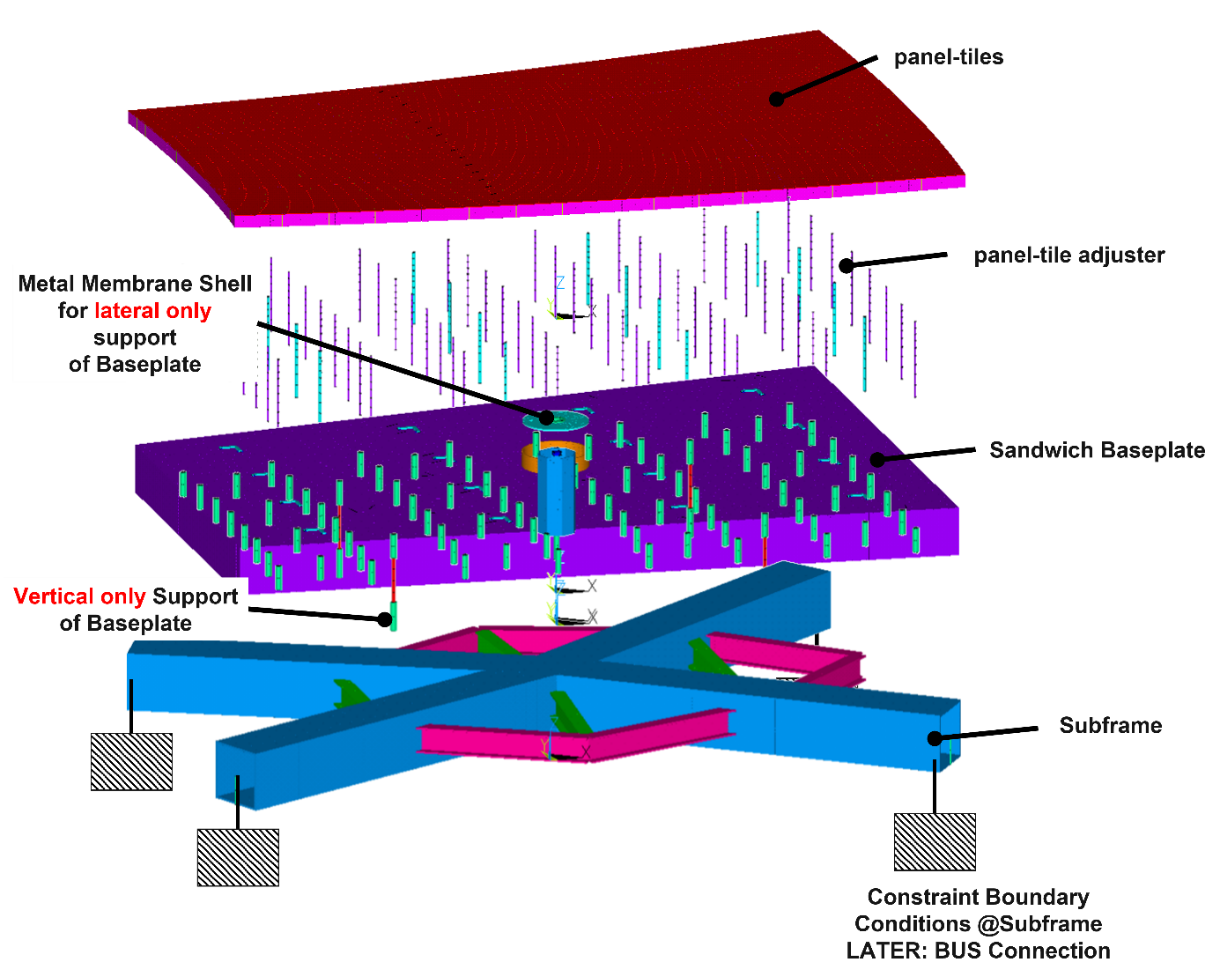
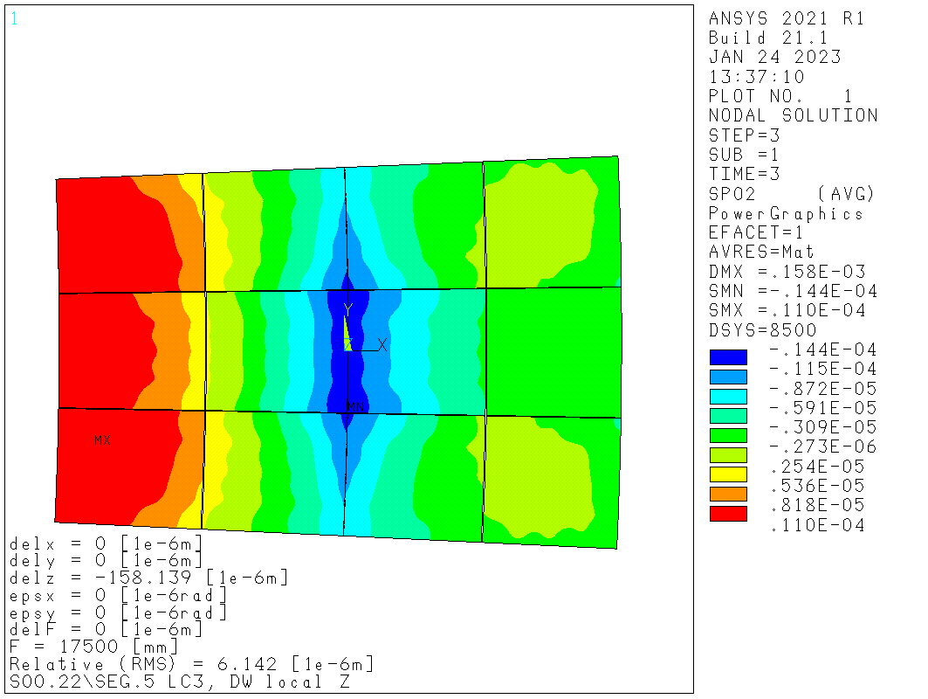
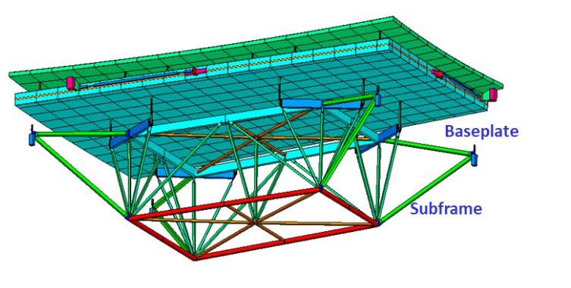
Verification with Finite Element Model
Active Main reflector Segments
416 panel segments
simplified FE panel segment model
Requirement < 8 µm rms under gravity
6.1 µm rms @EL=90° (exemplary)
Inspiration LMT
Notes:
5323 tiles
Maximum decoupled from deformation,

Slide 16
Metrology System
Study of different approaches
Alternative A
Alternative B
Alternative C
M1 Shape Control via Etalons (laser metrology)
M2 Position Control Etalons
M1 Shape Control via Depth Sensors on thermal stable substructure
M2 Position Control e.g. via Etalons
Overall Wavefront Control via
Microwave Interferometer in beam path (demonstrated on Nobeyama 45-m; see Tamura et al. 2022)

Slide 17
Surface accuracy vs atmospheric transmission
Plotted in blue: dish efficiency for 20 and 30 micron (night and daytime) RMS surface errors.
Black and grey curves show the median and top quartile transmission.
Surface accuracy will not be the limiting factor for high frequency observations.

Slide 18
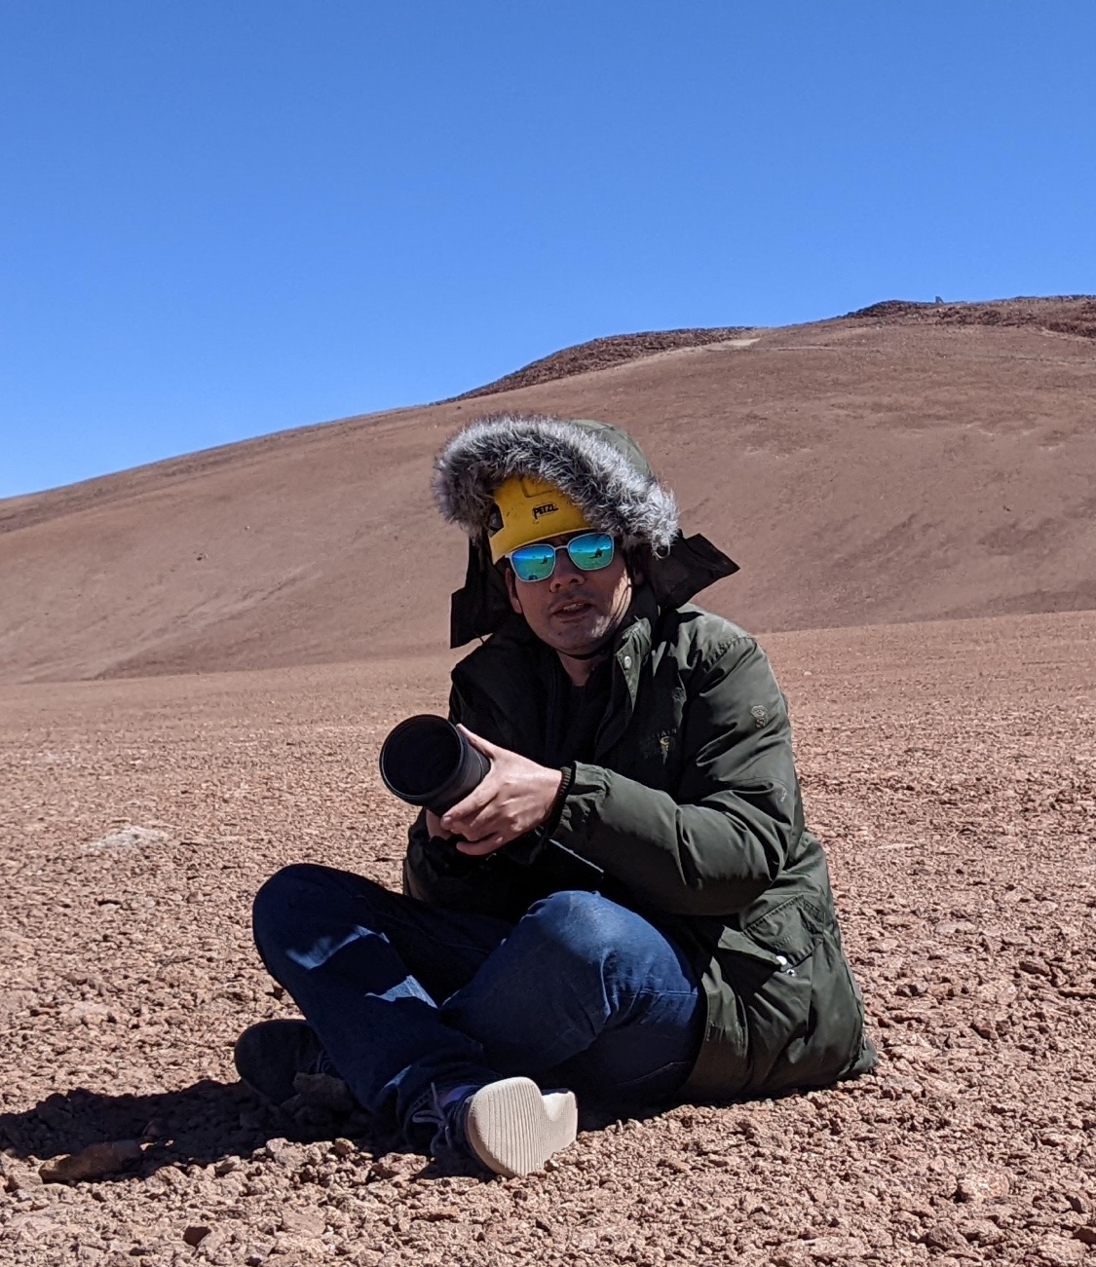
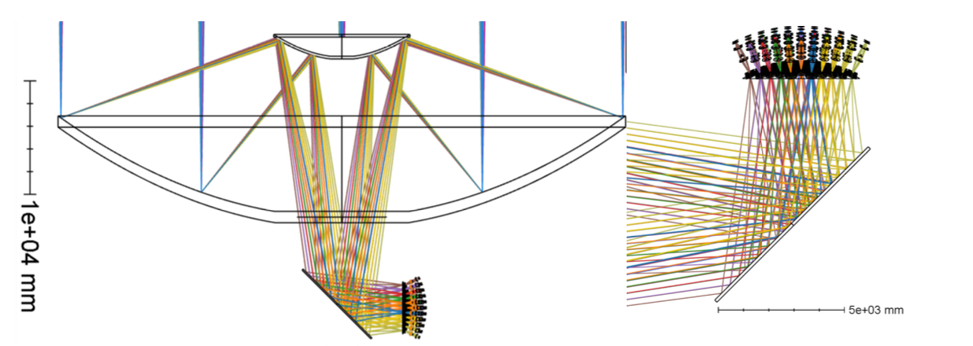
AtLAST Optics and Corrections in the receivers
Focal plane has large size (D=4.7m) and significant curvature but camera size is only a modest (~x2 diameter) scale up from that planned for CMB-S4
Diffraction-limited FoV delivered by telescope is ~0.45 deg at 0.45mm and ~1.4deg at 4mm
Correction of aberrations in instruments will greatly increase the DLFoV values
Lower image shows concept for breaking up the focal plane with 85 cameras (like CMB-S4).
AtLAST beams and corrections, provided by Patricio Gallardo (upper left).
The above plot shows the diffraction-limited field of view before corrections in the instrument.
Notes:
Important point: we will need corrections in the receivers.

Slide 19
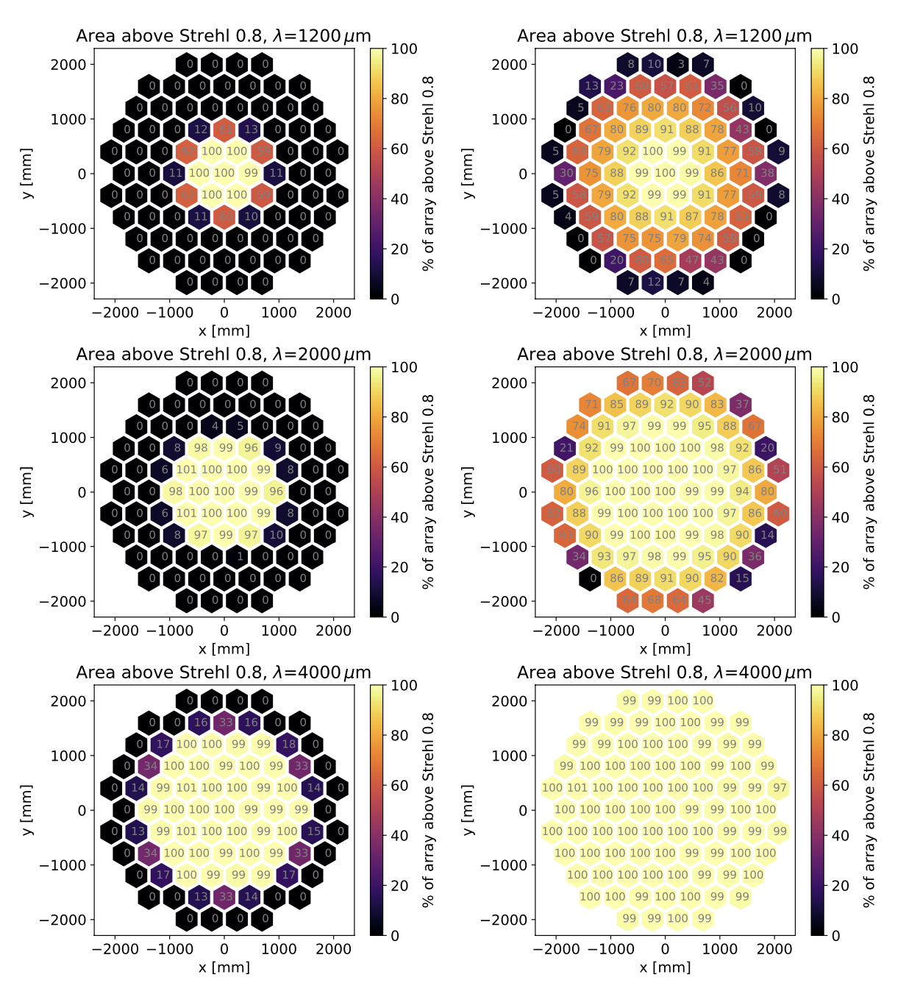
Optical corrections
Gallardo et al. 2024 (arXiv: 2406.11502)
With a huge (4.7 meter) focal surface, the idea is to break it up into modular cameras. Each camera then has corrective optics to recover a large field of view.
Lower frequencies (<300 GHz) are shown on right. Left column is uncorrected; right column is corrected.
Notes:
These corrections are standard, see the CCAT-prime, Simons Observatory, and CMB-S4 designs for example.

Slide 20
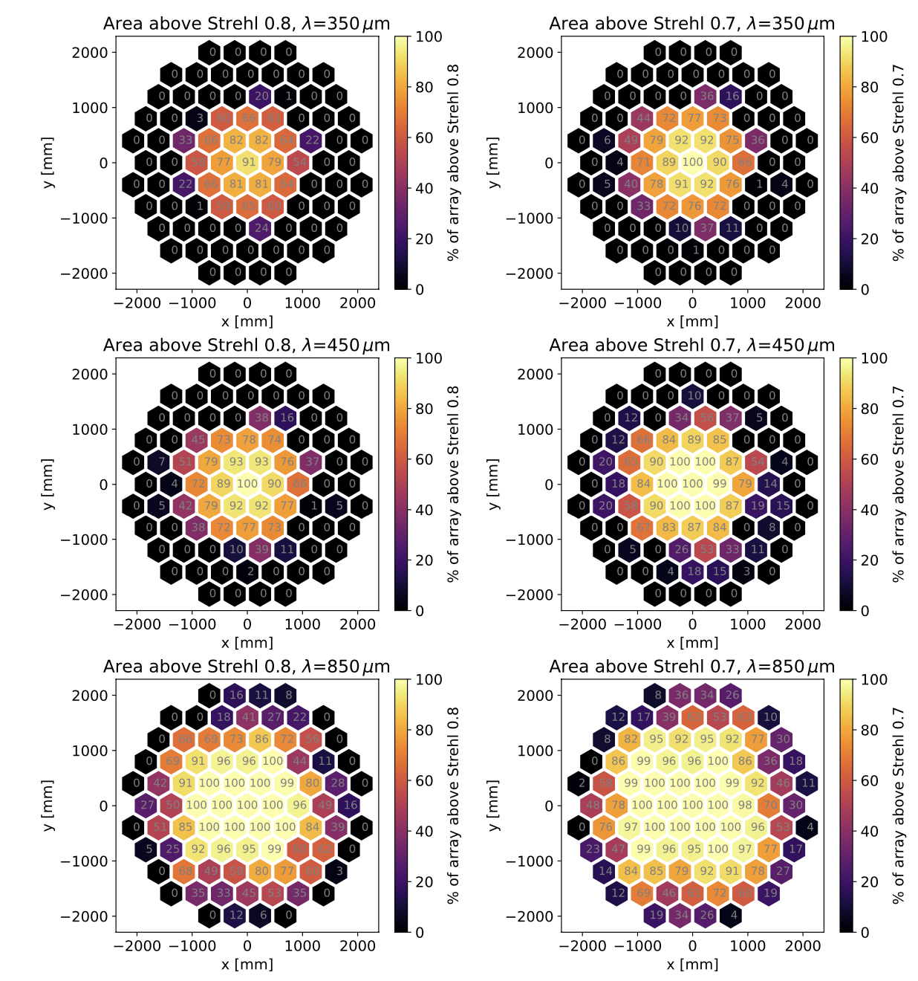
Optical corrections
Higher frequencies (>300 GHz) are shown on right. Left column corrected and diffraction-limit (Strehl=0.8).
The right column relaxes the requirement for diffraction limited optics (Strehl=0.7).
Gallardo et al. 2024 noted that this is for 3 lenses, and that additional optimization using 4 lenses can improve this.

Slide 21
AtLAST Beam properties
Puddu et al. 2024 (arXiv:2406.16602) carried out extensive physical optics calculations.
Simulating a 50-meter up to 950 GHz took some clever tricks in TICRA/GRASP to make it manageable.
Showing 900 GHz case (worst)
Ideal case
With panel gaps

Slide 22
AtLAST Beam properties
Puddu et al. 2024 (arXiv:2406.16602) carried out extensive physical optics calculations.
Simulating a 50-meter up to 950 GHz took some clever tricks in TICRA/GRASP to make it manageable.
Showing 900 GHz case (worst)
Ideal case
With struts

Slide 23
AtLAST Beam properties
Puddu et al. 2024 (arXiv:2406.16602) carried out extensive physical optics calculations.
Simulating a 50-meter up to 950 GHz took some clever tricks in TICRA/GRASP to make it manageable.
Showing 900 GHz case (worst)
Ideal case
With 20 micron Ruze Scattering

Slide 24
AtLAST Beam properties: overall profile
Puddu et al. 2024 (arXiv:2406.16602) carried out extensive physical optics calculations.
Simulating a 50-meter up to 950 GHz took some clever tricks in TICRA/GRASP to make it manageable.
Showing 900 GHz case (worst)

Slide 25
So what now?
AtLAST2 (https://cordis.europa.eu/project/id/101188037) is underway!
Continuation of the design work from original AtLAST design study is now 2 work packages:
  one focusing on instrumentation and (semi-independent) reviews (WP2)
  the other focusing on the design, prototyping, and overall engineering readiness (WP3)
We encourage instrument builders to join and help inform the instrumentation concepts that will achieve AtLAST’s next-generation science goals.
At the same time, we encourage astronomers, astrophysicists, cosmologists, planetary scientists, and solar physicists (and more?) to get involved in further defining the science cases.

Slide 26
first-light/first-gen instrumentation concepts
Spectroscopic receivers
Continuum detectors
First and second generation outlined in van Kampen et al. AtLAST memo #4 outlined 3-6 bands with 30-300k detectors in first generations.
“AtLAST Cam”: a multi-chroic continuum camera comprising ~0.5 million detectors likely covering 9 bands and using kinetic inductance detectors (KIDs).
Multi-chroic solar imager (see Mats Kirkaune’s poster).
Below: a compilation of submm detector counts vs year using a variety of technologies. Extrapolation suggests 0.5 megapixel cameras in mid-2030s, and gigapixels by 2060 (e.g. a fully populated IFU spectro-imager).
A 1000-pixels heterodyne focal plane array providing high spectral resolution dv < 1 km/s. Pixels can be deployed in many ways: from a single-band, uniformly filled FoV (maximising mapping speed) or smaller arrays covering multiple bands
A direct-detection, ultra-wide bandwidth integral field unit (IFU), with R~300-1000, effective receiver noise temperature comparable to quantum noise limit.
Single-beam, multi-frequency receiver for mmVLBI (EHT)
A multi-object spectrograph (MOS)?
Notes:
The important thing is that we need to link the science cases we have to instrument requirements, then proceed with concept designs.

Slide 27
First steps for defining instruments
We now have multiple tools for estimating sensitivity/mapping speed:
Sean Bryan’s early tools:
  Bolometer/KID sensitivity calculator: https://github.com/atlast-telescope/sens_calc
  Direct-detection spectrometer sensitivity calculator: https://github.com/atlast-telescope/sens_calc_spec
AtLAST (single-beam) heterodyne sensitivity calculator: https://www.atlast-telescope.org/sensitivity-calculator/
maria mock observations (mainly continuum KIDs/bolometers): https://thomaswmorris.com/maria/
gateau (the GPU-Accelerated Time-dEpendent observAtion simUlator): https://tifuun.github.io/gateau/

Slide 28
WP3: maturing the Metrology System
Study of different approaches
Alternative A
Alternative B
Alternative C
M1 Shape Control via Etalons (laser metrology)
M2 Position Control Etalons
M1 Shape Control via Depth Sensors on thermal stable substructure
M2 Position Control e.g. via Etalons
Overall Wavefront Control via
Microwave Interferometer in beam path (demonstrated on Nobeyama 45-m; see Tamura et al. 2022)

Slide 29
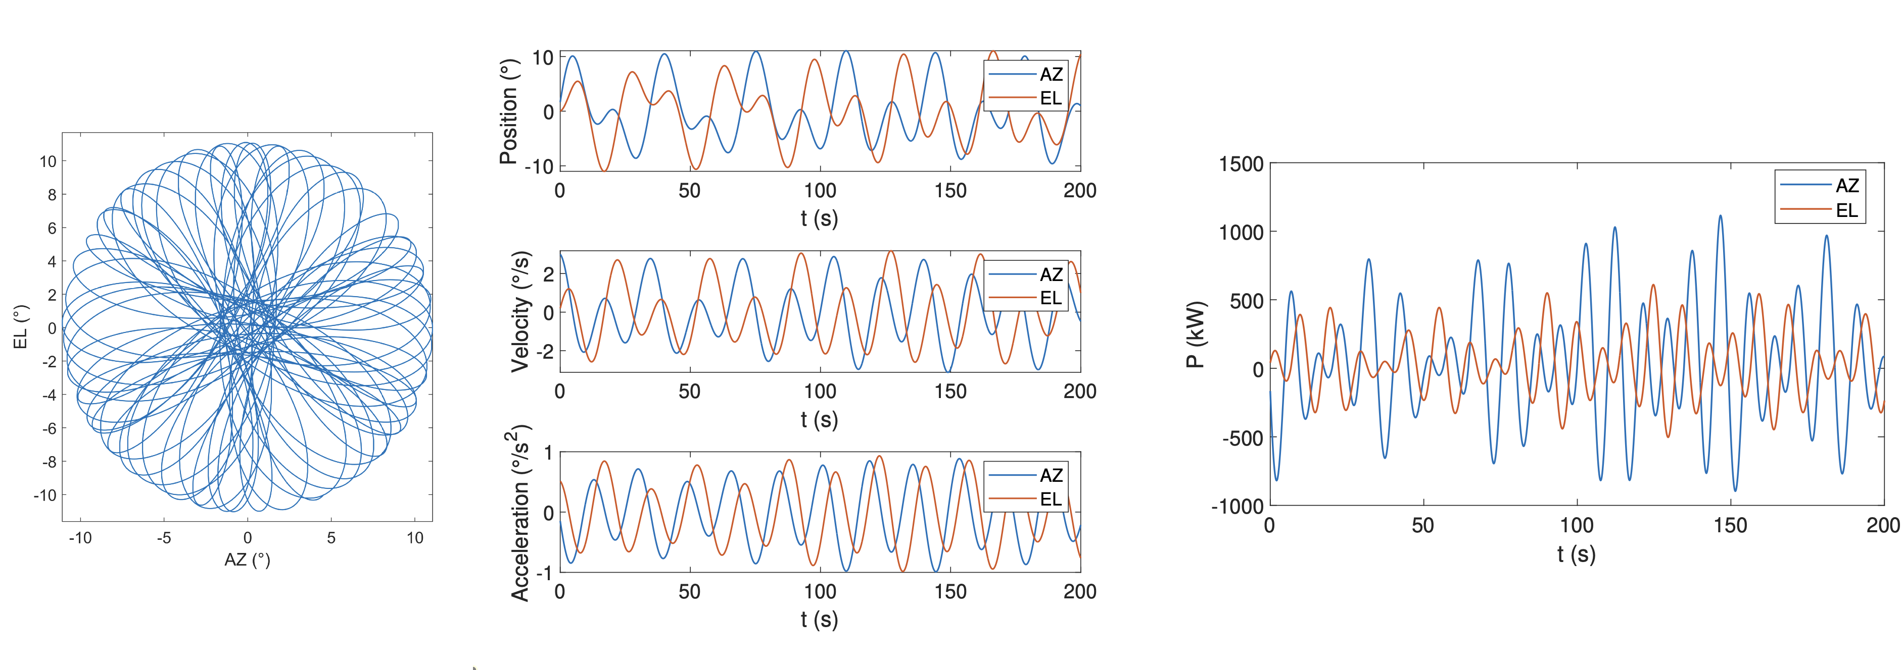
Energy use when scanning
fast Lissajous Daisy scan, motion, and power use
See Kiselev et al. (2024SPIE13094E..0EK)

Slide 30
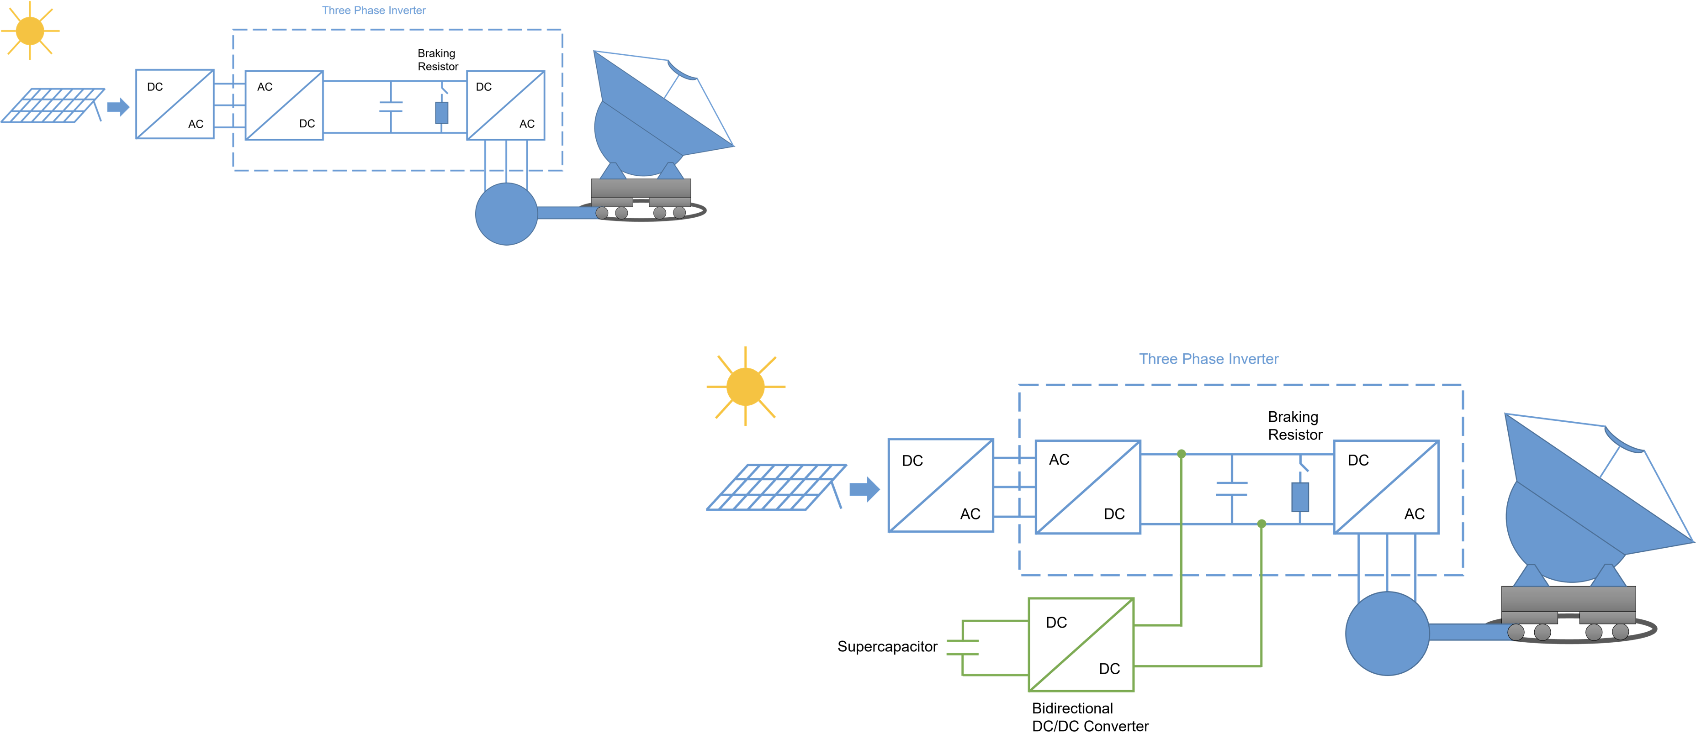
WP3 + WP7: braking energy recovery system
fast Lissajous Daisy scan, motion, and power use
A simple modification to the standard drives can recover >80% of the kinetic energy normally dissipated in braking!
By pre-charging the supercapacitors, our system also offers power shaving capabilities.
See Kiselev et al. (2024SPIE13094E..0EK)

Slide 31
Thanks!

Slide 32
Summary of Technical Specifications and Instrument concepts for AtLAST
Summary of Instrumentation:
First light / first generation concepts (see AtLAST Science Cases):
  Multi-band continuum receivers with >120k detectors spanning 90-950 GHz.
  Heterodyne receiver focal plane arrays with ~1000 feeds and spectral resolution R~10⁶ (< 1 km/s). Science cases will determine bands, though likely 70-116 GHz, 200-400 GHz, 580-720 GHz, and 850-950 GHz with ≥32 GHz instantaneous bandwidth.
  Direct-detection spectrometers (R~300-1000) covering e.g. 200-400 GHz instantaneous bandwidth for extragalactic tomography and cosmology through intensity mapping.
  Single beam, multi-band receivers for mmVLBI and EHT campaigns.
Entire volume behind primary will house instrumentation, electronics, and support equipment.
6 instrument bays: the 4 smaller instruments will be Cassegrain-mounted and can be up to 10 tons and up to 2.6 meters in diameter (red in figure below).
The 2 larger instruments will be Nasmyth-mounted (blue, below) and up to 30 tons and up to 5 meters in diameter (i.e. 5 times larger than the biggest receivers now fielded).
Parameter | Value
Wavelength (λ) range | 0.3 -10 mm
Primary mirror (M1) diameter | 50 m
Secondary mirror (M2) diameter | 12 m
Field of view (FoV) | 2°(1°)
Number of instrument mount points | 6
Optical design | Ritchey-Chrétien
Night(Day)-time half wavefront error | 20 (30) μm
Mechanical pointing accuracy | 2.5 arcsec
Astronomically-corrected pointing | < 0.5 arcsec
Solar observations | Yes
Scan speed | 3°/s
Acceleration | 1°/s²
Elevation (EL) range | 20° to 90°
Azimuthal (AZ) range | + 270°
Mount type | AZ-EL
Site location | 22°58'52"S, 67°45'56"W
Site elevation | ≈5000 m
AtLAST technical specifications (see Mroczkowski et al. 2025). The 50-meter primary mirror yields a resolution of 1.5” at 350 μm and 10” at 2 mm. Fast scanning will allow recovery of large angular scales, ensuring high fidelity imaging (see van Marrewijk et al. 2024). Mechanical pointing accuracy is before any astronomical pointing model corrections.

