Slide 1
Shaping together the next generation submm observatory
Evanthia Hatziminaoglou (IAC / ESO)

Slide 2

Astronomy in the (sub)mm
~50% of light in the Universe emitted in FIR/submm bands ➛ direct access to tracers of cold gas and dust (raw material for star formation)
Formation of stars and planetary systems
Baryon cycle (gas and dust from ISM to IGM scales)
Early, obscured assembly of galaxies and galaxy clusters
Submm (APEX 870 μm + Planck)
Infrared (Spitzer)
Near Infrared (VISTA)
Optical (S. Guisard)
Csengeri+16, Schuller+09

Slide 3
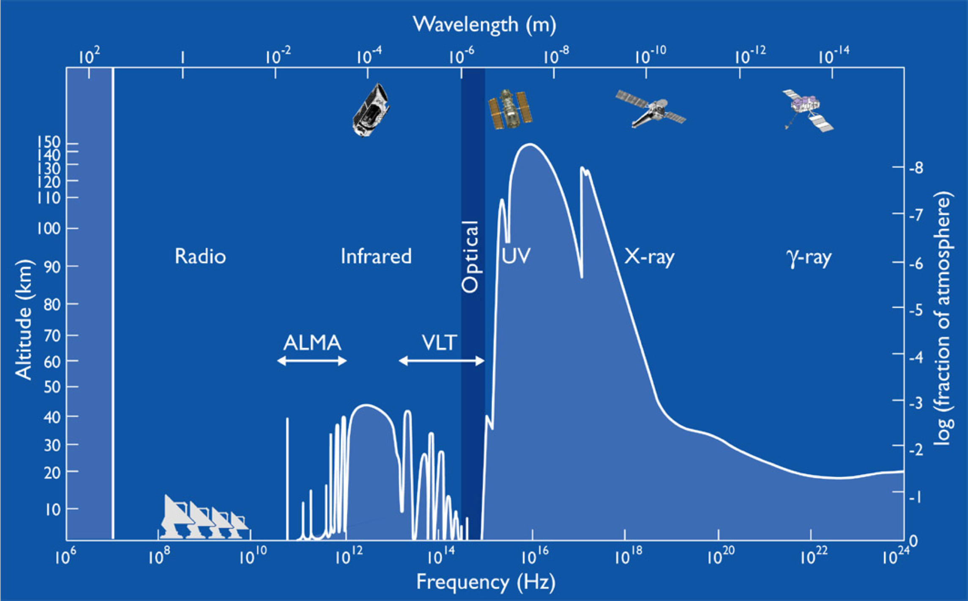
Astronomy in the (sub)mm
100 − 1000 GHz = 3−0.3 mm

Slide 4

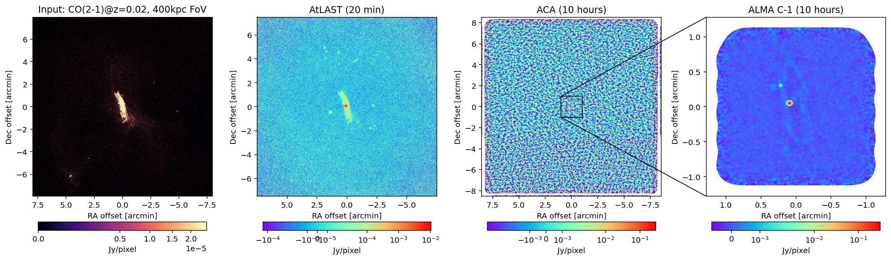
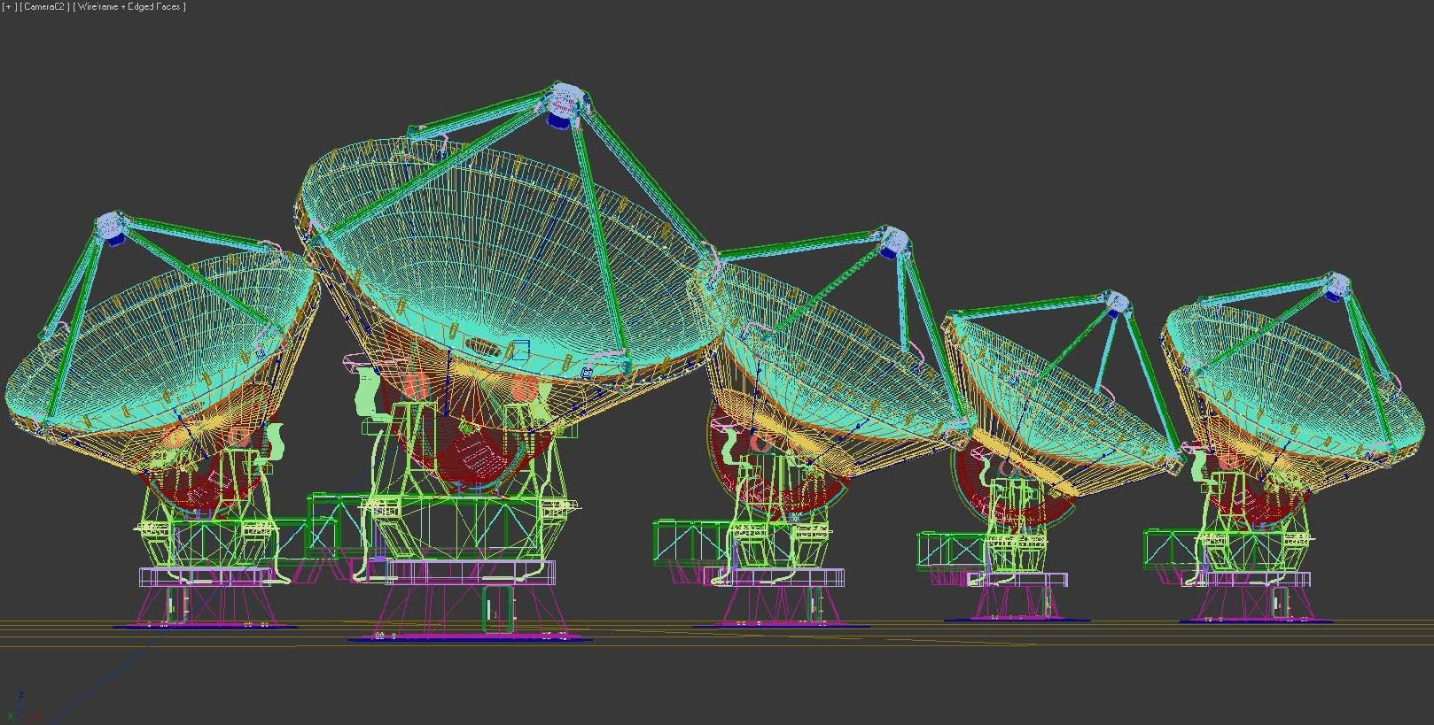
Single dishes or interferometers?
Angular resolution of an array: ~λ/Bmax
Field of view of an array: ~λ/D
Maximum angular scale: ~ λ/Bmin; a source is resolved if its angular size is > λ/Bmin
Interferometer sensitive to angular sizes λ/Bmax < θ < λ/Bmin
Interferometers not sensitive to angular scales larger than λ/Bmin, cannot recover total flux of resolved sources; the problem of the "missing flux"
maria simulator, created by C. Cicone
Bmax
Bmin

Slide 5
Single dishes or interferometers?
Interferometers are powerful follow-up machines but optimised to deliver high resolution images and narrow-band spectroscopy of individual targets or small (~ few 10″ to ~ a few ′ wide) fields
(sub-)mm interferometers have a small FoV ➛ mapping of large areas very costly
New sources (positions and redshifts) unlocked almost exclusively through single-dish observations
Single dishes crucial to test new instrumentation
Without a new large submm single dish we will be following up the submm source population that was discovered 10-20 years ago with current generation of 10m class single dishes.
Without a large single-dish facility interferometers will reach a “source-starving” regime

Slide 6
Single dishes or interferometers?
BOTH!

Slide 7
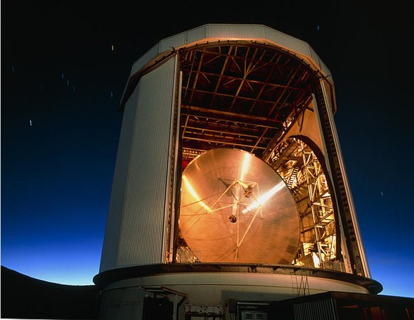
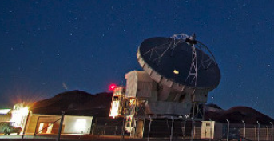


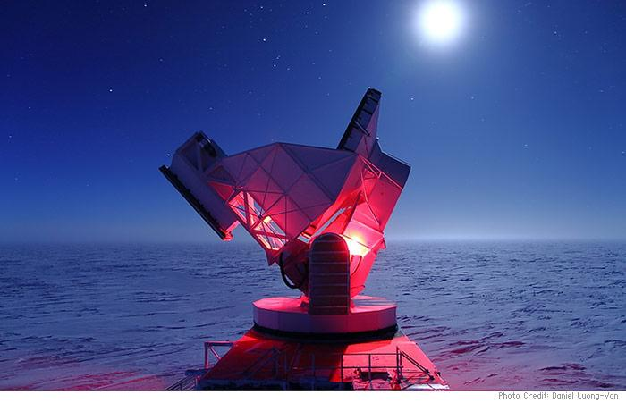

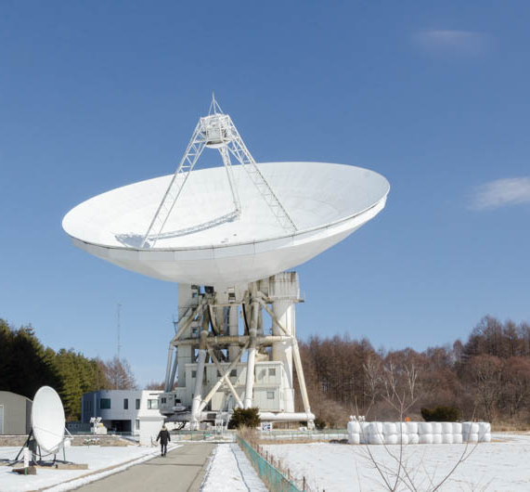
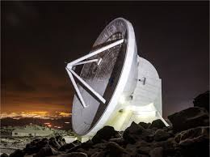

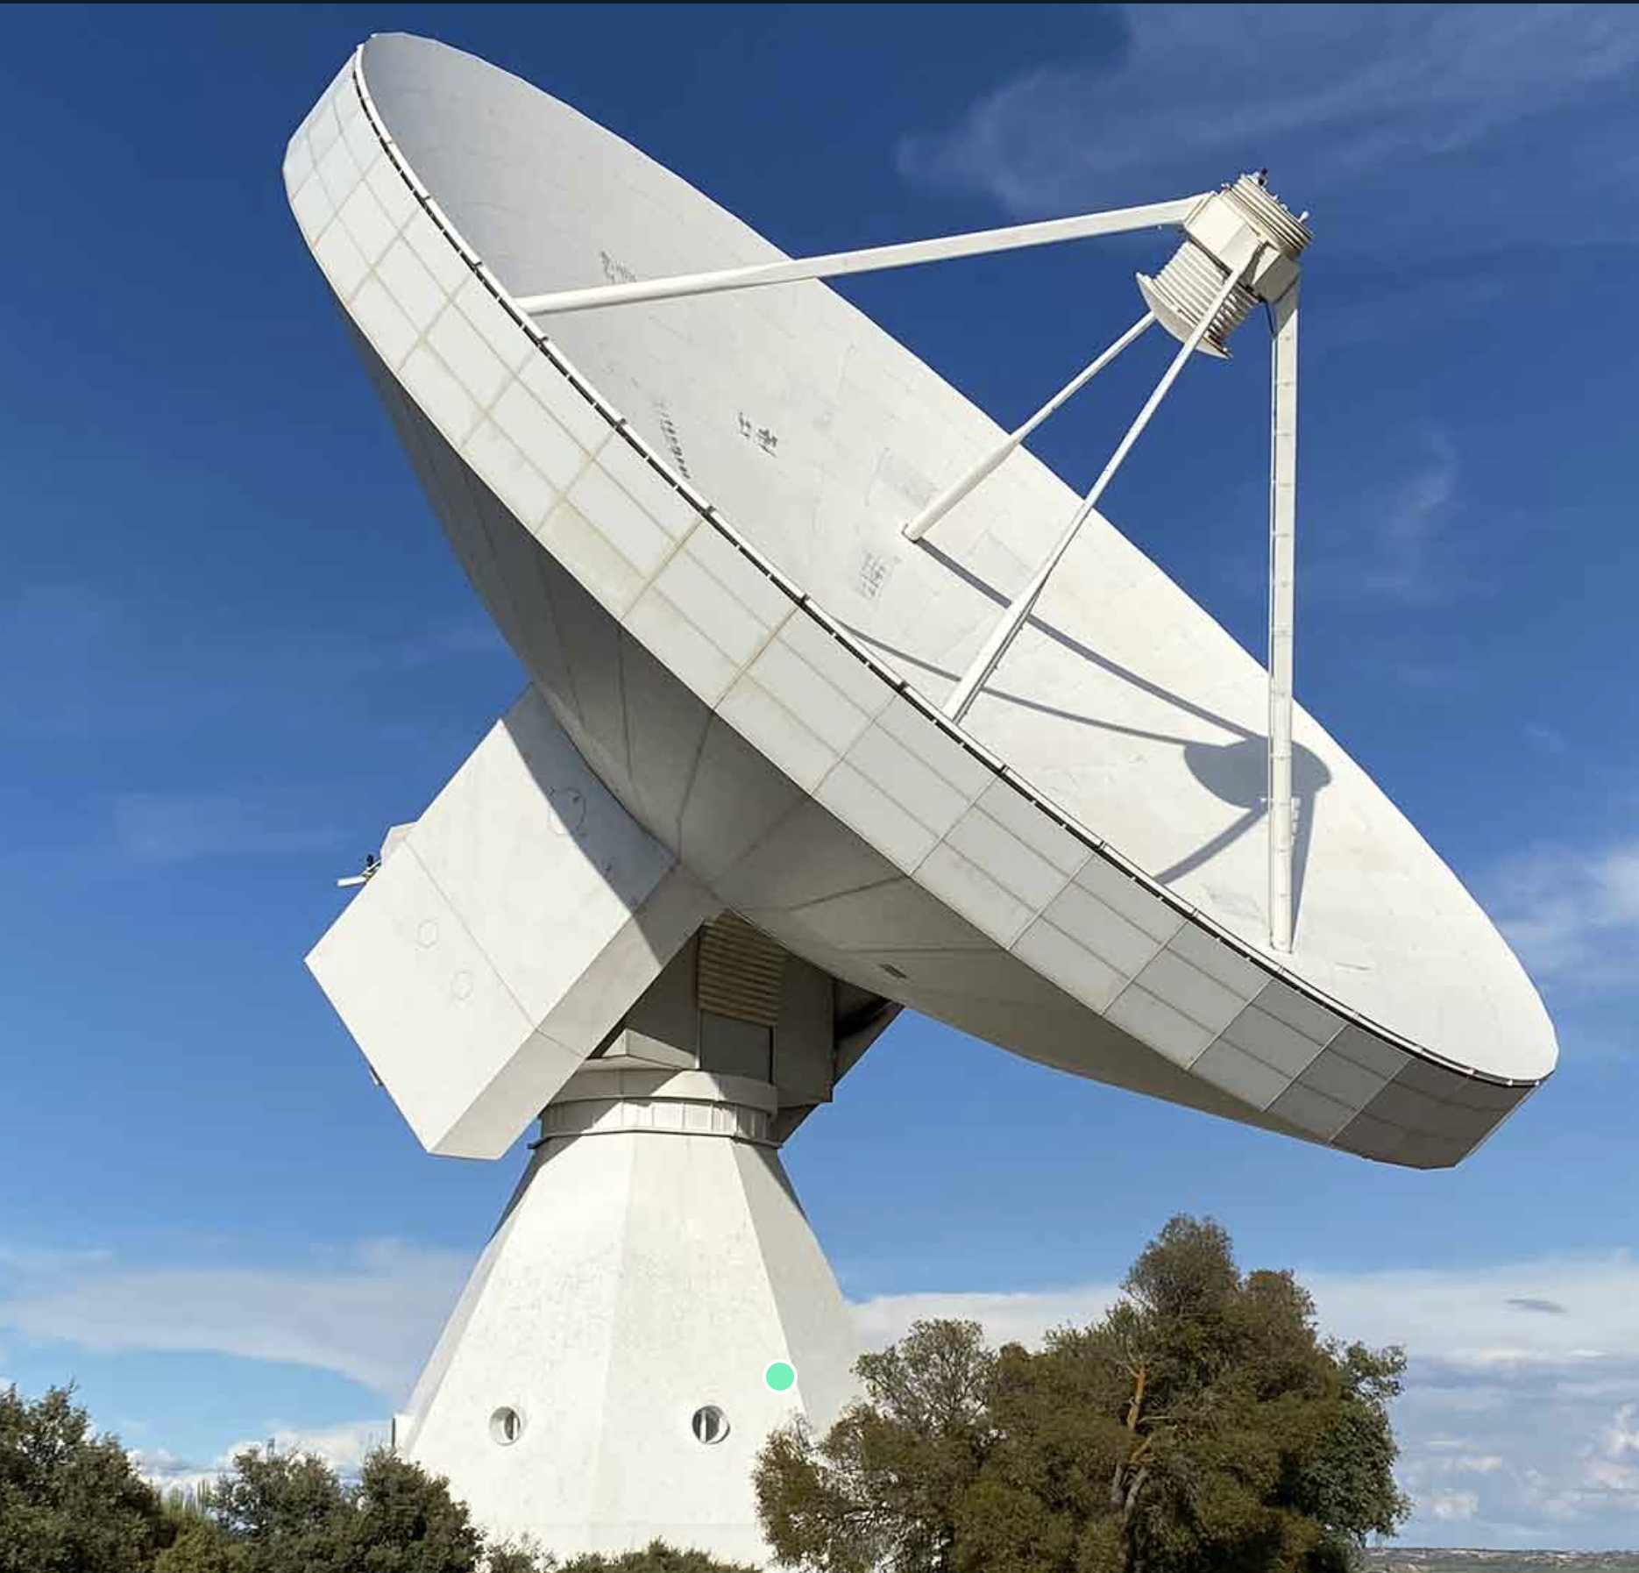
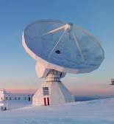
Existing single-dish facilities
JCMT (Hawaii)
APEX (Chile)
Atacama Pathfinder EXperiment
5100m, Chajnantor Plateau
12m diameter, a suite of facility and PI instruments, (sub)mm
Since 2005
MPG
James Clerk Maxwell Telescope
4092m, Mauna Kea
15m diameter, 0.4 - 1.4mm, SCUBA(2)
Since 1987
Currently EAO (UK/Canada/NL)
SPT (South Pole)
South Pole Telescope
2800m, Amundsen-Scott South Pole Station
10m diameter, microwave and mm
CMB, SZ
Since 2007
US
Nobeyama 45m
(Japan)
Nobeyama Radio Observatory
1350m, Minamimaki, Nagano
45m diameter, 3 - 300mm
Since 1982
NAOJ
LMT (Mexico)
Large Millimeter Telescope
4850m, Sierra Negra
50m diameter, 0.85 - 4mm, a couple of instruments
Since 2011
NAOE/UMass
IRAM 30m
(Spain)
Yebes
980m
40m diameter, 3.3mm - 9mm
Since 1975
IGN
Institut de Radioastronomie Millimetrique
2850m, Pico Veleta, Sierra Nevada
30m diameter, 0.9 - 3mm
Since 1984
IRAM (CNRS/MPG/IGN)

Slide 8
Existing single-dish facilities
Cannot observe beyond ~350 GHz ➛ limits spatial resolution
High frequencies necessary for
  Component separation of the thermal, relativistic, and kinetic Sunyaev-Zeldovich (SZ) effects
  Detection of high-J transition CO, [CI] and fine structure lines across a wide range of redshifts
  Constraining the dust SED of high-redshift galaxies
AtLAST will be the only telescope with large aperture that can reach frequencies > 400 GHz, enabling this type of studies

Slide 9
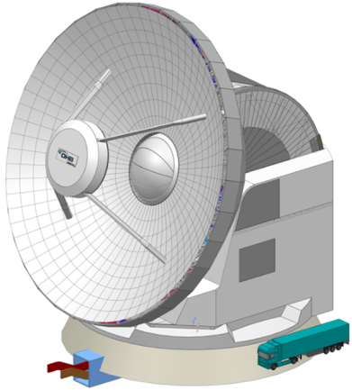
What is AtLAST
A next-generation single-dish astronomical observatory with a 50-meter diameter and a wide field of view (1-2 deg) ➛ requires a unique, cutting edge design
Capable of observing the full submm wavelength range: 10mm to 350µ ➛ requires a high and dry site. ➛ requires a high surface accuracy (20µm) ➛ complex technology ➛ a site with low wind
See next presentation by Tony

Slide 10
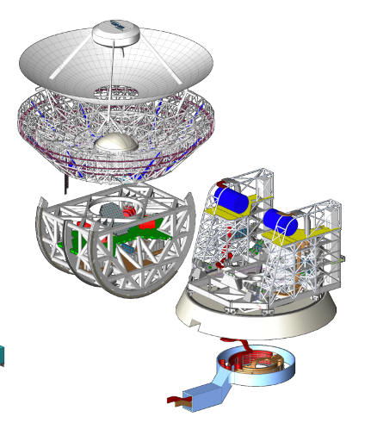
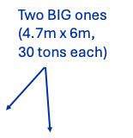
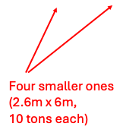
What is AtLAST
Environmentally sustainable ➛ tailored renewable energy system
Serving a wide community of users for >50 years (long-term sustainability)
Hosting 6 instruments: ➛ fast switching, allows multiple science ➛ upgradable, exploiting new technological advances in the decades to come
See next presentation by Tony

Slide 11
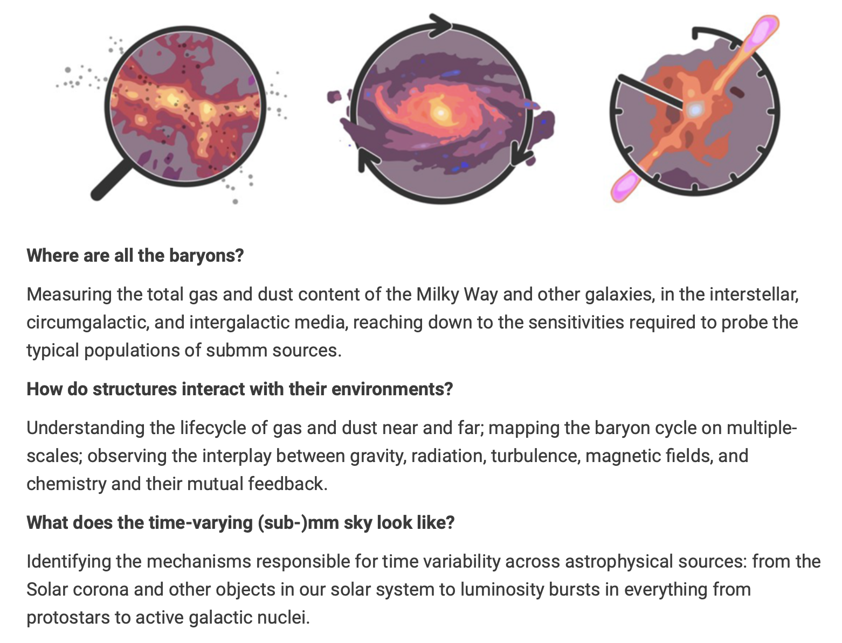
What is AtLAST
Key Science Drivers
See presentation by Teresa and Jose
+ numerous science talks

Slide 12
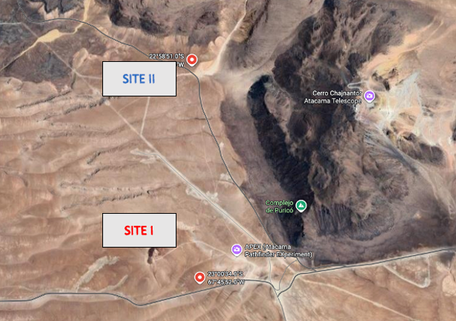
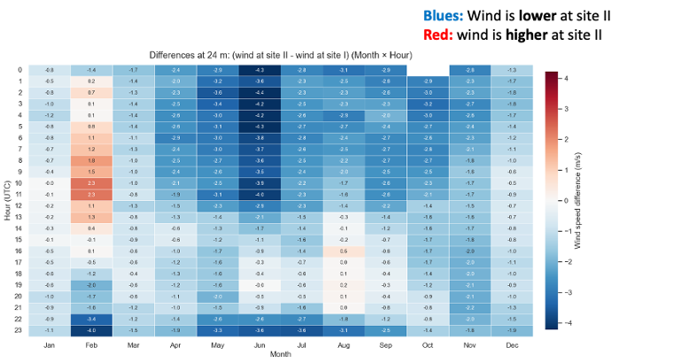
Where could AtLAST be built?

Slide 13
Horizon Europe AtLAST2 project (2025-2028)
Larger than original H2020 design study (2021-2024) in team size and scope, many new partners (CSIC, UCM, ICE, IAC, EST; Japan, South Africa), same coordinator and large overlap of "core" team (WP leaders)
>200 AtLAST2 team members (not including all science contributors) ➛ Possible to join through non-disclosure agreements (NDAs)

Slide 14
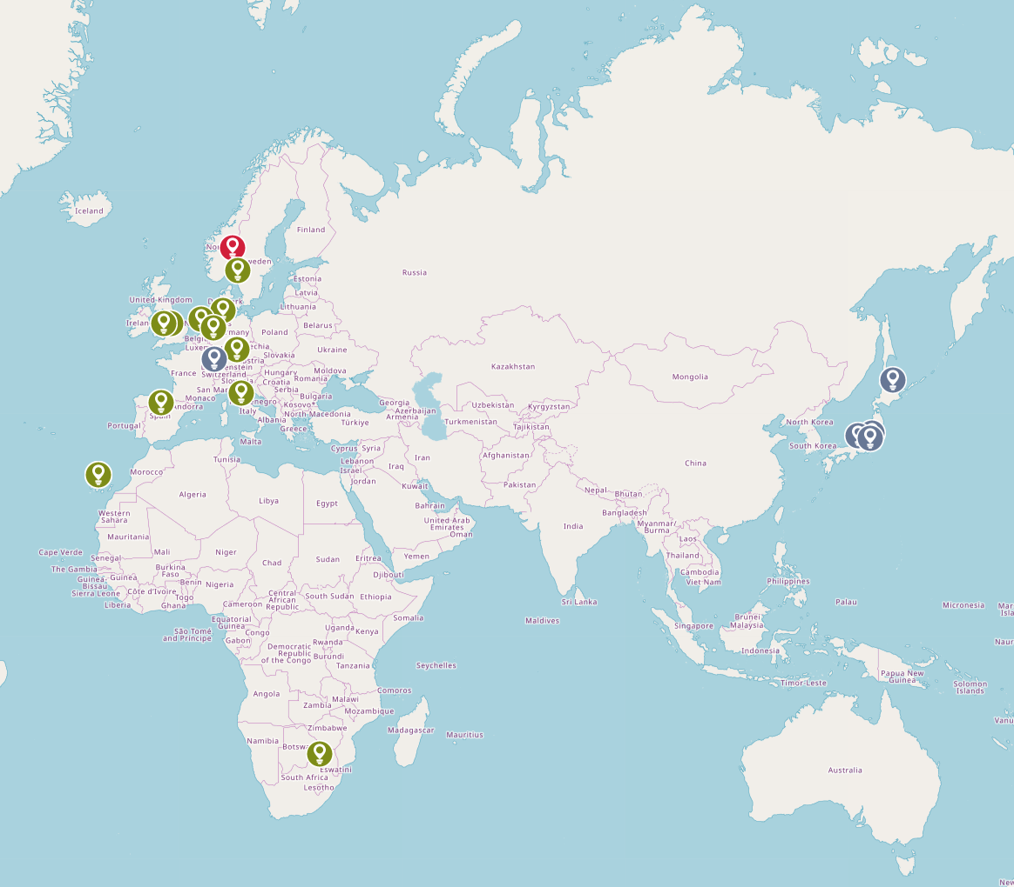
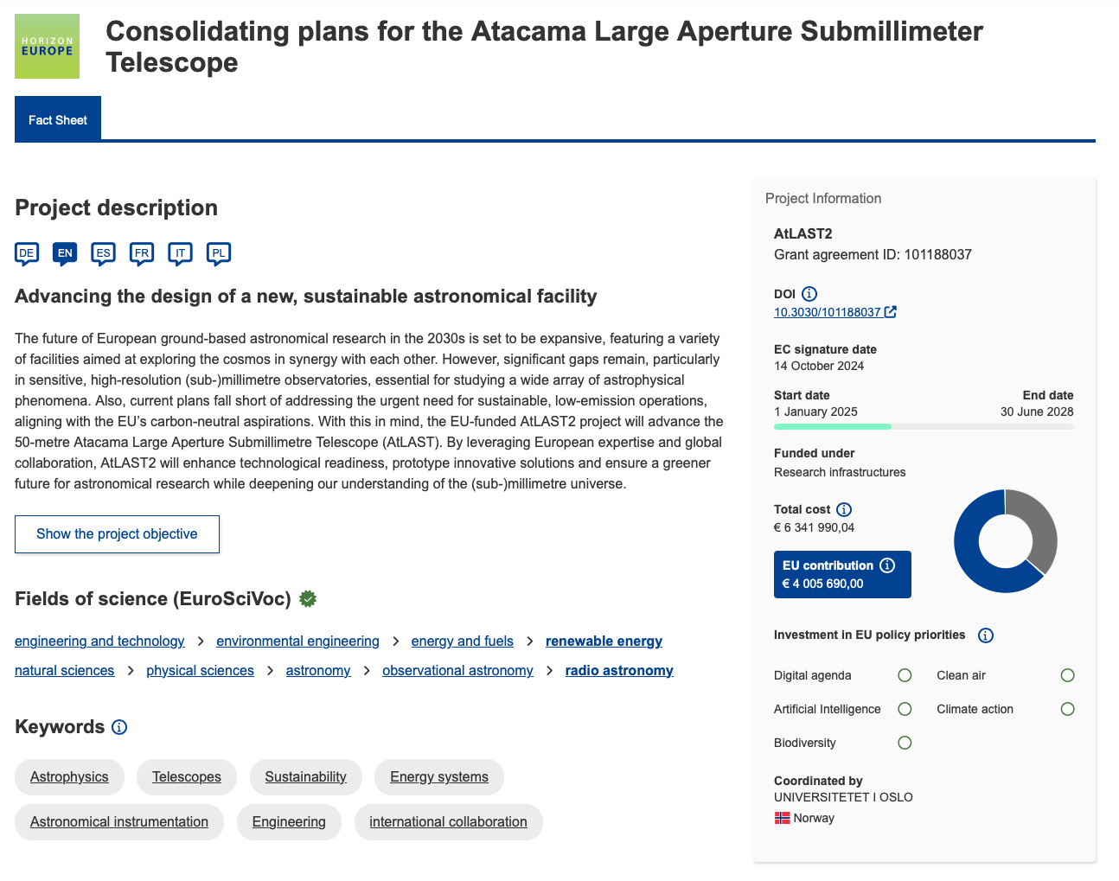

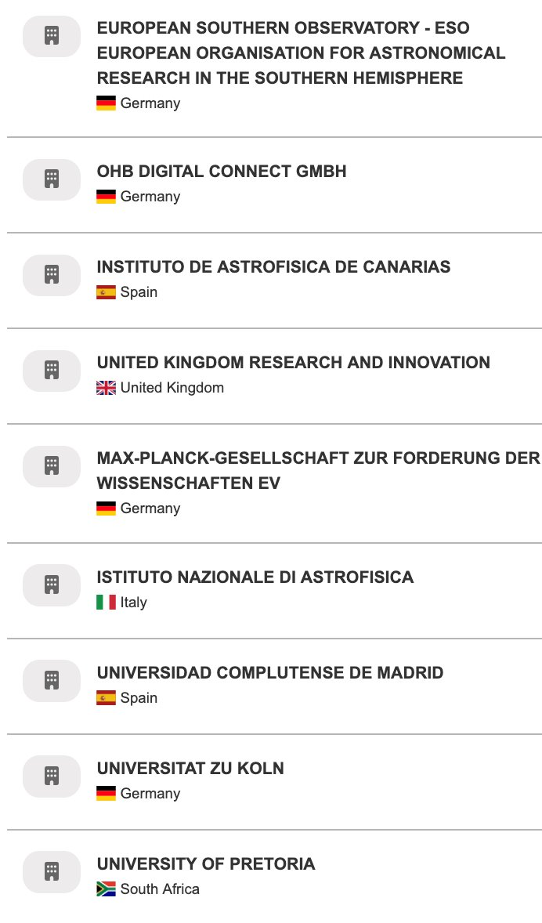

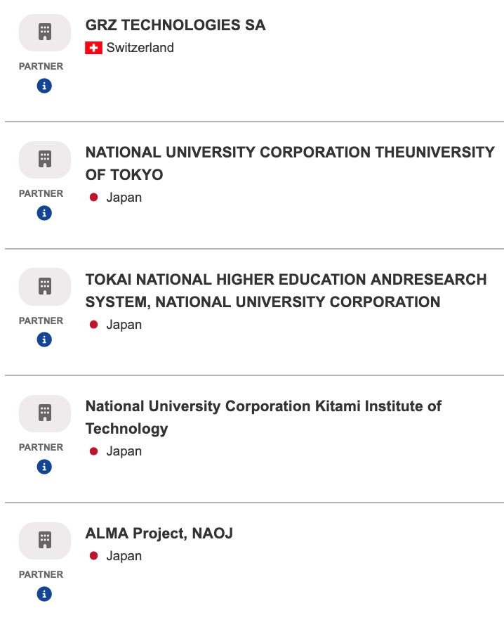
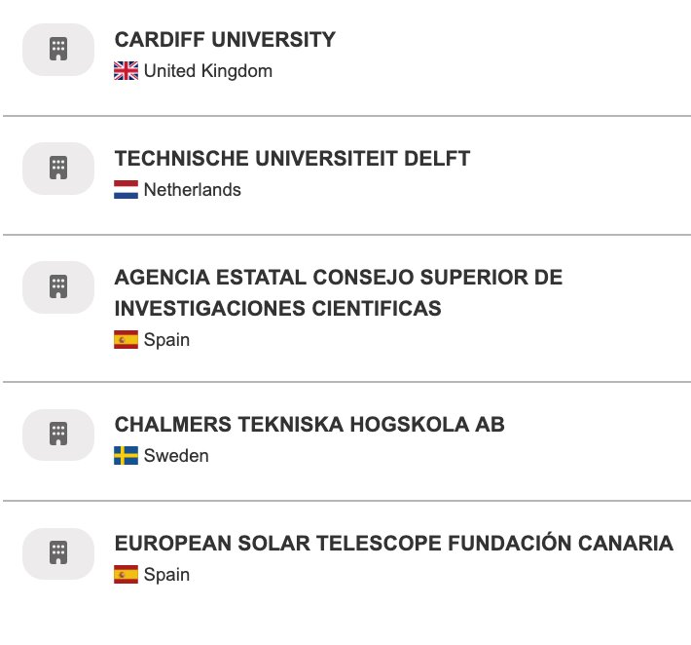
Horizon Europe AtLAST2 project (2025-2028)
Larger than original H2020 design study (2021-2024) in team size and scope, many new partners, same coordinator and large overlap of "core" team (WP leaders)
>200 AtLAST2 team members (not including all science contributors) ➛ Possible to join through non-disclosure agreements (NDAs)

Slide 15
Of interest to the Iberian community
Rare opportunity to participate and contribute to a project of this scale from its inception
Science cases
Instrumentation
Software
Data infrastructure, data archiving and user access
Energy and sustainability
Novel operations models (remote, distributed, AI-assisted)
User support models
Exploitation of synergies (scientific, technological, operational)
Societal impact of large infrastructures

Slide 16
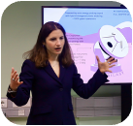

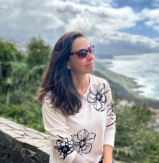
Of interest to the Iberian community
WP1 activities: Science, community engagement, impact
Science Reference Plan: Collection of ambitious science cases and corresponding observing strategies to be carried out by AtLAST. Developed through community coordination. Goals: 1) refine observing strategies; 2) evaluate science impacts of AtLAST; 3) create a user base ready to maximise AtLAST’s scientific output; 4) study societal impact of large facilities.
➛ Involvement of Iberian community vital (ICE, UCM, IAC partners; scientists from other research centers involved)
➛ Experience and lessons learned from IRAM 30m & Yebes 40m telescopes

Slide 17
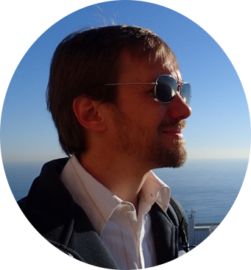
Of interest to the Iberian community
WP2 activities: Instrumentation
➛ Demonstrators on mm/radio platforms like the IRAM 30m, Yebes 40m, QUIJOTE, and SKA.
➛ Improvements in the noise levels and materials (e.g. frequency range) of kinetic inductance detectors (KIDs).
➛ Improvements in the noise performance and scalability of MMIC/HEMT amplifiers.
➛ Revolutionary new designs for on-chip and direct-detection spectrometers to reach higher coupling efficiencies.
➛ Fundamental improvements to the design, optimization, and implementation of feeds, antennas, and waveguide structures.
➛ Reducing the power consumption and improving the processing of readout electronics to reach AtLAST scales.
➛ Working on cryogenic moving parts for filters, multi-object spectroscopy, etc.

Slide 18
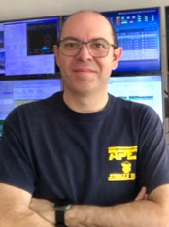
Of interest to the Iberian community
WP4 activities: Operations model, data & archiving
Sustainable operations modes, applicable to Iberian facilities: AI-assisted remote distributed operations
Data flow platforms: high-level requirements for software components and interfaces necessary for the facilitation of the end-to-end data flow (project preparation, data acquisition, quick data check and calibration, quality assurance, data processing, delivery)
➛ Leading role at IRAM & Yebes operations, 2) strong involvement in ALMA and 3) recognised expertise within the International Virtual Observatory Alliance, the Iberian community is ready to support the vision of AtLAST.
➛ Members of SKA, that faces similar challenges

Slide 19
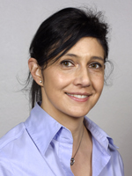
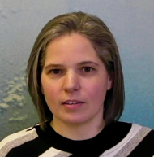
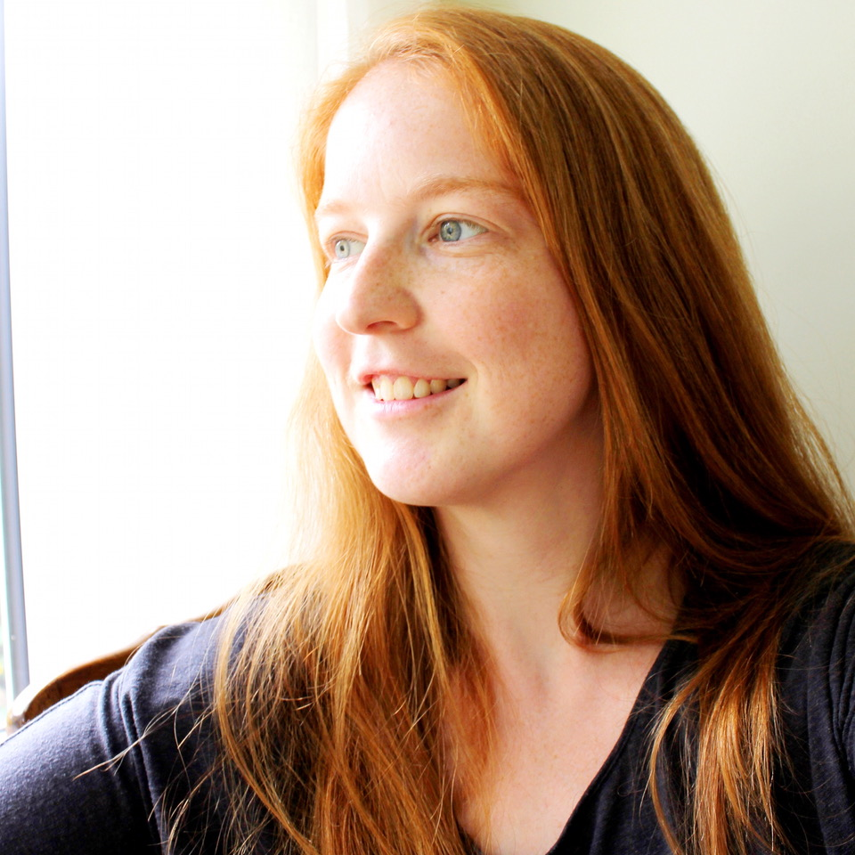
Of interest to the Iberian community
WP5: Renewable energies
WP6: Upgraded tools for science users
WP7: Pathfinders (IRAM, Yebes)
➛ E.g. wide-field mapping techniques; data combination methods

Slide 20
Get informed - join us - stay connected
AtLAST webpages: https://www.atlast.uio.no/atlast2/
Subscribe to the AtLAST newsletter: https://www.atlast.uio.no/about/contact/index.html
AtLAST Forum + other videos: https://www.atlast.uio.no/news-and-events/events/
ORE papers: https://ui.adsabs.harvard.edu/search/q=docs(library%2FSdEb-5nETuyuaflVd4BdOA)&sort=date%20desc%2C%20bibcode%20desc&p_=0
ESO Expanding Horizons white papers: https://ui.adsabs.harvard.edu/search/q=docs(library%2F4WM0PuFcSZ6PddE2gd0rLg)&sort=date%20desc%2C%20bibcode%20desc&p_=0

Slide 21
Get informed - join us - stay connected
Contact us:
  Tony Mroczkowski (WP2, tonym@ice.csic.es)
  Francisco Montenegro Montes (WP4, fmontene@ucm.es)
  Evanthia Hatziminaoglou (WP4, ehatzimi@eso.org / evanthia@iac.es)
  Claudia Cicone (WP1, claudia.cicone@astro.uio.no)
Sign an NDA

Slide 22
User support models
Short survey (9 points) on the projected needs of the AtLAST user community in terms of user support
Conceived to inform the user support model and the Operations Plan
Given the stage of the project, focused on items that are deemed important in order to move forward
Item to be assessed ➛ Question ➛ Concrete action

Slide 23
User support models
Level of onboarding & training intensity during the first years
Automation vs expert-facing system design
Prioritisation of tools and functionalities
Structure of user support model
Computing infrastructure
Delivery mode of training and interactions
Early identifications of pressing needs and risks

Slide 24
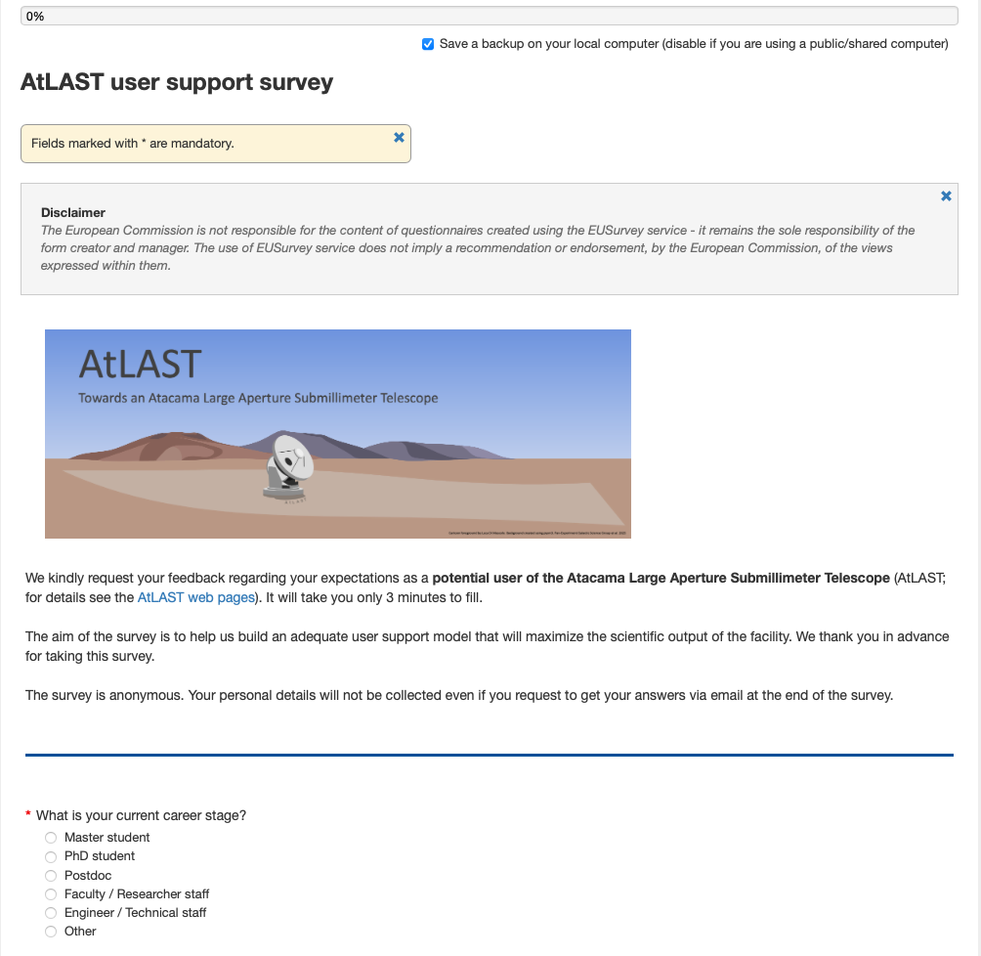

User support models
https://ec.europa.eu/eusurvey/runner/a1411b6c-5847-13b7-e056-969c7a0ad12c
Open till June15

