Slide 1
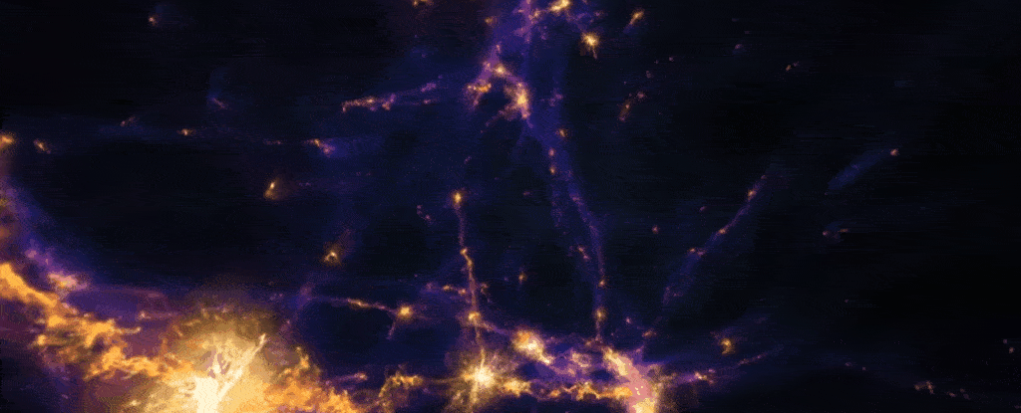

The Magnetised Cosmic Web:
Joint RM and SZ Probes with AtLAST
Shane O’Sullivan
Dpto de Física de la Tierra y Astrofísica & IPARCOS-UCM
Universidad Complutense de Madrid s.p.osullivan@ucm.es
Movie: IllustrisTNG
5 Jun 2026
Iberian AtLAST days

Slide 2
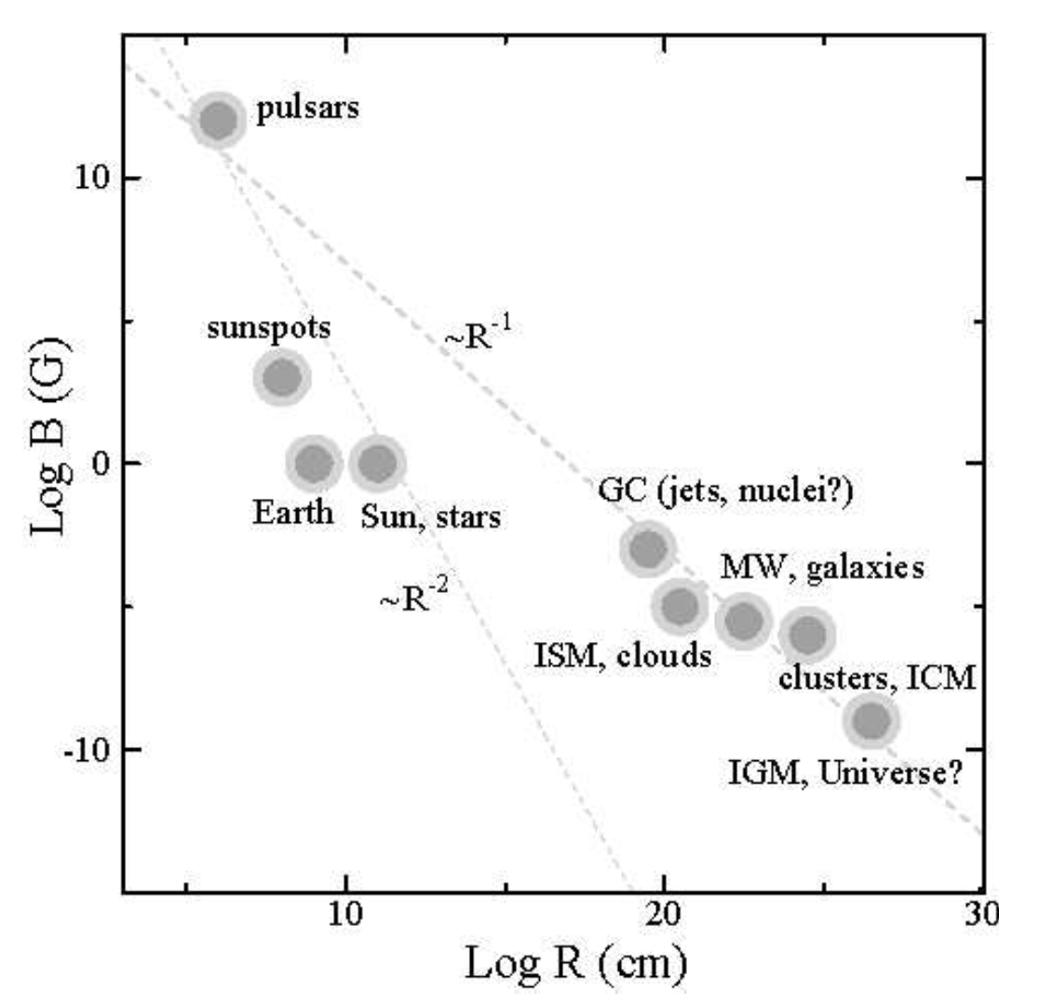
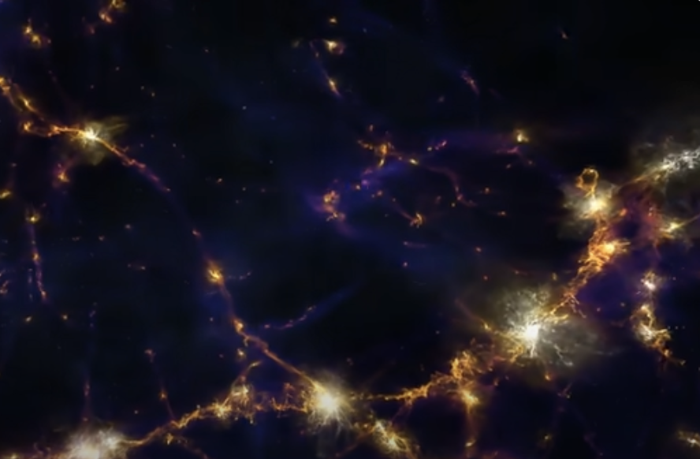
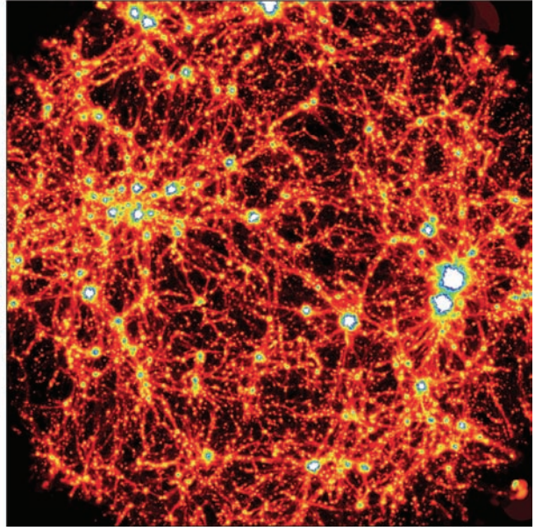
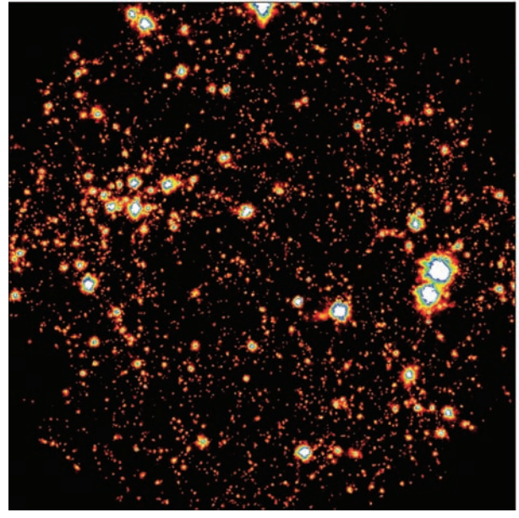
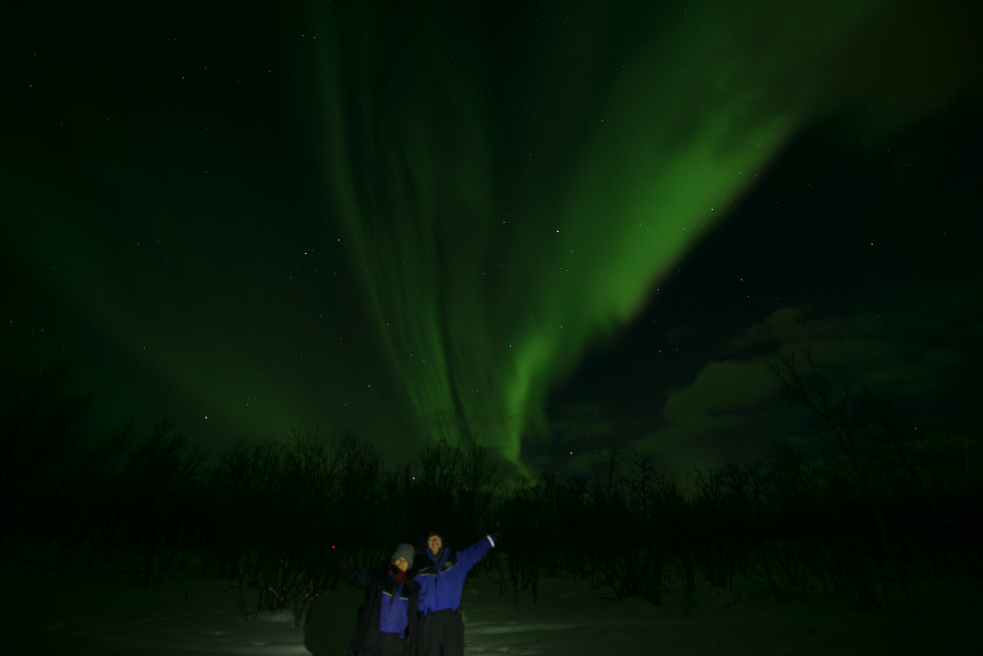
Cosmic magnetic fields
eg. Neronov & Vovk 2010, Subramanian+19, Vachaspati+21, Mtchedlidze+24
Akahori+17
Astrophysical magnetic fields play a crucial role on many different scales in the Universe
  planetary habitability, star formation, extracting energy from black holes, affecting the thermodynamics of the ICM and the baryon cycle in CGM, .…
Growing evidence of magnetic fields on the largest scales of the cosmic web of matter
  10⁻¹⁶ G < B < 10⁻⁹ G
  Primodial and/or “astrophysical” origin?
1 G = 10⁻⁴ T
Outflows
Magnetic field strength @ z = 0
(primordial scenario)
Magnetic field strength @ z = 0
(astrophysical-only scenario)
Void
200 Mpc
filament
Donnert+09
Primordial
Node
Notes:
B → affecting the thermodynamics of the intracluster medium and the baryon cycle in galaxy halos.
GC → Galactic centre
Slow/regulate the collapse/fragmentation of molecular clouds, help transfer angular momentum outwards (magnetic braking, MRI in disks, jets), affect cosmic ray diffusion (heating, ionization, chemistry).
Extract energy from rotating black holes
They allow you to attach things to the door of your refridgerator…
NS: 10^12 to 10^15 G (TeraG to PetaG)
Magnetic field strengths span about 30 orders of magnitude (femtoG to PetaG)

Slide 3
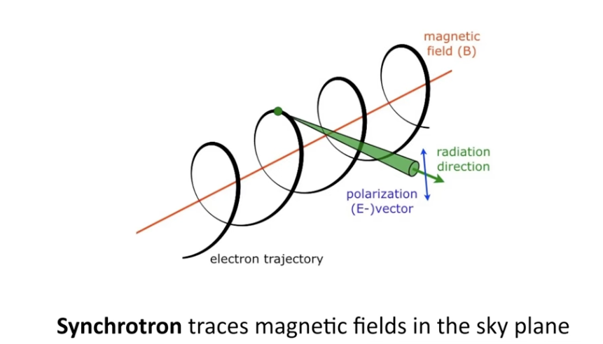
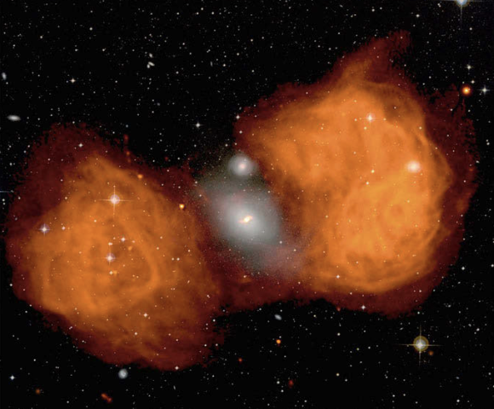
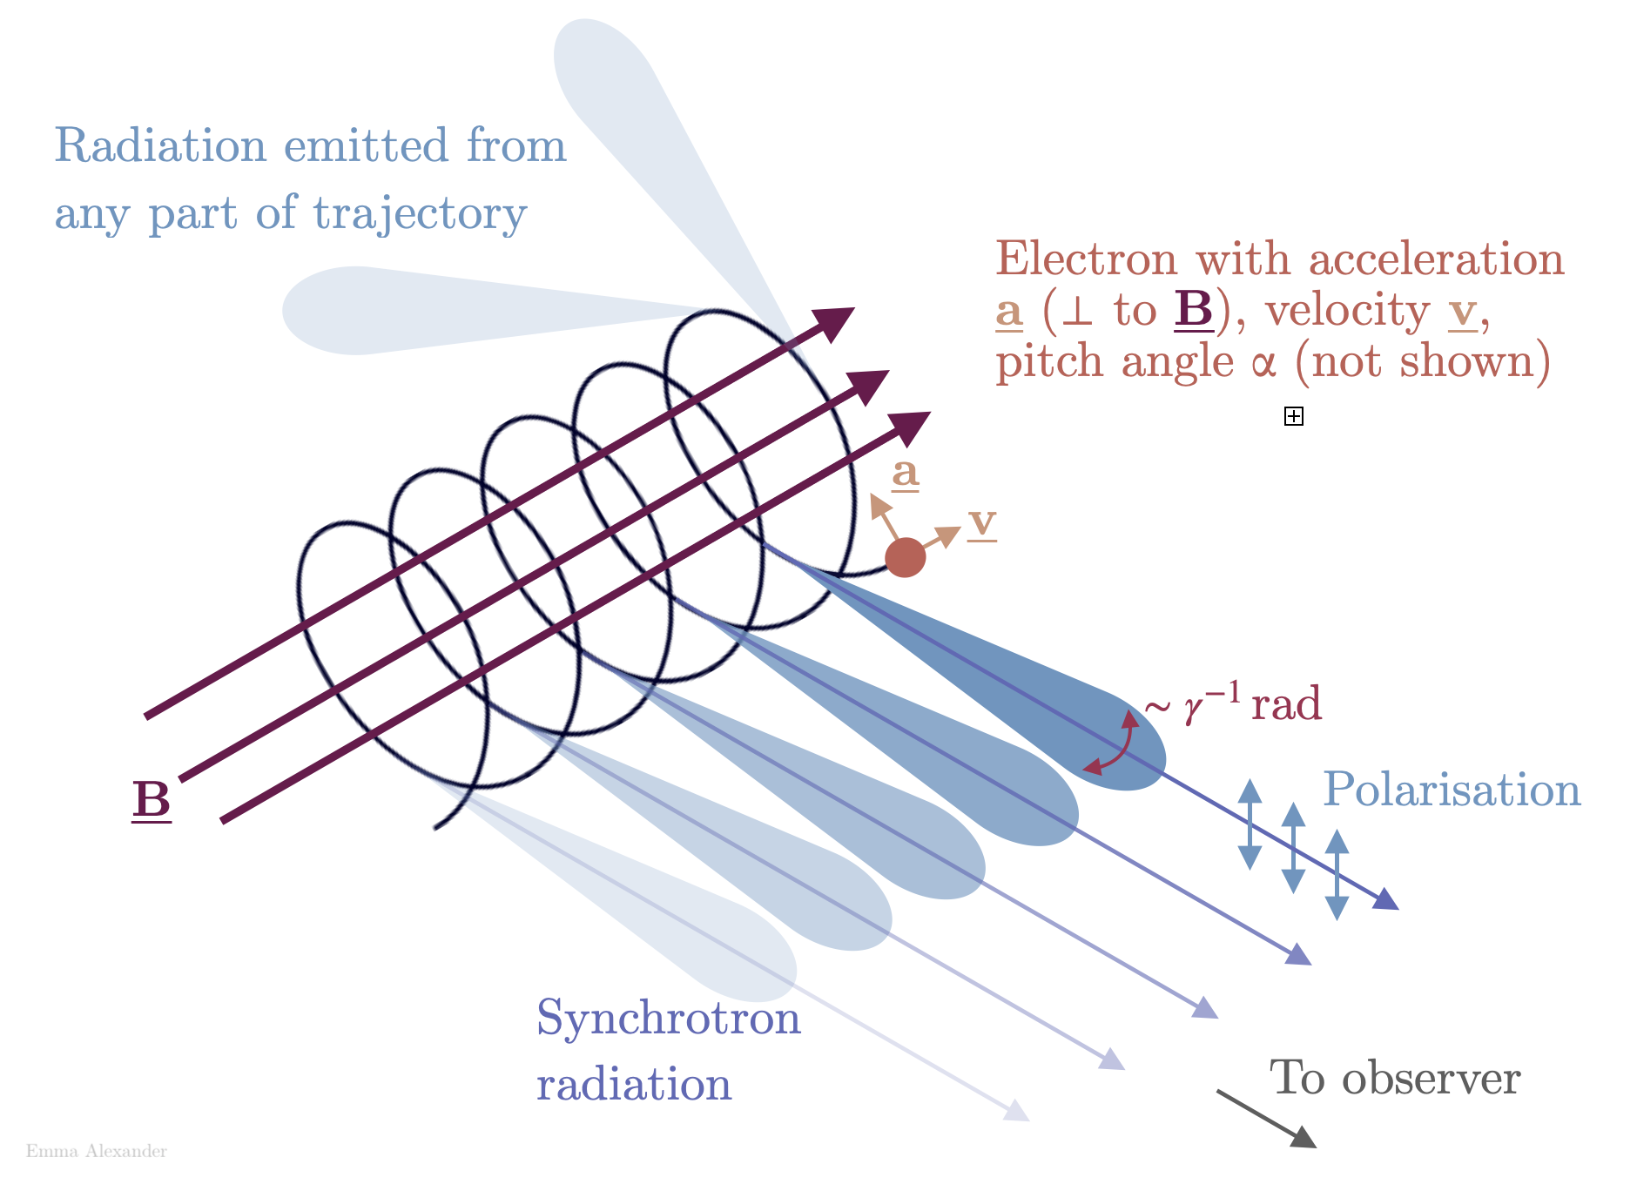
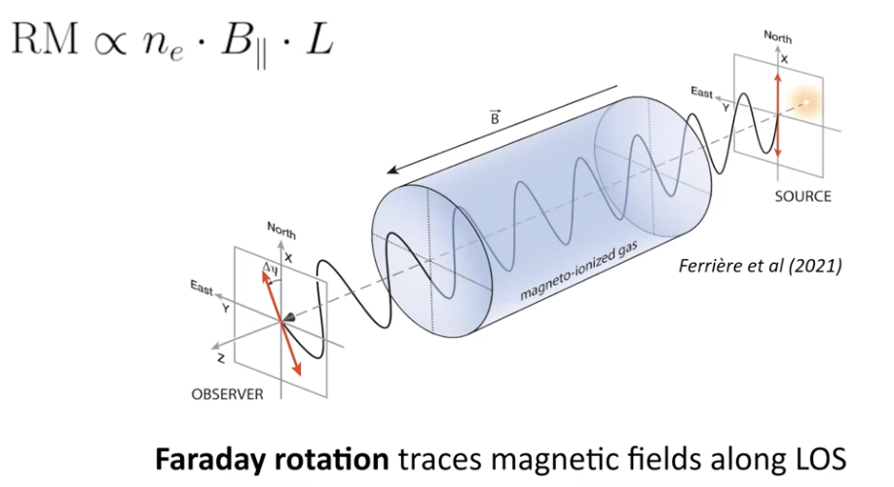
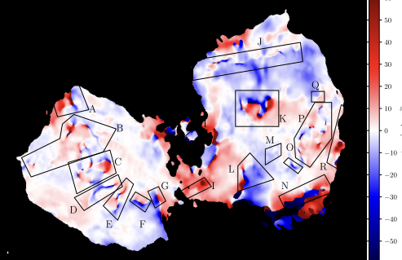
Magnetism with radio telescopes
Fomalont+89
G. Heald
Orange: radio synchrotron emission from Fornax A
Red/blue: Faraday rotation from Fornax A (Anderson+18)
Notes:
The electron undergoes curved (circular/spiral) motion perpendicular to the magnetic field, producing radiation with a preferred electric-field orientation.
phase delay between circular modes (different refractive indices because the electrons have a constrained motion due to the presence of the magnetic field) → rotation of linear polarisation
Mode whose electric field rotates in the same sense as the gyration of the electrons about the magnetic field in the plasma is “faster”
Effect is “dispersive” not ”dissipative” ie. energy of EM wave not lost
Faraday (1845)

Slide 4
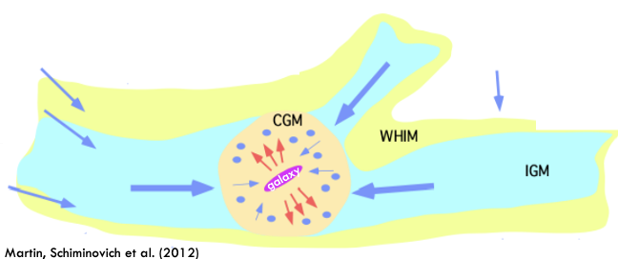
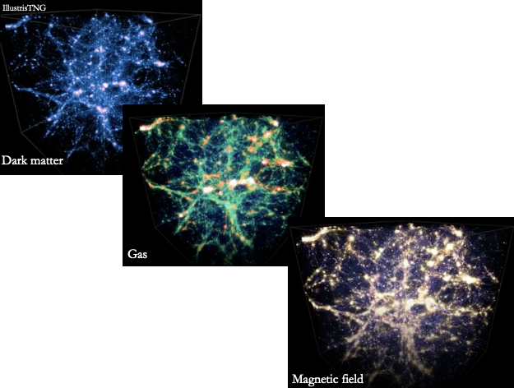
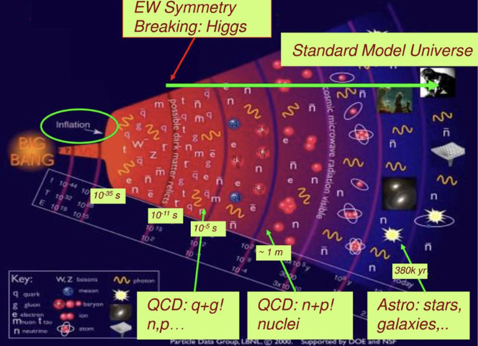
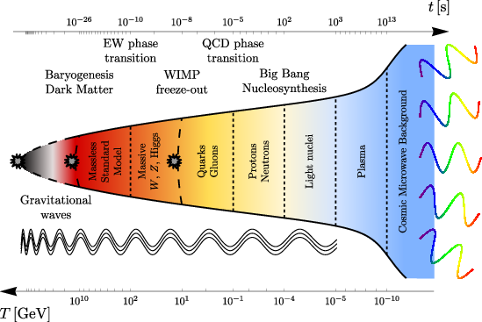
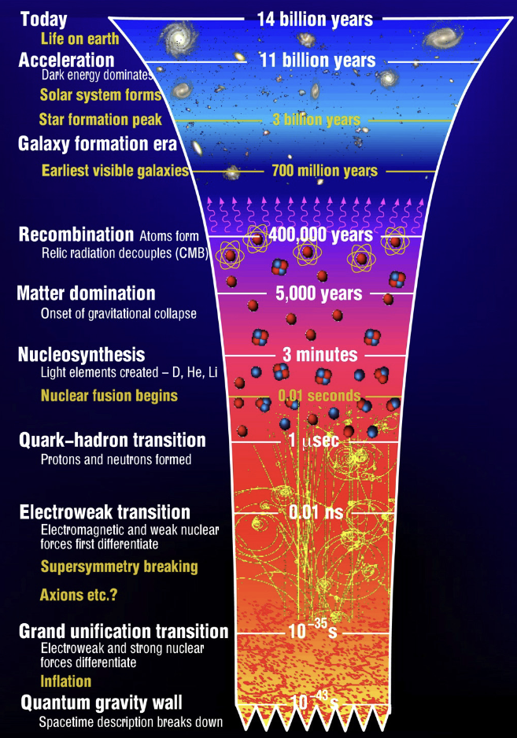
Motivation
Faraday rotation: tracer of the inventory of matter out to cosmic noon
  Cluster outskirts & IGrM – IGM interface (Anderson+21,24)
  Testing MHD models of the CGM (Heesen+23, Ramesh+24)
  Constraining extent of AGN feedback (Blunier & Neronov 2024)
Radio cosmic web: the origin of cosmic magnetism & properties of primordial magnetic fields
  Probe of early Universe physics (Vachaspati+21)
    Inflation, Electroweak, QCD eras
  Stochastic Gravitational Wave Background (Neronov+21)
  Alleviate “Hubble Tension” (Jedamzik & Pogosian 2020)
  Influence on structure formation and reionisation (Ralegankar+24, Sanati+24)
Image credit: M.J. Ramsey-Musolf
Primordial magnetic fields?
Image credit: Schmitz (2022)
Notes:
Schmitz (2022) https://cds.cern.ch/record/2804870/plots
2-for-1 → ie. to constrain B0 we need to measure B(rho), ie. trace filaments

Slide 5
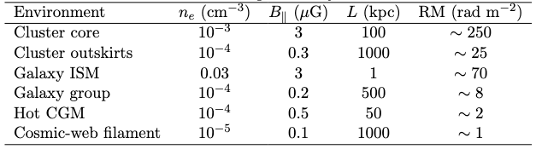



RM values in different environments
Combine RM with ionised gas tracers (eg. tSZ, kSZ, X-ray) to get more robust B estimates

Slide 6
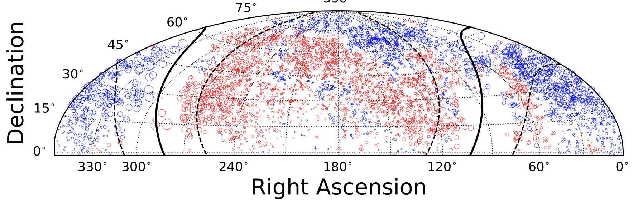
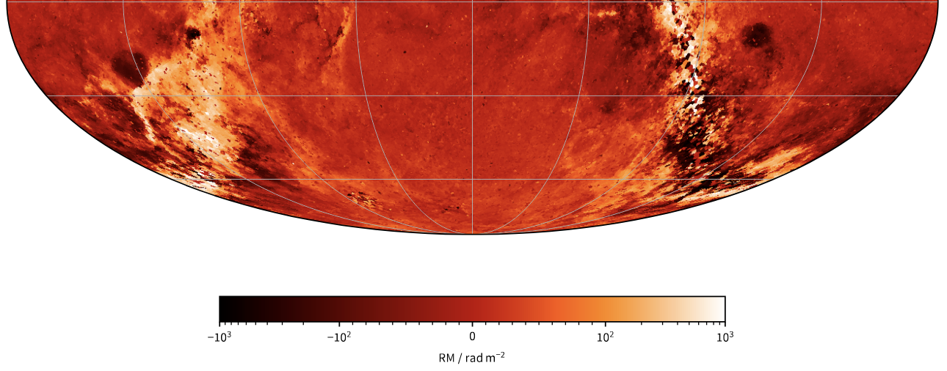
Next generation of RM Grids
LOFAR RM Grid
O’Sullivan+26, in prep
~0.3 RM/deg²
RM error ~ 0.1 rad/m²
LOFAR and ASKAP
ASKAP RM Grid
Thomson+26
~7 RM/deg²
RM error ~ 2 rad/m²
ASKAP-POSSUM
RM Grid
~40 RM/deg²
RM error ~ 2 rad/m²

Slide 7
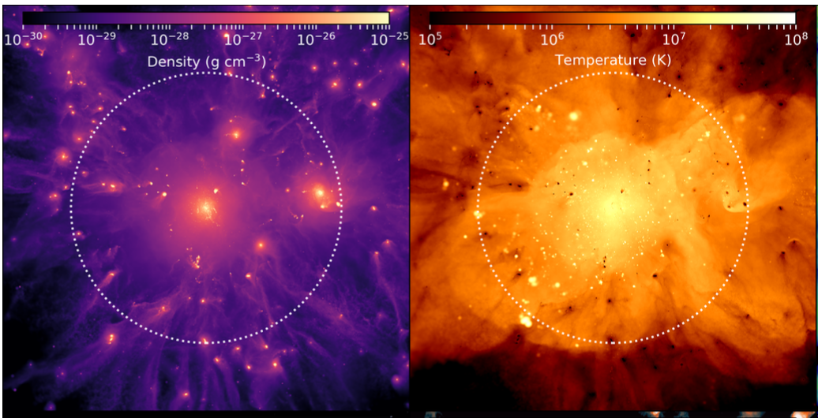

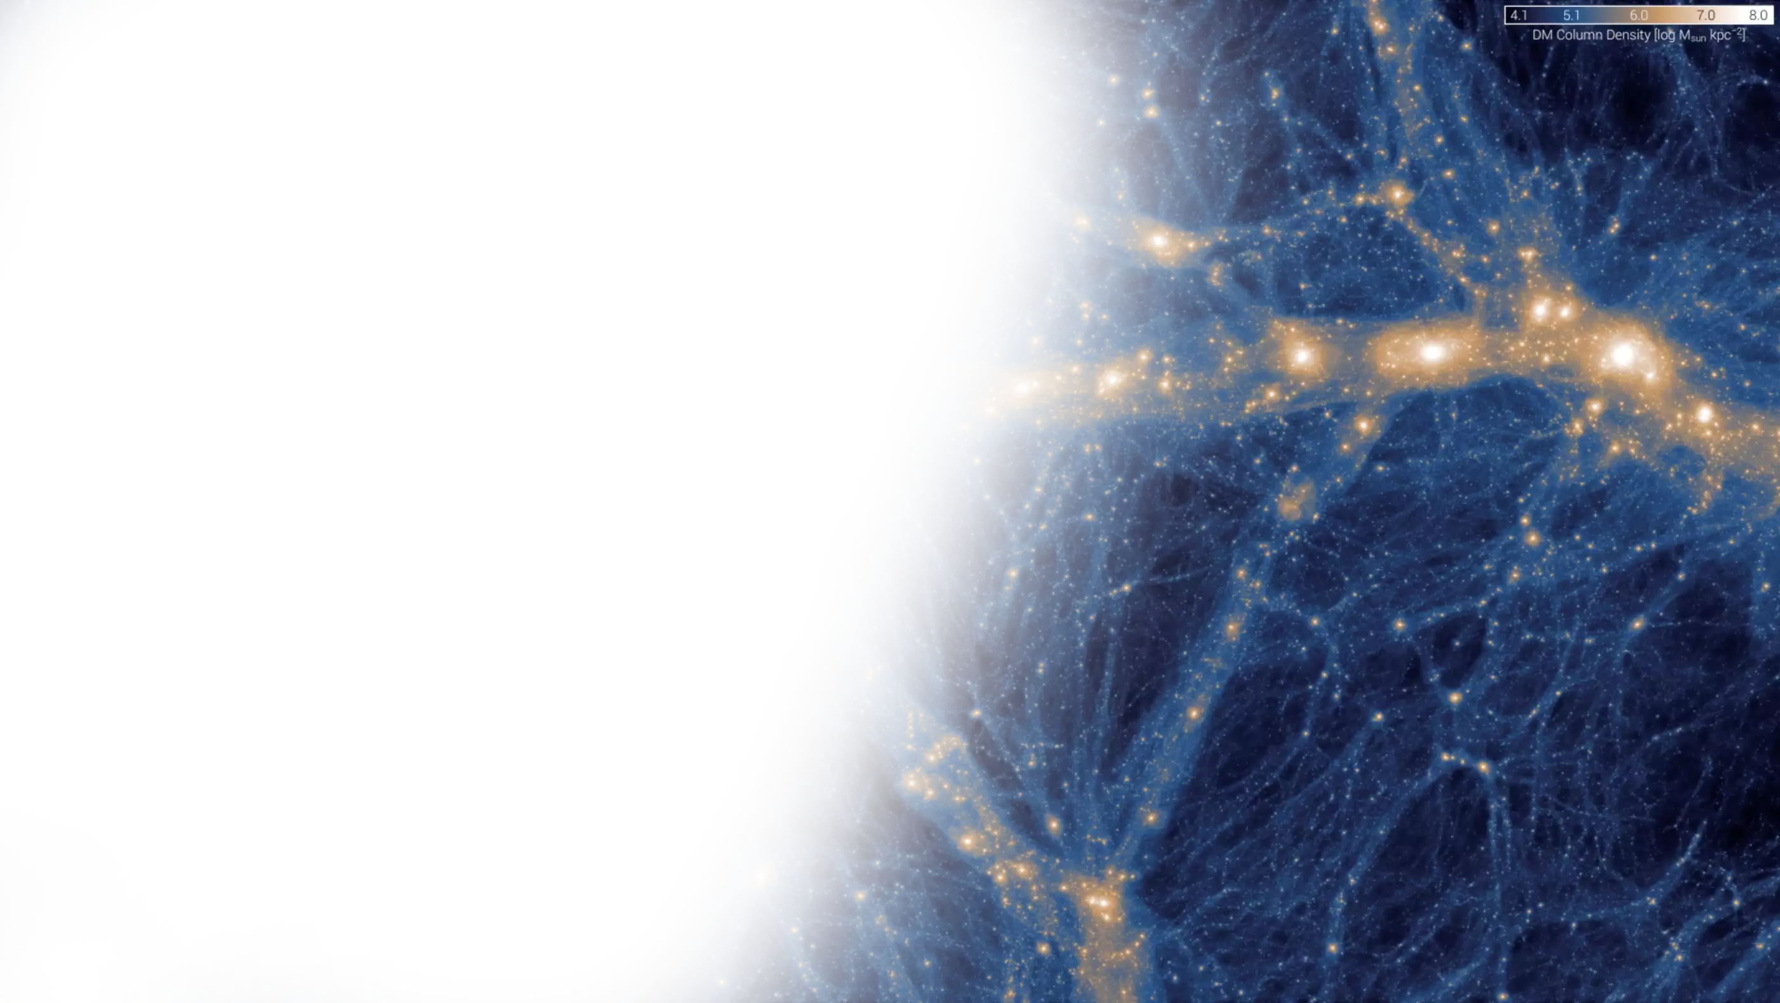
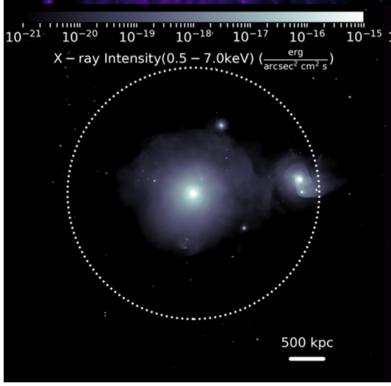
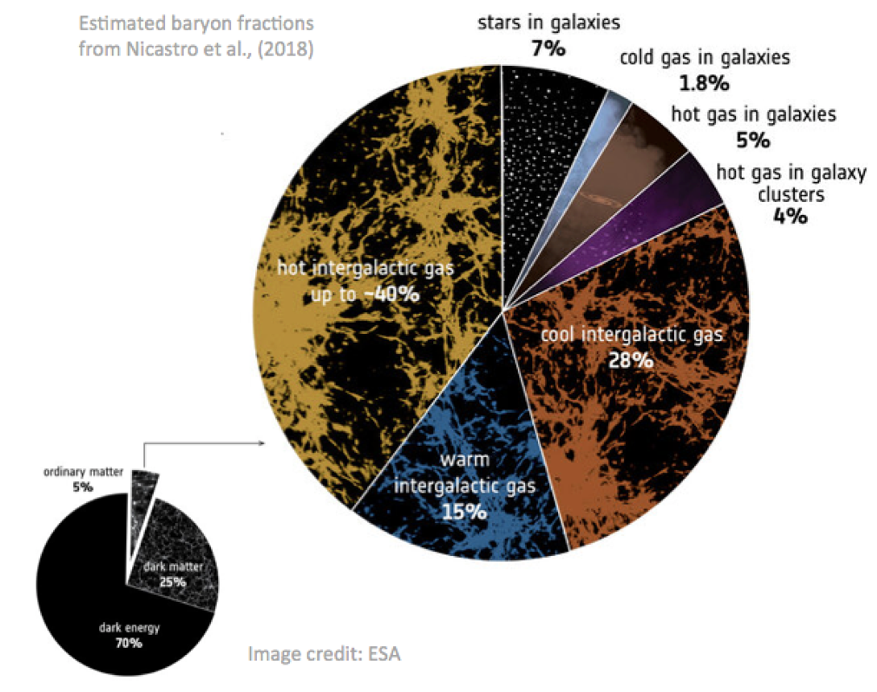
Mapping the baryon distribution
What we think should be there
n_{e}
T
ROMULUSSC – c/o Oppenheimer+2021
what we can typically observe
“missing baryon” problem: most normal matter not in stars or galaxies or intracluster medium
_{X-rays}
Can be up to 15R_{vir} until universal baryon fraction is reached Ayromlou+23
Notes:
Beautiful cosmo sims that predict the existence of complex gas dynamical flows around galaxies
Mix of gas inflows and outflows from galaxies
Universal baryon fraction: ratio of baryons to dark matter expected for entire universe (from cosmology)
Most mass (and baryons) in filaments
15 Rvir → galaxies and galaxy groups (not massive clusters)

Slide 8
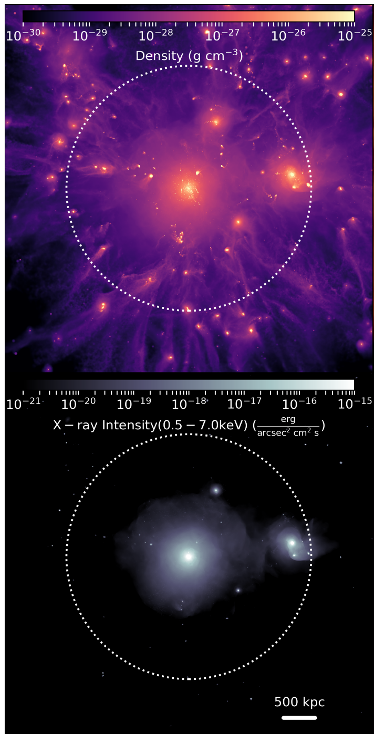
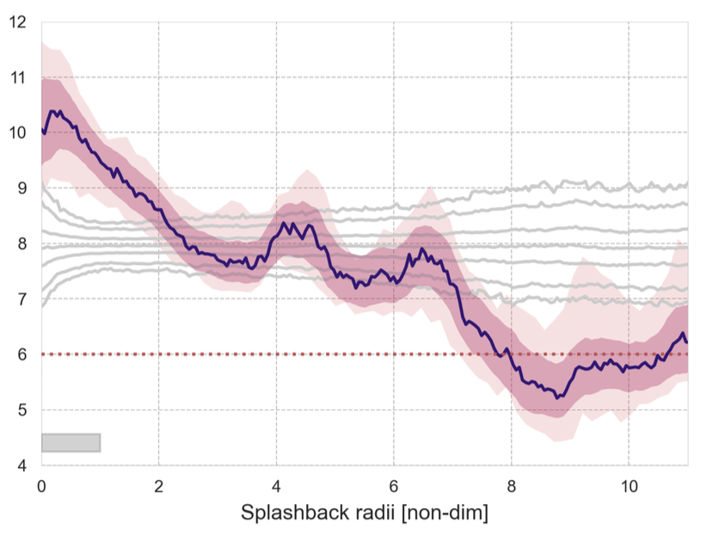
Galaxy groups
Excess σ_{RM} from hot intragroup medium (IGrM) & connecting filaments (WHIM) in 55 nearby groups
Magnetised thermal gas at interfaces of galaxy groups and the cosmic web: 0.1 < B_{IGrM/WHIM} [μG] < 1
CGM
ASKAP-POSSUM: cm RM Grid
Hot IGrM
Anderson, incl. O’Sullivan+24
(~20,000 RMs)
WHIM
RM dispersion [rad/m²]
Extragalactic background
~30 RMs/deg²
Simulation
Splashback radius (~1.5R_{virial})
Notes:
https://arxiv.org/abs/1504.05591 More+15: ~1.5 for slowly accreting halos (~1.1 for highly accreting halos)
The light gray lines show the percentile distribution (1st/99th, 5th/95th, 25th/75th, and 50th) of 1000 σRRM curves generated identically to the main curve, but derived from randomly re-pairing RRM values with source positions in each case, illustrating the behaviour of the metric when the spatial relationship between source position, RRM, and group position is broken.
30 RMs/deg2 for nearby group of 0.1 kpc/” is ~4 RM/Mpc2 which is about 12 RMs inside the circle
Hot: 10^6 to 10^8 K, ~7 rad/m2 excess
WHIM: 10^5 to 10^7 K, ~4 rad/m2 excess

Slide 9
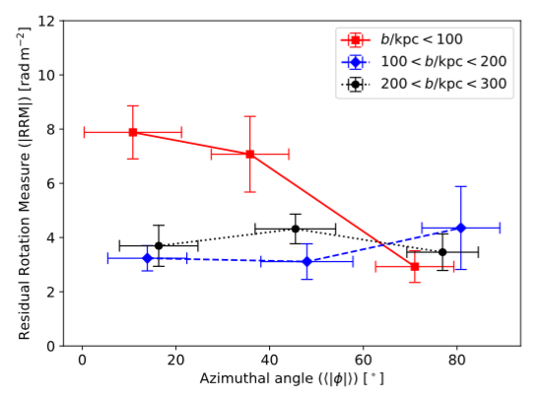
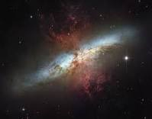
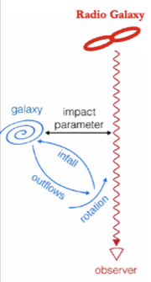
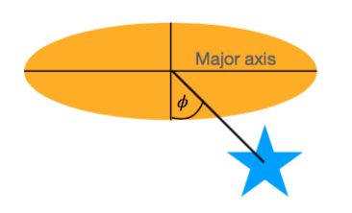
Hot CGM
Excess σ_{RM} (3.7 ± 0.9 rad/m²) from circumgalactic medium along minor axis of 183 nearby galaxies
Implies ~0.5 μG for n_{e} ~ 10⁻⁴ cm⁻³ at ~50 kpc
      Magnetised galaxy outflows
LOFAR: m RM Grid
Heesen, O’Sullivan+23
RM dispersion [rad/m²]
M82
Azimuthal angle [deg]
Simulation
Notes:
sigmaRM vs Azimuthal angle now instead of redshift, and binned by impact parameter

Slide 10
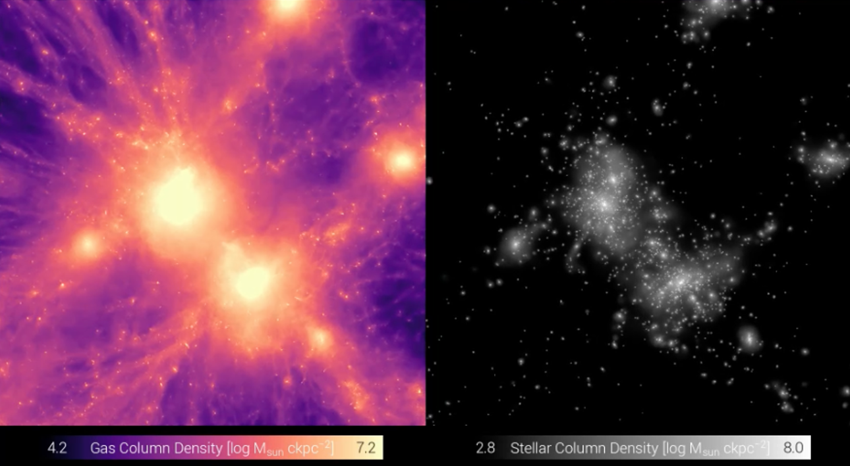
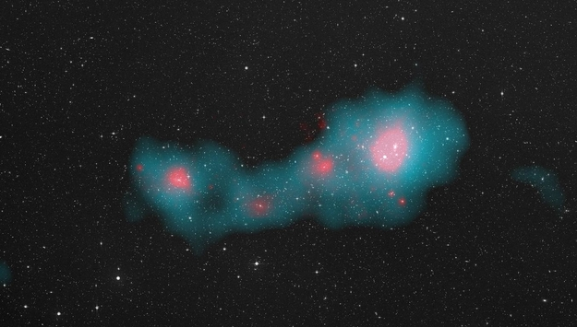
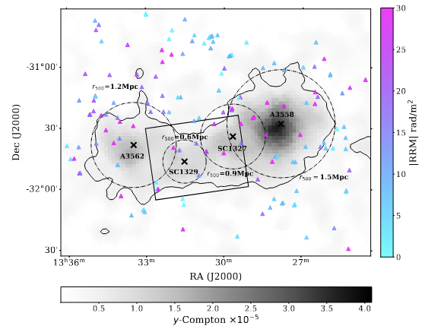
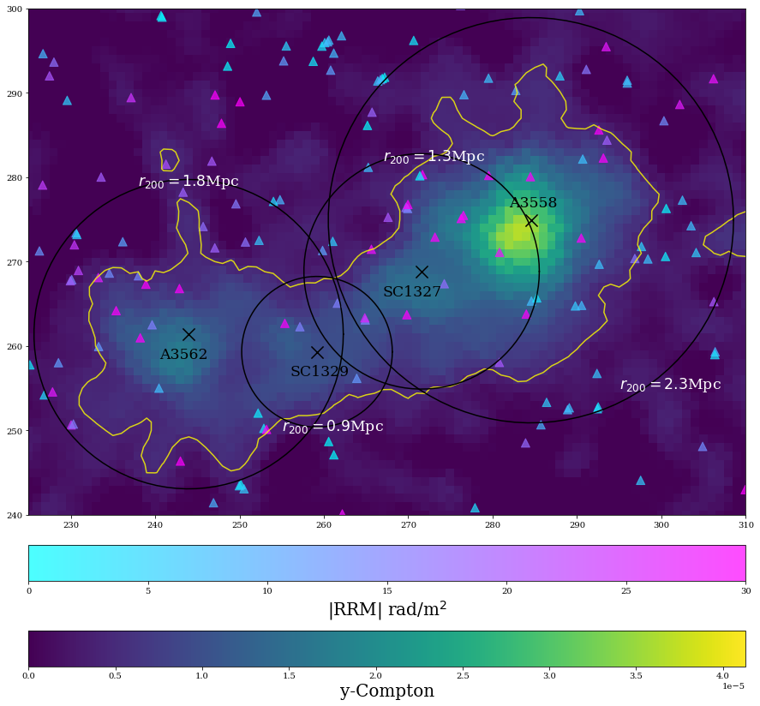



Gas between galaxy clusters
Simulation
ASKAP-POSSUM: cm RM Grid
Planck tSZ contour:
tracer of gas density
Observations of the centre of the Shapley Supercluster (z ~ 0.05)
Excess σ_{RM} from intercluster matter bridge at the core of the Shapley Supercluster
Alonso-López, O’Sullivan, et al. (2026)

Slide 11
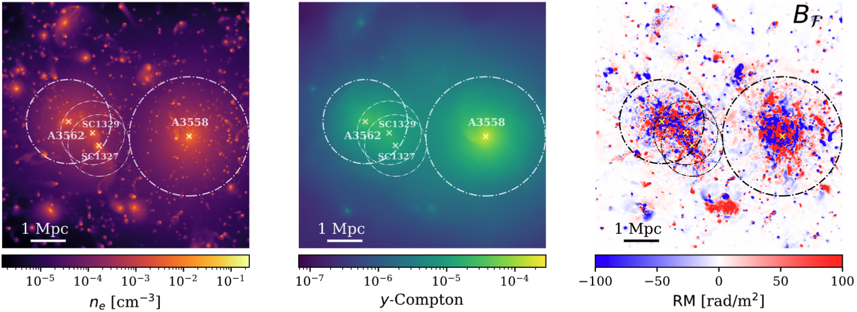
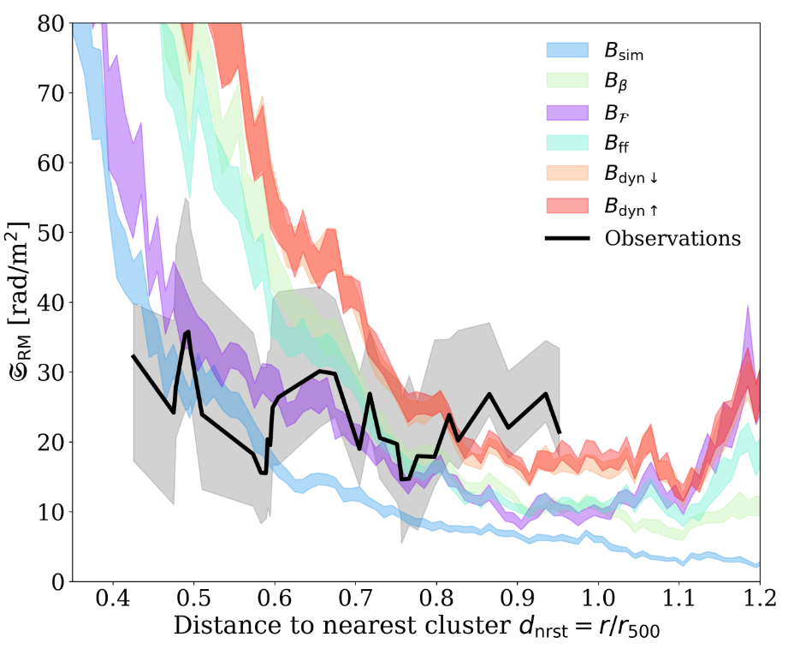
SLOW MHD simulation of the Shapley supercluster
Alonso-López et al. (2026)
Interaction + Merger history
State of the art
Detailed ICM physics
Realistic range of magnetic field coherence lengths
Systematically flatter-than-expected RM scatter profiles from observations compared SLOW profiles.
Challenging to explain: cluster substructure with coherent fields? Magnetic reconnection?
See also Osigna+25, Khadir+26

Slide 12
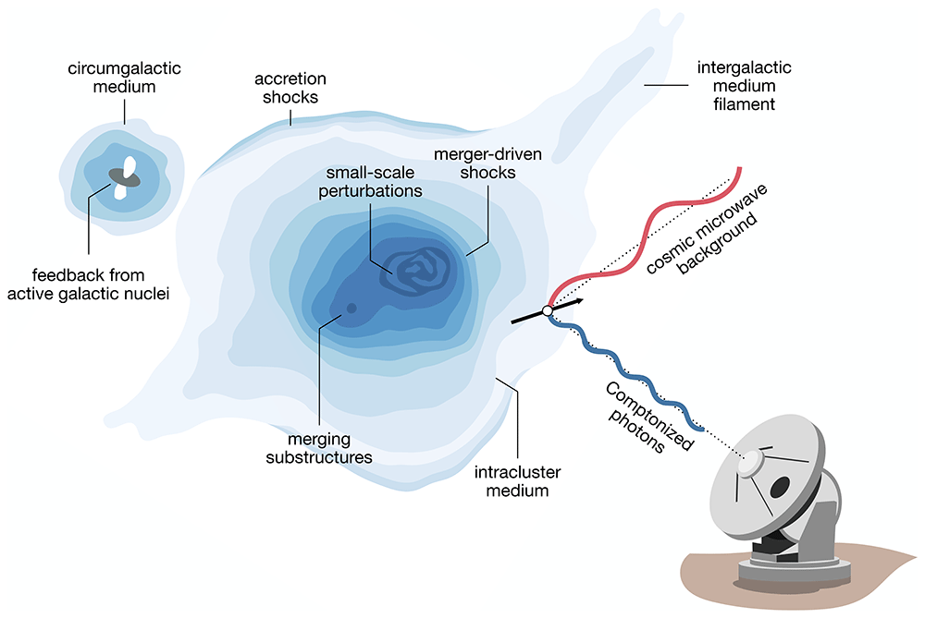
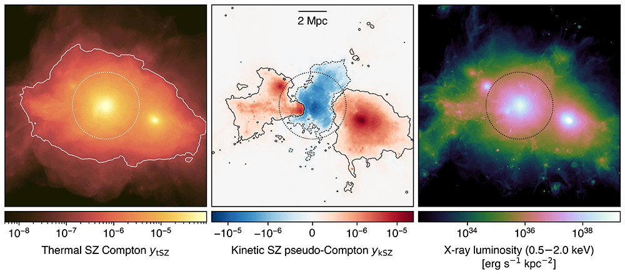
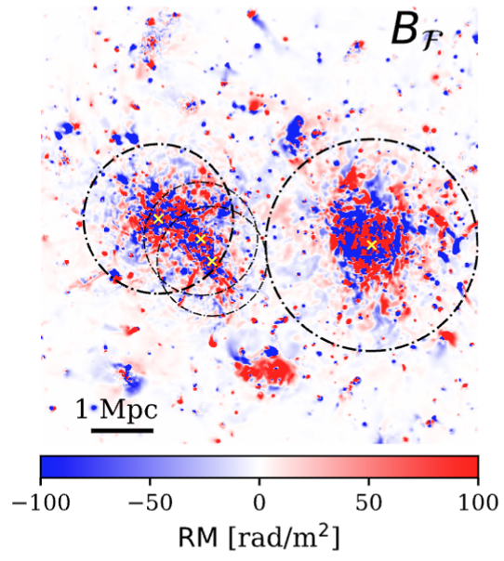
Probing cluster substructure with AtLAST
Detailed mapping of the tSZ and kSZ will probe shocks, gas motion and substructure
Invaluable to understand the magnetic field amplification process and RM distribution
Di Mascolo+24

Slide 13
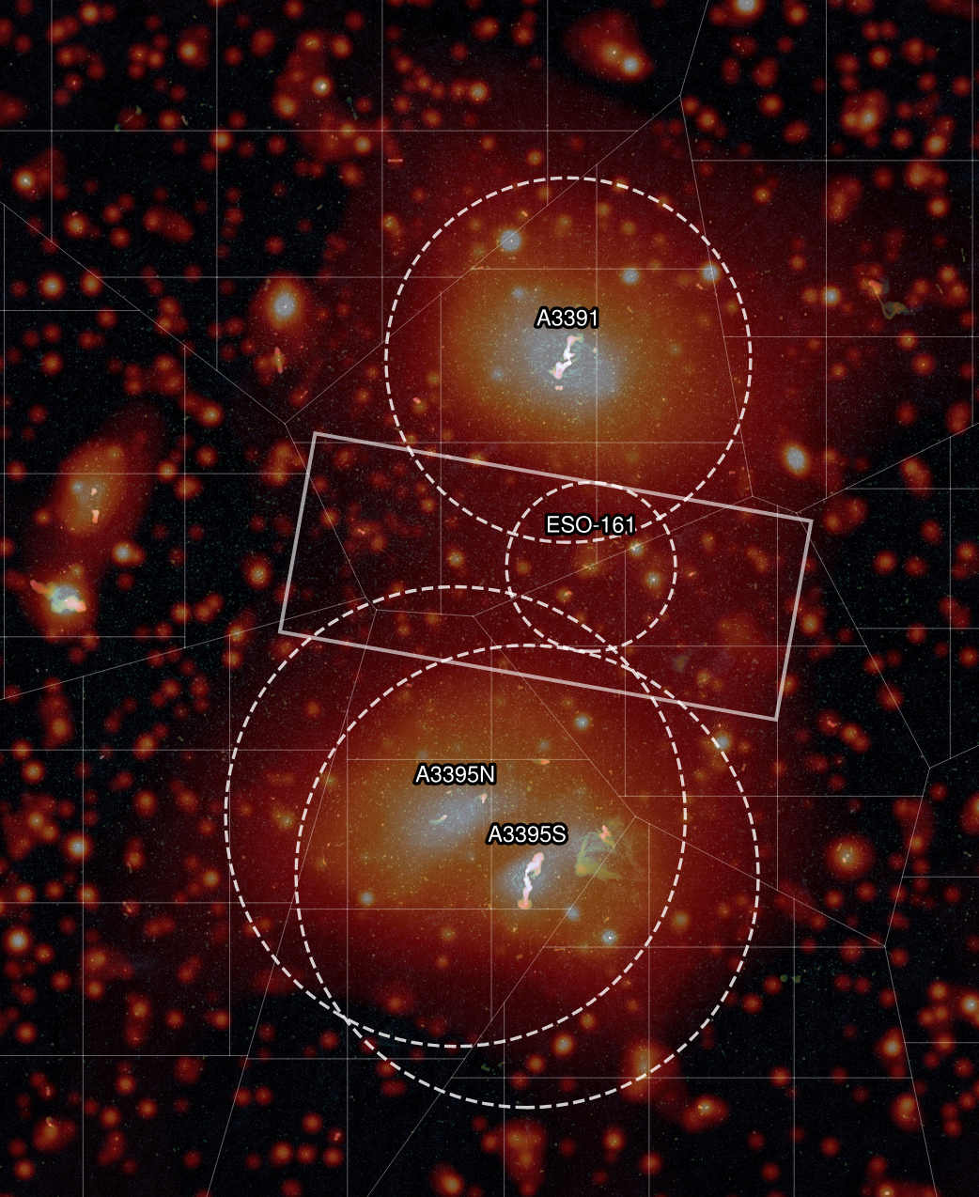
Abell 3391-3395 cluster bridge
Gustafsson et al. (2026)
SKA-Mid equivalent RM Grid of 110 RMs/deg²
Both clusters and “bridge” detected in RM
  Implies an ordered bridge magnetic field (in tension with turbulent amplification models; maybe explains why no diffuse radio bridge)
Need larger sample of X-ray, radio and tSZ-detected cluster bridges
Notes:
A399–A401 yes in tSZ and radio but tSZ

Slide 14
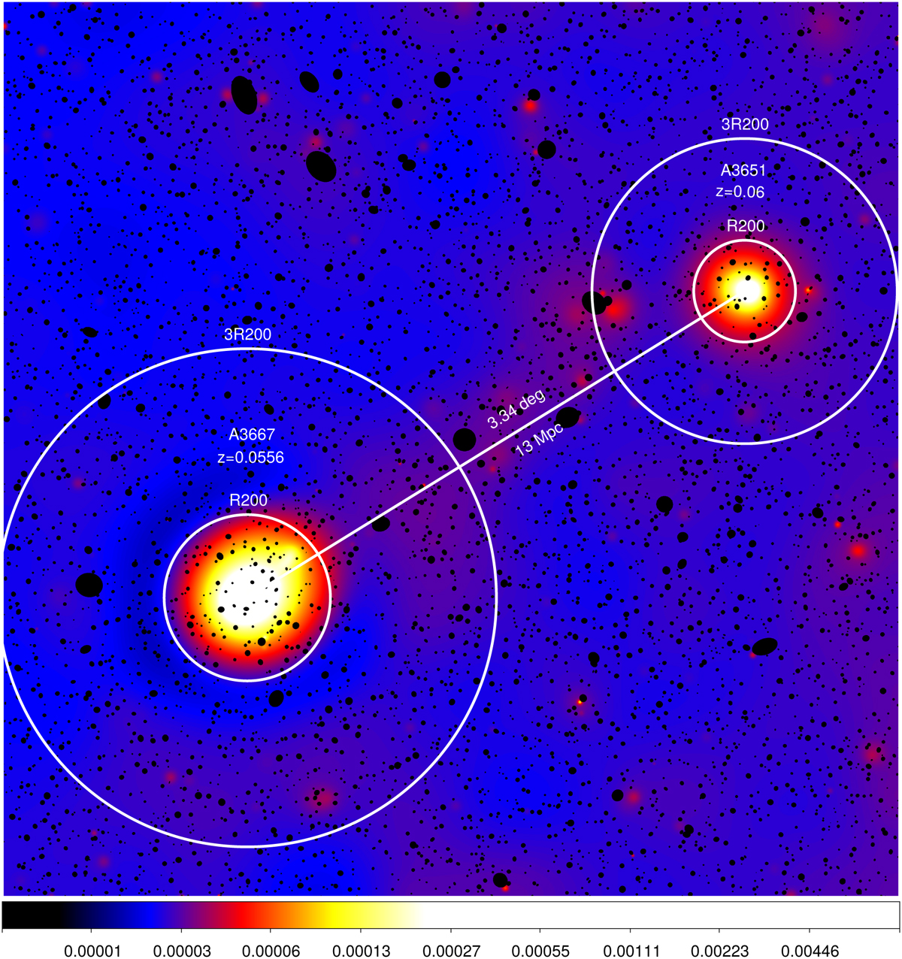
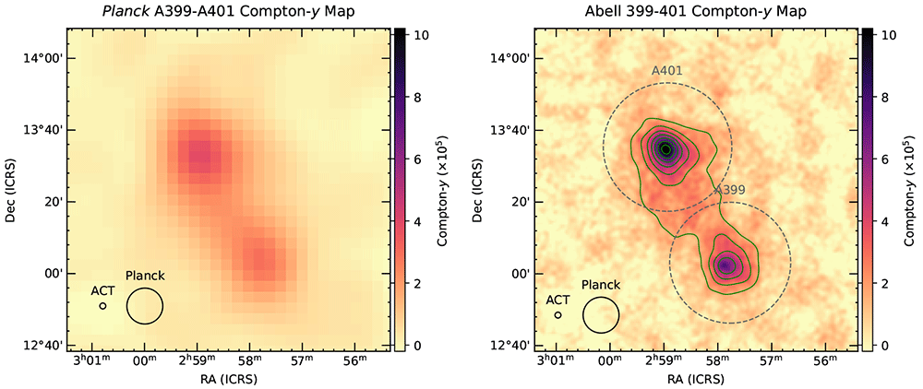
Cluster bridges to filaments?
A399-A401 cluster bridge
  Detected in X-ray, radio synchrotron and tSZ
  AtLAST can detect more & provide better detail
Dense filaments?
  13 Mpc X-ray filament between A3667 - A3651
  Dietl+24 (δ~210, T~0.9 keV): predicted y ~ 10⁻⁶
Di Mascolo+24

Slide 15
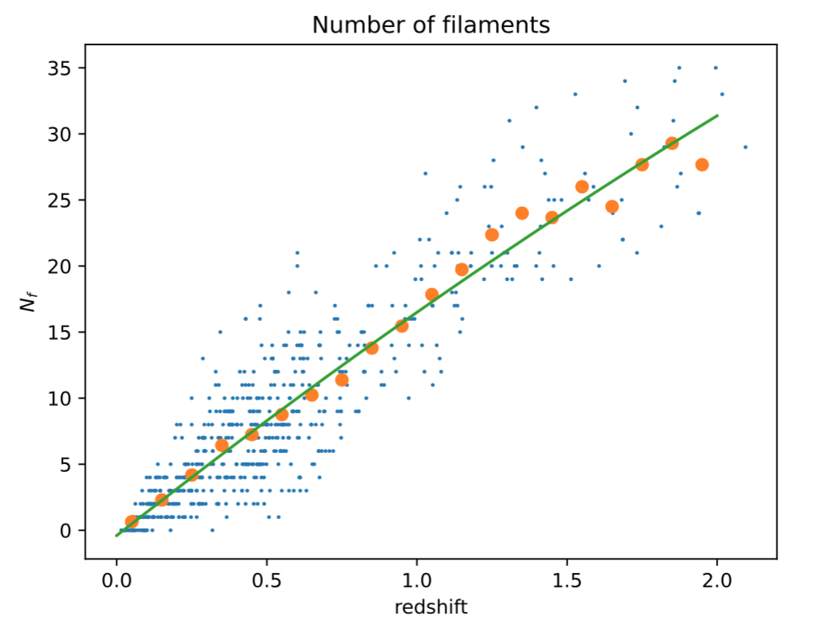

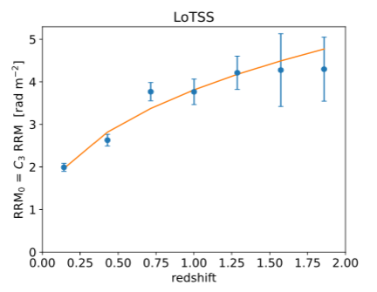
Cosmic web filaments with AtLAST?
Carretti, Vacca, O’Sullivan, et al. (2022), MNRAS, 512, 945. arXiv:2202.04607 (Paper I)
  σ_{(R)RM} vs z analysis for 1003 RMs, z < 2
  Compare with number of filaments along each line of sight
    Chen+15, Carrón-Duque+21
Number of filaments
  Assuming typical n_{e,f} ~ 10⁻⁵ cm⁻³ and mean path length through a filament L_{f} ~ 3 Mpc => average B_{f} ~ 30 nG
  y-map stacking (z > 0.5) with AtLAST? y <~ 10⁻⁸
      eg. Tanimura+19, de Graaff+19
redshift
RM dispersion [rad/m²]
Redshift
Notes:
We consider the most reasonable interpretation (based on various tests on the data) that the RM signal is really from filaments and not dominated by clusters. But not yet definitive.
10 nG or greater in filaments, depending on how we model n_e

Slide 16
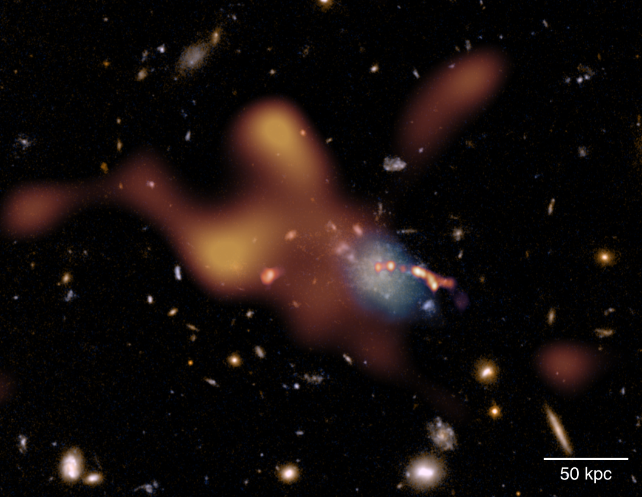
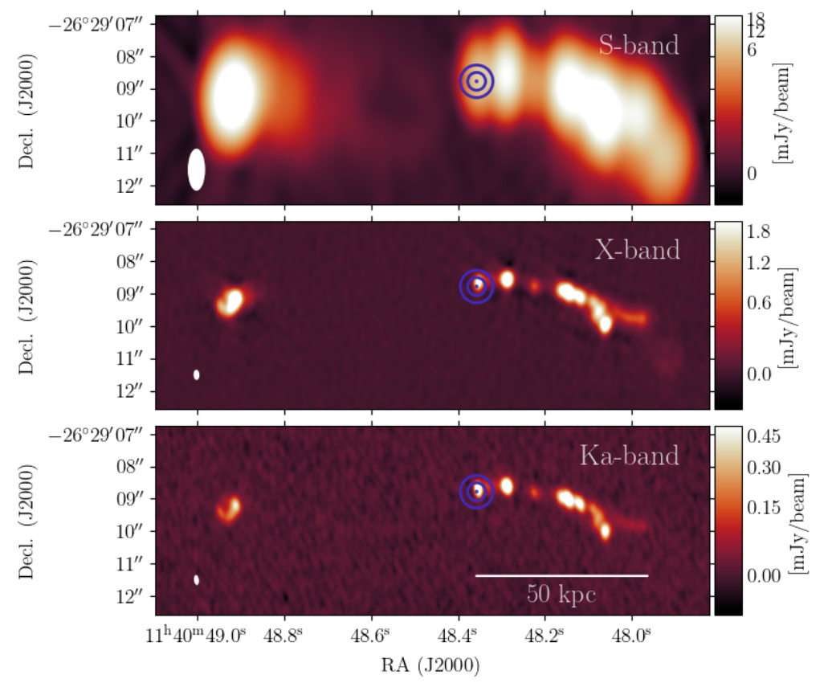
Proto-clusters
Spiderweb proto-cluster: being magnetized by its central radio jet?
  Anderson et al. (2022)
RM and SZ effect remain observable to high redshift
  complementary probes of the co-evolution of magnetic fields and baryons during cluster assembly
Can AtLAST provide a better view of the gas thermodynamics in proto-clusters?
  Jet feedback on proto-cluster gas
  Is the high-RM/jet-bend region coincident with overpressured gas?
  Are jet-gas interaction regions visible as tSZ enhancements?
Di Mascolo+24
Notes:
ALMA tSZ signal

Slide 17

Summary
Current Faraday rotation surveys are able to probe diffuse (magnetised) gas from the CGM to IGM
    magnetised CGM in nearby galaxies (< 0.1 Mpc) Heesen+24
    IGrM – WHIM interface (0.1 – 5 Mpc, 0.1 – 1 μG) Anderson+24
    Supercluster of galaxies (~1 μG, < 5 Mpc) Alonso-López+26
    cosmic web filaments (WHIM, > 5 Mpc), B ~ 10 nG (z ~ 0) Carretti+23
tSZ and kSZ from AtLAST can break degeneracies in order to more reliably infer the magnetic field properties across a wide range of cosmic scales
Future is bright with SKA-Mid and SKA-Low (2029+)
  AtLAST as the perfect buddy?
This research is supported by funding from the Comunidad de Madrid Atracción de Talento program via grant 2022-T1/TIC-23797, and grant PID2023-146372OB-I00 funded by MICIU/AEI 10.13039/501100011033 and by ERDF, EU.
Notes:
Naively favours inflationary vs causal or astro
However “inverse-cascade” pushes B power to large scales, so TBD (need self consistent sims from generation to structure formation)

Slide 18
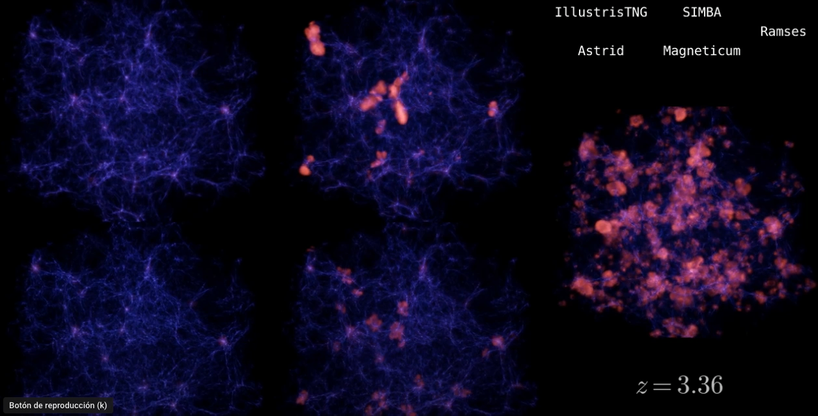
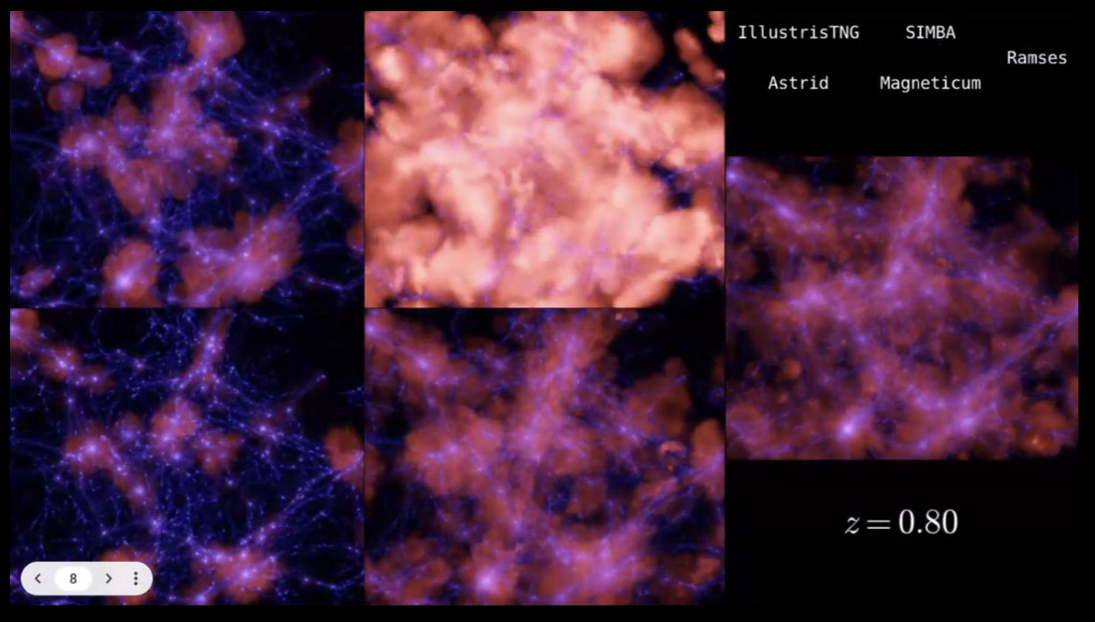
Differences in simulation predictions
Francisco Villaescusa-Navarro
gas density (blue) and gas temperature (red), 25 Mpc³ box
Notes:
https://www.youtube.com/watch?v=-Za5Eer0DXw

