Slide 1
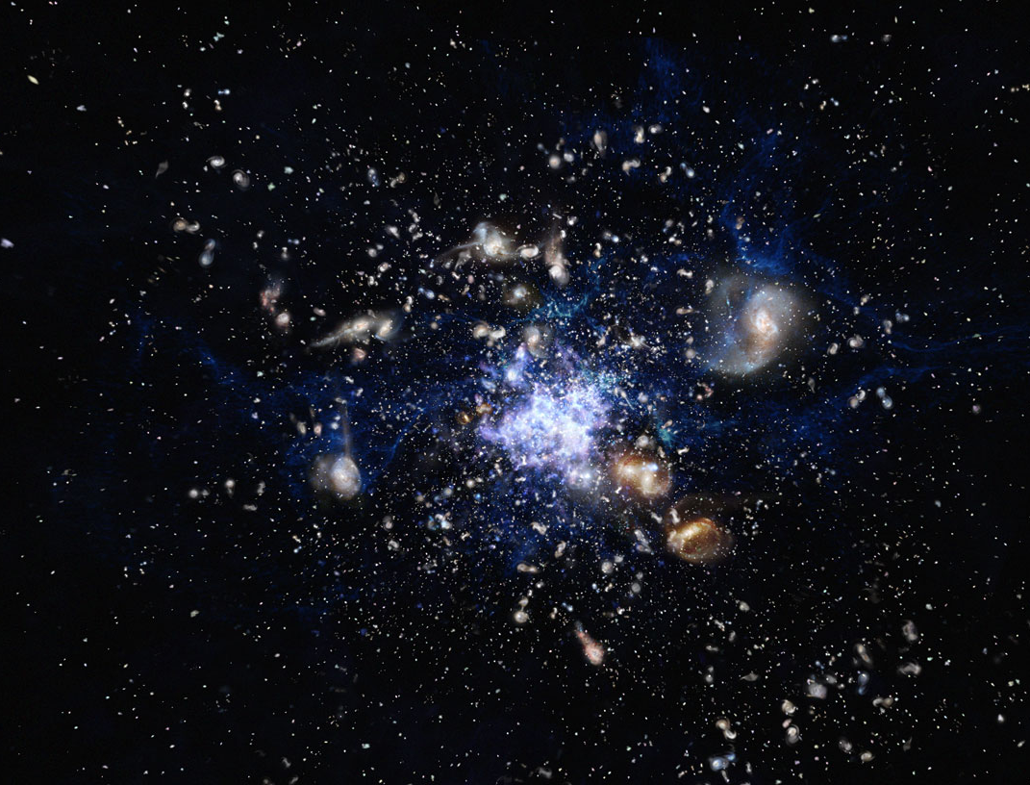



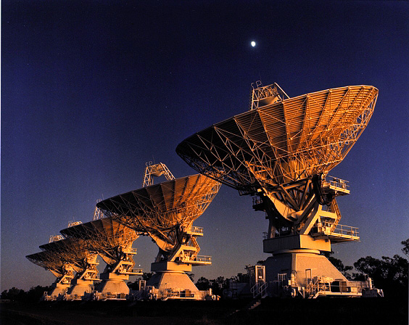


Extended Molecular Gas in Protoclusters:
A Science Case for AtLAST
Helmut Dannerbauer
Instituto de Astrofísicas de Canarias
@ESO/Kornmesser

Slide 2
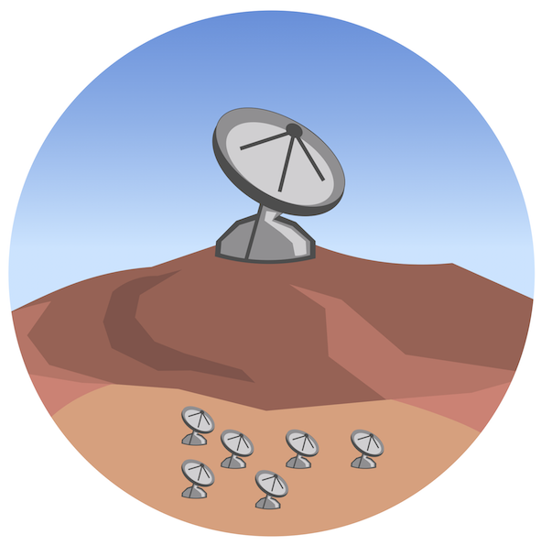
Extended Molecular Gas in Protoclusters:
A Science Case for AtLAST
Helmut Dannerbauer
Instituto de Astrofísicas de Canarias
@ESO/Kornmesser

Slide 3
Extended Molecular Gas in Protoclusters:
A Science Case for AtLAST
Science case white paper CGM:
Lee + AtLAST coll., 2024, ORE, arXiv: 2403.00924
WG1-2 Charting the gas flows around early galaxies with AtLAST (Lagos & Pensabene)
Helmut Dannerbauer
Instituto de Astrofísicas de Canarias
@ESO/Kornmesser

Slide 4
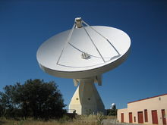
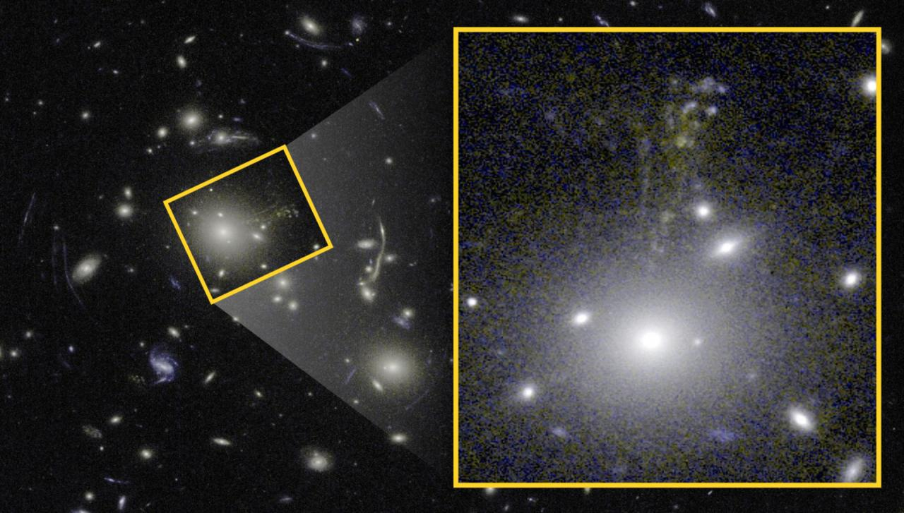
Cosmic Seahorse – Milky Way Analogue @ z=1.6
Sulzenauer, Dannerbauer et al. 2021

Slide 5
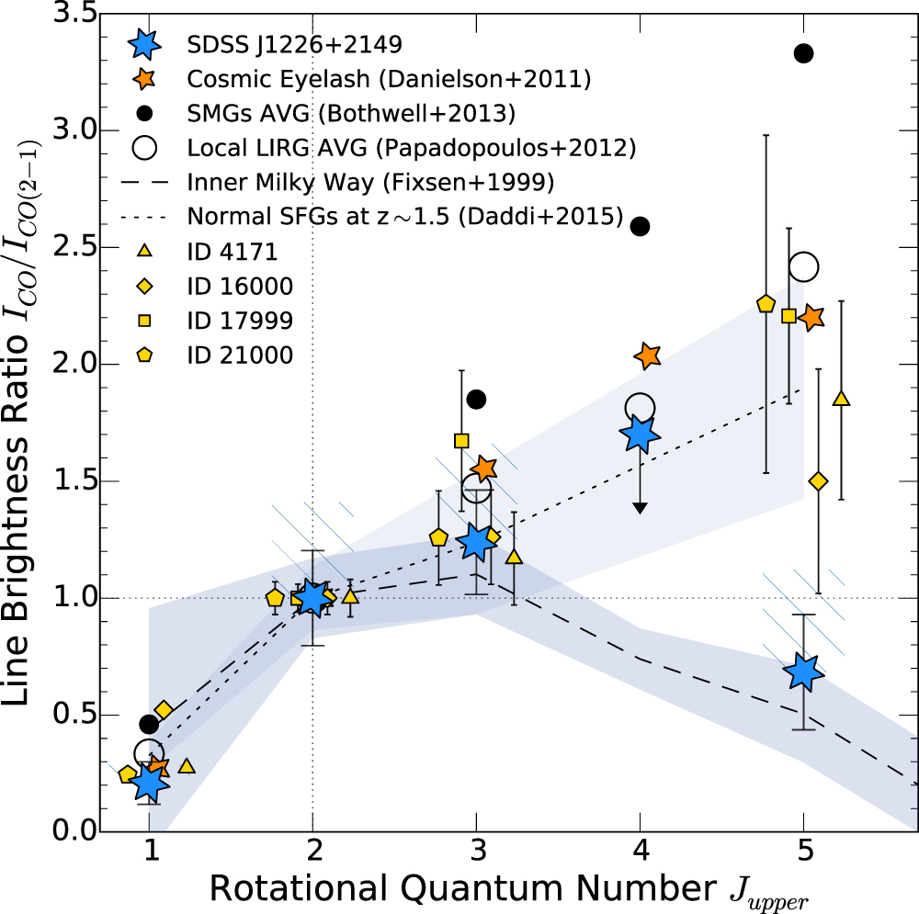
Cosmic Seahorse – Milky Way Analogue @ z=1.6
37.2hrs on-source
Cold gas excitation is very low in SDSSJ1226. High density, high temperature component typical for high-redshift normal SF galaxies (Daddi+2015) seems to be missing.
First ever detection of ultra-bight Milky Way-like gas excitation at high-redshift!
CO Spectral Line Energy Distribution

Slide 6
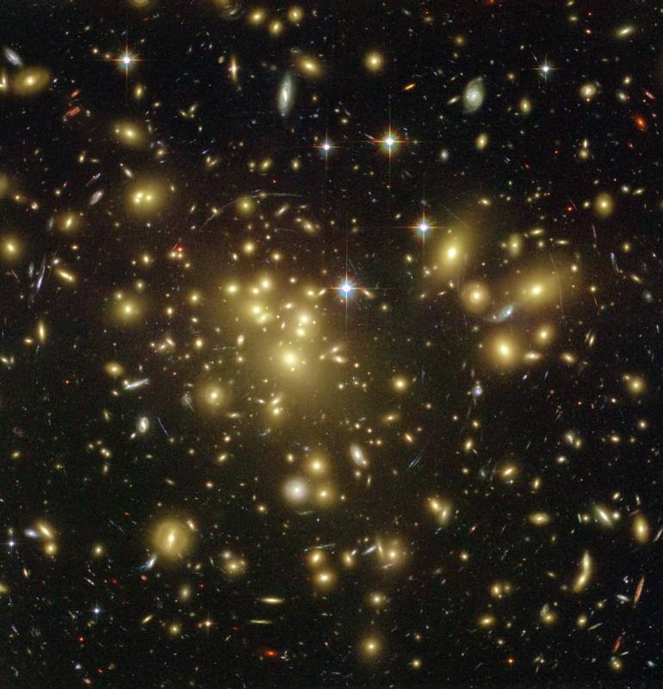
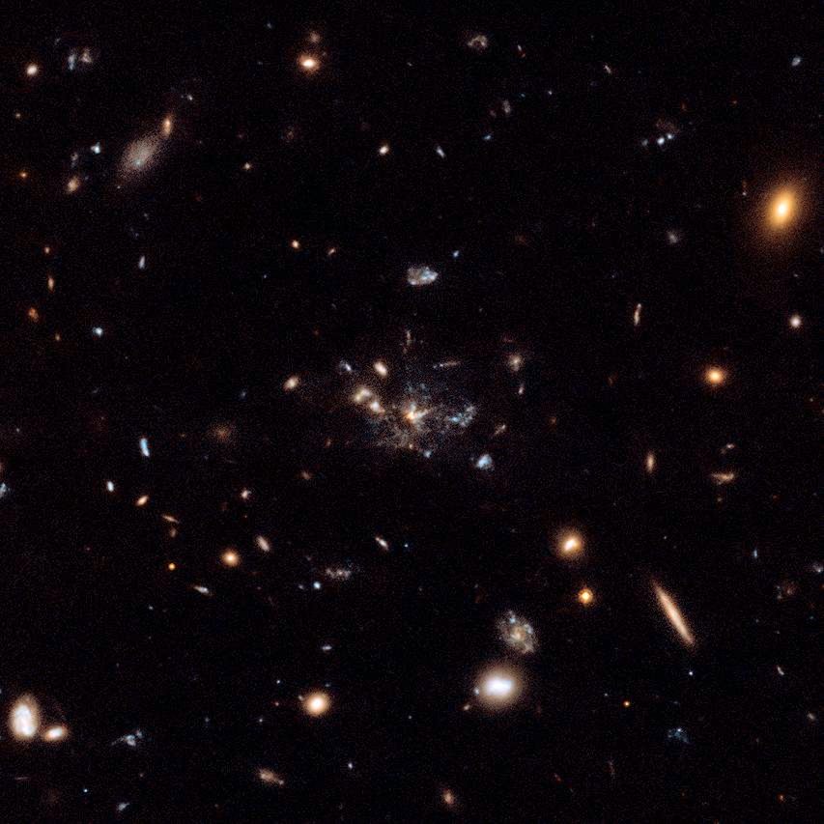
Main Scientific Questions
assembly, formation and evolution of the progenitors of local galaxy clusters and its galaxy members
formation of red sequence galaxies (in clusters)
local
distant
red sequence
blue cloud
Peng et al. (2010)

Slide 7

Galaxy Protoclusters
see also José‘s and Itziar‘s
talks tomorrow ☺
not yet an official definition, isn‘t it?!
Popular Science
.
„Clusters of galaxies have back-stories worthy of a Hollywood blockbuster: their existences are marked by violence, death and birth, arising after extragalactic pile-ups where groups of galaxies crashed into each other“
by N. Seymour in on-line journal
„The Conversation“
Scientific Definition
.
“a non-virialized structure in the distant universe which will finally collapse into a typical local galaxy cluster, a virialized system of a mass larger than 10¹⁴ M_{sun}”
R. Overzier, 2016, A&ARv, 24, 14
popular one, widely accepted☺
Notes:
Read Narayanan ea 2010 paper

Slide 8
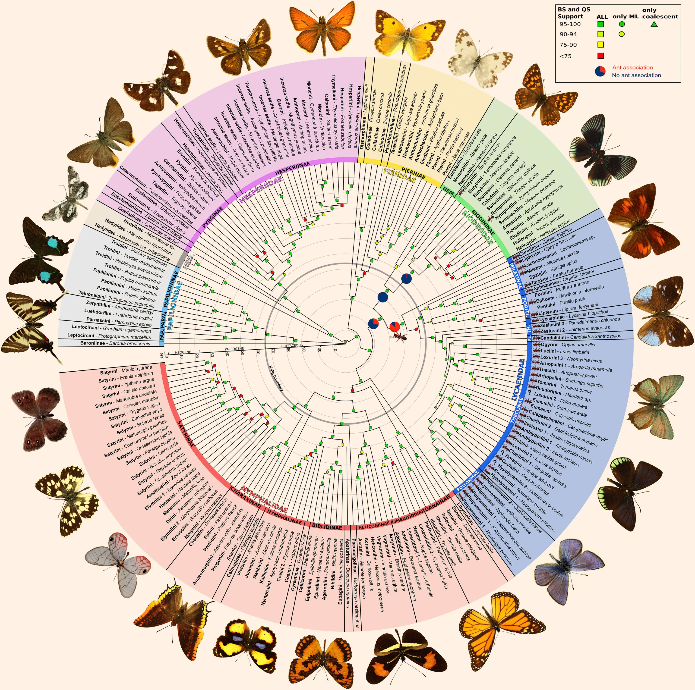

increase sample sizes: cluster AND their members
Espeland+2018, Current Biology
from butterfly collecting...
galaxy members #
.....to evolutionary biology
(proto)galaxy cluster at high-z#
adapted(inspired) from(by) Roderik Overzier

Slide 9

increase sample sizes: cluster AND their members
Espeland+2018, Current Biology
great prospects with
AtLAST☺
from butterfly collecting...
galaxy members #
.....to evolutionary biology
(proto)galaxy cluster at high-z#
adapted(inspired) from(by) Roderik Overzier

Slide 10

Helmut´s Wish List
large field of view > deg2
multi-object spectroscopy (crowded field)
(sub)mm IFU
simultaneous multi-band continuum imaging
sensititve to low-surface brightness emission
Sunyaev-Zeldocvic’h effect detection beyond z=2

Slide 11
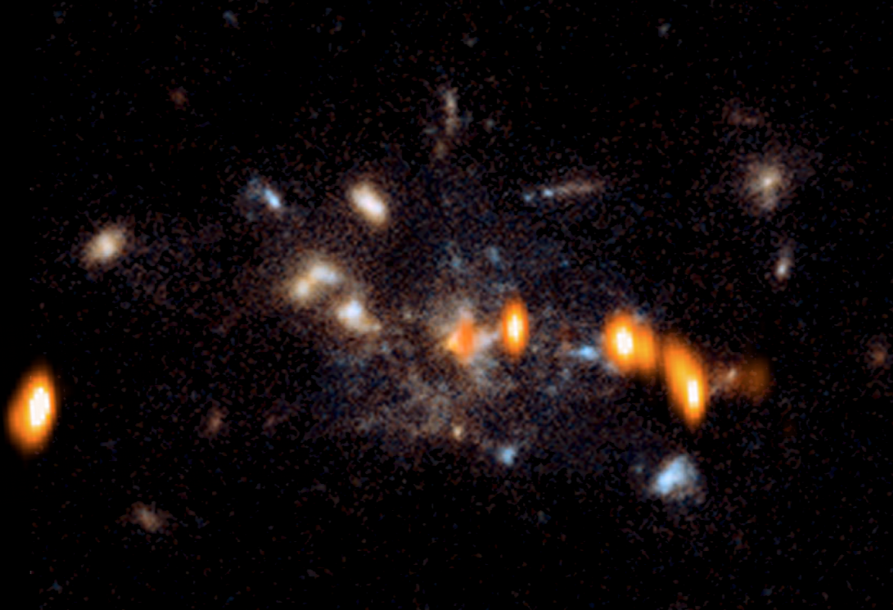
HzRG: MRC1138-262 alias Spiderweb Galaxy
→will evolve into a Brightest Cluster Galaxy
Carilli et al 1997
25 kpc
z = 2.16
(23% of age Universe)
Miley et al. 2006 (Credits: NASA, ESA, George Miley and Roderik Overzier (Leiden Observatory, NL)

Slide 12
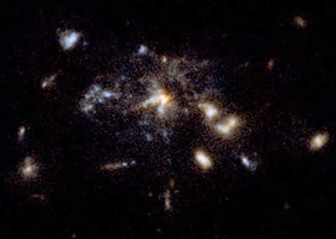
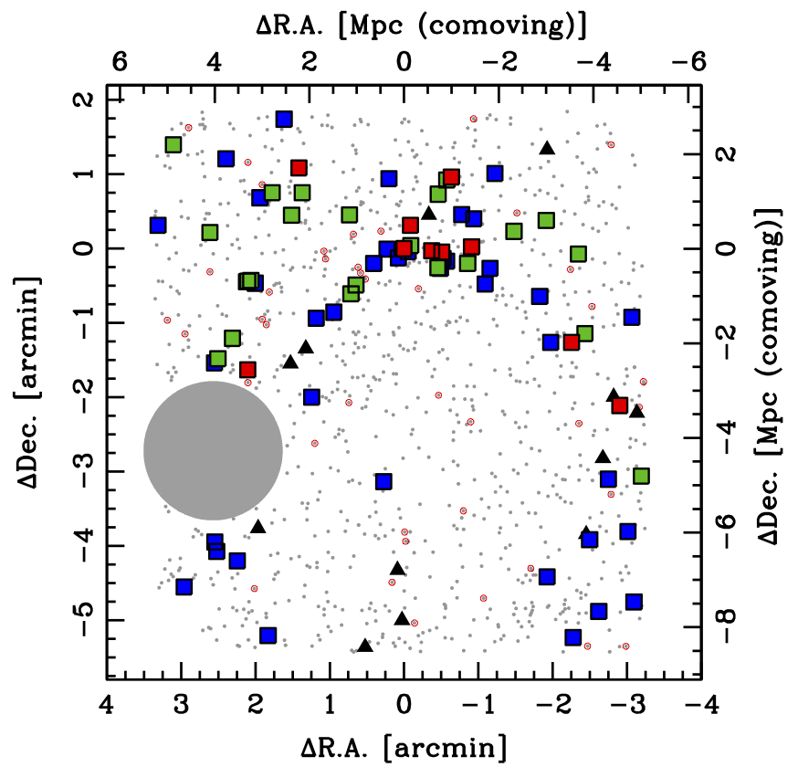
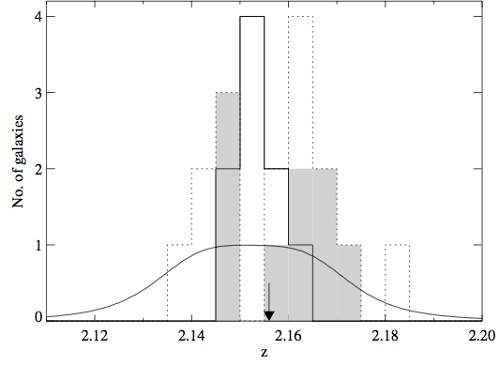
Protocluster MRC1138 @ z=2.16
→will evolve into a BCG
HAEs
13arcsec
Miley+2006
Koyama+2013
Koyama+2013
Kurk+2004b
Shimakawa … HD et al. 2018, MNRAS
Notes:
HzRG signpost for cluster formation
HzRG is beacon and dusty starbursts as traces of filamentary structures
Red sequence as well there
Solid: HAE
Dotted: LAE (shaded in ISAAC field)
Eight times larger area than SCUBA

Slide 13

Di Mascolo, Saro..a.o. HD.. et al. 2023, Nature
ESO PR: „Finding a large reservoir of hot gas in the Spiderweb protocluster would indicate that the system is on its way to becoming a proper, long-lasting galaxy cluster rather than dispersing.“

Slide 14
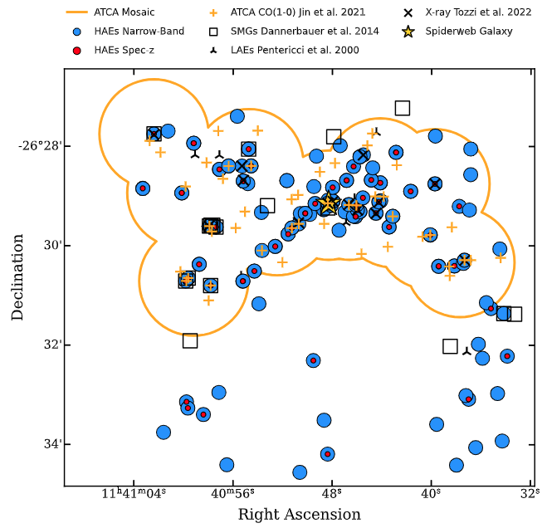
The Spiderweb protocluster @ z=2.16
revealing different galaxy populations
Spiderweb Radio Galaxy
Van Ojik+95, Pentericci+98
Miley+06, Emonts+16,+18
Anderson+22
H$α$ Emitters (PCL-backbone)
Kurk+04ab, Koyama+13
Shimakawa+18,+24ab,
Perez-Martinez+23,+24
Daikuhara+24
Perez-Martinez+24c (sub.)
>100 z-spec members
Ly$α$ Emitters
Kurk+00, Pentericci+00
Molecular Gas
Dannerbauer+17
Emonts+18, Tadaki+19,
Jin+21, Chen+24,
Perez-Martinez+25
Red Sequence
Kurk+04, Kodama+07
Zirm+08, Tanaka+13
Naufal+24
D’Eugenio+ subm.
4 pMpc
Dusty/SMG
Rigby+14
Dannerbauer+14)
Zeballos+18
Zhang+24, 26
X-ray
Tozzi+22ab, Carilli+23
Lepore+24
Perez-Martinez+25
SZ-effect
Di Mascolo+23
Shimakawa, priv. comm.

Slide 15
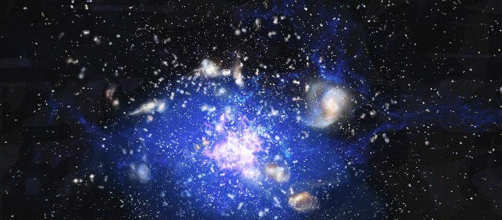
Spiderweb Galaxy: Cold Molecular IGM
Emonts … HD et al. 2016, Science
low-surface-brightness emission!
VLA sees only
~33% of ATCA flux!!
WG1-15 Missing Flux (Andreani)

Slide 16
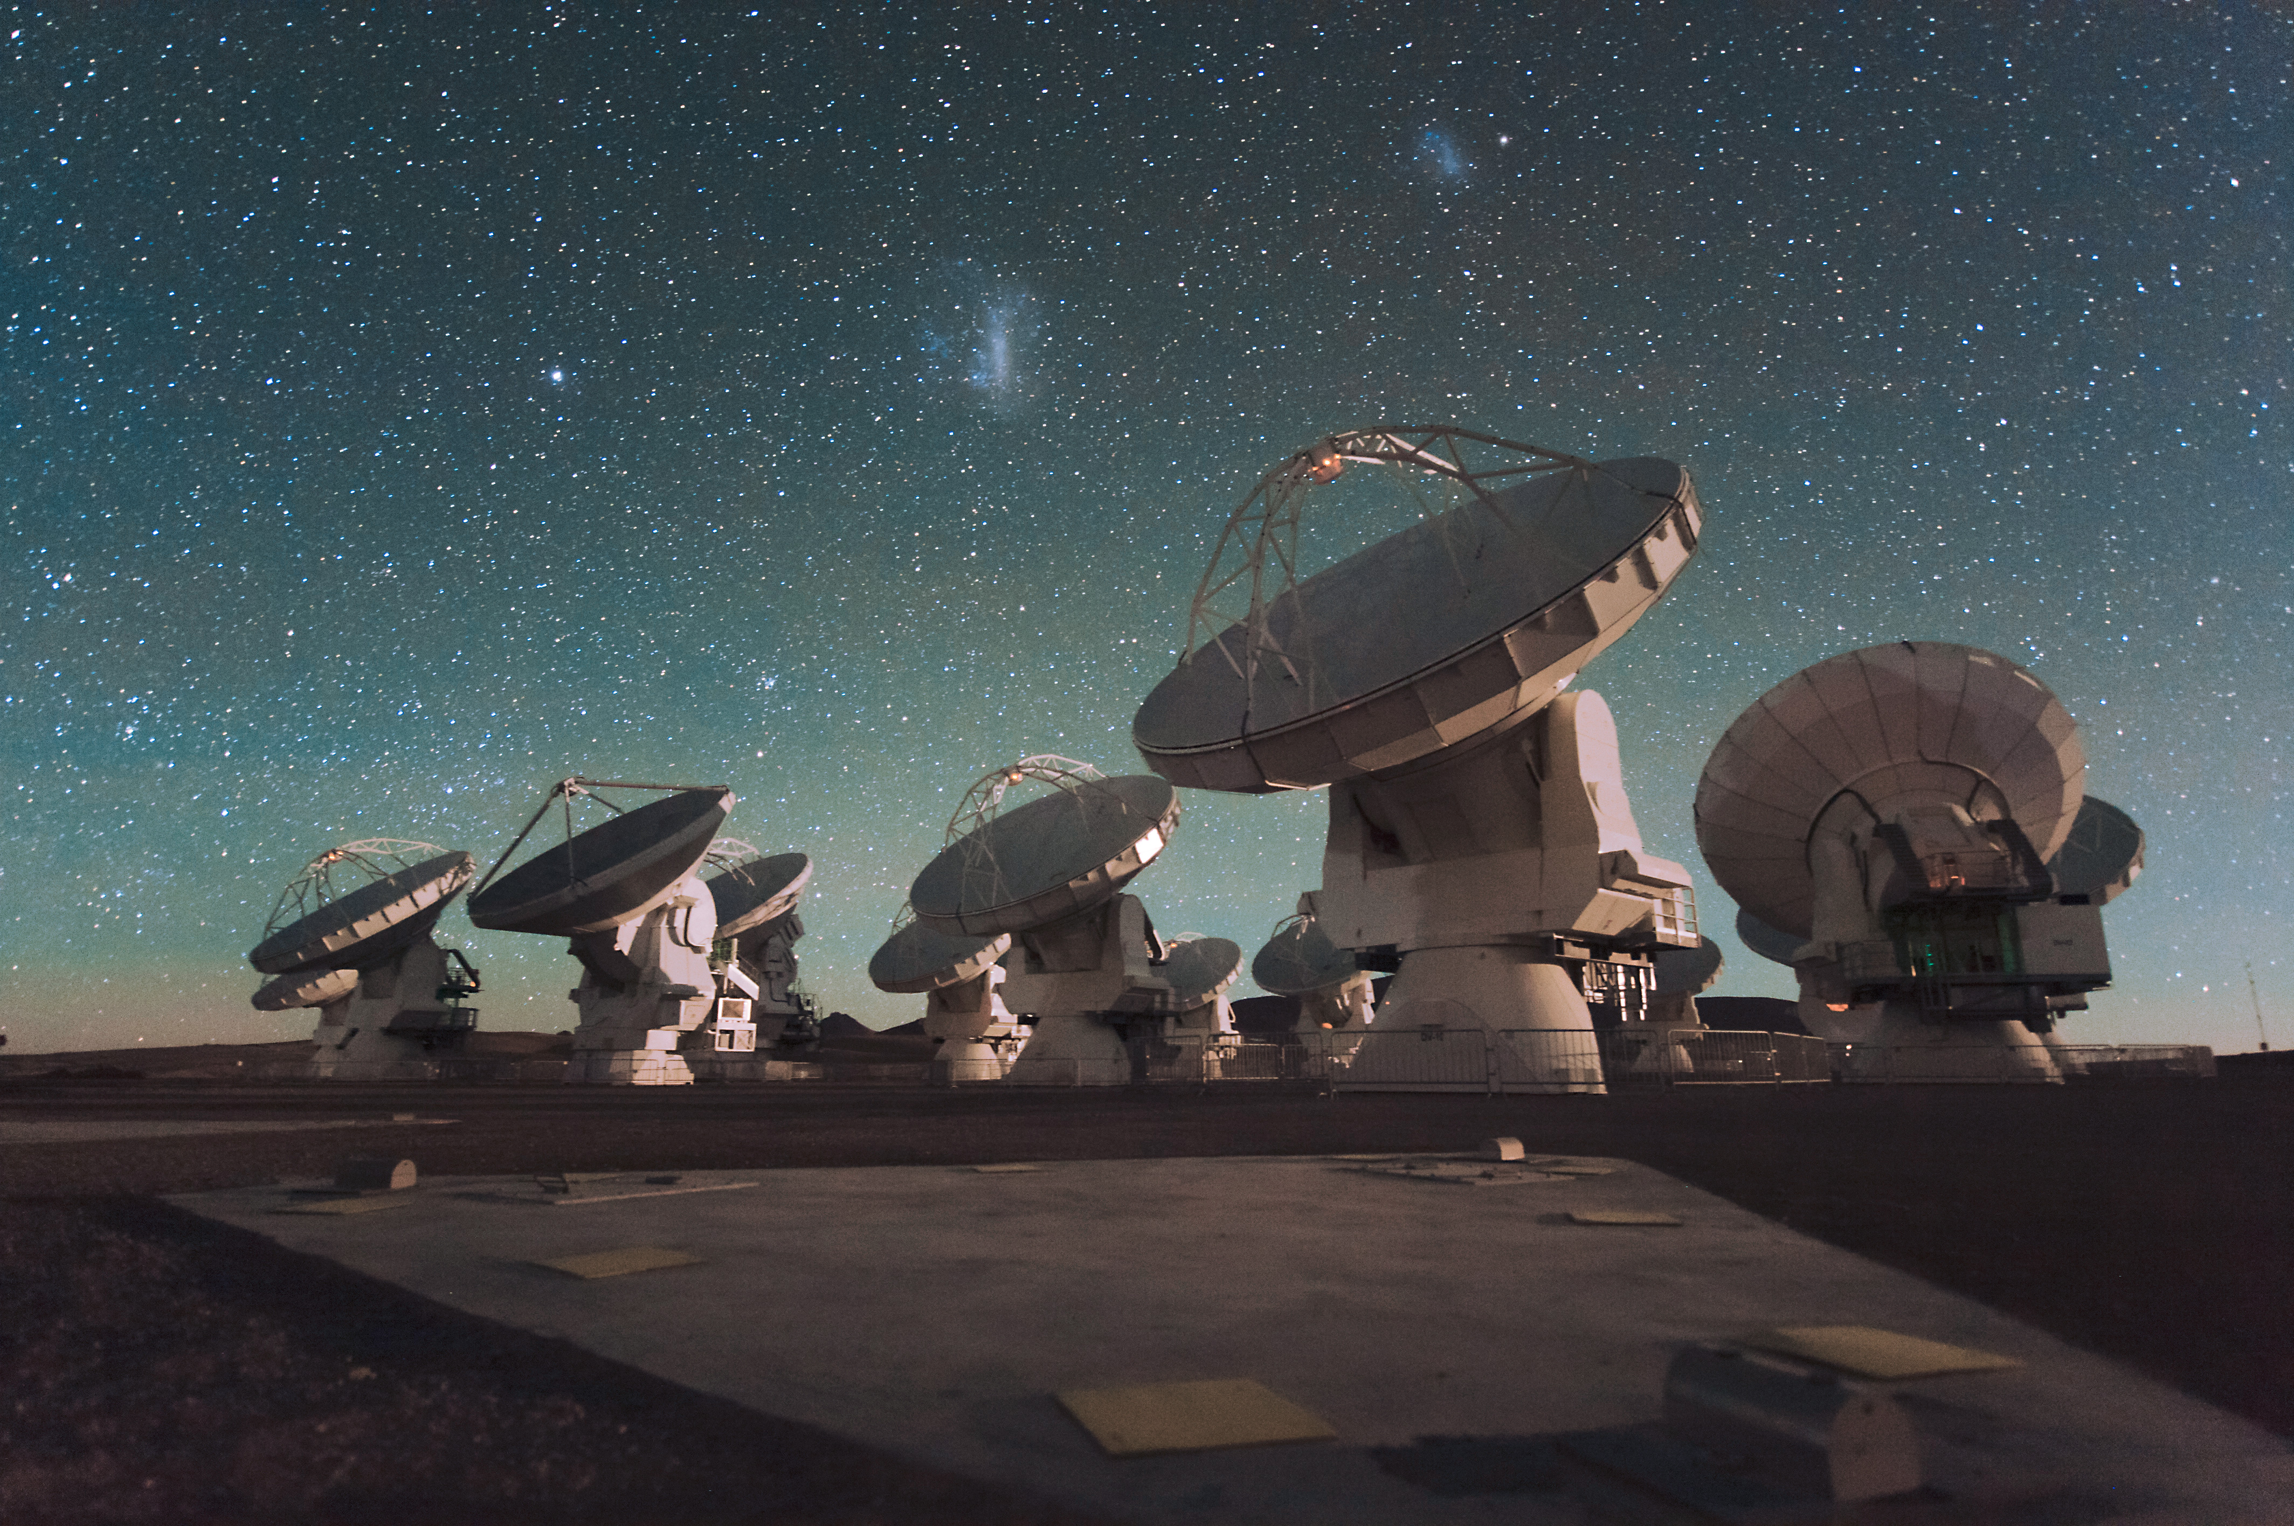
Extended Cold IGM in the Spiderweb Galaxy
ALMA
Emonts, Lehnert, HD et al. 2018, MNRAS, 477, 60
Subaru
Subaru
Shimakawa … HD et al. 2018, MNRAS, 481, 5630

Slide 17
[CII] is extended too
APEX observations
[CII] line cannot be
done with ALMA!
De Breuck … HD et al. 2022, A&A

Slide 18
ATCA
Emonts et al. (2013)
Dannerbauer, Lehnert, Emonts et al. 2017, A&A, 608, 48

Slide 19
CO(1-0): 40kpc large molecular gas reservoir
ATCA
NW
SE
HD, Lehnert, Emonts et al. 2017, A&A, 608, 48

Slide 20
Extended molecular gas reservoirs
typical sizes are up to 6-8 kpc
large molecular gas reservoirs could feed the ICM through “truncation”
Hodge et al. 2015; Ivison et al. 2011
in Spiderweb Protocluster
Emonts et al. 2016
Dannerbauer et al. 2017
Spiderweb Galaxy
HAE229
Ginolfi et al. 2017

Slide 21
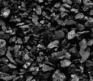
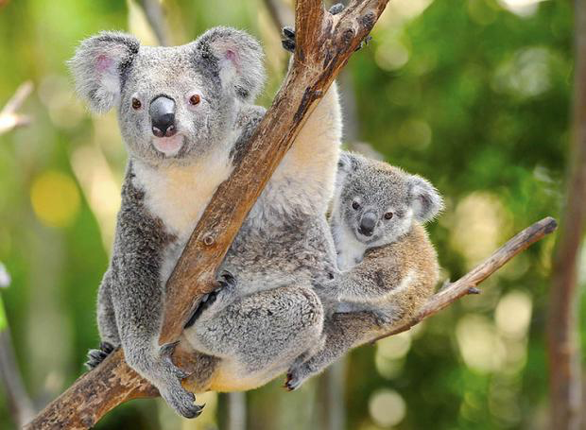

COALAS
CO ATCA Legacy Archive
of Star-Forming Galaxies
ATCA Large Program (PI: Dannerbauer)
Team: Zhengyi Chen, Bjorn Emonts, Shuowen Jin, Matthew D. Lehnert, José M. Pérez Martínez, Alaisdair Thomson, James Allison, Bruno Altieri, Itziar Aretxaga, Jack Birkin, Niel Brandt, Scott Chapman, Caitlin Casey, Jackie Champagne, Carlos De Breuck, Guillaume Drouart, Nina Hatch, Jackie Hodge, Minh Huynh, Balt Indermuehle, Amy Kimball, Tadayuki Kodama, Yusei Koyama, Claudia Lagos, Peter MacGregor, George Miley, Desika Narayanan, Ray Norris, Huub Roettgering, Eva Schinnerer, Paolo Serra, Nick Seymour, Rhythm Shimakawa, James Simpson, Mark Swinbank, Ivan Valtchanov, Fabian Walter, Julie Wardlow
>800 hrs approved, observations finished in March 2020
CO(1-0) observations of (dusty) star-forming galaxies
selected from the Spiderweb Protocluster field and ALESS (APEX-LABOCA survey of the Extended Chandra Deep Field South) field
complementing ALMA molecular gas and dust observation
GOAL: impact of environment on molecular gas reservoir

Slide 22
COALAS survey:
ATCA CO(1-0) map of Spiderweb protocluster
1.8 arcmin
450hrs, 13 pointing
still largest, coherent CO map of a high-z cluster stucture
46 detections
Shuowen Jin, HD et al., 2021, A&A

Slide 23
COALAS survey: ATCA CO(1-0) map

Slide 24

Search for large molecular gas reservoirs > 40kpc
carried out by former PhD student Zhengyi Chen, Nanjing U + IAC (through CSC fellowship)
inhomogeneous data set
Assessment of data quality:
SNR of the CO emission detection
beam spatial resolution
location in the pointing
Criterion Binary Ranking
9 bits
Extendeded Molecular Gas: Chen, Z., HD, et al. 2024, MNRAS, 527, 8590

Slide 25
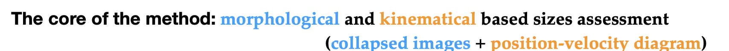
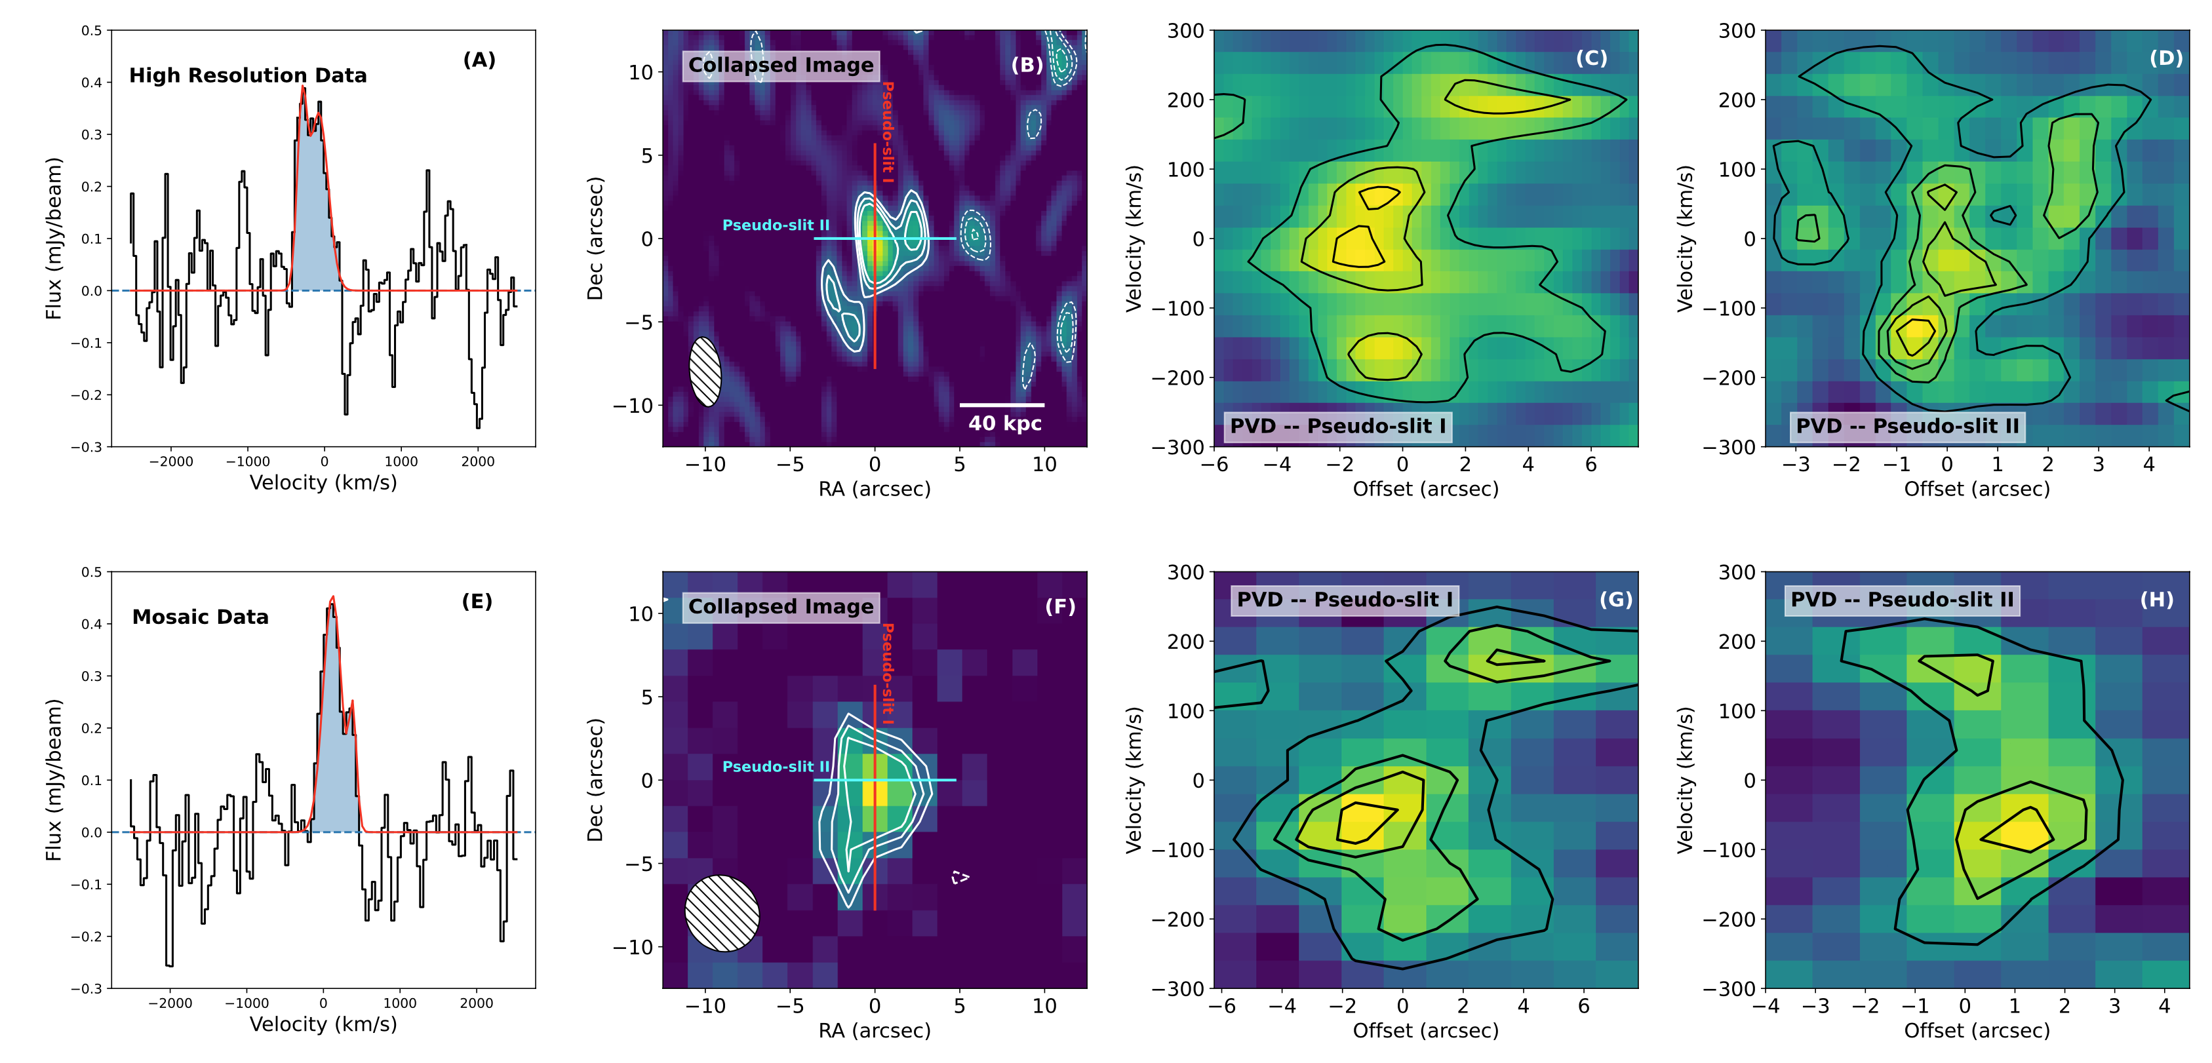
Search for large molecular gas reservoirs > 40kpc
collapsed images position-velocity diagram
Coarse Data – map/mosaic
(low-resolution;
7-10 arcsec)
To confirm our assessment - large molecular gas reservoir
— follow-up observations have been conducted.
High resolution
@ 3 arcsec

Slide 26
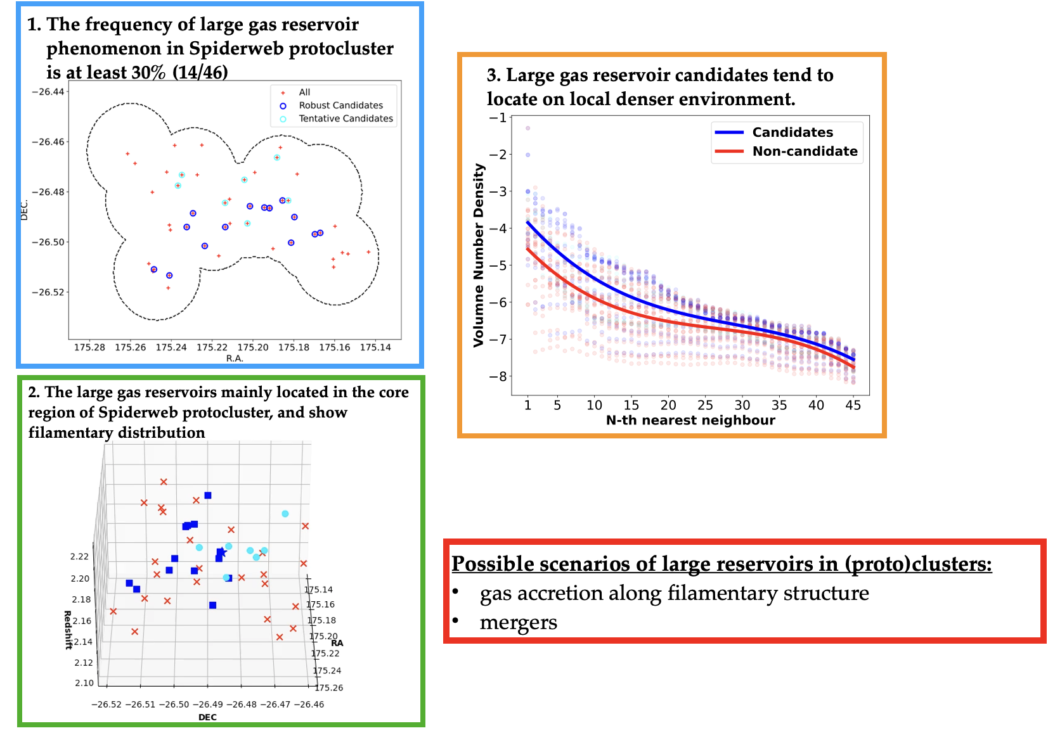
Search for large molecular gas reservoirs > 40kpc

Slide 27
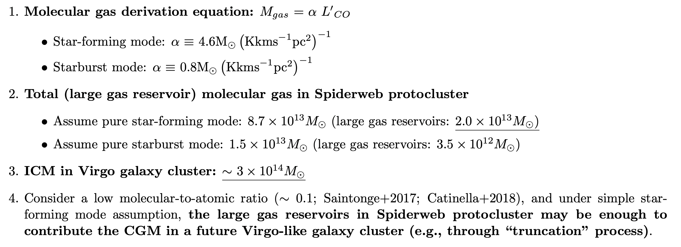
Can the large molecular gas reservoirs feed the future ICM?
→ the large molecular gas reservoirs in the SW protocluster may be enough to contribute to the ICM in a future Virgo-like galaxy clusters (e.g. through „truncation“ process)
“truncation” process: galaxy-galaxy encounter or gravitational interactions between galaxies and the (proto)cluster environment can result in the distortion, stripping, and truncation of galaxy halos (Moore+96, 98; Fujita 98)

Slide 28
Literature Search

Slide 29
Literature Search

Slide 30
More Studies☺
Li, Emonts et al. 2023, ApJ
Cicone et al. 2021, A&A
Rybak et al. 2025, A&A
Lee, Schimek et al. 2024, A&A

Slide 31
Science Case for AtLAST
white paper CGM: Lee + AtLAST coll., 2024, ORE, 4, 177 (arXiv: 2403.00924)

Slide 32
Conclusions and Remarks
Discovery of large molecular gas reservoirs appears to be a common feature in galaxy protoclusters.
These large molecular gas reservoirs could significantly contribute to the formation of the future ICM.
How frequent is this phenomenon?
Does it depend on environment?
Systematic studies are still scarce.
Large-number statistics are needed, but with current instrumentation such studies remain very demanding and time-consuming.
AtLAST would be a true game changer. 🙂

