Slide 1
Designing a sustainable off-grid power system in the Atacama Desert for AtLAST
A Techno-economic, environmental, and social approach
Guillermo Valenzuela-Venegas, Paola Velasco Herrejón, Marianne Zeyringer, Sabrina Sartori
Department of Technology Systems
University of Oslo

Slide 2
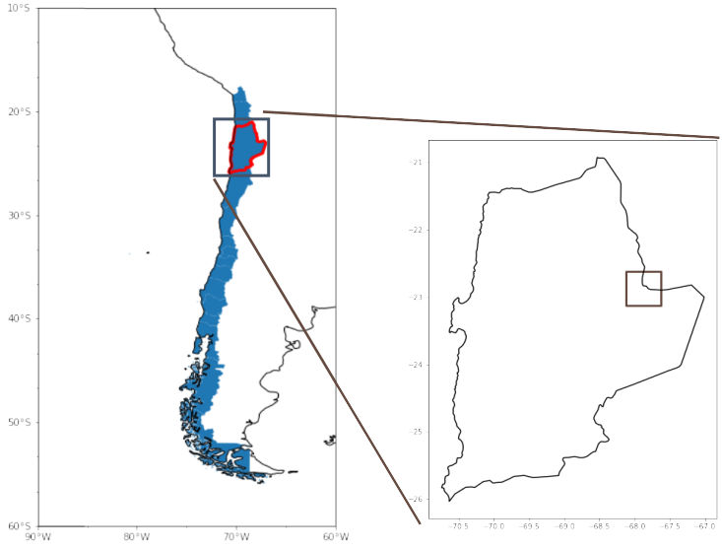
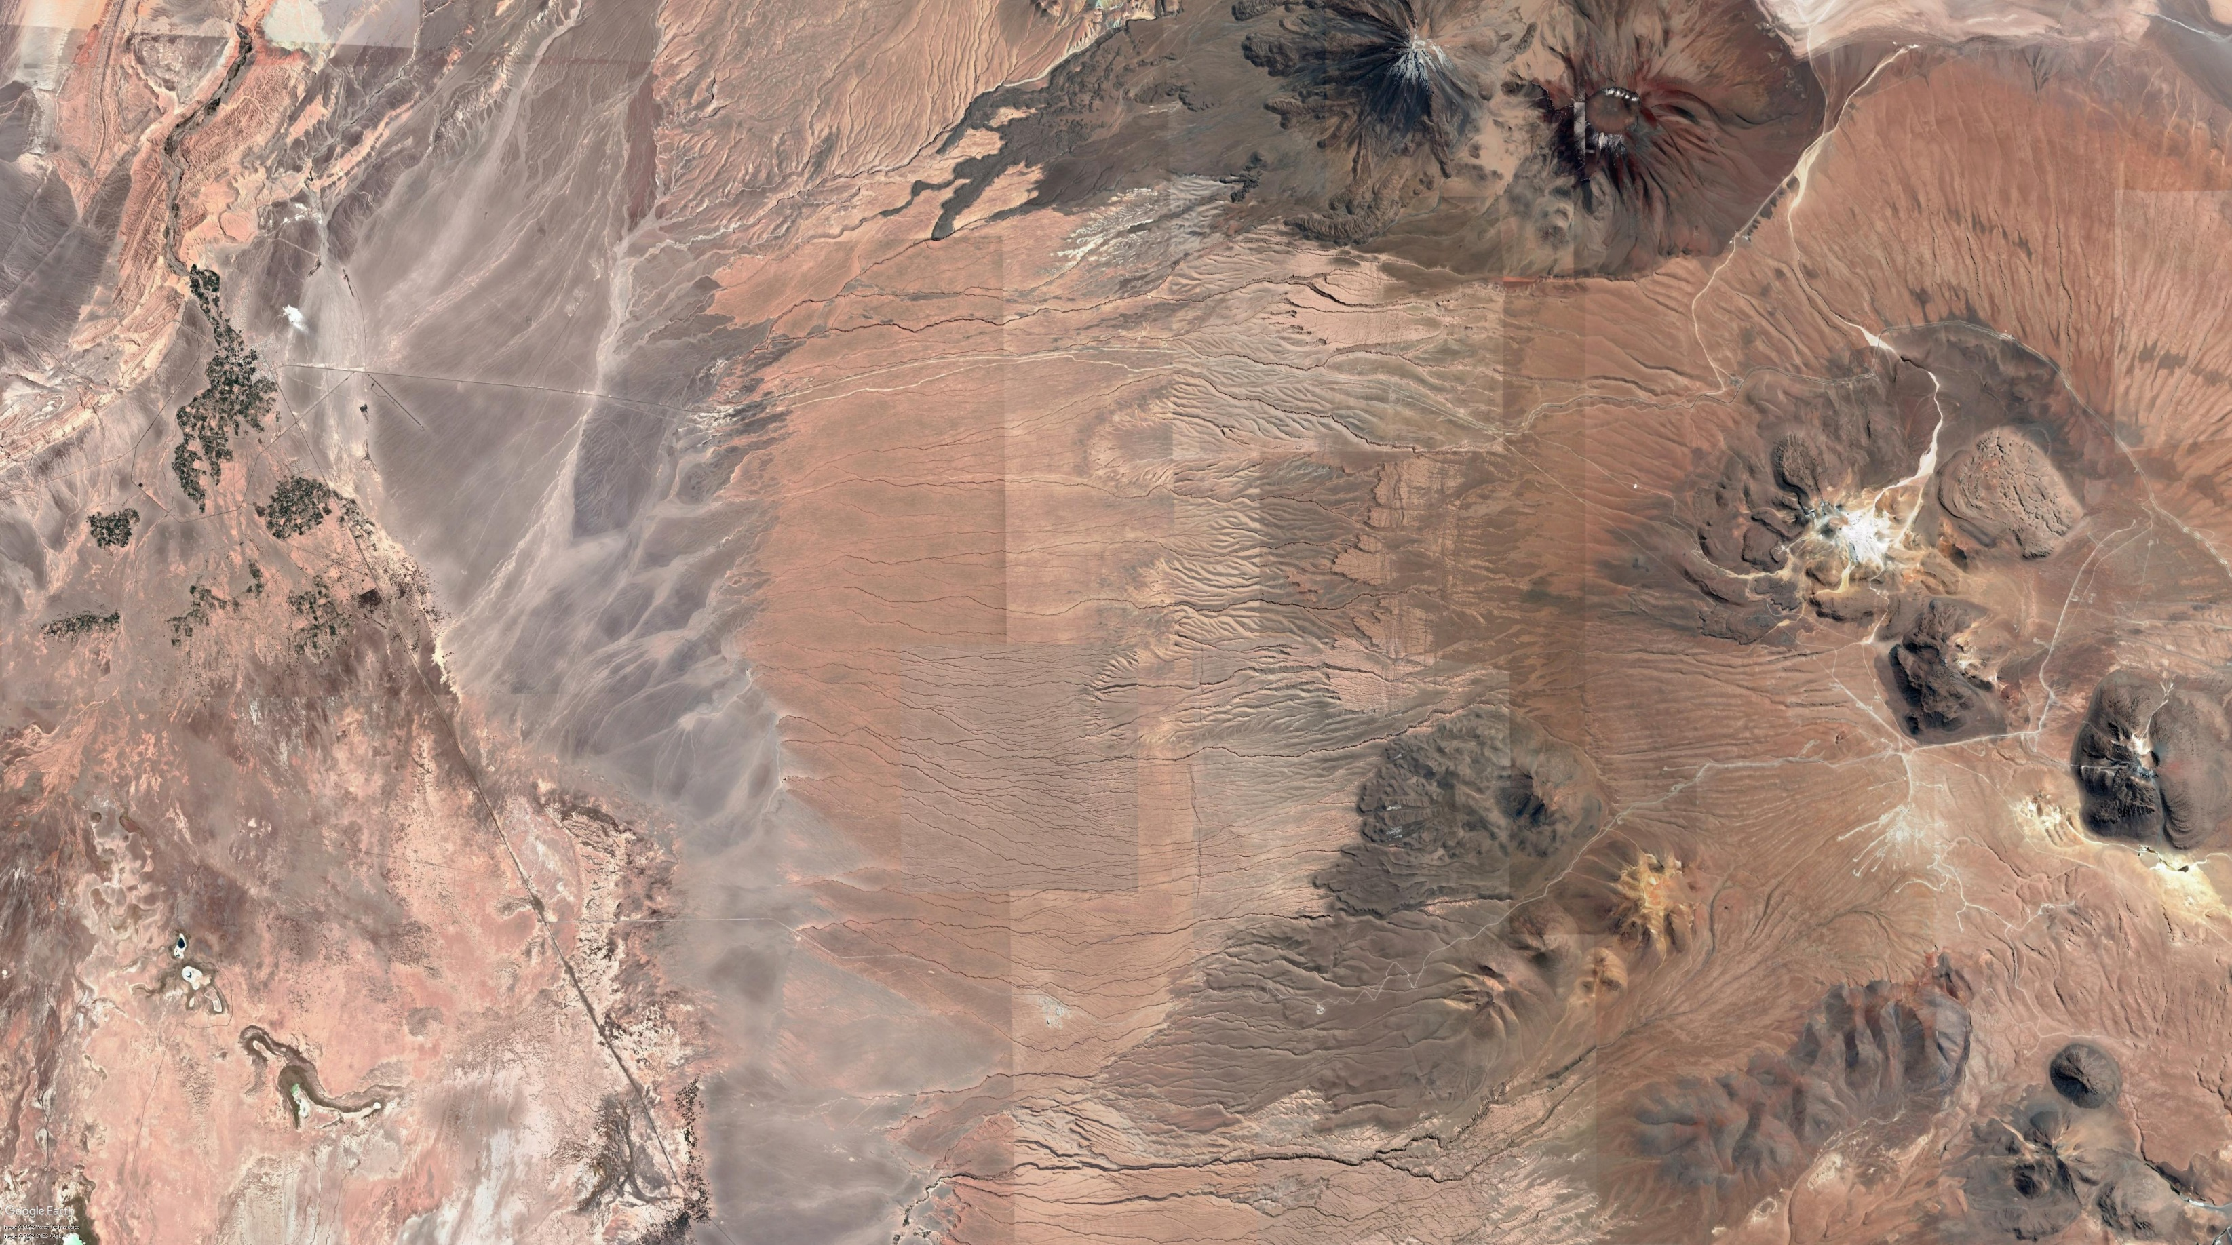
Chajnantor Plateau, Antofagasta, Chile
2

Slide 3

Chajnantor Plateau, Antofagasta, Chile
San Pedro
De Atacama
3

Slide 4
Chajnantor Plateau, Antofagasta, Chile
San Pedro
De Atacama
Diesel/natural gas generator (2022)
Telescopes in Chajnantor
San Pedro de Atacama
18-24 kt CO₂e/yr
9-12 kt CO₂e/yr
4

Slide 5
Chajnantor Plateau, Antofagasta, Chile
This area is also highly suitable for renewable energy generation (solar)
5

Slide 6
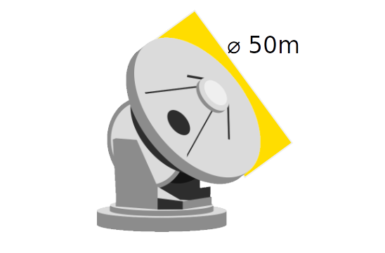
AtLAST
AtLAST is the first telescope to consider renewable (solar) energy sources in its design phase
Explore options to incorporate nearby communities
6

Slide 7
How can we power a remote telescope and include local communities?
7

Slide 8
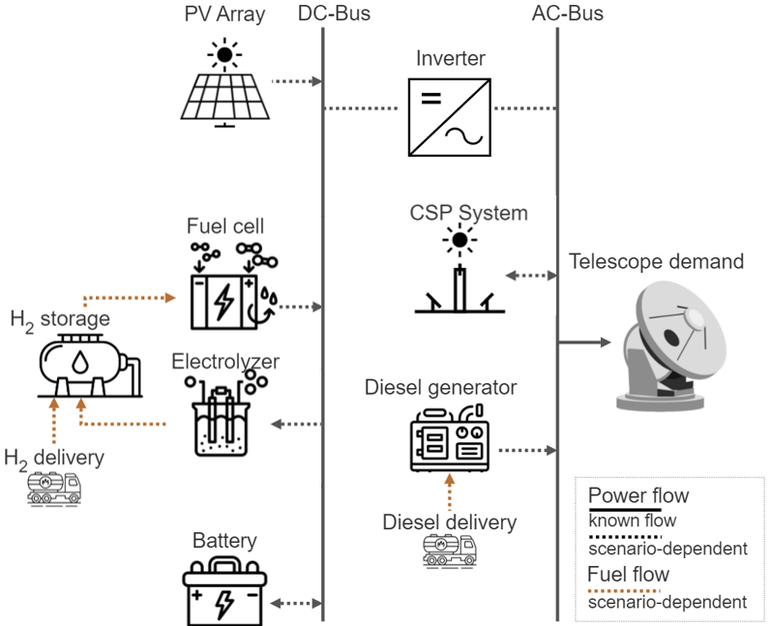
Renewable power system for an off-grid system
Projected operation: 2030
Considerations:
  Wind generation is not possible
  High altitude of 5000m or 2500m above sea level
  No transmission line
8

Slide 9
Renewable power system for an off-grid system
Renewable energy system for AtLAST
Economic
Environmental
Social
9

Slide 10
Renewable power system for an off-grid system
Renewable energy system for AtLAST
Economic
Environmental
Social
Techno-economical optimization
10

Slide 11
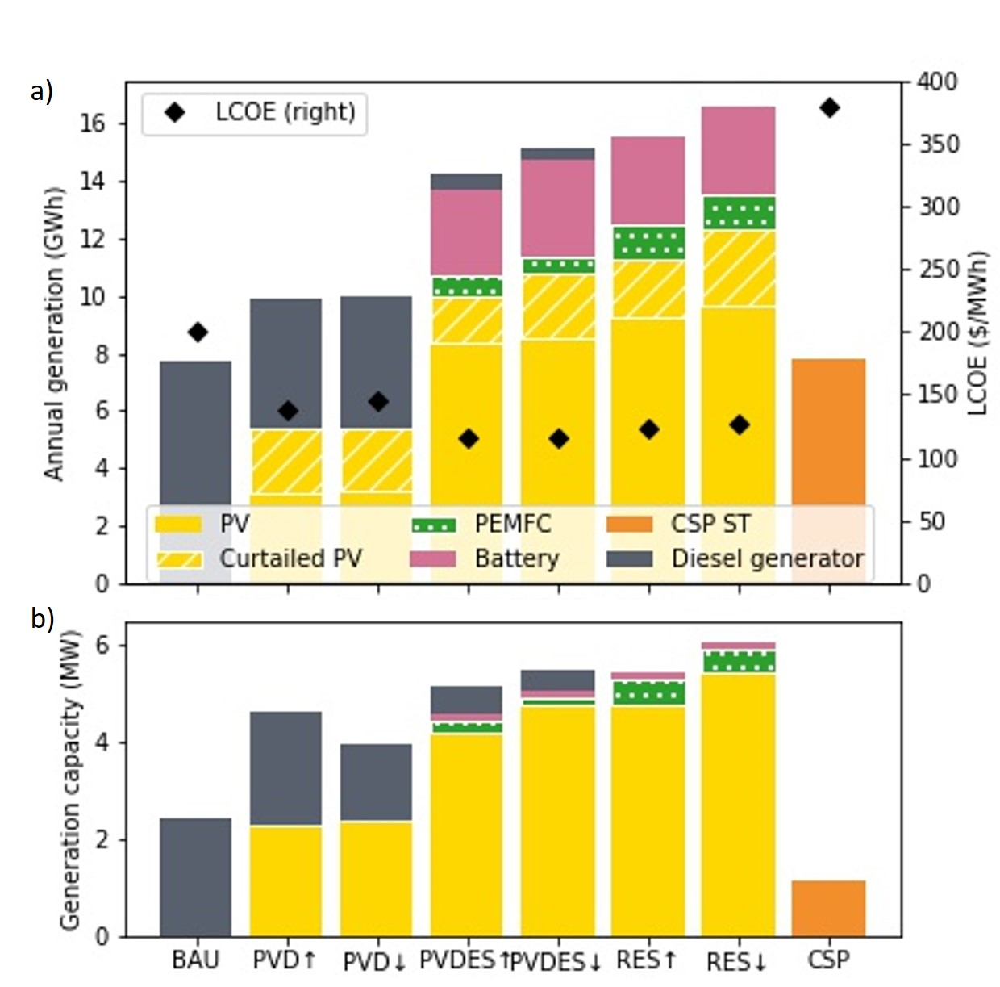
Renewable power system for an off-grid system
Source: Viole et al., 2023
DOI 10.1016/j.energy.2023.128570
11

Slide 12
Renewable power system for an off-grid system
Source: Viole et al., 2023
DOI 10.1016/j.energy.2023.128570
12

Slide 13
Renewable power system for an off-grid system
What is the environmental impact of these alternatives?
Which is the best option?
Source: Viole et al., 2023
DOI 10.1016/j.energy.2023.128570
13

Slide 14
Renewable power system for an off-grid system
Renewable energy system for AtLAST
Economic
Environmental
Social
Techno-economical optimization
Life Cycle Assessment
14

Slide 15
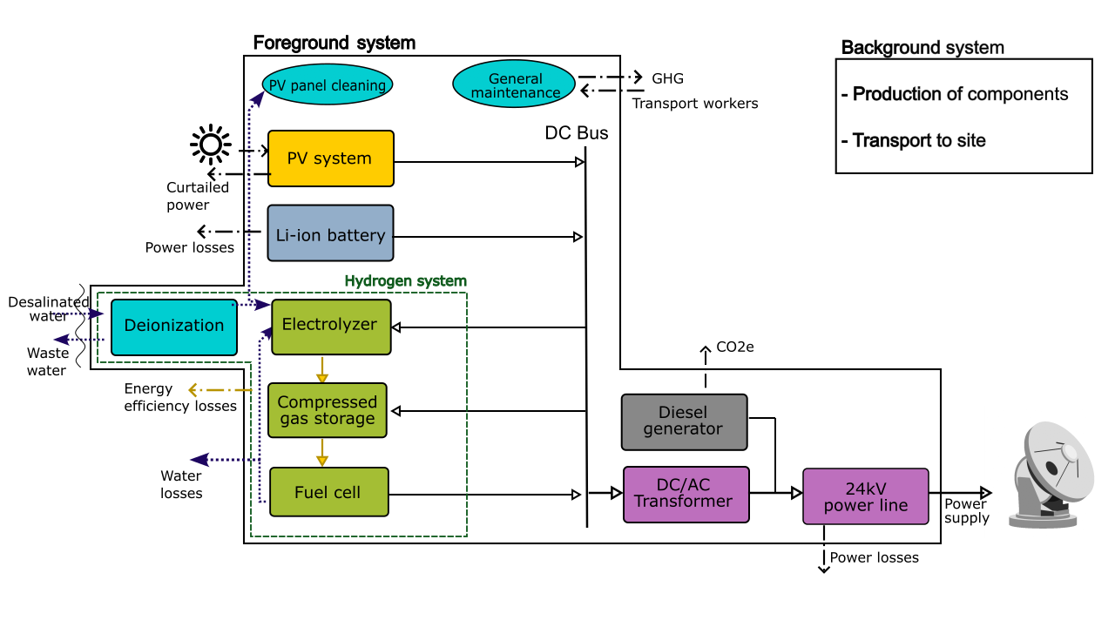
Life Cycle Assessment of a Renewable Power System
Environmental impact of AtLAST’s power system
  Climate change (CO₂e emissions)
  Water use
  Mineral resource depletion
Source: Viole et al., 2024
DOI 10.1007/s11367-024-02288-9
15

Slide 16
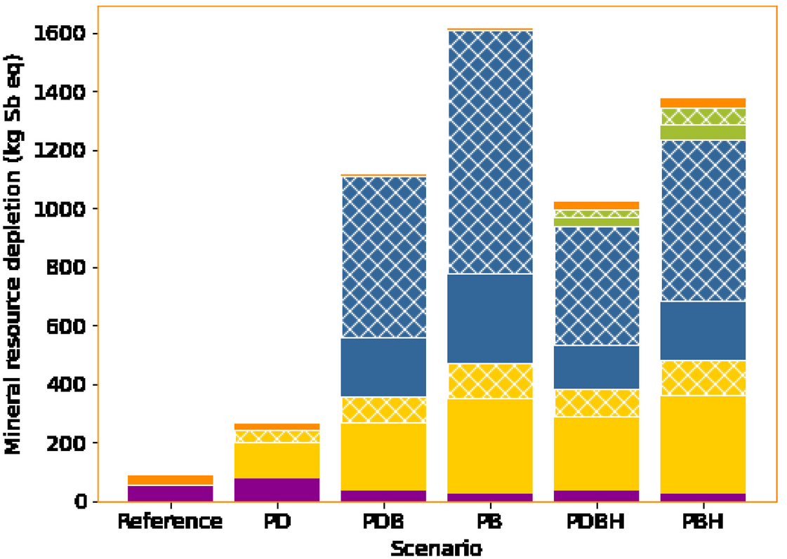
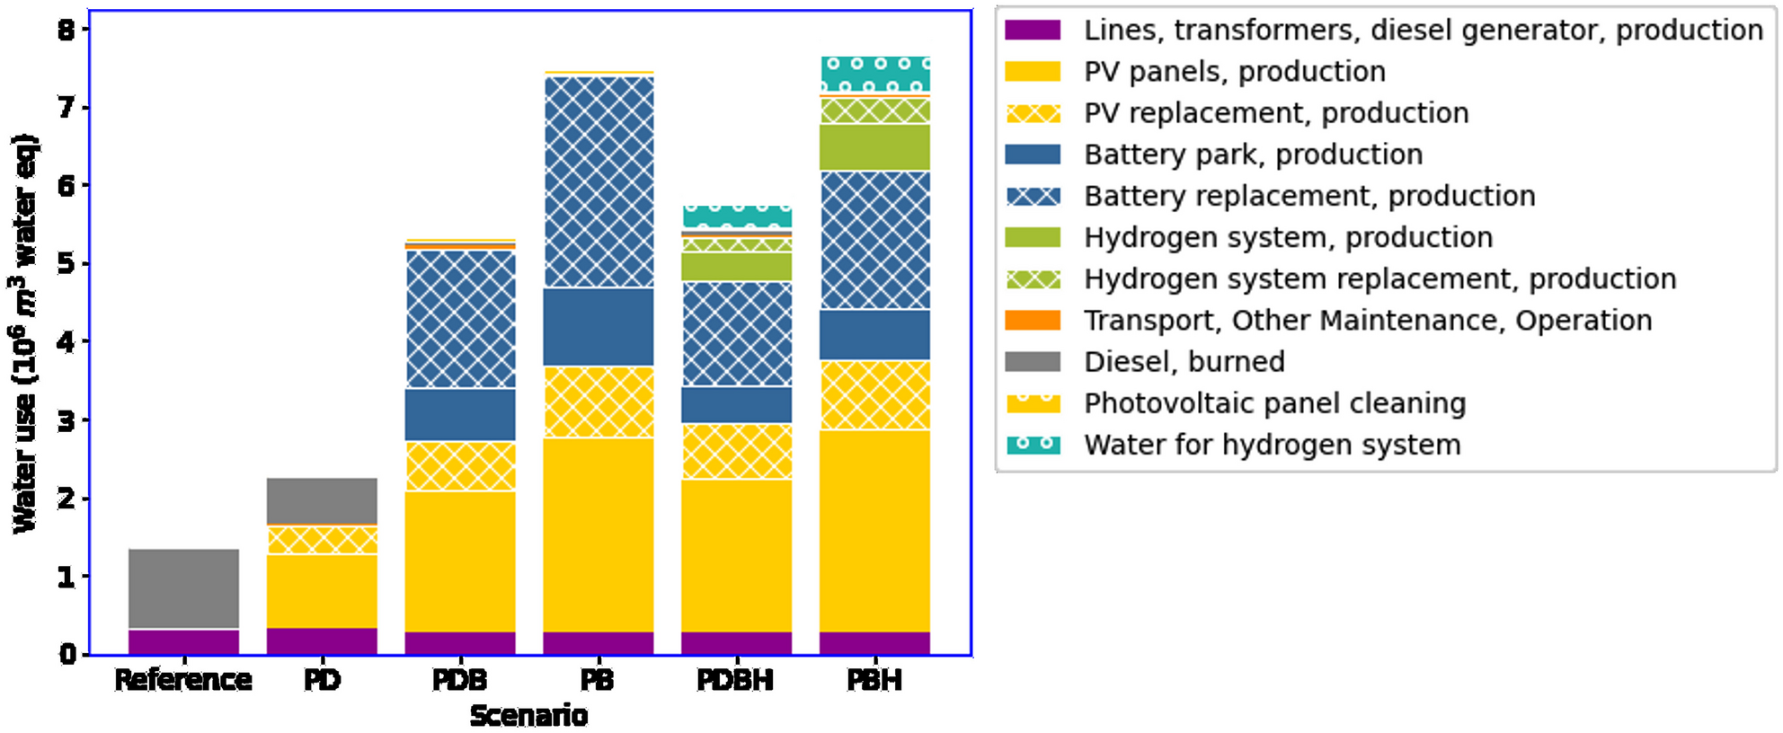
Life Cycle Assessment of a Renewable Power System
Source: Viole et al., 2024
DOI 10.1007/s11367-024-02288-9
Scenarios using diesel have the lowest impact on mineral resource depletion and water use
The manufacturing of PV panels and batteries has more impact on water use than for hydrogen production (<8% of this impact)
The scenarios with PV panels and batteries present more impacts on mineral resource depletion due to the use of copper, zinc, silver, and titanium
16

Slide 17
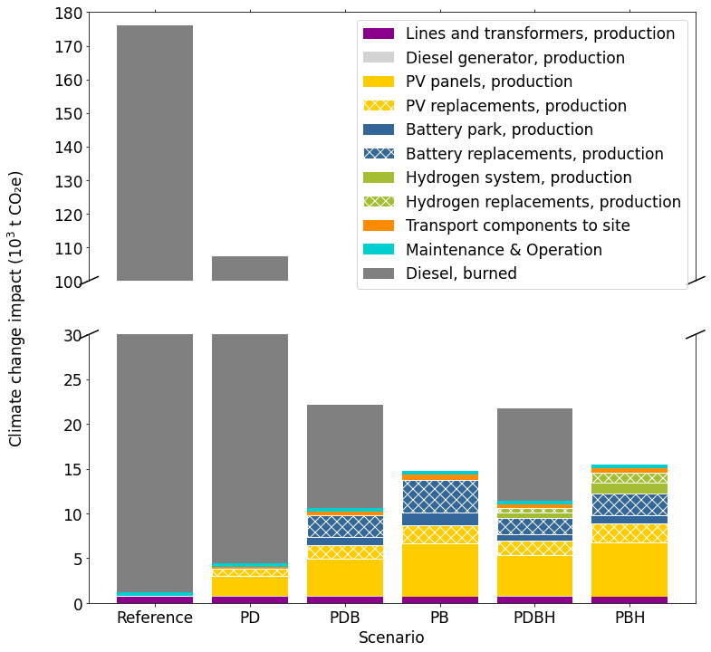
Life Cycle Assessment of a Renewable Power System
While scenarios using diesel have the lowest impact on mineral resources depletion and water use, they present the highest climate change impact (GHG)
The scenarios with PV and batteries have the lowest carbon emission impact
Source: Viole et al., 2024
DOI 10.1007/s11367-024-02288-9
17

Slide 18
Life Cycle Assessment of a Renewable Power System
While scenarios using diesel have the lowest impact on mineral resources depletion and water use, they present the highest climate change impact (GHG)
The scenarios with PV and batteries have the lowest carbon emission impact
Source: Viole et al., 2024
DOI 10.1007/s11367-024-02288-9
What is the best alternative?
18

Slide 19
Renewable power system for an off-grid system
Renewable energy system for AtLAST
Economic
Environmental
Social
Techno-economical optimization
Life Cycle Assessment
Multi-objective optimization
19

Slide 20
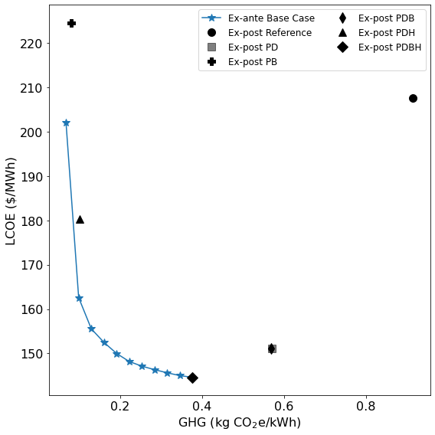
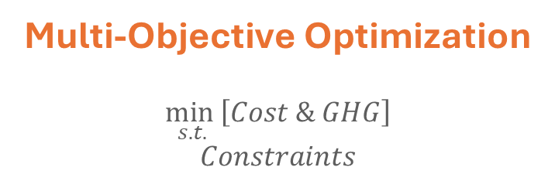
Renewable power system for an off-grid system
Life Cycle Assessment
Techno-economic assessment
Results
Trade-offs
  Cost of the system
  GHG emissions
Energy System Optimization Model
Multi-Objective Optimization
$$\min_{s.t.}\left[Cost \& GHG\right]$$
$$Constraints$$
Source: Viole et al., 2024
DOI 10.1016/j.apenergy.2024.123334
20
20

Slide 21
Renewable power system for an off-grid system
Renewable energy system for AtLAST
Economic
Environmental
Social
Techno-economical optimization
Life Cycle Assessment
MAMCA: Multi-Actor Multi-Criteria analysis
Multi-objective optimization
21

Slide 22
Chajnantor Plateau, Antofagasta, Chile
San Pedro
De Atacama
22

Slide 23
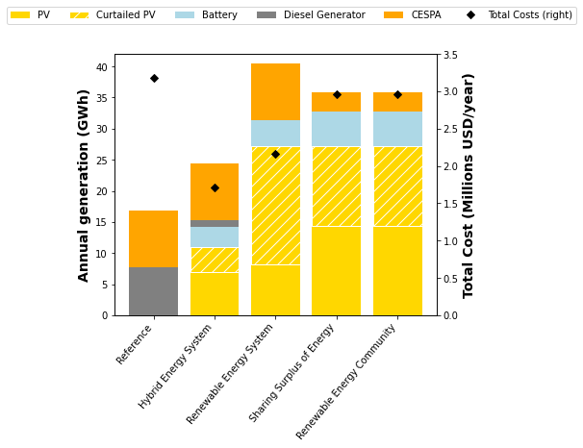
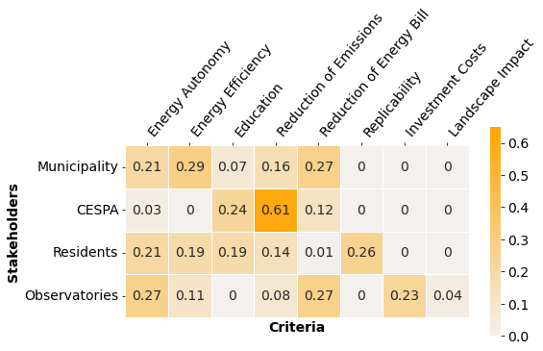
MAMCA: Multi-Actor Multi-Criteria Analysis
Stakeholders:
Residents of San Pedro de Atacama
Municipality
Electricity provider (CESPA)
Telescopes
Source: Valenzuela-Venegas et al., 2024
DOI 10.1038/s41893-024-01442-3 Nature Sustainability
Non cooperative
Cooperative
23

Slide 24
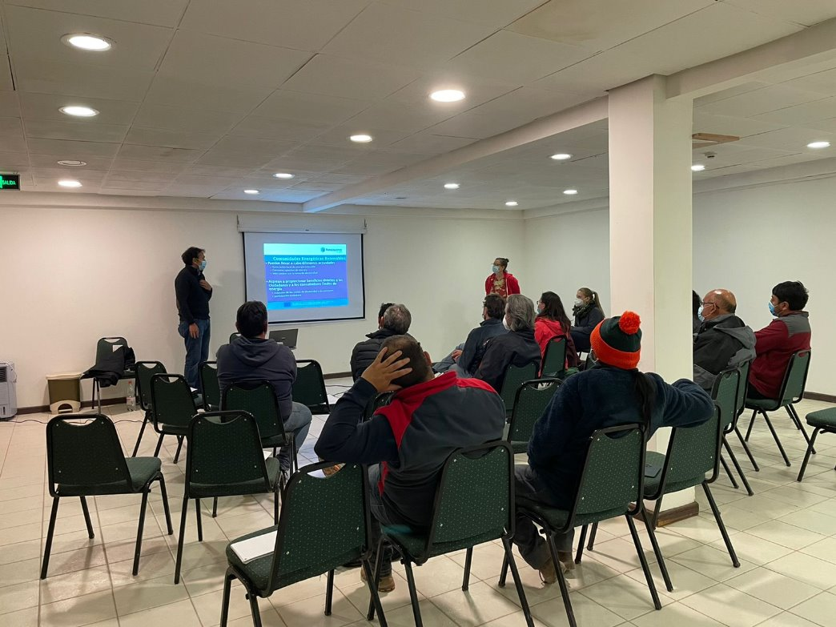
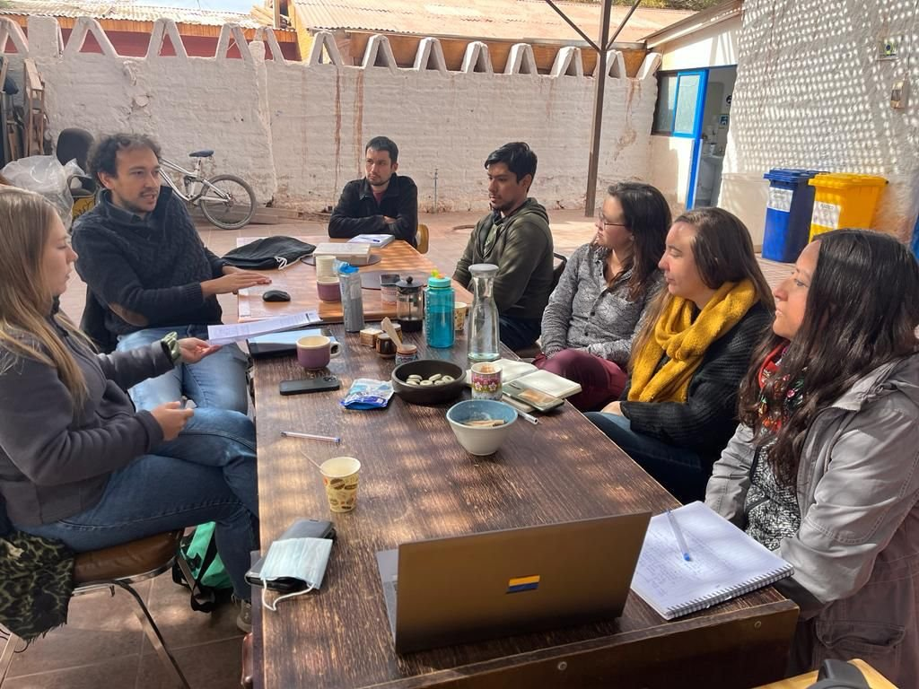
Workshops
Presentation and discussion of the energy scenarios
Discussion on the most preferred scenario
  Cooperative scenario (Sharing Surplus of Energy)
    It reduces CO₂ emissions and electricity costs
Observatories:
  Non-cooperative scenario (Hybrid Energy System)
    Diesel generation as a backup
    Cheapest solution and can reduce direct emissions at the same time
Source: Valenzuela-Venegas et al., 2024
DOI 10.1038/s41893-024-01442-3 Nature Sustainability
24

Slide 25
Conclusions
25

Slide 26
Main takeaways
Techno-economic assessment
  The cheapest scenario is a hybrid energy system consisting mainly of photovoltaics, batteries, and hydrogen. Diesel is used as a backup
Environmental assessment
  The scenario with a 100% renewable energy system presents the lowest impact on the climate change category
Social aspect
  At the same time as having a renewable energy system, the energy system can contribute to social inclusion by integrating the preferences of the residents and stakeholders
26

Slide 27
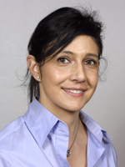



Thank you for your attention!
Techno-economic assessment
  DOI 10.1016/j.energy.2023.128570
Environmental assessment
  DOI 10.1007/s11367-024-02288-9
Economic and environmental assessment
  DOI 10.1016/j.apenergy.2024.123334
Social study
  DOI 10.1038/s41893-024-01442-3
  DOI 10.4324/9781003492573-13
Guillermo Valenzuela-Venegas
guillermo.Valenzuela@its.uio.no

Slide 28
Future Steps – AtLAST2
Power management supervisory control of the AtLAST energy system
Control the different components of the system in specific conditions and how they interact with the telescope
Energy storage
Design new materials for hydrogen storage, considering their performance and environmental impacts
Long-term sustainability of the research infrastructure
LCA of the whole infrastructure
Develop energy scenarios with the participation and inclusion of neighboring communities

