Slide 1
Simulating mapping observations with AtLAST
Tony Mroczkowski (ICE-CSIC), with help and inputs from Thomas Morris, Mats Kirkaune, Jonas Würzinger, Joshiwa van Marrewijk, and Luca Di Mascolo
4 June 2026, AtLAST Iberian Days, Universidad Complutense de Madrid
Funded by the European Union. Views and opinions expressed are however those of the author(s) only and do not necessarily reflect those of the European Union or European Research Executive Agency. Neither the European Union nor the European Research Executive Agency can be held responsible for them.

Slide 2
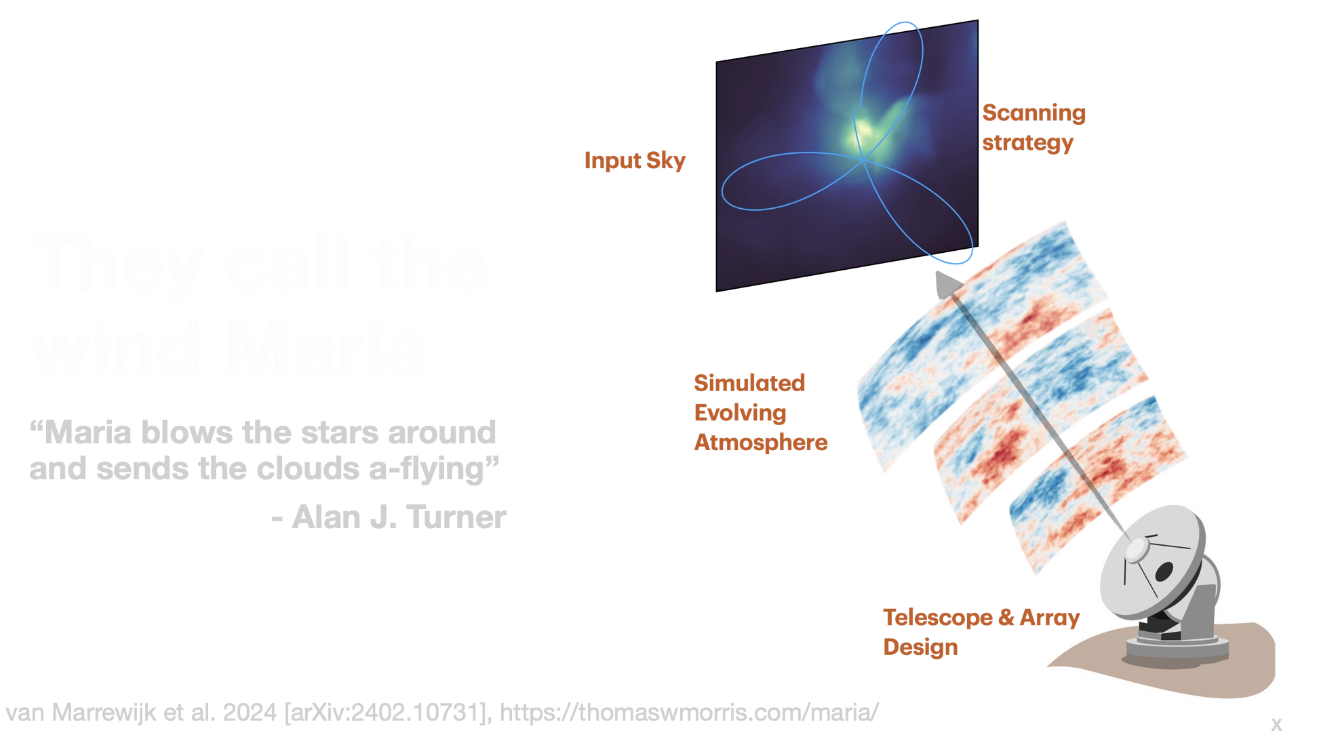
They call the wind maria

Slide 3
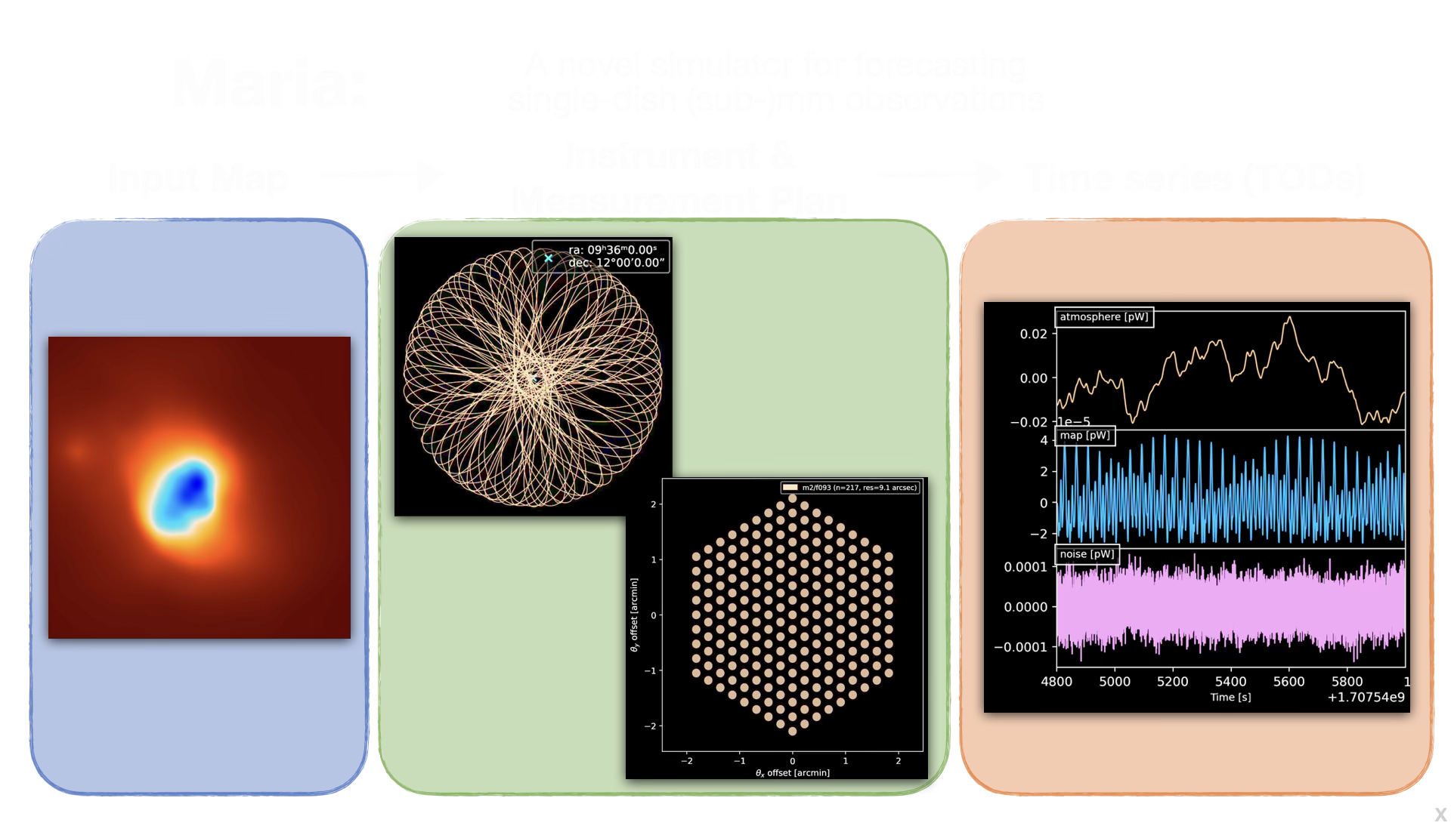

Slide 4
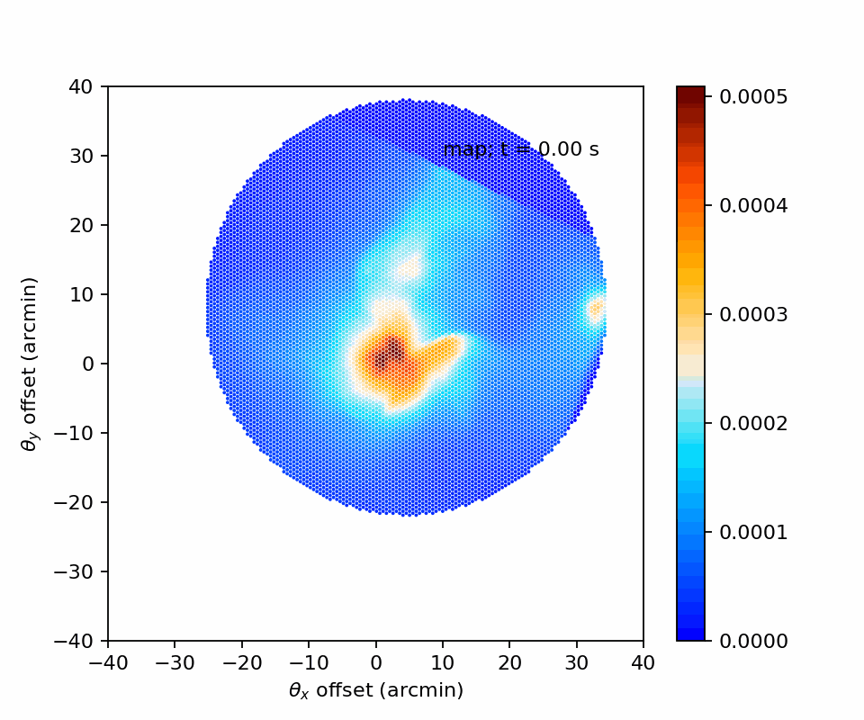

Slide 5
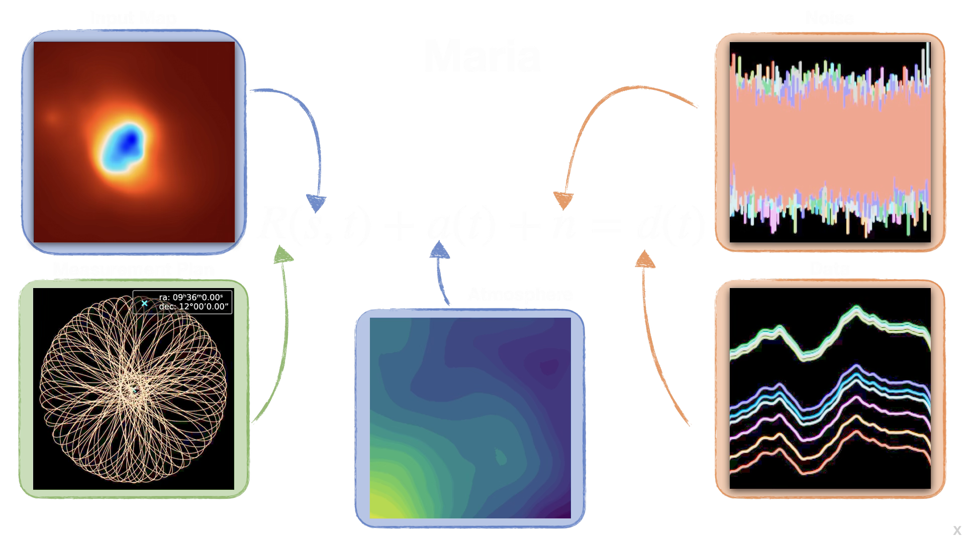

Slide 6
1. Getting started

Slide 7
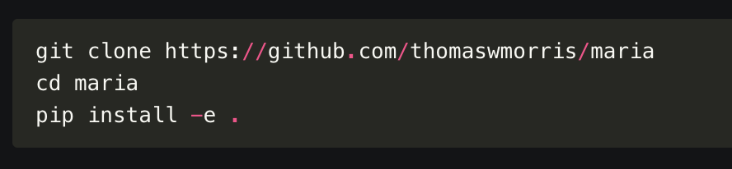
Install maria
https://thomaswmorris.com/maria/installation.html
Use the source code installation

Slide 8
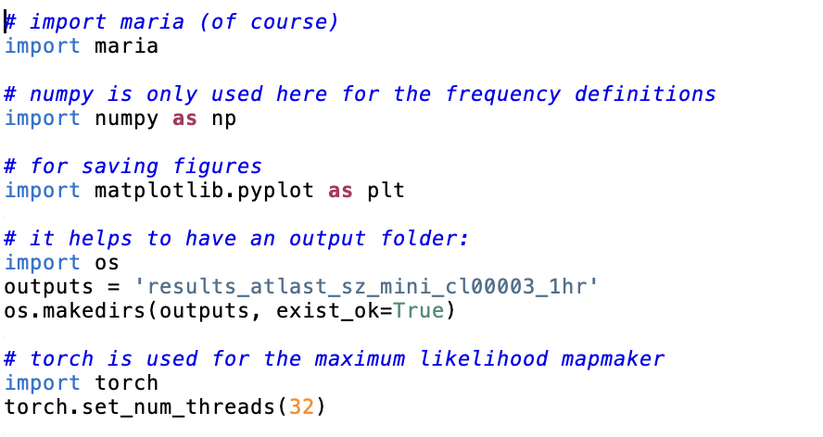
Set up maria
I run ipython on a big machine
all this code is based on the tutorials here: https://thomaswmorris.com/maria/tutorials.html
I can send you the code

Slide 9
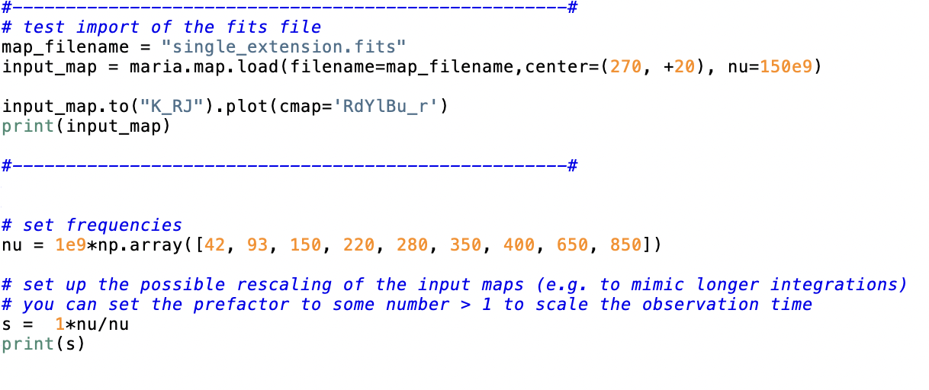
import a map and (optionally) set up some frequency scaling
There are many maps online
This is how to use a local FITS file as input

Slide 10
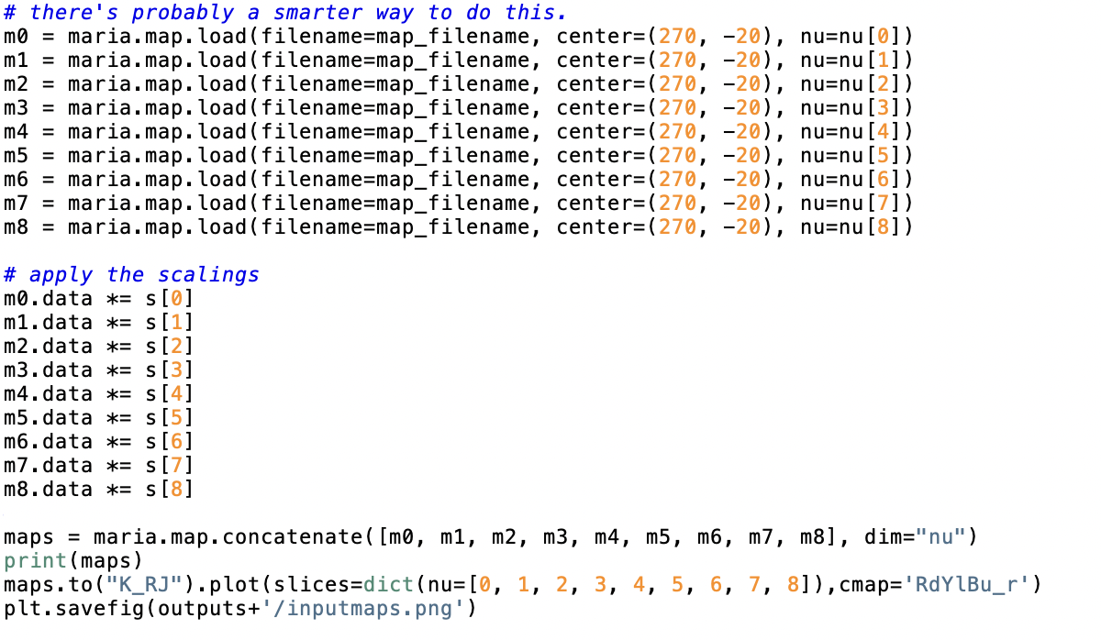

Slide 12
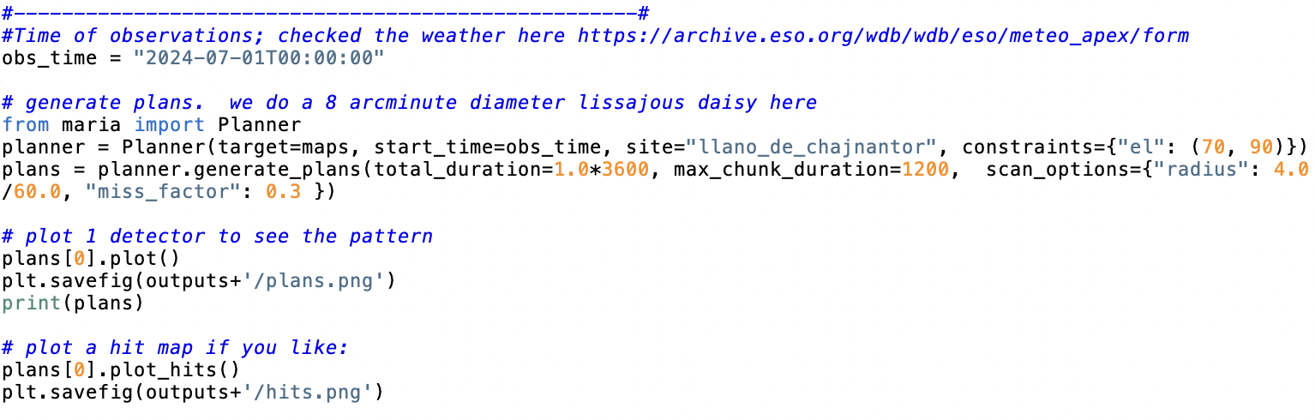
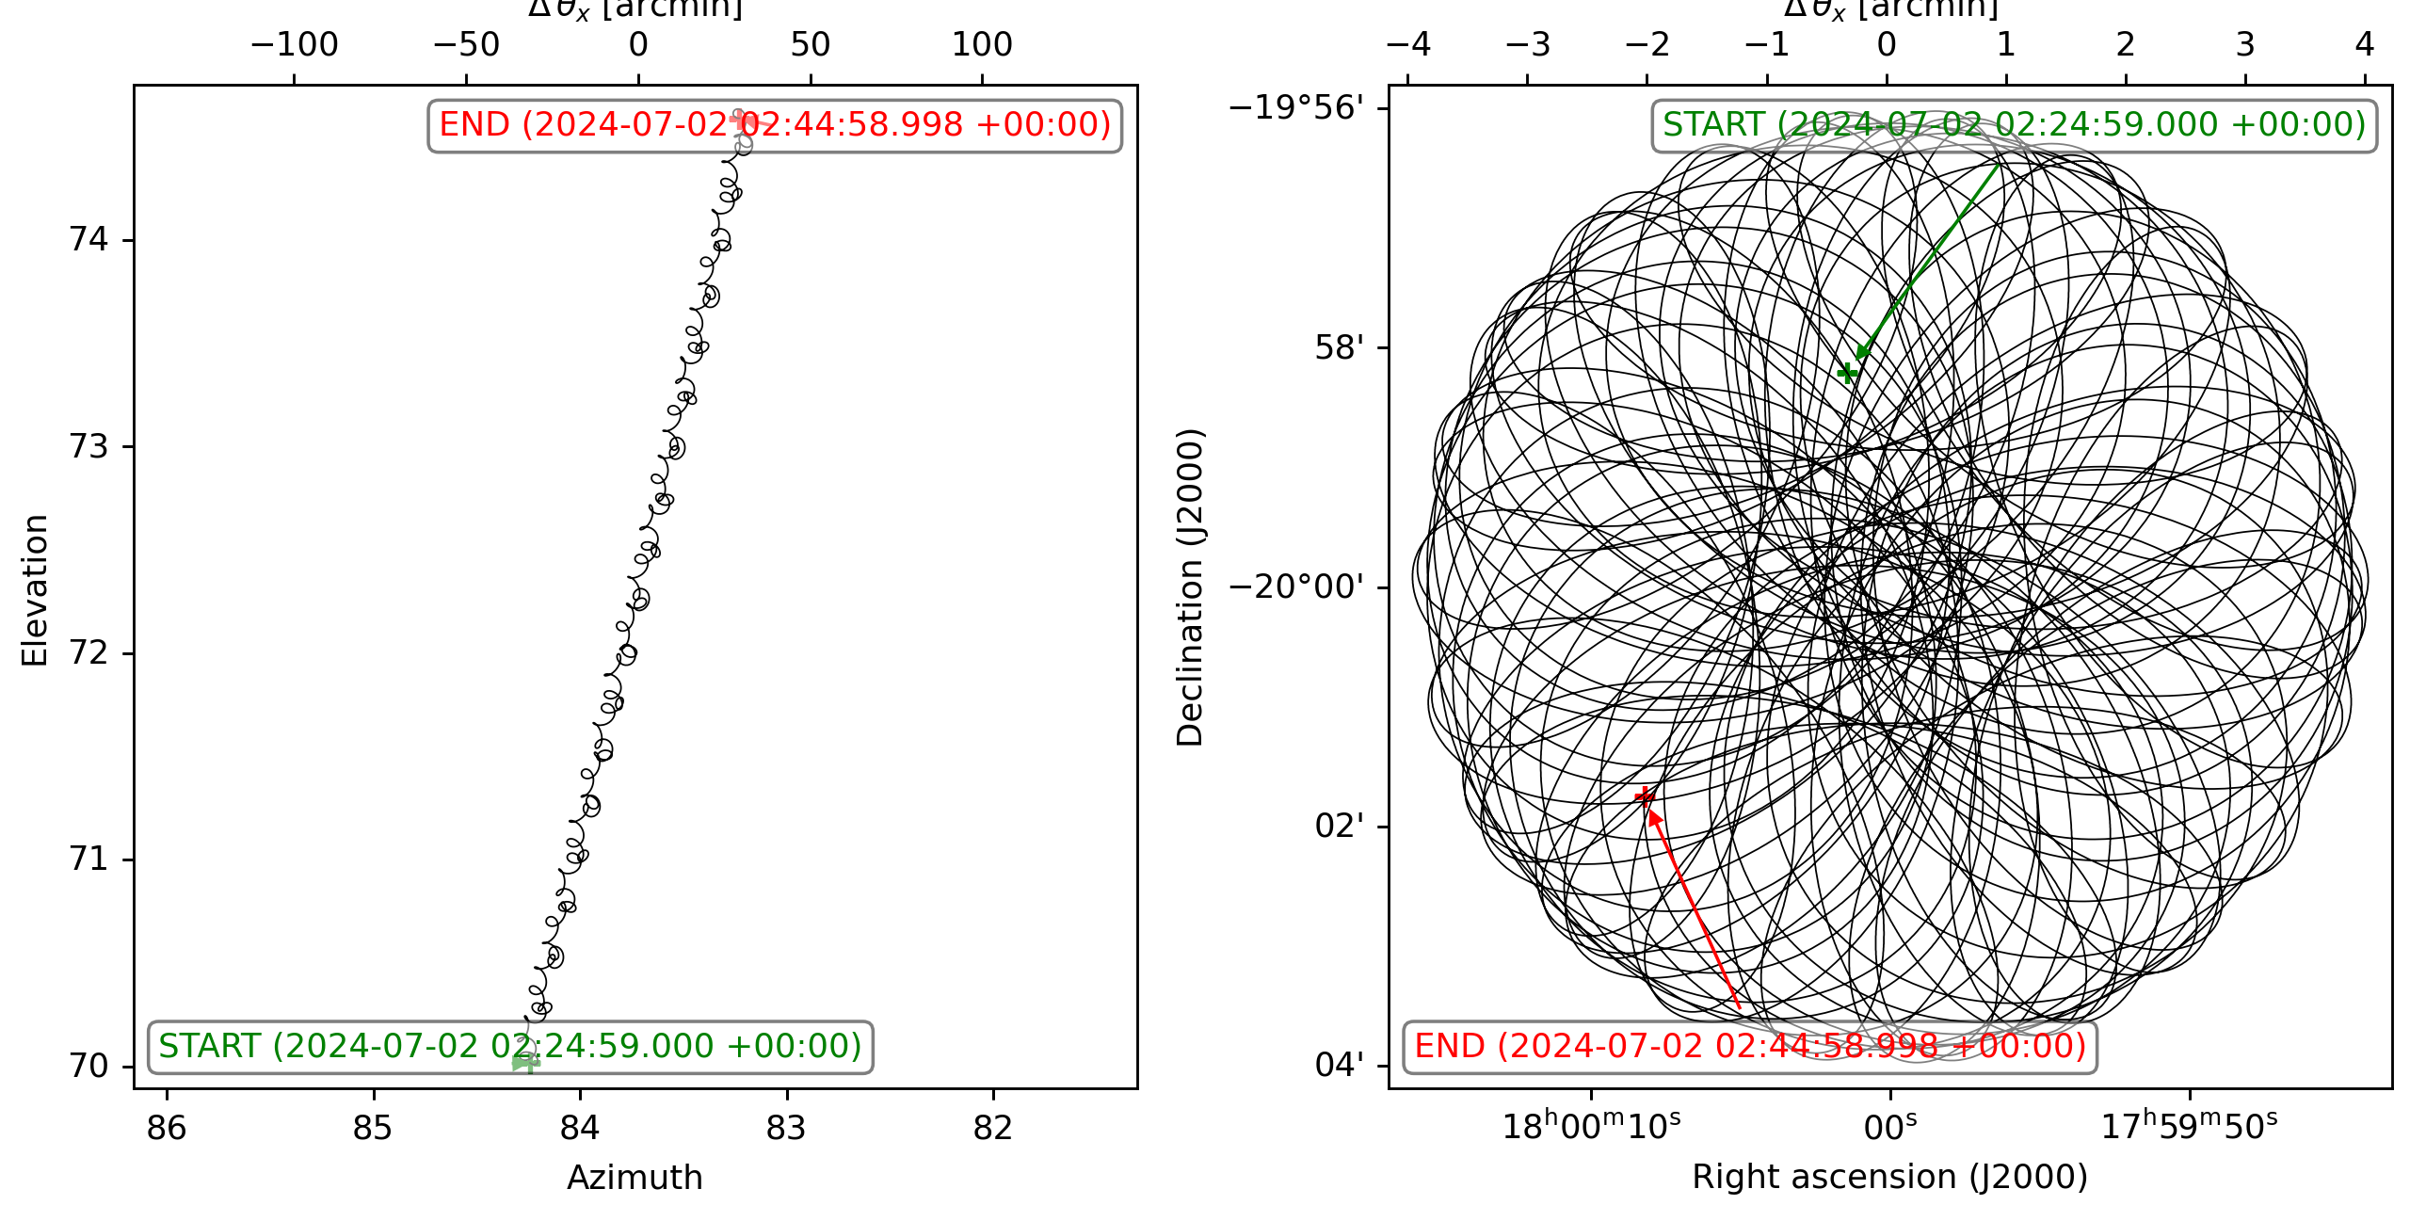
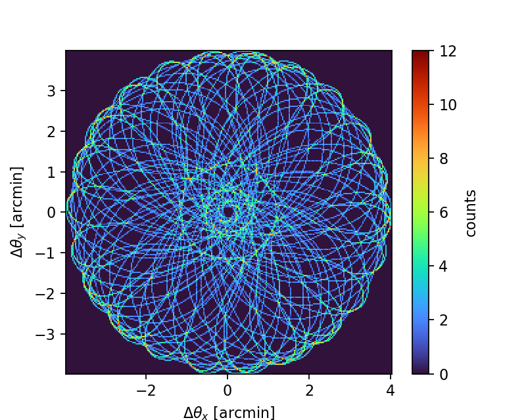

Slide 13
Next: defining an instrument
Examples are given here: https://thomaswmorris.com/maria/tutorials/custom-map-simulations.html
Things to consider first: spacing, field of view, bandwidth, pixel counts, frequencies

Slide 14
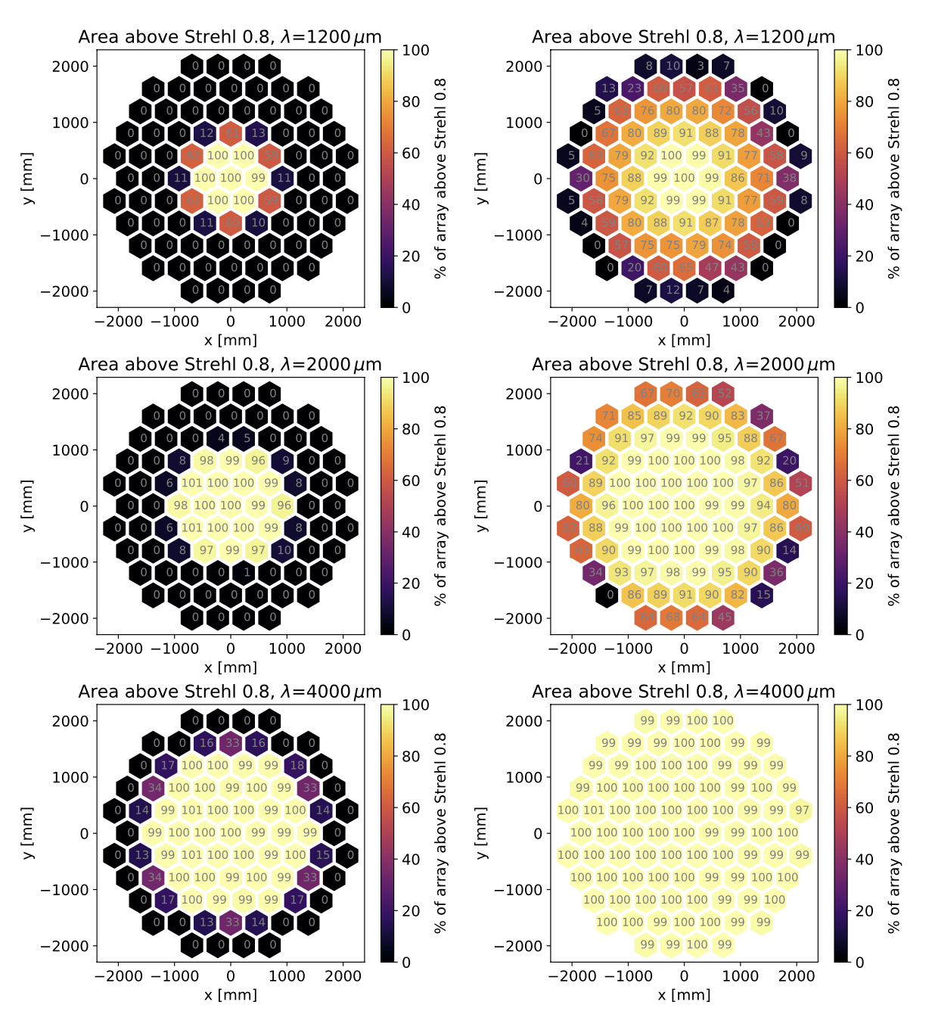
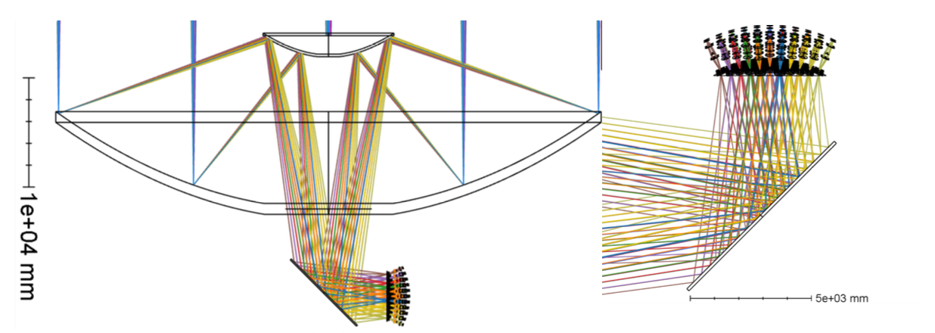
AtLAST FoV
Recall from earlier:
With a huge (4.7 meter) focal surface, one idea is to break it up into modular cameras. Each camera then has corrective optics to recover a large field of view.
Lower frequencies (<300 GHz) are shown on right. Left column is uncorrected; right column is corrected.
Gallardo et al. 2024
Notes:
These corrections are standard, see the CCAT-prime, Simons Observatory, and CMB-S4 designs for example.

Slide 15
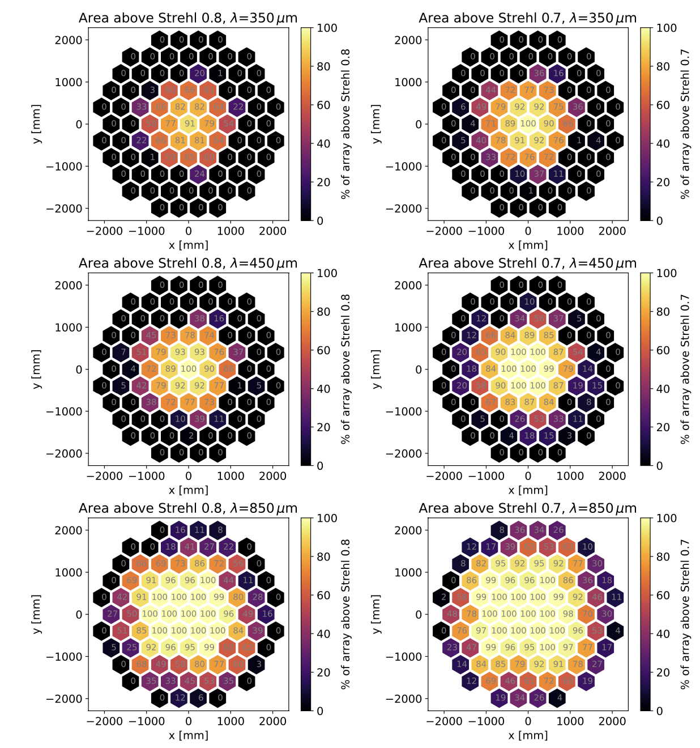
AtLAST FoV
Recall from earlier:
Higher frequencies (>300 GHz) are shown on right. Left column corrected and diffraction-limit (Strehl=0.8).
The right column relaxes the requirement for diffraction limited optics (Strehl=0.7).
Gallardo et al. 2024 noted that this is for 3 lenses, and that additional optimization using 4 lenses can improve this.
Gallardo et al. 2024

Slide 16
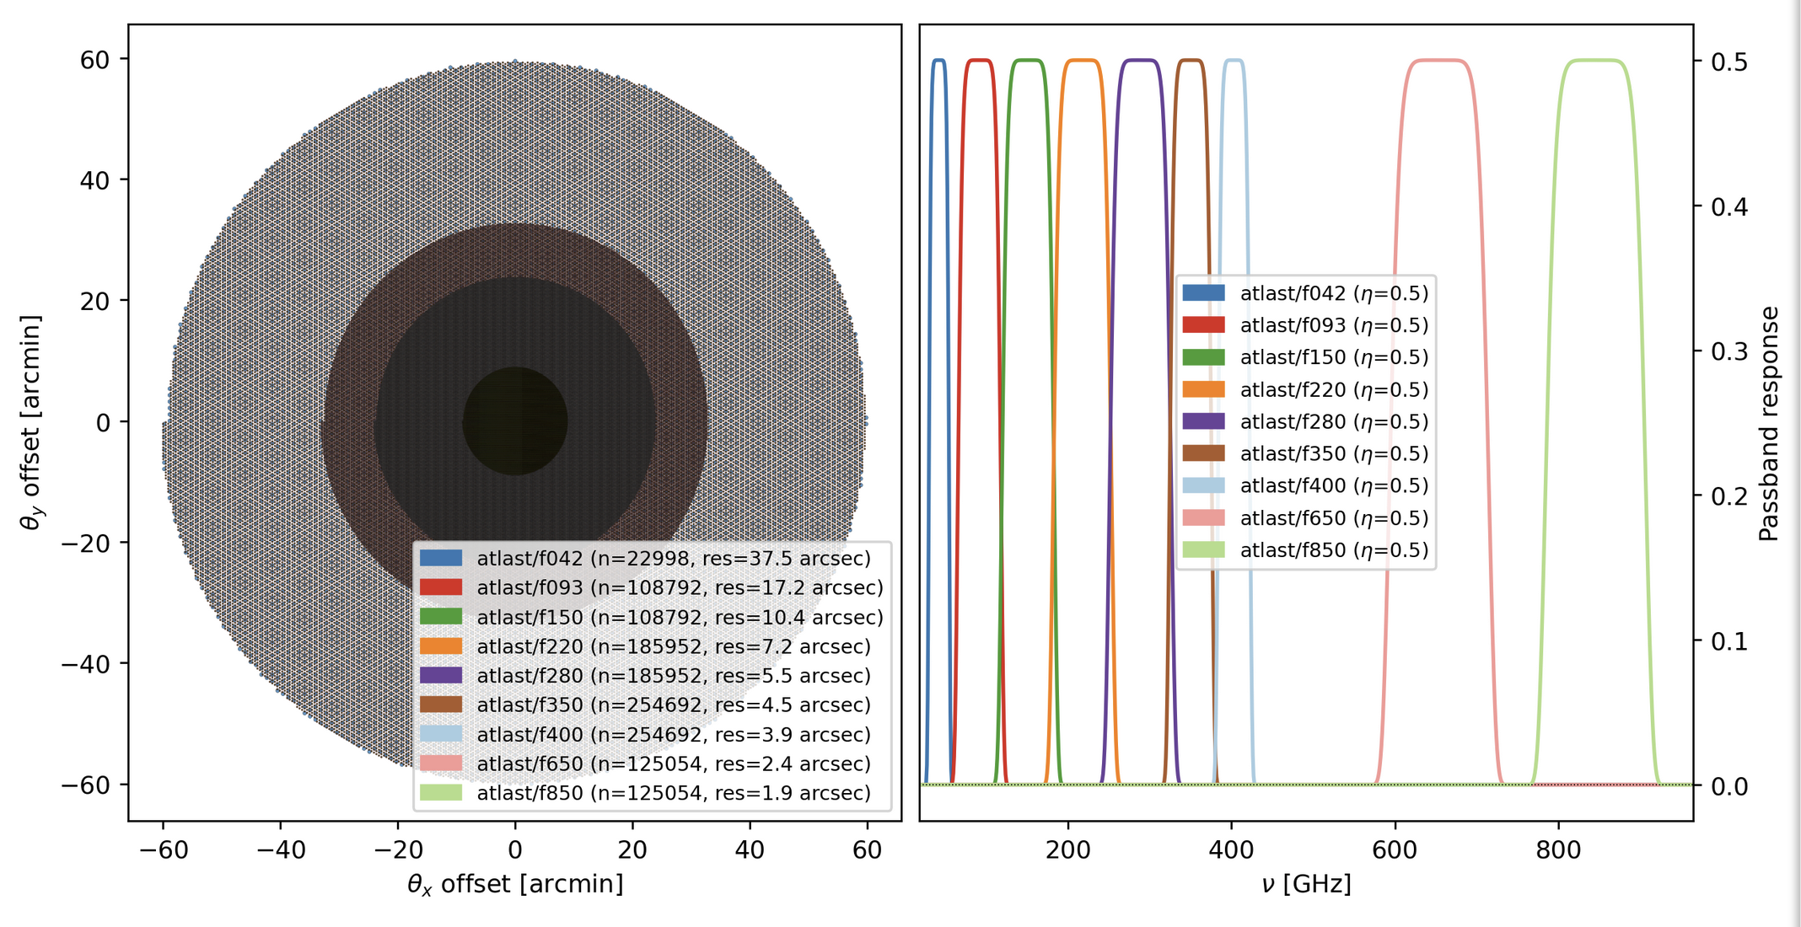
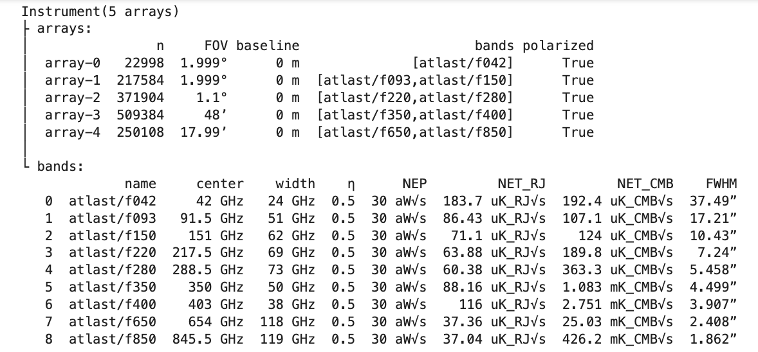
camera concepts in maria: atlast-sz
9-band multichroic camera following Di Mascolo, Perrott et al. 2025.
Fills the fields of view in Gallardo et al. 2024.
Lowest band is monochromatic. The rest are dichroic.
All 9 bands are 1.7 f-lambda spacing.
Polarized!
1.4 million detectors total. Going to Nyquist would lead to (1.7/0.5)^2 = 11.56 times more detectors

Slide 17
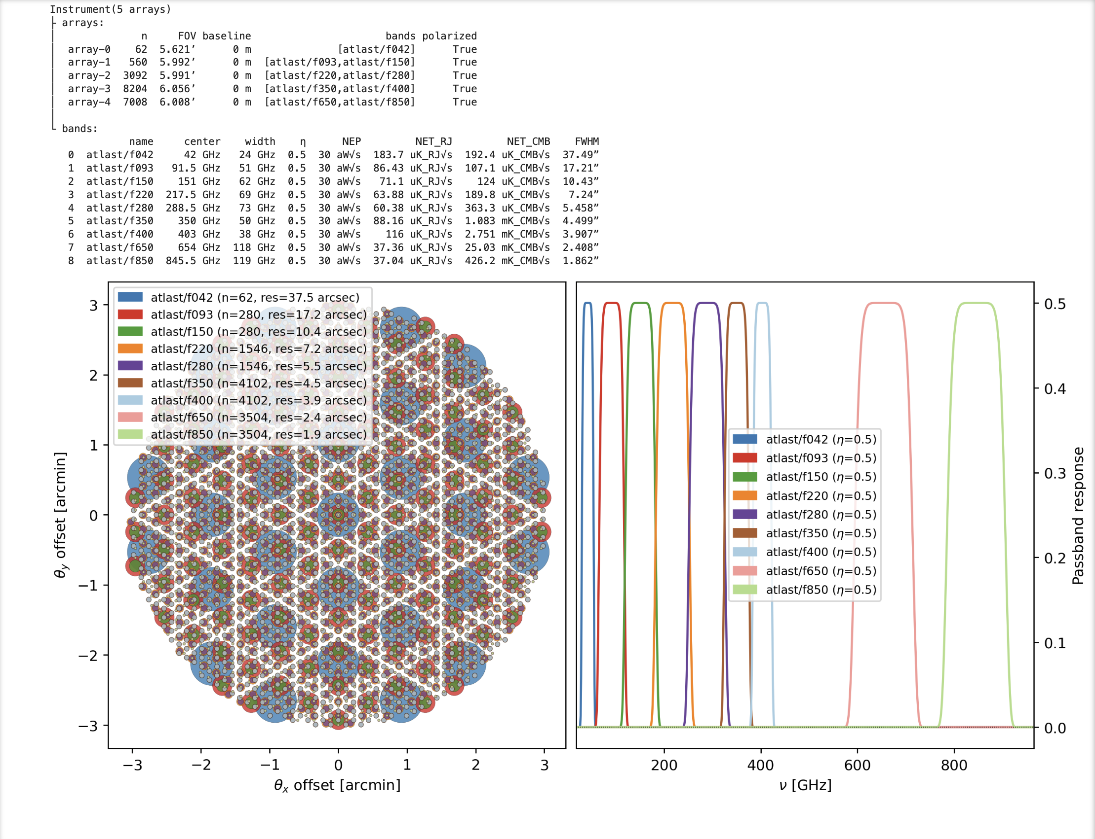
camera concepts in maria: atlast-sz_mini
A more modest version of the 9-band multichroic camera
Fills only a 6’ field of view.
Lowest band is monochromatic. The rest are dichroic.
First 7 bands are 1.7 f-lambda.
Highest 2 frequencies have a sparser spacing of 3.4 f-lambda.
Polarized!
19k detectors. Again, a filled array (1/2-f-lambda) would require >11 times more.

Slide 18
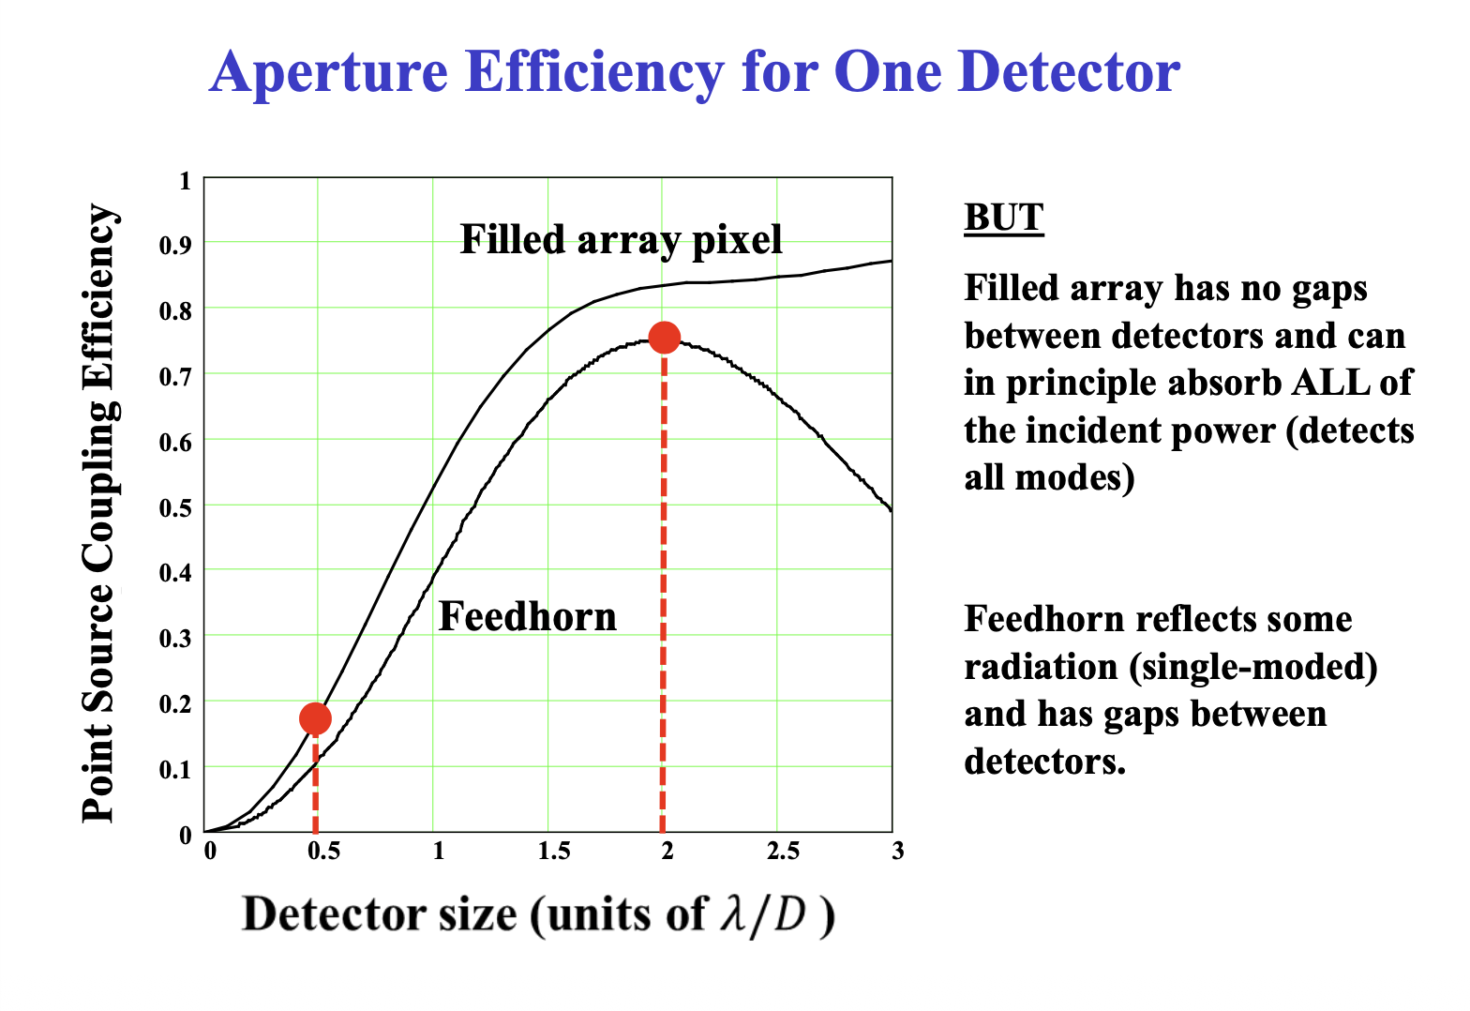
Detector spacings: filled vs sparse?
From Matt Griffin’s talk

Slide 19
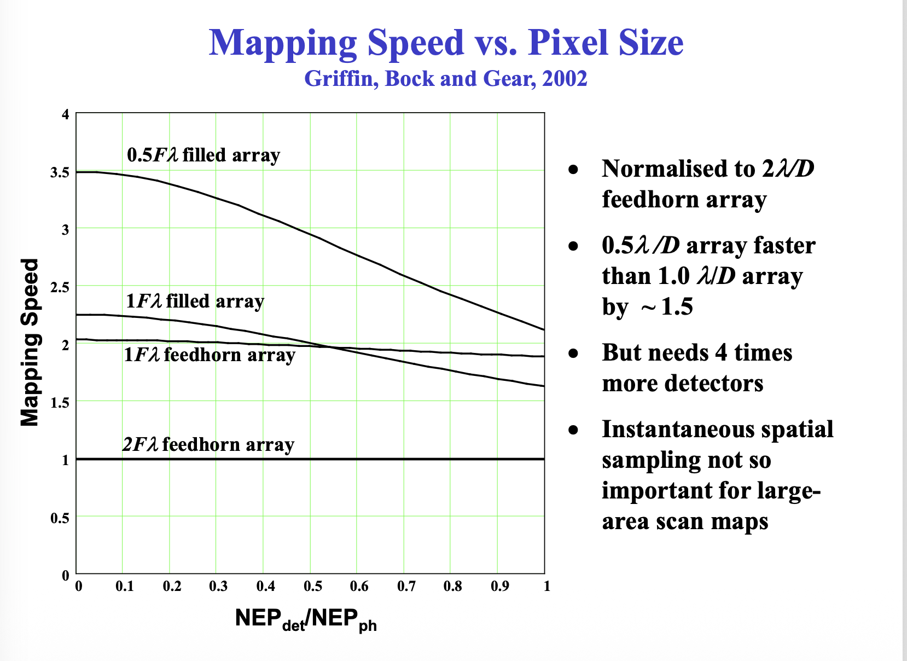
Detector spacings: filled vs sparse?
From Matt Griffin’s talk
Left side of plot is for background dominated regime (i.e. detector noise < photon noise)

Slide 20
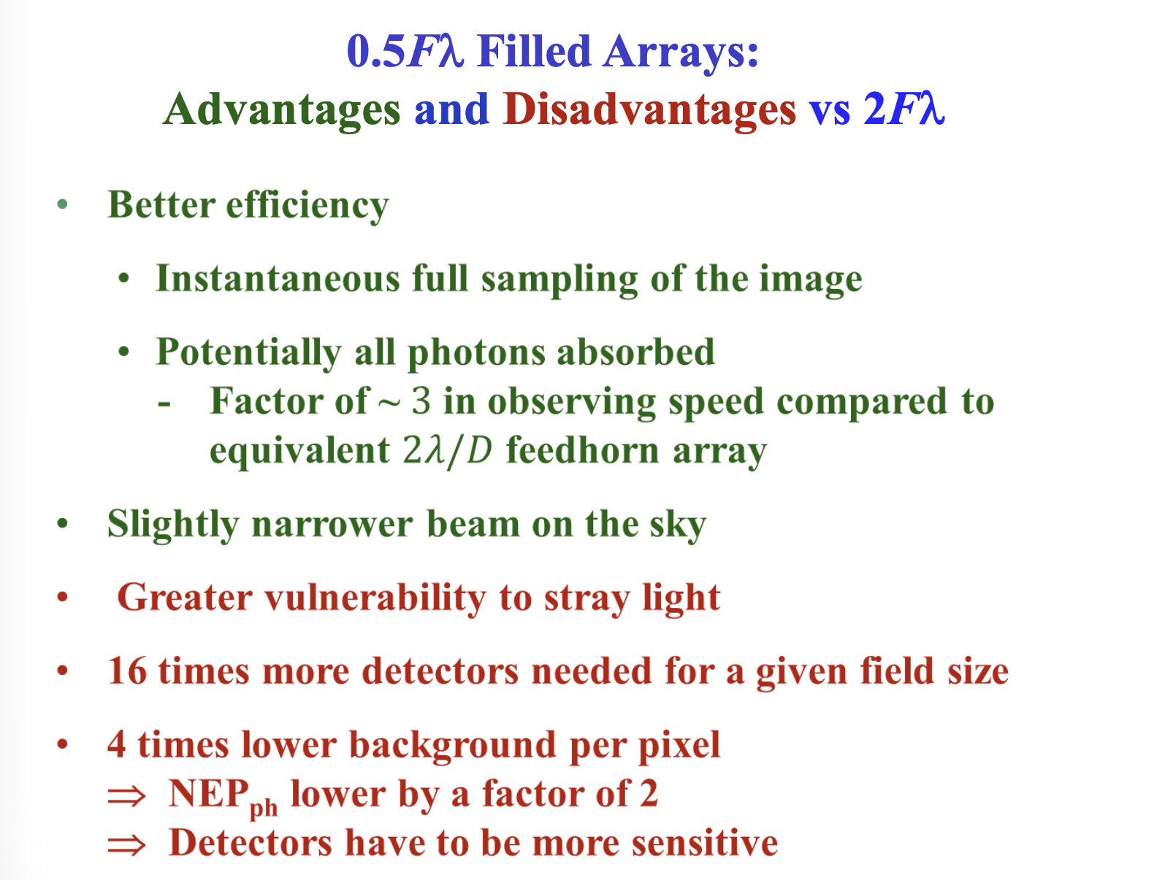
Summary for 0.5 f-lambda (from Matt Griffin)

Slide 21
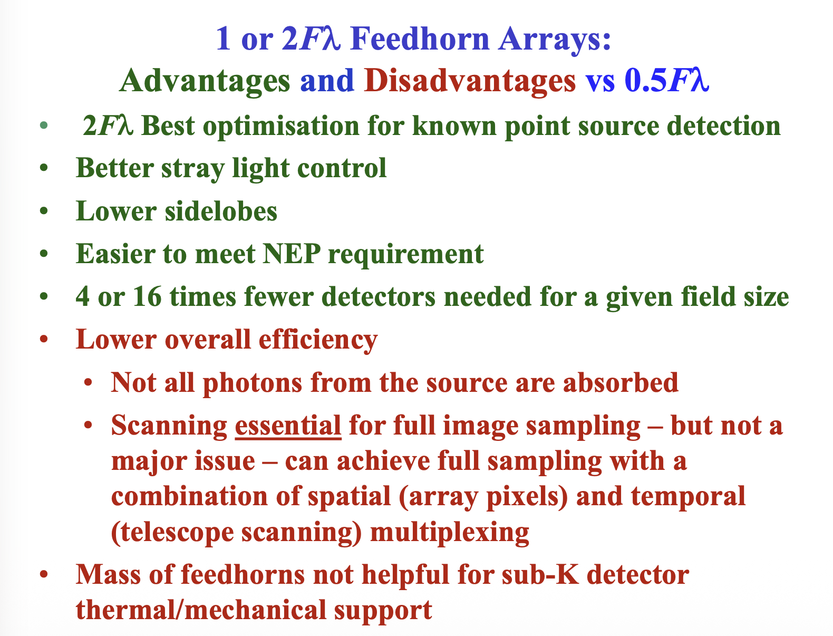
Summary for 1 or 2 f-lambda (from Matt Griffin)

Slide 22
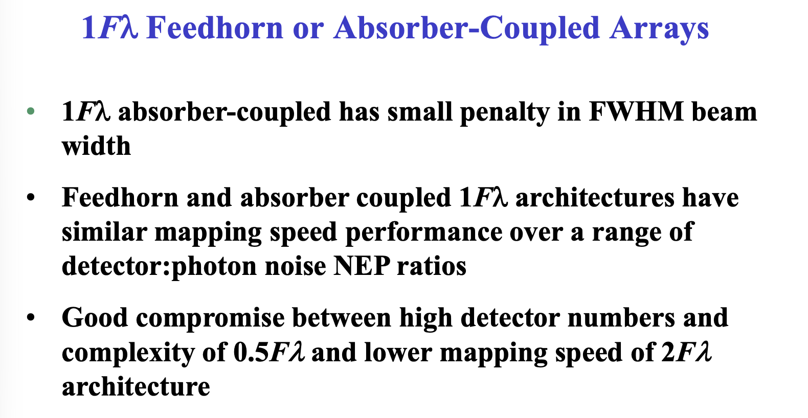
Compromise? 1 f-lambda (from Matt Griffin)

Slide 23
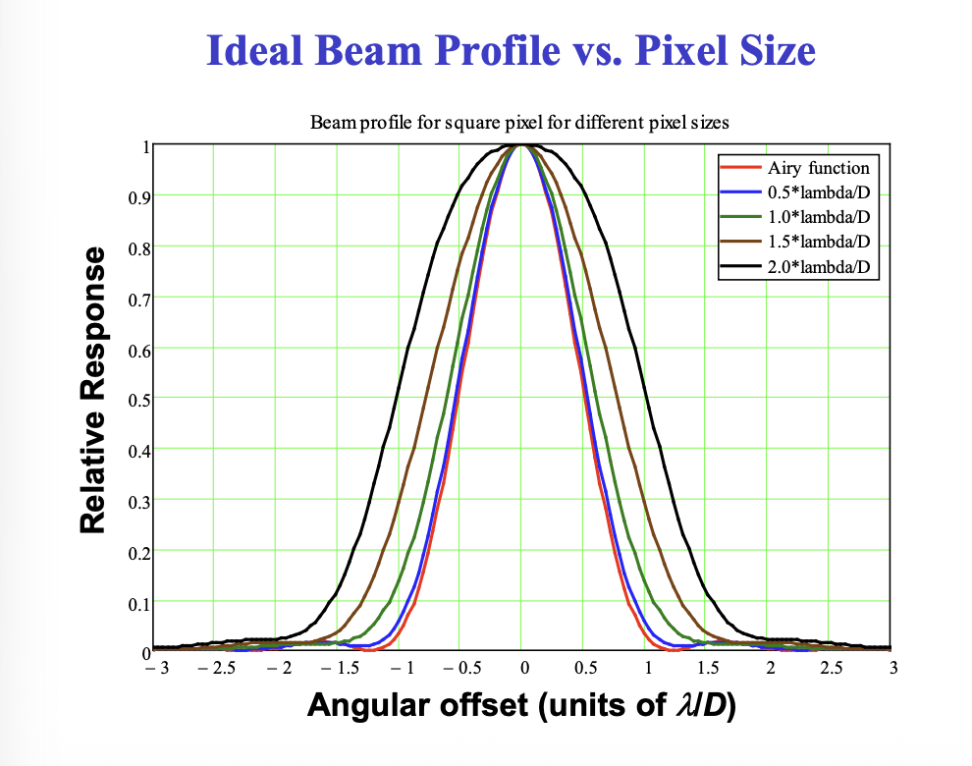
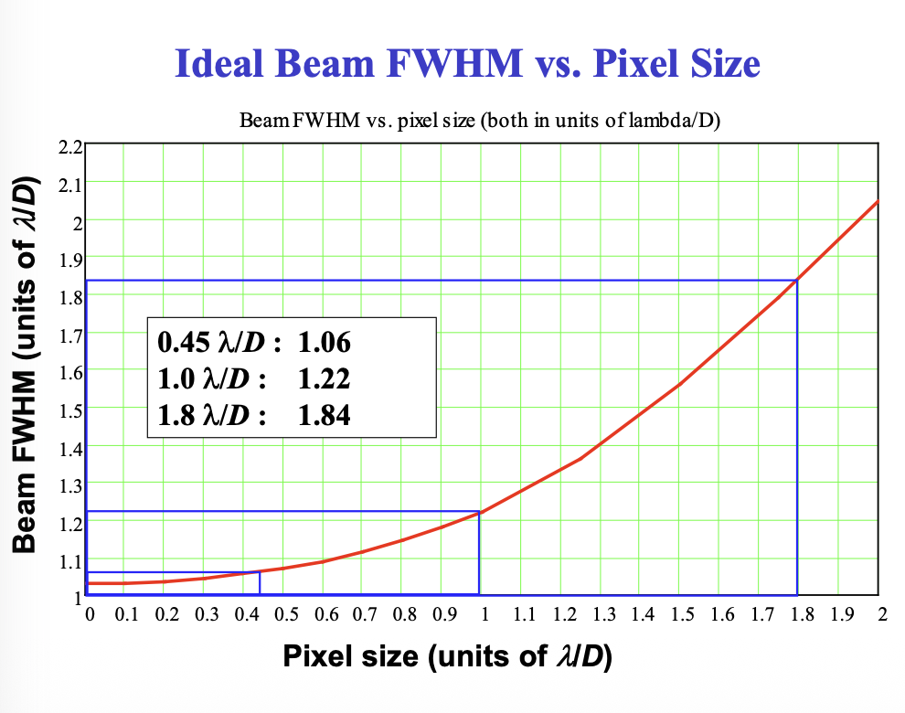
Super important side note on resolution
(again, from Matt Griffin)

Slide 24
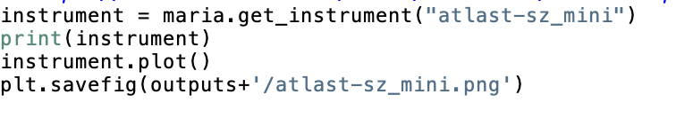
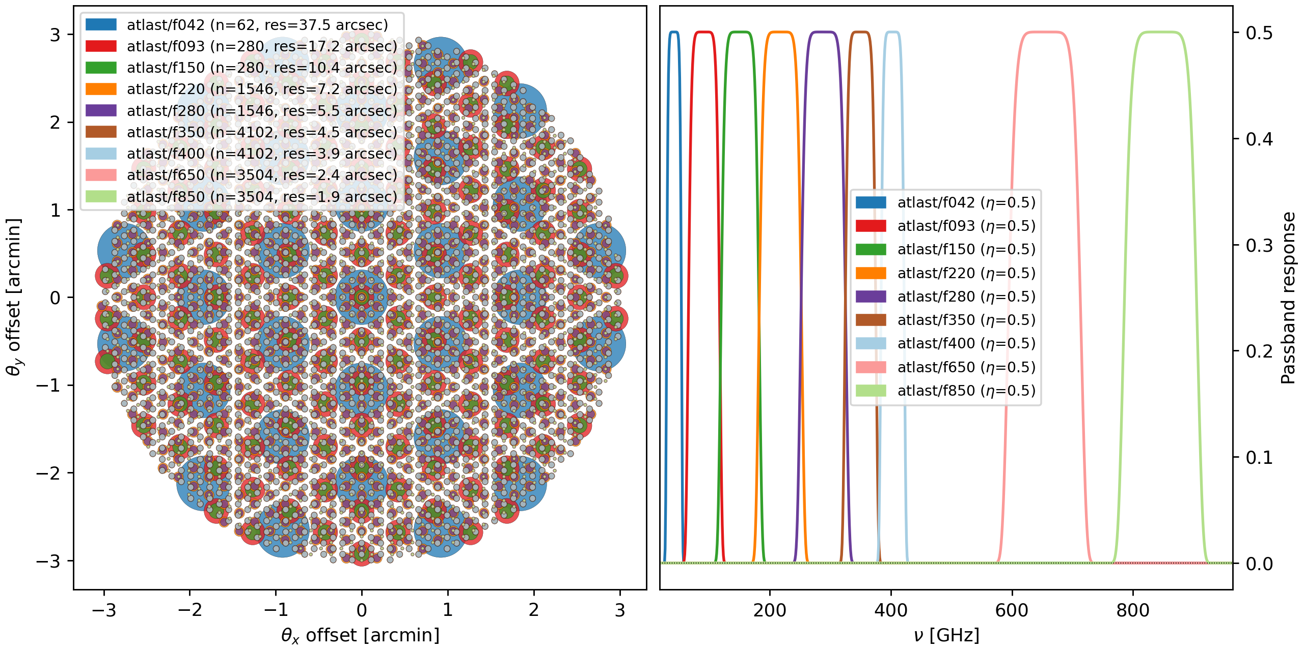
Instrument

Slide 25
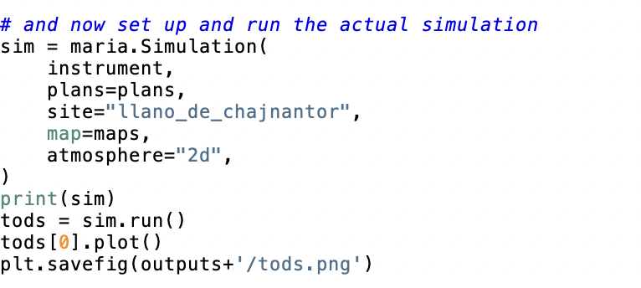
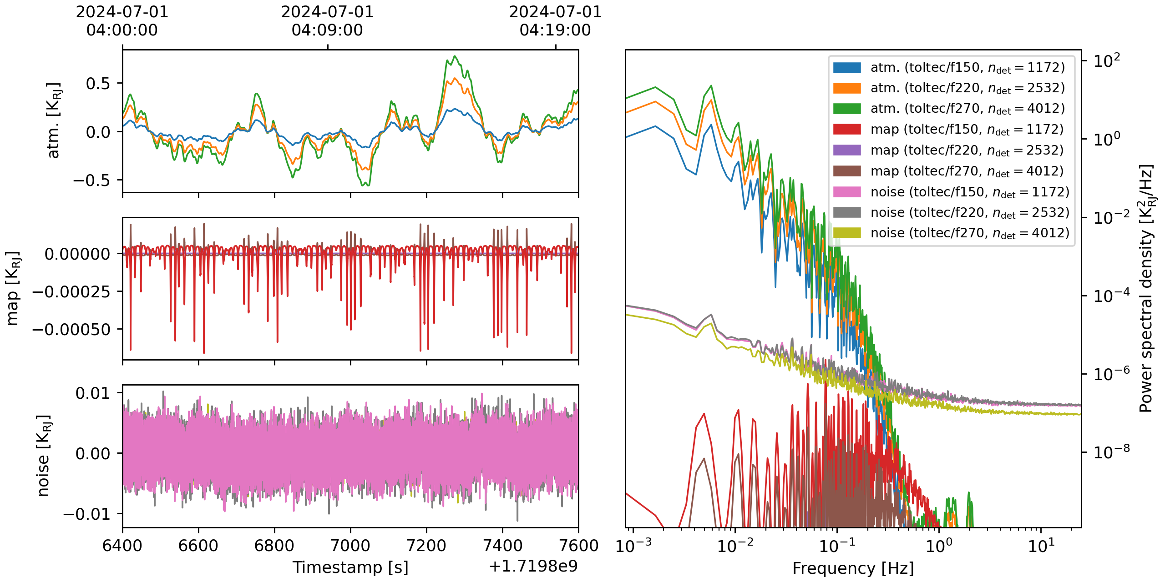
Now simulate

Slide 26
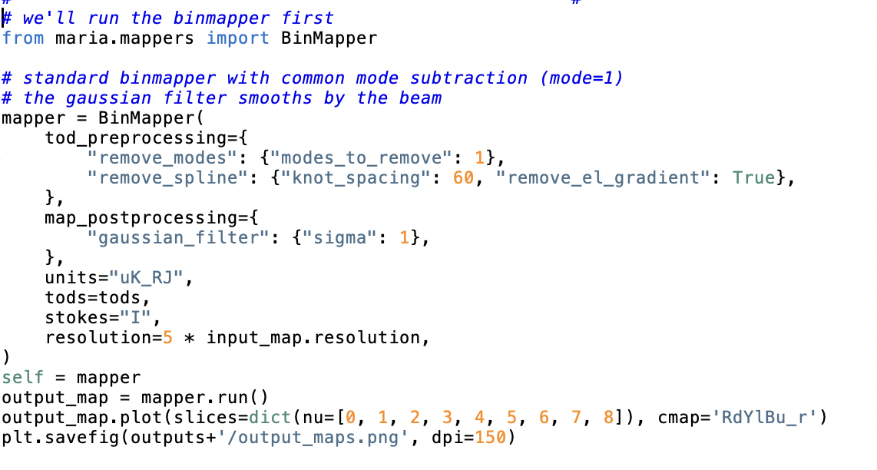
Classic bin mapper

Slide 27
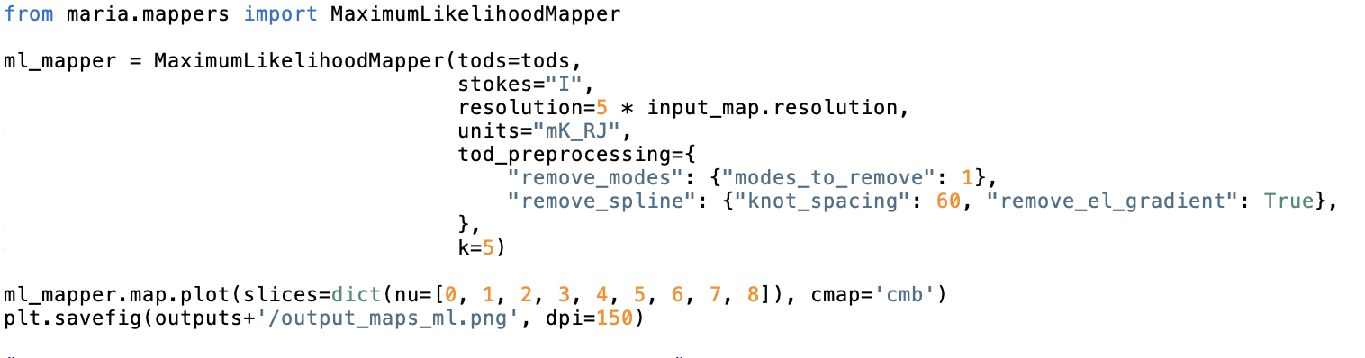
Maximum likelihood

Slide 28
Comparing: input, binmapper, and ML mapper

Slide 29
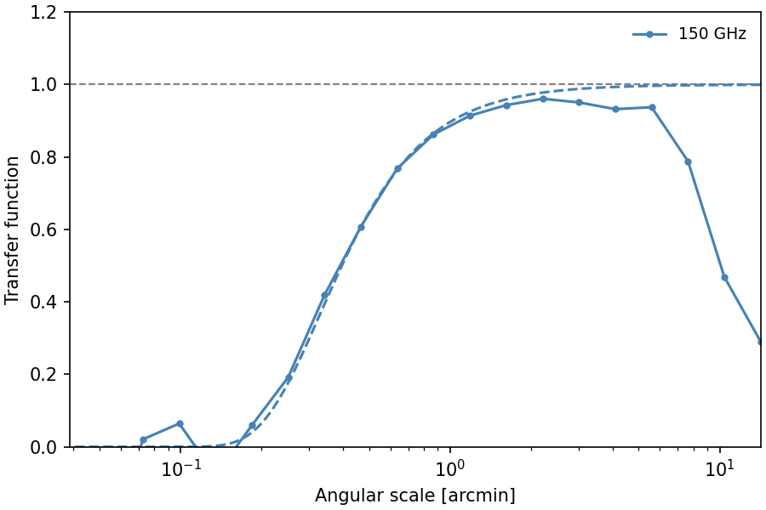
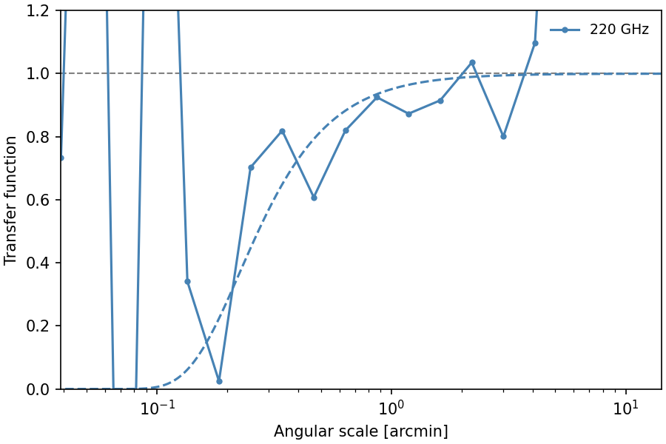
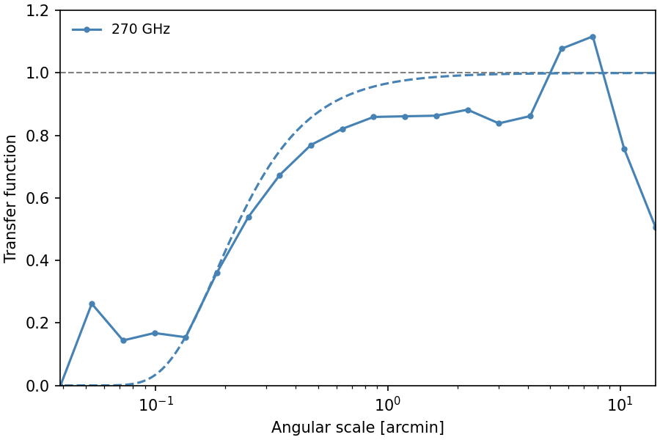
Coming soon: transfer function calculations!
The 220 GHz input map is close to the noise level (due to the null in the thermal SZ effect)

Slide 30
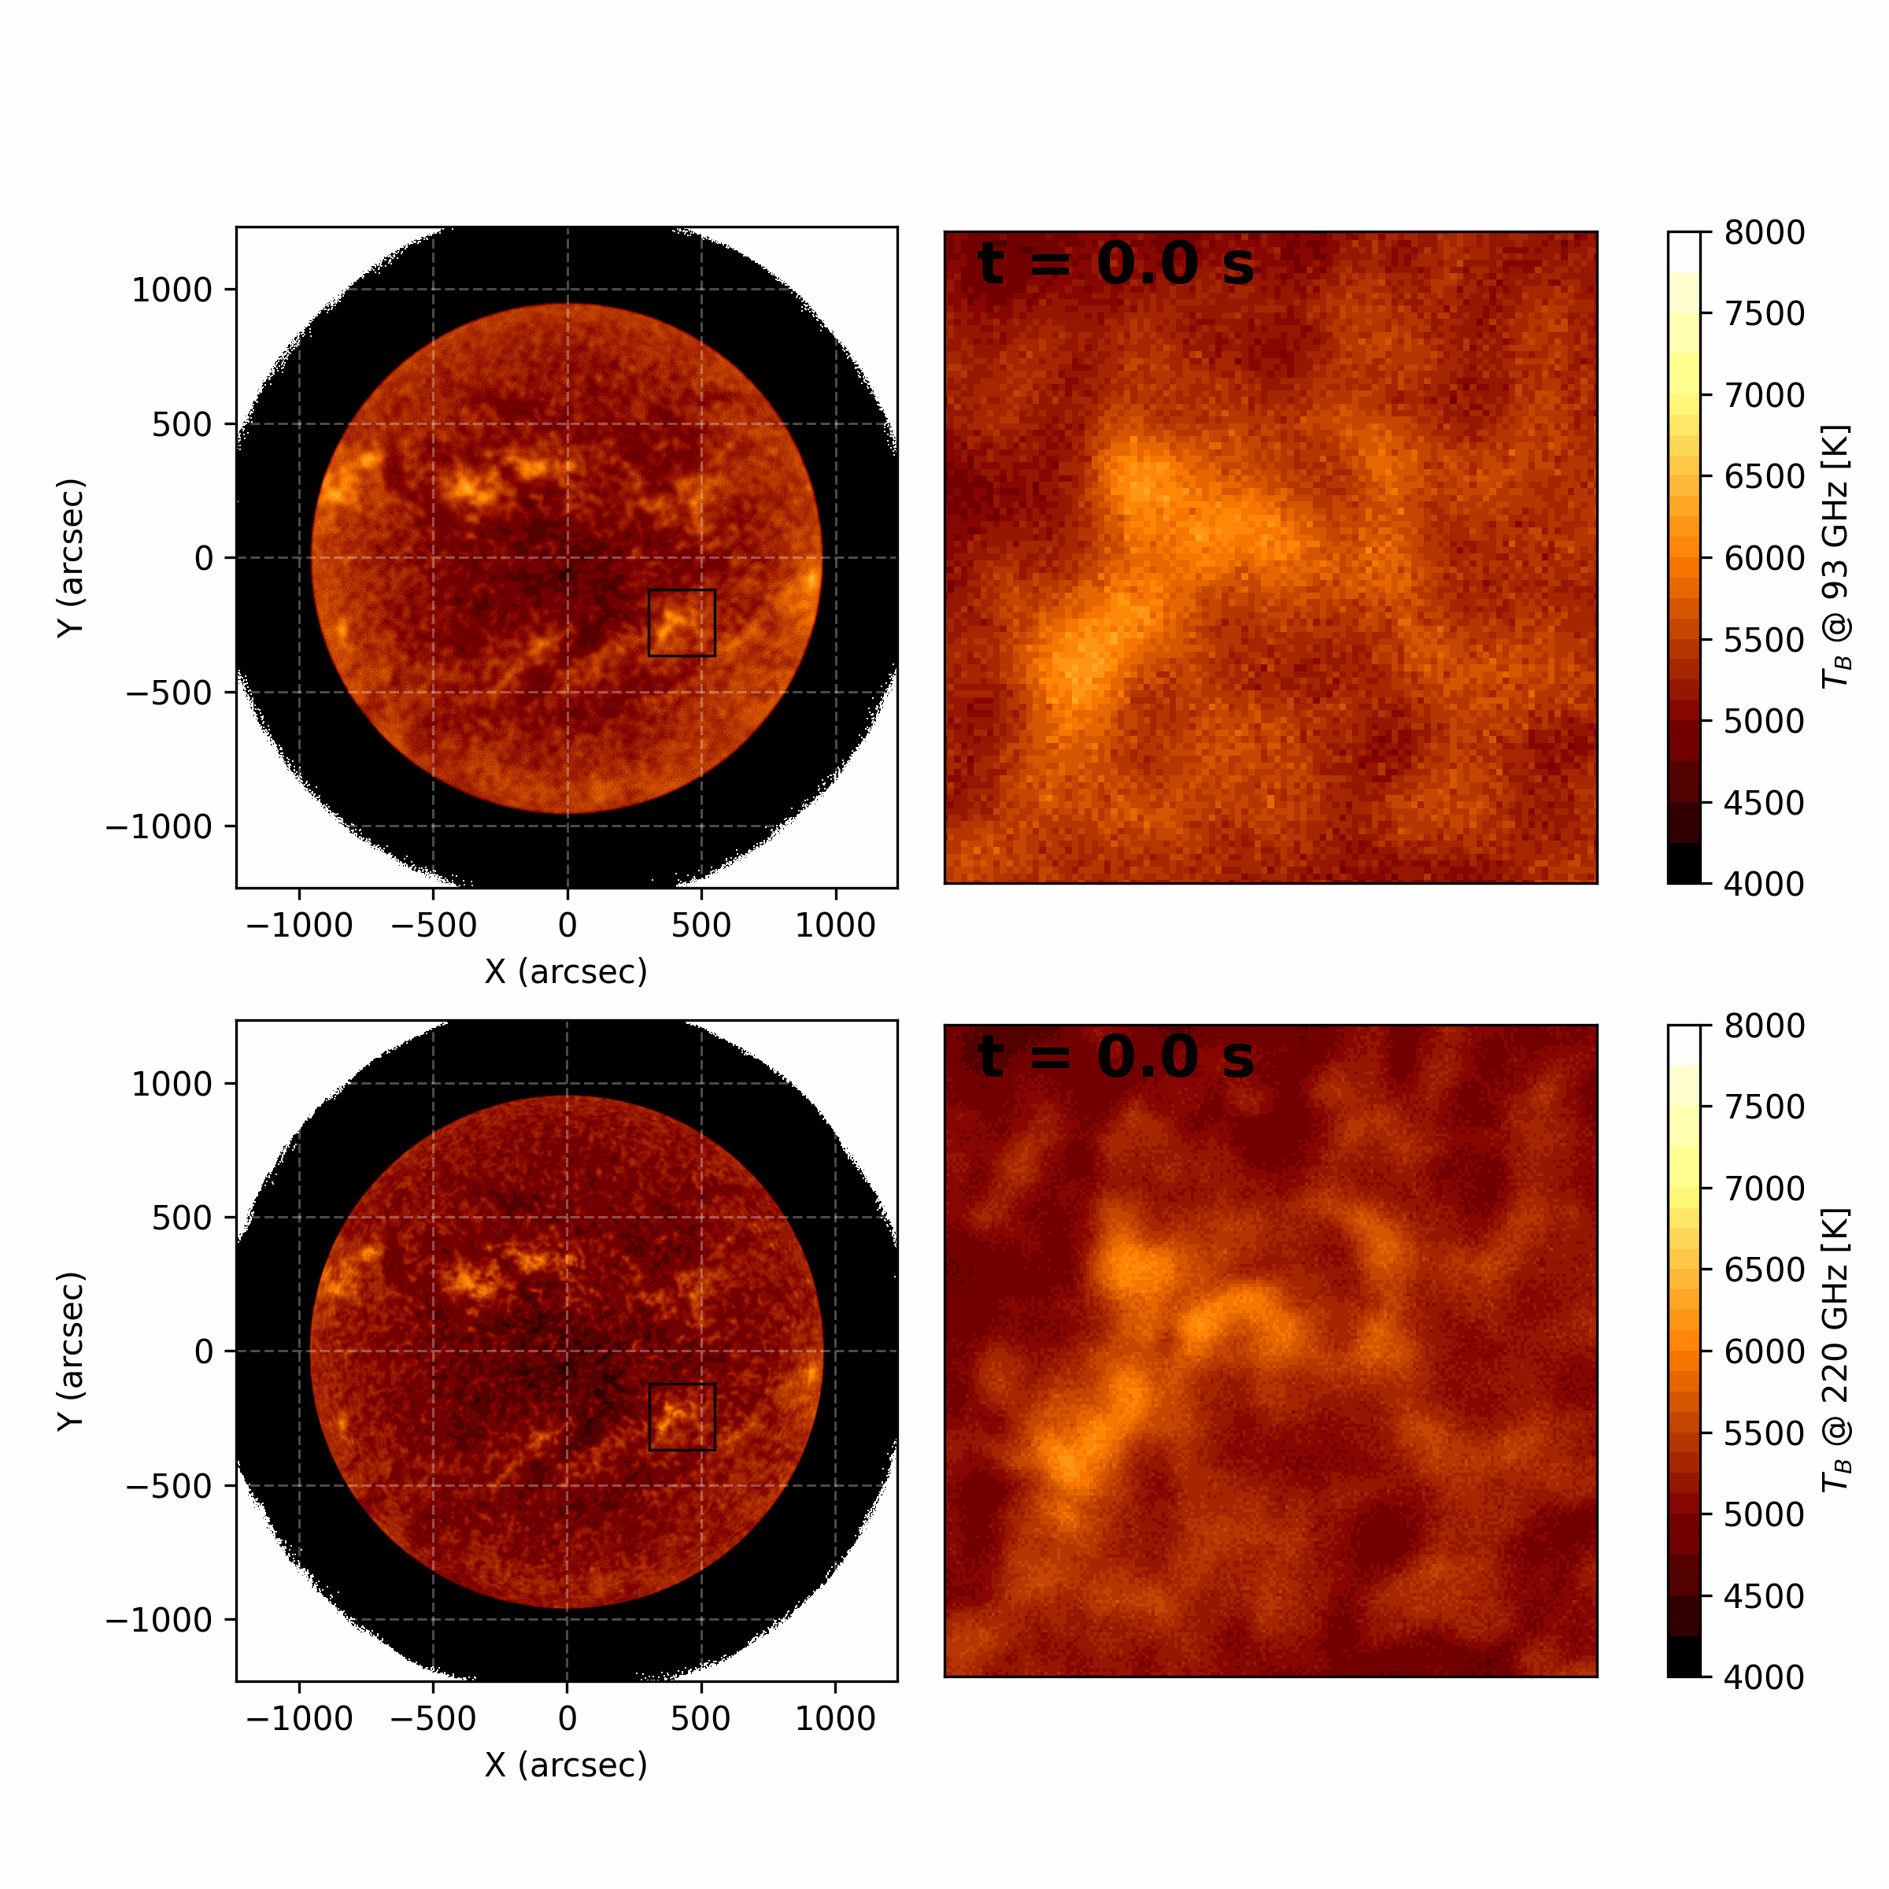
Solar figures from Mats. See his poster!
93 GHz
220 GHz

Slide 31
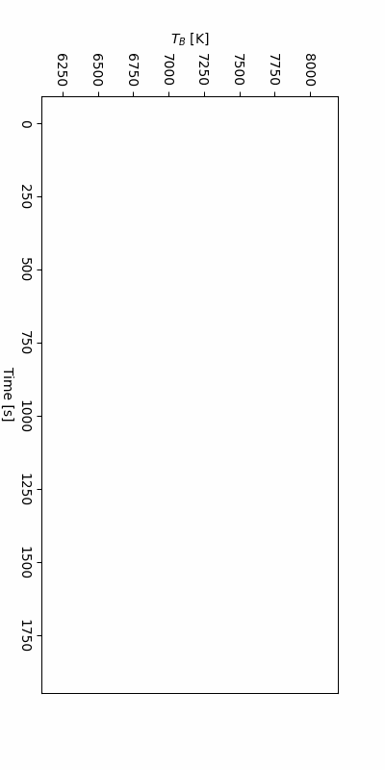
220 GHz
93 GHz
93 GHz
220 GHz
Solar figures from Mats. See his poster!

Slide 32
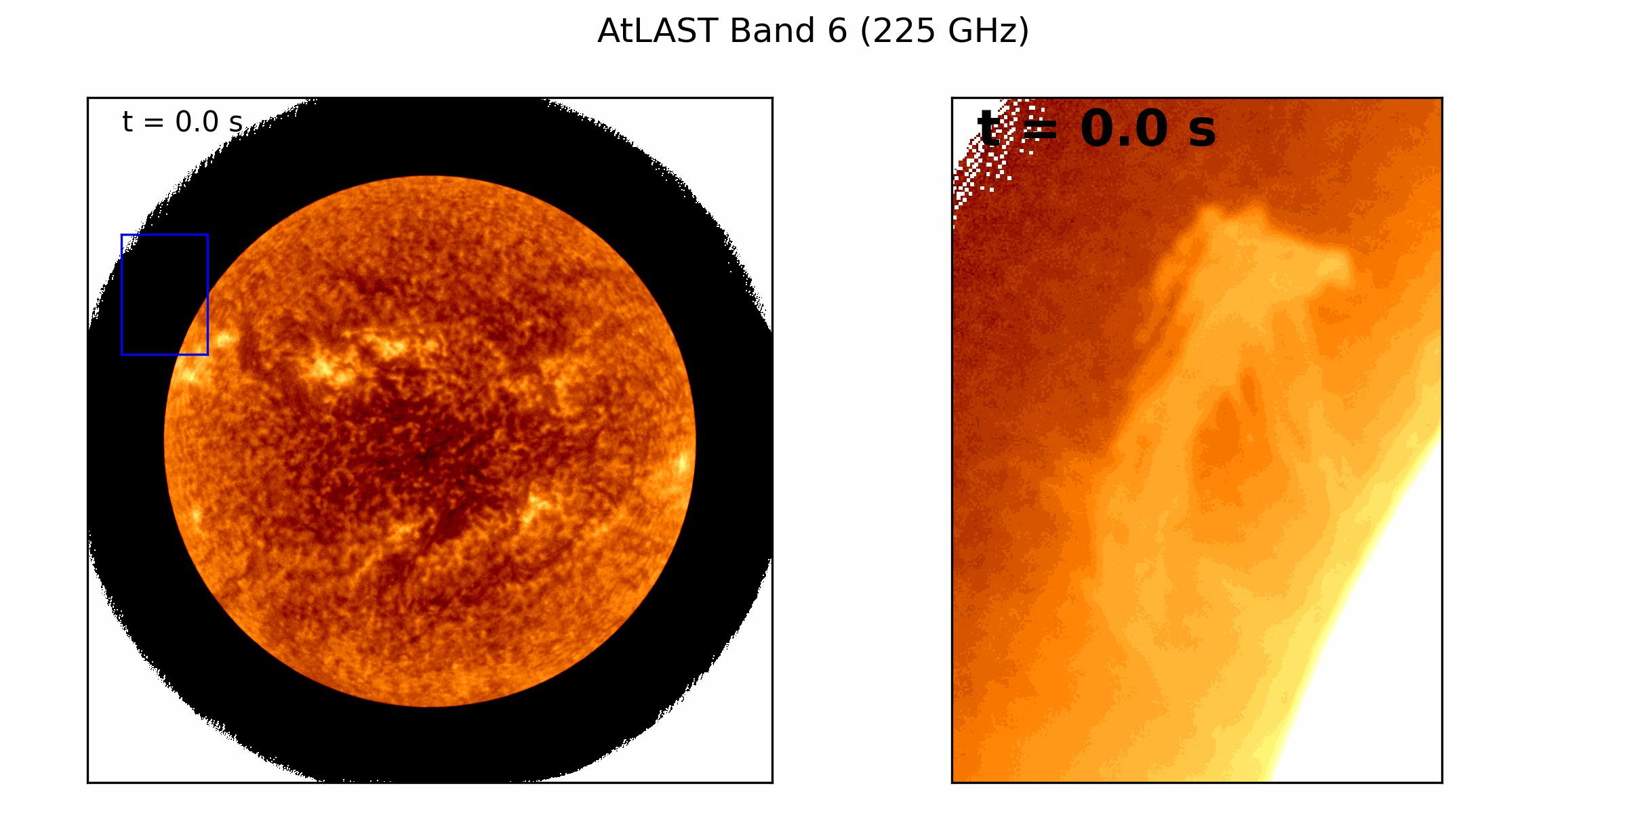
Solar figures from Mats. See his poster!
220 GHz

Slide 33
Thanks!

